Slide 1

E m p o r i U m South Region Sales Analysis
Analyst: Sharleen Guerrero
Period: Jan 2022 – Dec 2025
Tools: Power Query, DAX, Power BI

Slide 2
Project Overview
EmporiUm is a student bookstore chain with in-store and online sales channels, operating 24 stores for the South Region across Florida, Texas, and South Carolina Regional Director Andy Gisselquist requested a Power BI report analyzing four fiscal years of South Region in-store sales performance data that will be presented to territory managers and store managers at the regional meeting.
Purpose of Analysis
After a nearly flat 2024, the South Region surged 58% in 2025, raising a critical question: what drove it and how can we sustain it?
This report analyzes four years of in-store sales data to surface what's working, what's lagging, and where the biggest opportunities lie to turn that one-year surge into a long-term strategy for 2026.
Scope of Analysis
Region: South Territories: Florida, Texas, South Carolina Stores: 24 (FL: 11, TX: 11, SC: 2) Period: Jan 2022 – Dec 2025 (4 calendar years) Channel: In-store only (Online = West region) Total Revenue: $8.00M Transactions: 57,300

Slide 3
ETL & Modeling Pipeline
IMPORT
CLEAN
MODEL
DAX
MEASURES
VISUALIZE
Excel workbook
Dates Formatting
Star schema
Revenue totals
Required visuals
TXT reference file
Errors replaced
Merged queries
Time intelligence
KPI cards
Power Query
Nulls resolved
Region scope filtered
Rankings
Slicers
Named queries
Fixed Data Types
Table for Report Measures
Book KPIs
Bookmark
9
>20
8
16
3
Tables
Key Fixes
Relationships
DAX Measures
Report Pages
Notes:
8 tables imported, 6 key cleaning fixes, star schema with 8 relationships, 16 explicit DAX measures, 3-page report with all 4 required visuals.

Slide 4
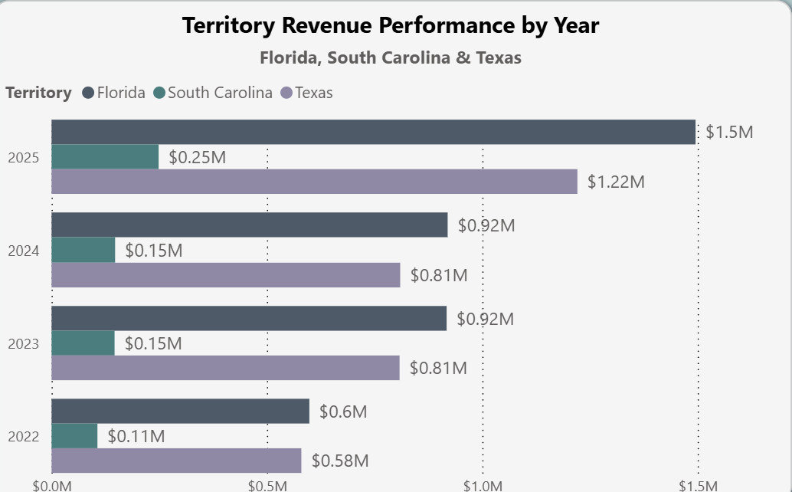
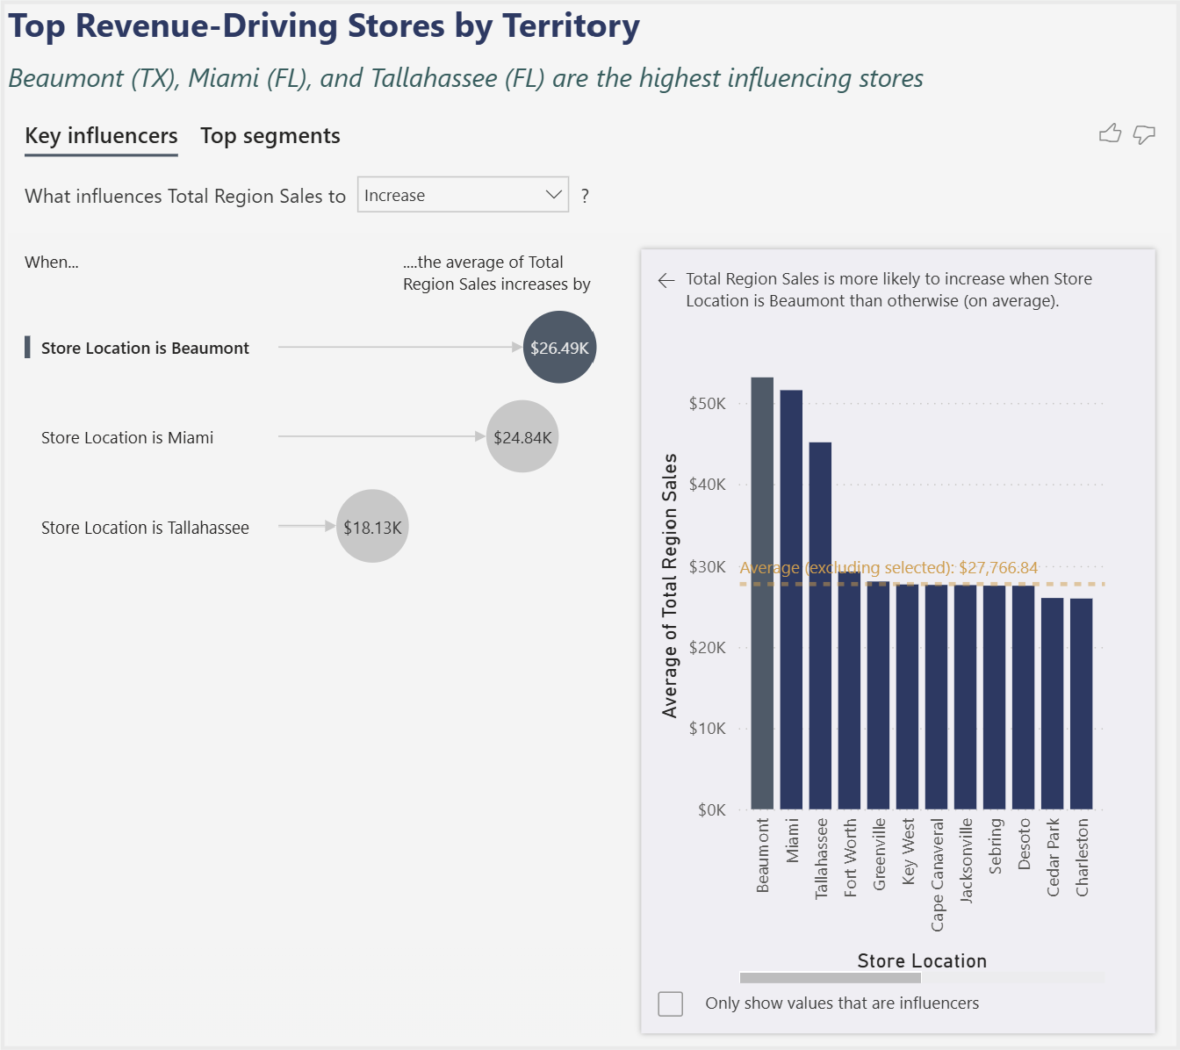
Executive Summary
YoY Growth %
Best Quarter
Peak Month
Region YTD
58.90%
Q4
October
$2.96M
📸 INSERT SCREENSHOT:
Top-Selling General Books table
📸 INSERT SCREENSHOT:
General Books Sales Trend line chart
Despite having the same amount of stores, Florida leads Texas every year. The gap grew from $19K (2022) to $274K (2025). Yet Beaumont, TX ($637K) is the #1 individual store, outperforming every Florida location. Q4 ($2.18M) and October ($819K) are peak periods across all 4 years combined.

Slide 5
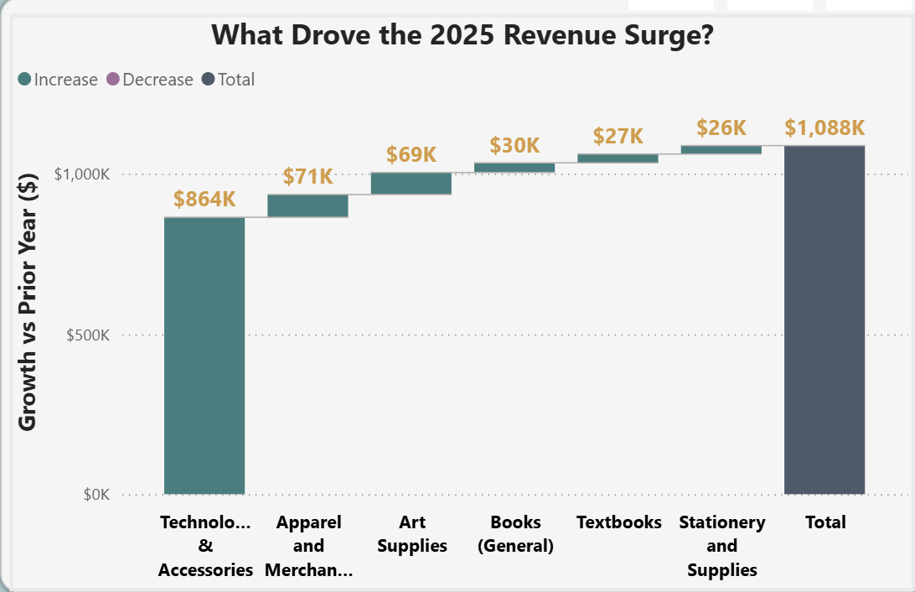
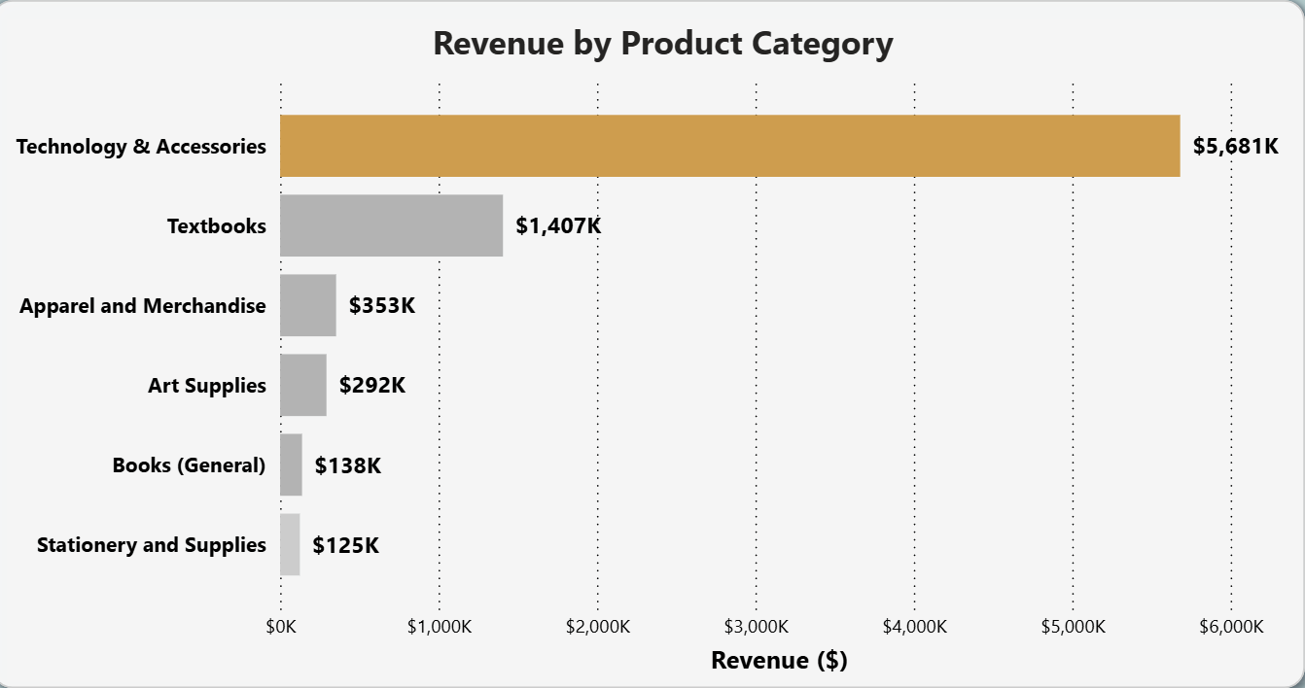
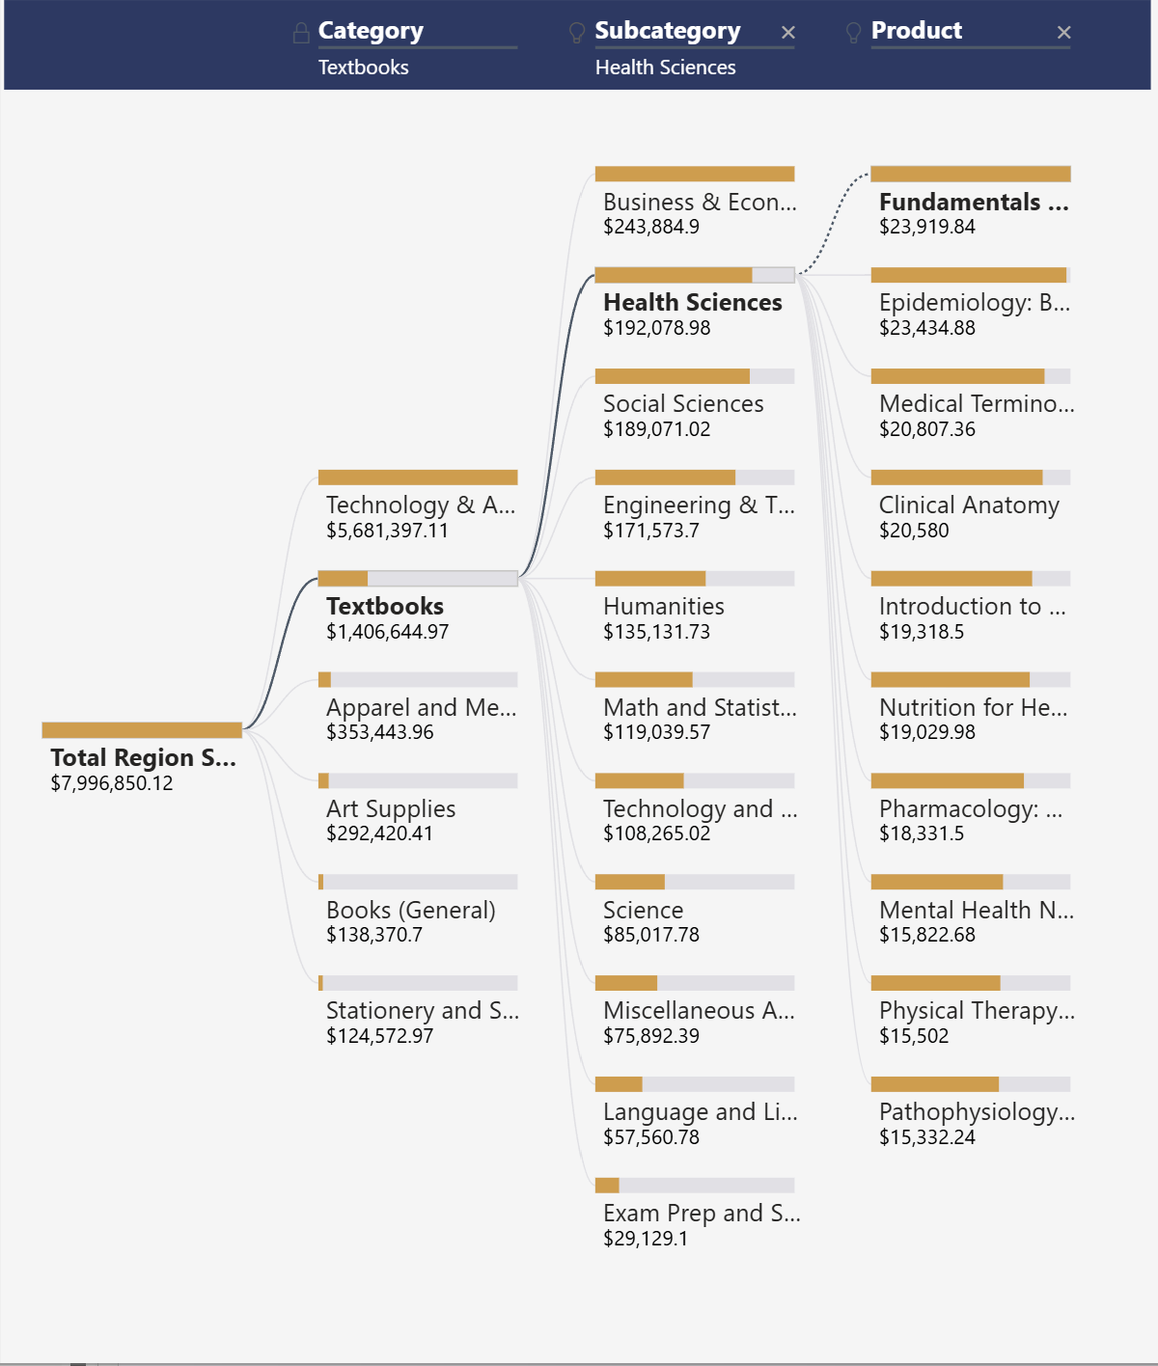
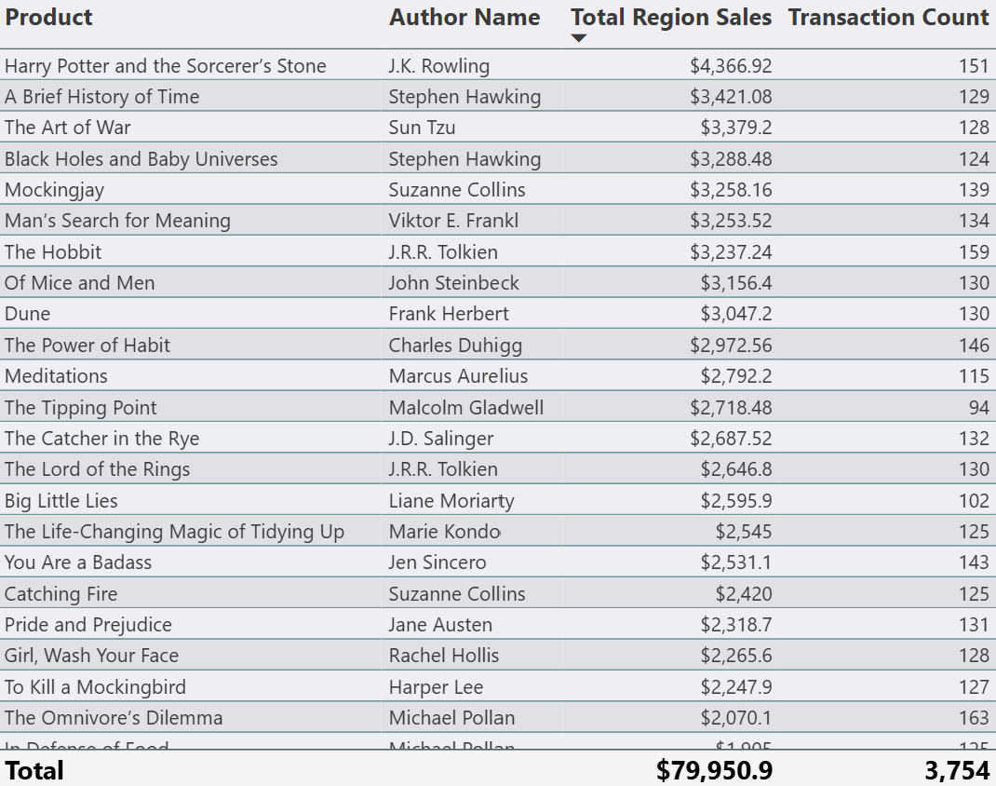
The Multi-Layer STEM Student
The gift that keeps on giving — already shopping here across multiple categories.
79%
71%
3 of 5
#1
of 2025 growth = Tech
of revenue = Tech & Accessories
top categories belong to STEM
Harry Potter — $4,366 · 151 transactions
What the data is telling us
Harry Potter and the Sorcerer's Stone leads at $4,366 (151 txns). Stephen Hawking holds 2 of the top 4 spots, confirming South Region customers gear toward STEM. Decomp tree reinforces the pattern: 3 out of 5 top categories belong to STEM. Health Sciences = #2 textbook subcategory ($192K). Study Guides dominate Books (General) at 38.3%. Book sales doubled in 2025 (+101%) — peak in May 2025 at $7,034.
Notes:
Walk through each visual briefly. Then say: 'Harry Potter leads our book sales at $4,366. Stephen Hawking holds 2 of the top 4 spots. The decomp tree shows 3 out of 5 top textbook categories belong to STEM. Health Sciences is our #2 textbook subcategory. Study Guides dominate general books at 38.3%. And book sales doubled in 2025. Four visuals. Three data layers. One customer. That's exactly who we're building the Study Ecosystem bundle for.'

Slide 6
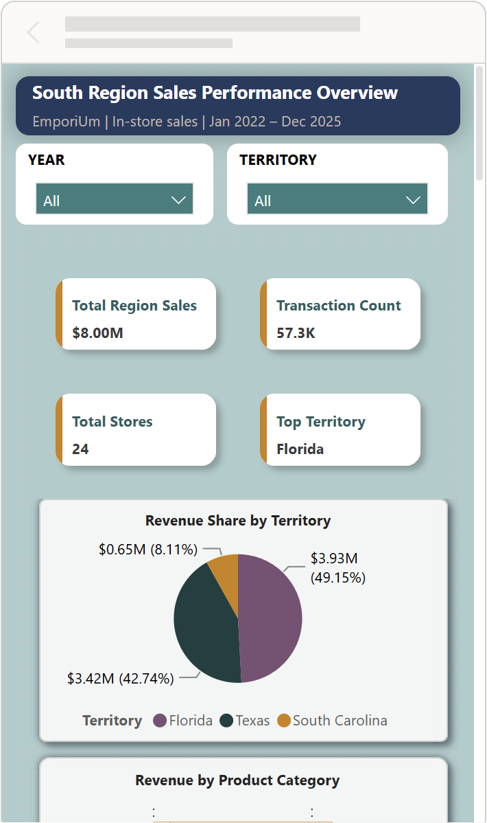

Live Power BI Filtering & Mobile Layout

Slide 7
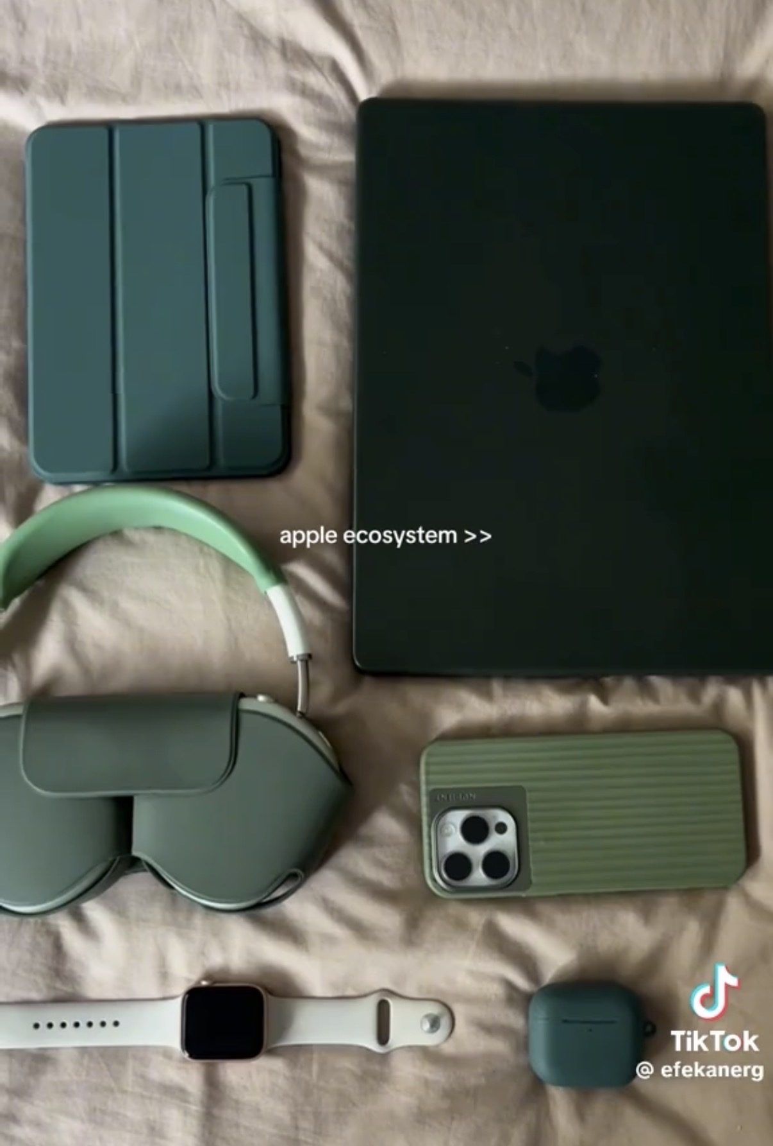
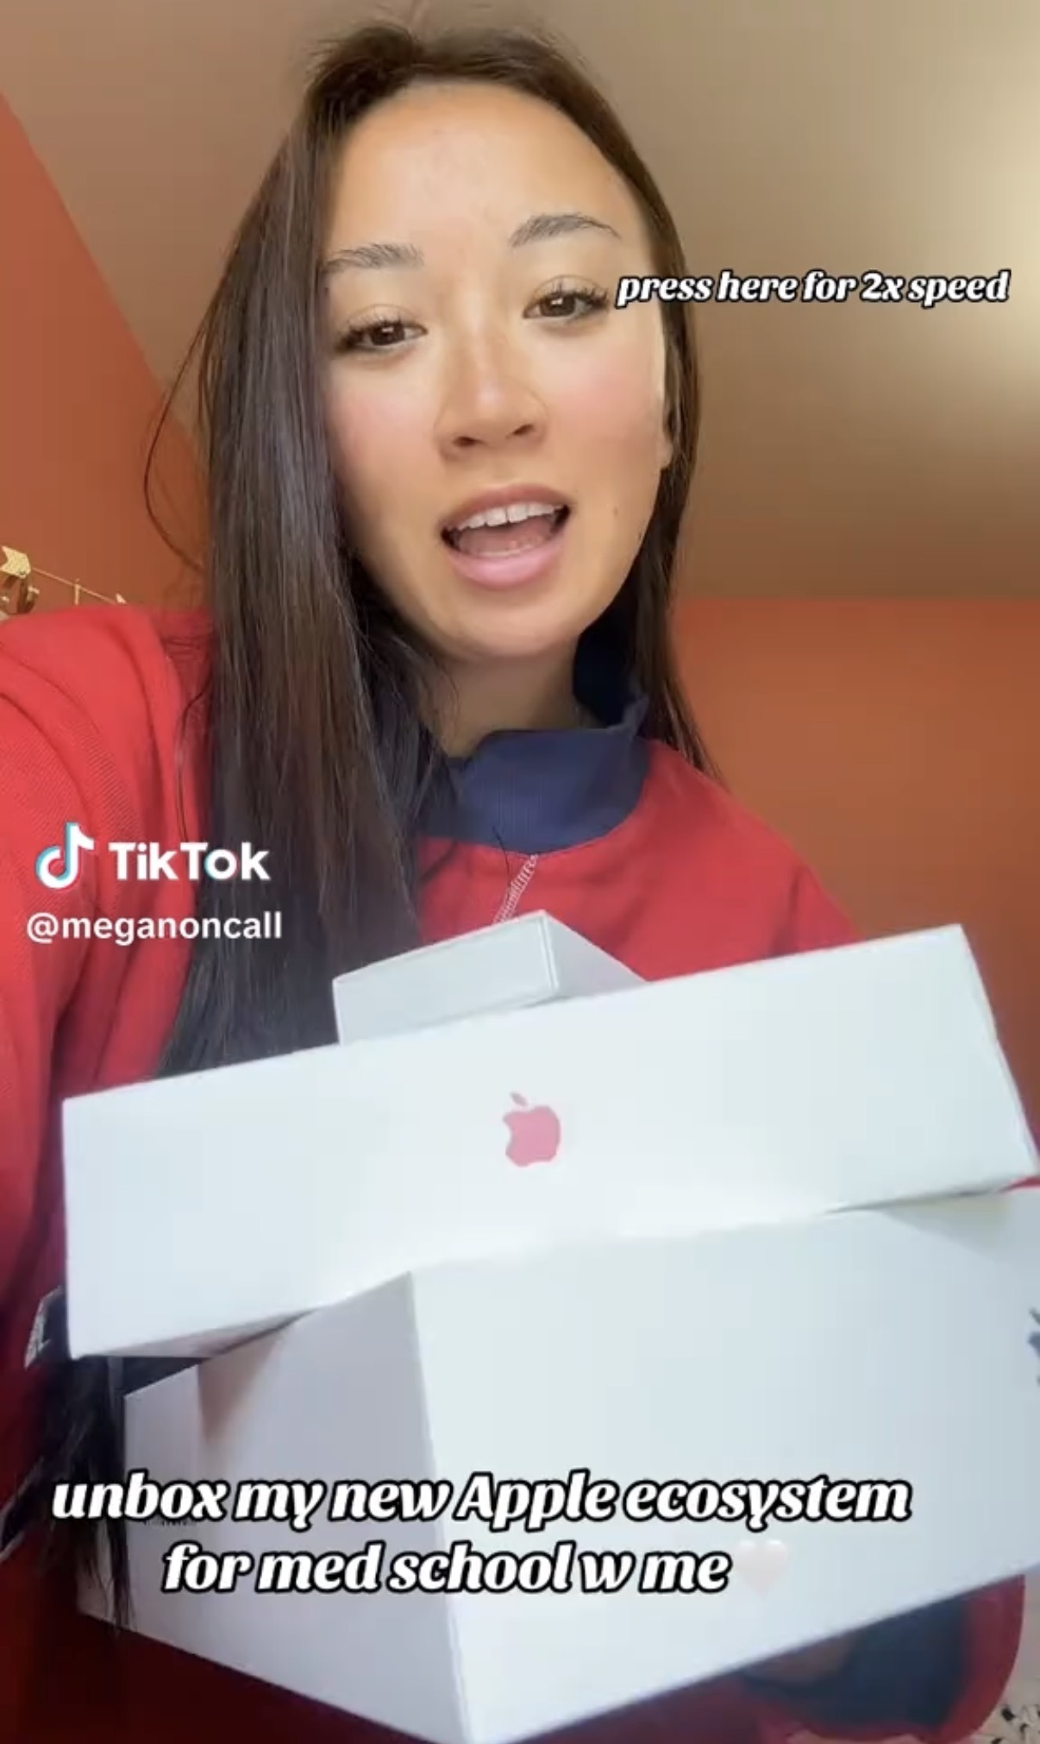
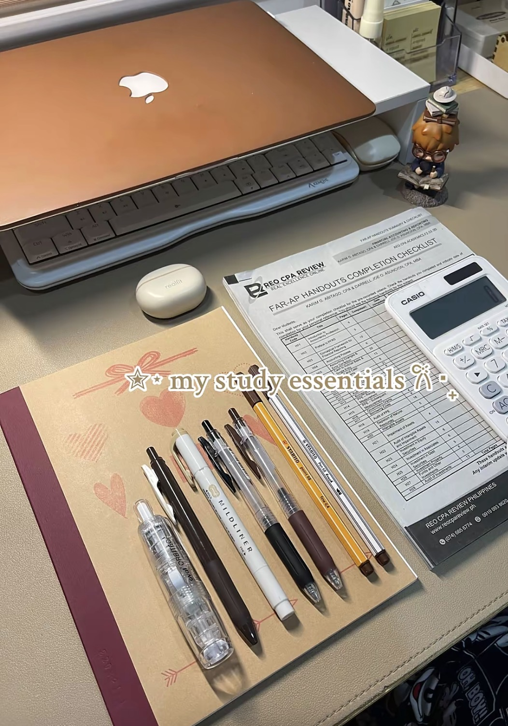
Strategic Recommendations
South Region 2026 — turning the special 2025 surge into a targeted strategy that yields benefits across more categories and locations
01 - Launch a "Study Ecosystem" Bundle
02 Close the Territory Gap (Florida-Texas)
Proposed Bundle: Laptop + discounted textbook + study guide + stationery, priced so buying together saves more to create a high transaction value sale.
Will this work?
Tech = 71% of revenue + 79% of 2025 growth.
Health Sciences = #2 textbook subcategory.
Study Guides = 38.3% of Books (General).
All pointing to the same large STEM customer base.
Keeping Up with the Trends: : TikTok's Apple ecosystem study aesthetic has normalized premium student setups as a “uni student” identity purchase.
Launch January 2026 — Q1 & Q2 average weakest at ~$1.90M with no spring trigger.
Q4 which is naturally driven by back-to-school and holiday spending , the spring semester has no structured purchasing moment pulling students into stores.
A January bundle launch created that trigger meeting students exactly when new semester motivation is highest and spending intent is at its peak.
The gap: Florida leads Texas $3.93M vs $3.42M despite equal store counts (11 each). Gap grew from $19K in 2022 to $274K in 2025. The counter-narrative: Beaumont, TX ($637K) is the #1 individual store region-wide, outperforming every Florida location. Its population is not impressive, so Its store execution carries their success.
Action: Audit Beaumont + Florida's flagship stores, extract the tactics, apply to underperforming Texas locations. Extend to South Carolina: South Carolina only has 2 stores, but it holds its own with Greenville ($337K), which is in the top 5 region-wide. This proves the model can work in small markets. Apply the model to neighboring store Charleston.

Slide 8
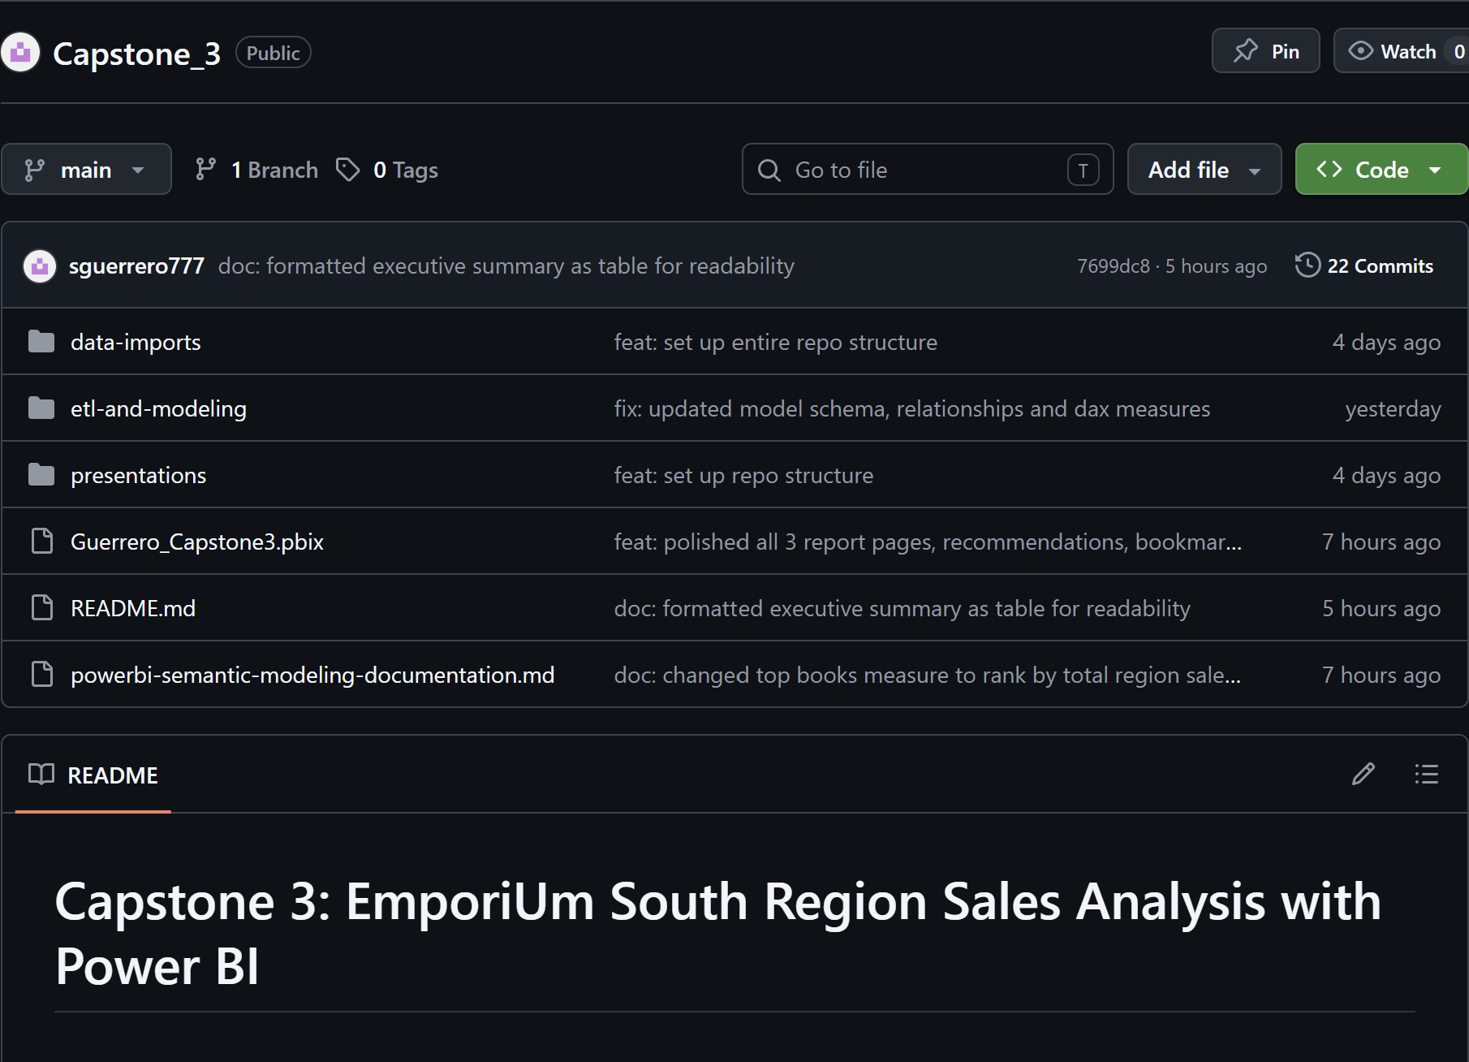
GitHub Repository
Capstone 3 GitHub Repository
Power BI Service Report Link
sguerrero@my.yearupunited.org
Thank you!

