Slide 1

E m p o r i U m South Region Sales Analysis
Analyst: Sharleen Guerrero
Period: Jan 2022 – Dec 2025
Tools: Power Query, DAX, Power BI

Slide 2
Project Overview
EmporiUm is a student bookstore chain with in-store and online sales channels, operating 24 stores for the South Region across Florida, Texas, and South Carolina Regional Director Andy Gisselquist requested a Power BI report analyzing four fiscal years of South Region in-store sales performance data that will be presented to territory managers and store managers at the regional meeting.
Purpose of Analysis
After a nearly flat 2024, the South Region surged 58% in 2025, raising a critical question: what drove it and how can we sustain it?
This report analyzes four years of in-store sales data to surface what's working, what's lagging, and where the biggest opportunities lie to turn that one-year surge into a long-term strategy for 2026.
Scope of Analysis
Region: South Territories: Florida, Texas, South Carolina Stores: 24 (FL: 11, TX: 11, SC: 2) Period: Jan 2022 – Dec 2025 (4 calendar years) Channel: In-store only (Online = West region) Total Revenue: $8.00M Transactions: 57,300

Slide 3
Raw Data Sources
Capstone3_Sample_Sales.xlsx
book_list.txt
7 sheets loaded as separate queries:
Custom-delimited text file:
90 Book (General) book titles with respective authors
Delimiter * and ‘by’ (custom)
Required manual split into Book Title and Author columns
Trimmed whitespace after splitting
Merged into Products on similar Book Title column
Store Sales – fact table with transaction data of ~ 57,300 rows
Online Sales – excluded from analysis because it belongs to West Region
Products – 669 unique products
Inventory Categories – category lookup
Store Locations – store locations across 4 regions, filtered to South
Management Team – region/director information
Shipper List – shipping reference for online sales

Slide 4
ETL & Modeling Pipeline
IMPORT
CLEAN
MODEL
DAX
MEASURES
VISUALIZE
Excel workbook
Dates Formatting
Star schema
Revenue totals
Required visuals
TXT reference file
Errors replaced
Merged queries
Time intelligence
KPI cards
Power Query
Nulls resolved
Region scope filtered
Rankings
Slicers
Named queries
Fixed Data Types
Table for Report Measures
Book KPIs
Bookmark
9
>20
8
16
3
Tables
Key Fixes
Relationships
DAX Measures
Report Pages
Notes:
8 tables imported, 6 key cleaning fixes, star schema with 8 relationships, 16 explicit DAX measures, 3-page report with all 4 required visuals.

Slide 5
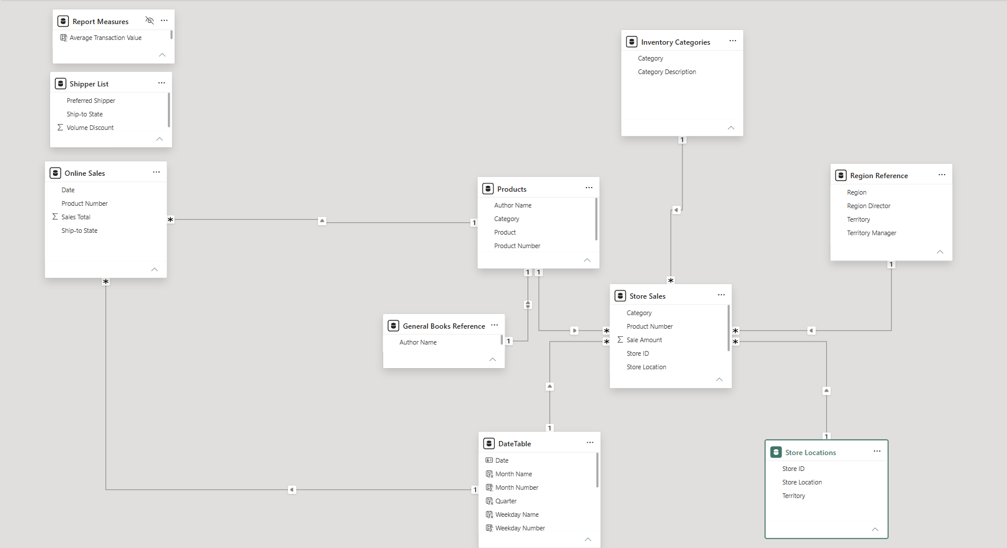
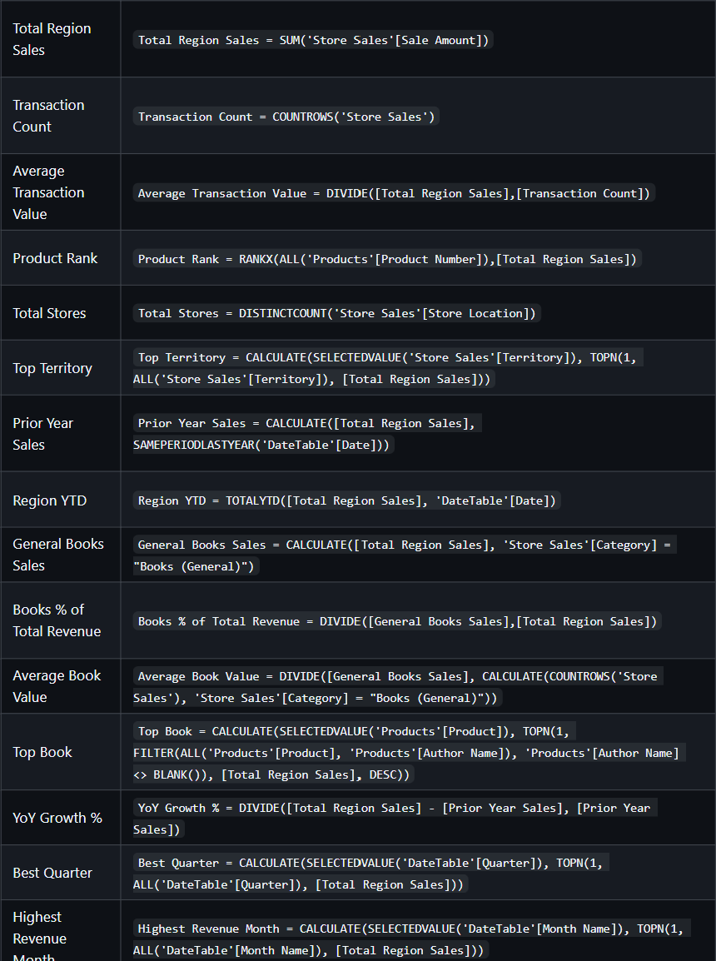
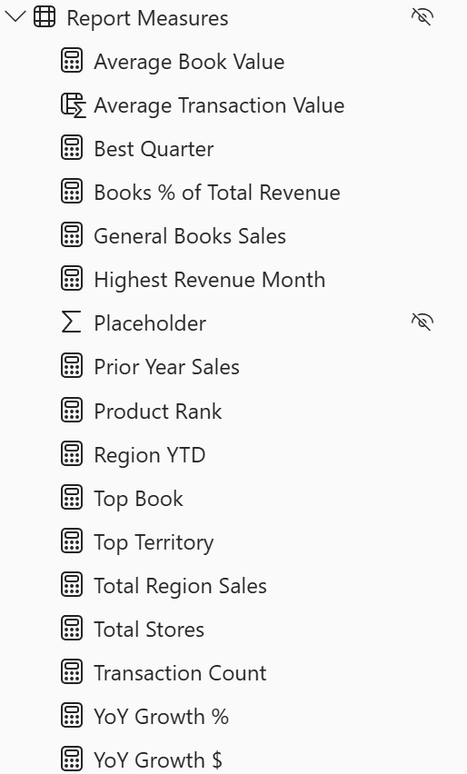
Schema and DAX measures

Slide 6
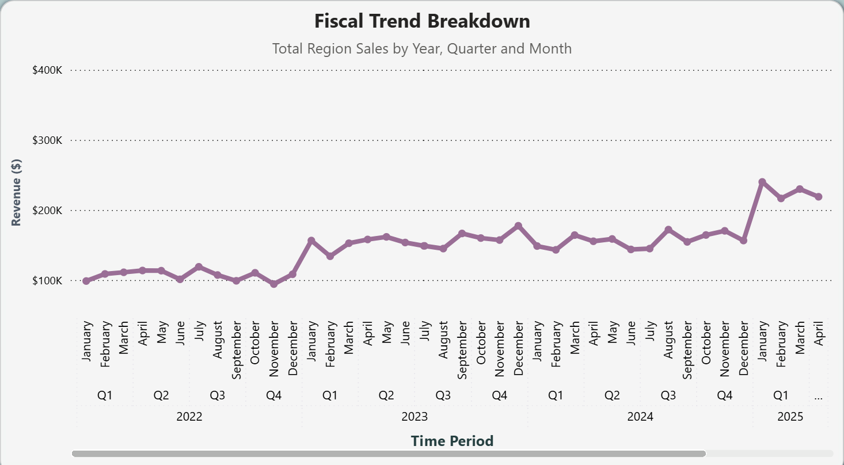
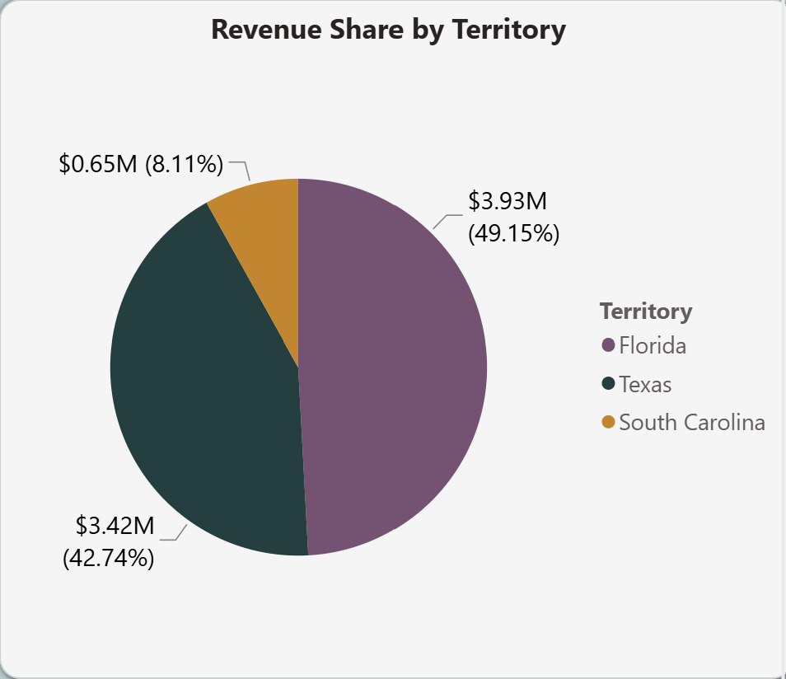
South Region Sales Trend and Territories
Key Insight — Sales Trend
Key Insight — Territory
Revenue grew +122% over 4 years ($1.28M → $2.96M).
2024 was nearly flat at just +0.3% across every category
Suddenly, 2025 surged at +58%, the strongest year on record.
Florida and Texas both have 11 stores.
Florida leads at 49.15% ($3.93M).
Texas at 42.74%
South Caroline makes up 8.11% of revenue, understandable with only two stores.

Slide 7
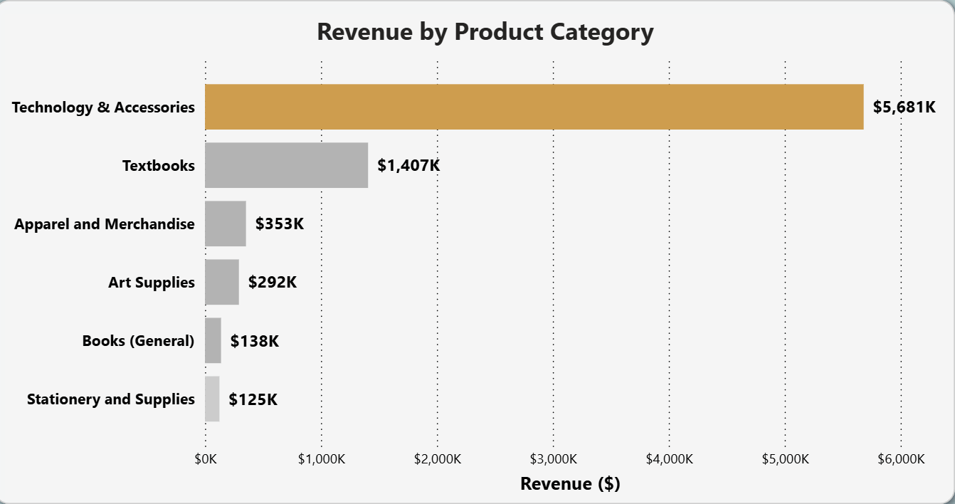
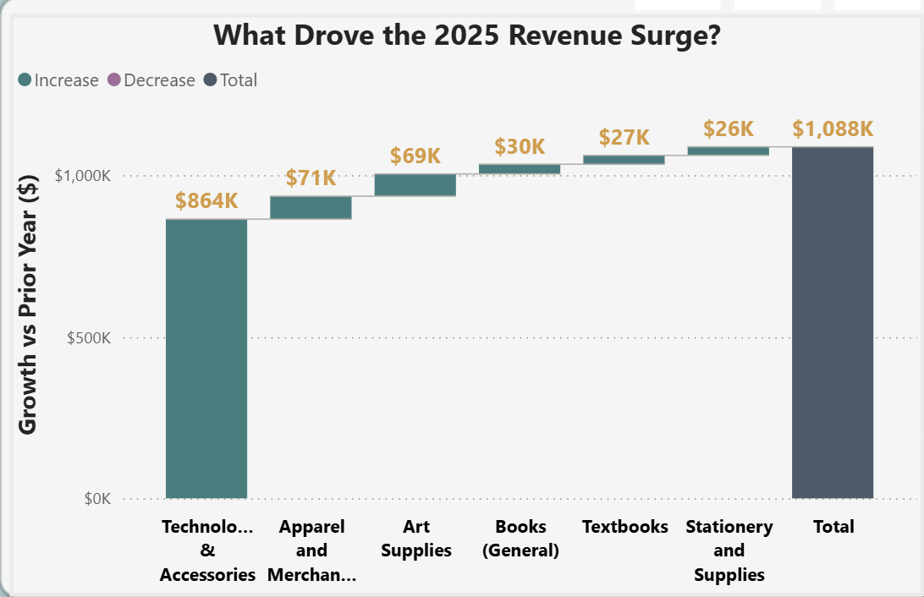
Region Category Performance and 2025 Surge
Key Insight — Categories
Key Insight — 2025 Surge
Tech & Accessories clearly dominates at $5.68M, carrying the entire region revenue at 71%
Textbooks second at $1.41M (17.6%). General Books is 11.73% ($138k)
EmporiUm seems to favor being a tech retailer, how can we leverage this?
79% of 2025’s $1.09 growth came from Tech alone (+$864k).
Art supplies grew fastest at +114%
Tech drove the story, but we can shift the story so that more categories can win!

Slide 8
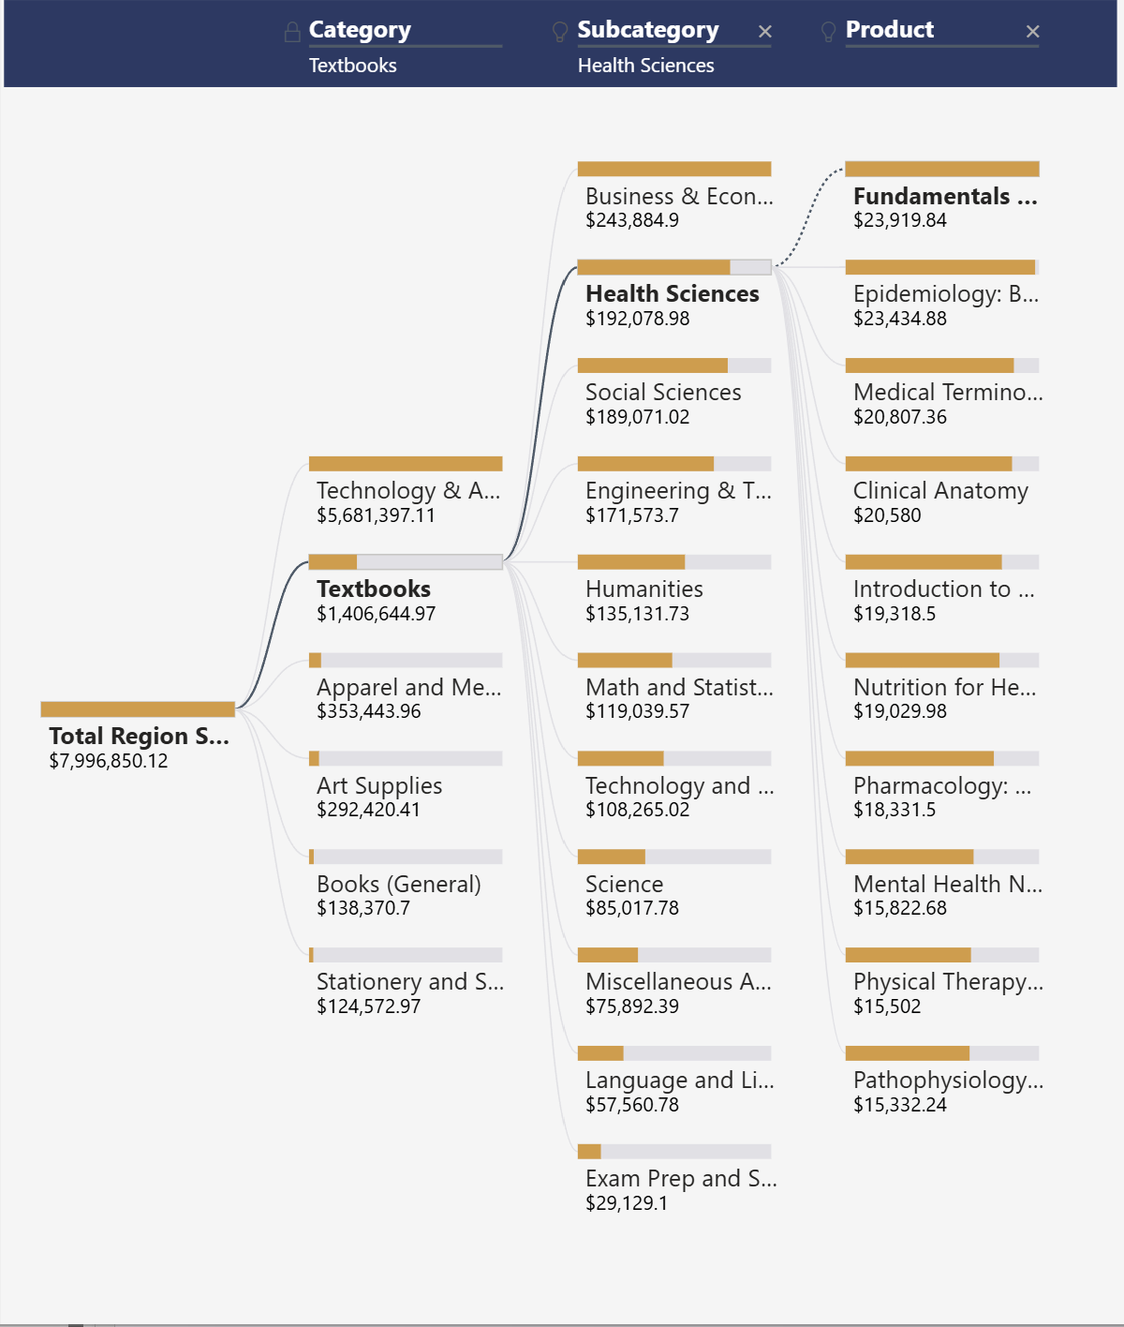
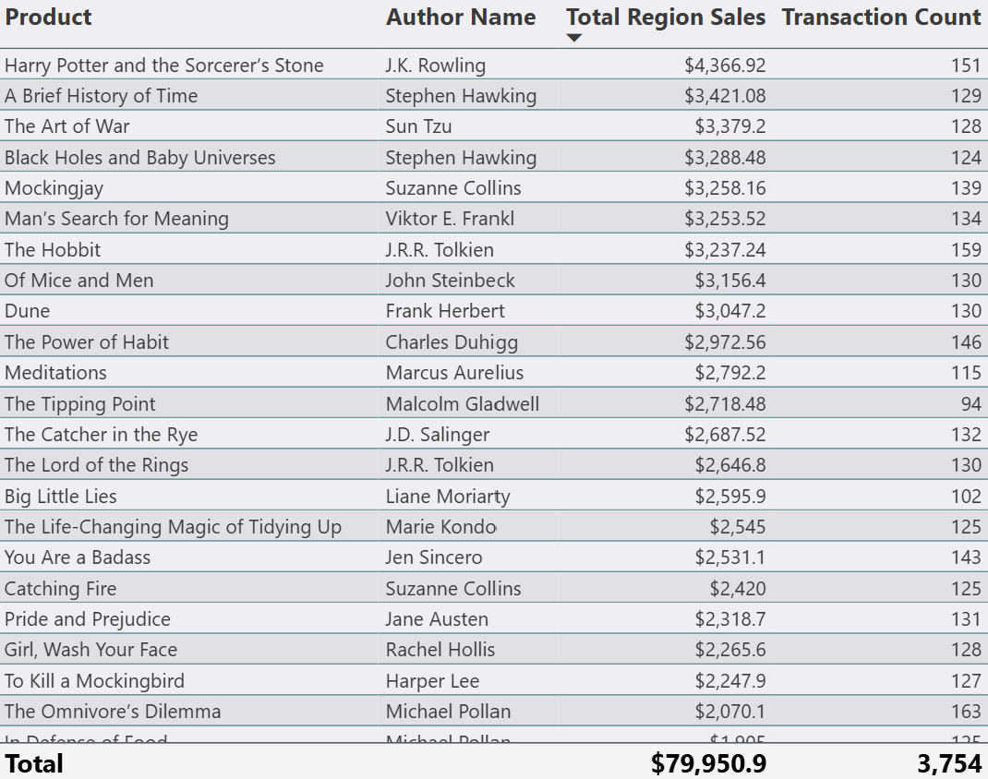
Product & Book Breakdown
General Books Sales
Books % of Revenue
Avg Book Value
Top Book
$138.37K
1.73%
$29.49
Harry Potter and the Sorcerer’s Stone
📸 INSERT SCREENSHOT:
Top-Selling General Books table
📸 INSERT SCREENSHOT:
General Books Sales Trend line chart
Harry Potter and the Sorcerer's Stone leads at $4,366 (151 transactions). Stephen Hawking holds 2 of the top 4 spots — confirming South Region customers gear toward STEM topics. Decomp tree reinforces the pattern, 3 out of 5 top categories belong to STEM. Heath Sciences is the #2 textbook subcategory ($192K). Study Guides dominate Books (General) at 38.3%. Book sales doubled in 2025 (+101%) with a peak in May 2025 at $7,034.

Slide 9
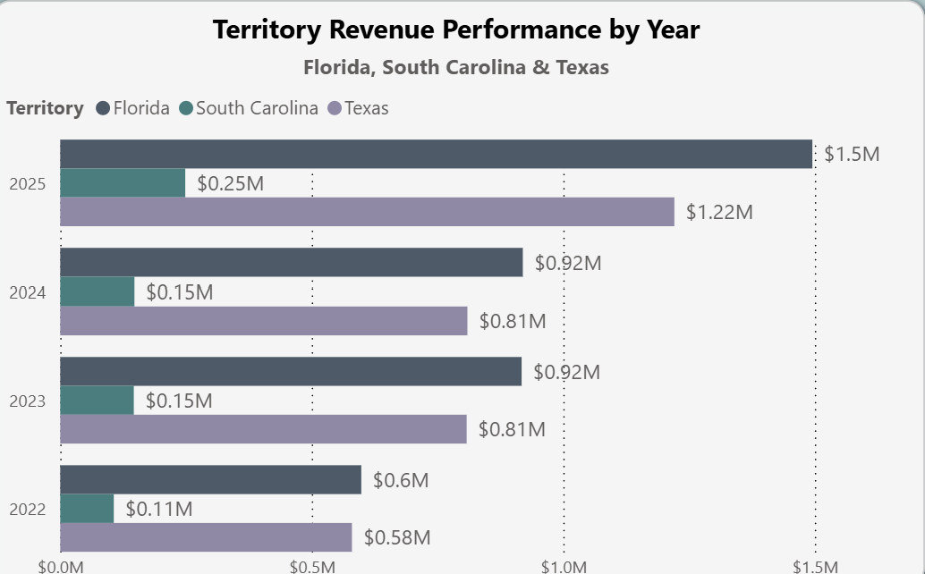
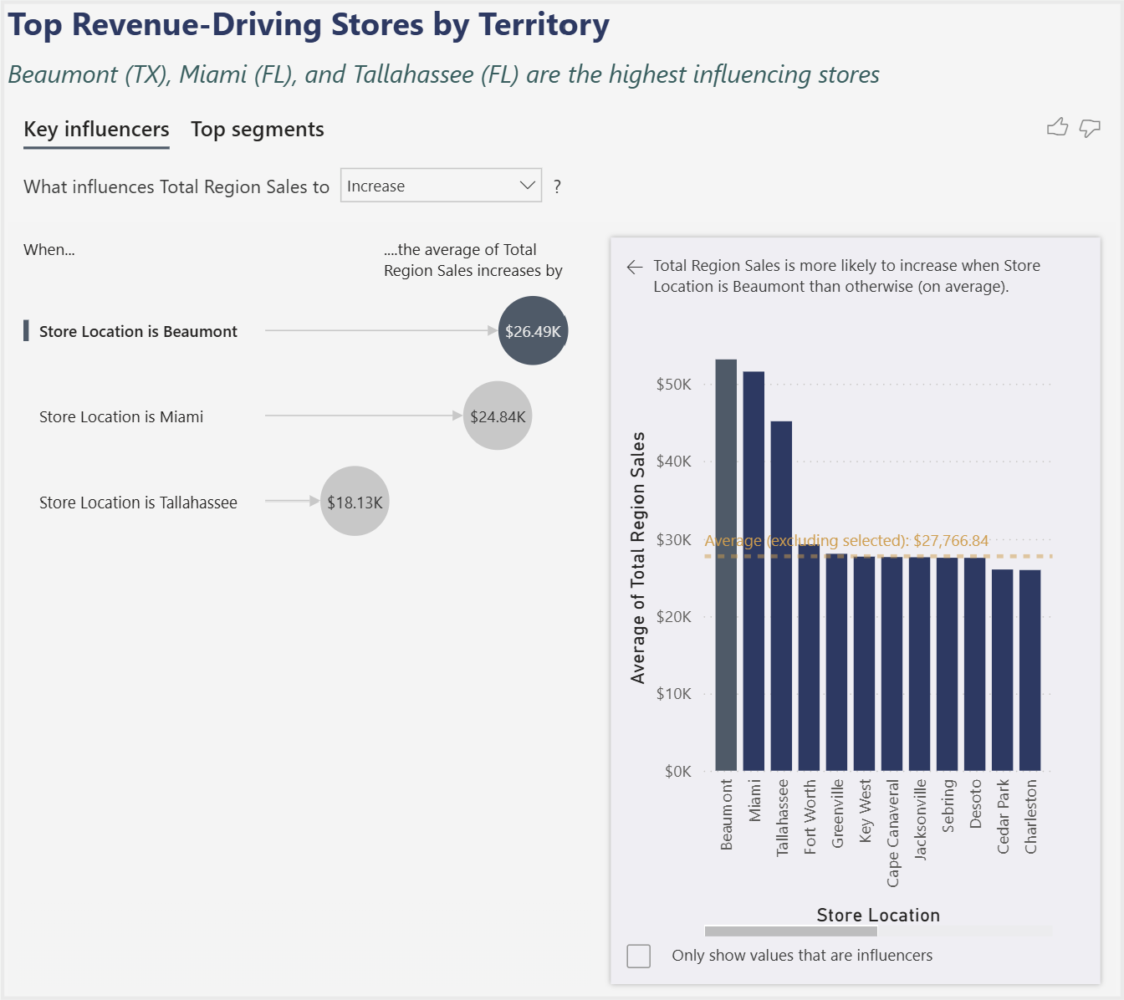
Executive Summary
YoY Growth %
Best Quarter
Peak Month
Region YTD
58.90%
Q4
October
$2.96M
📸 INSERT SCREENSHOT:
Top-Selling General Books table
📸 INSERT SCREENSHOT:
General Books Sales Trend line chart
Despite having the same amount of stores, Florida leads Texas every year. The gap grew from $19K (2022) to $274K (2025). Yet Beaumont, TX ($637K) is the #1 individual store, outperforming every Florida location. Q4 ($2.18M) and October ($819K) are peak periods across all 4 years combined.

Slide 10
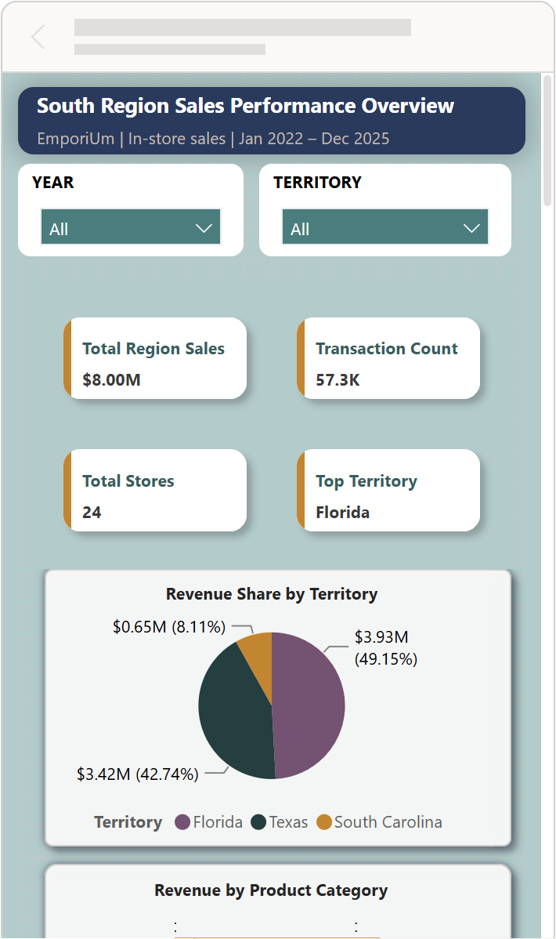

Live Power BI Filtering & Mobile Layout

Slide 11
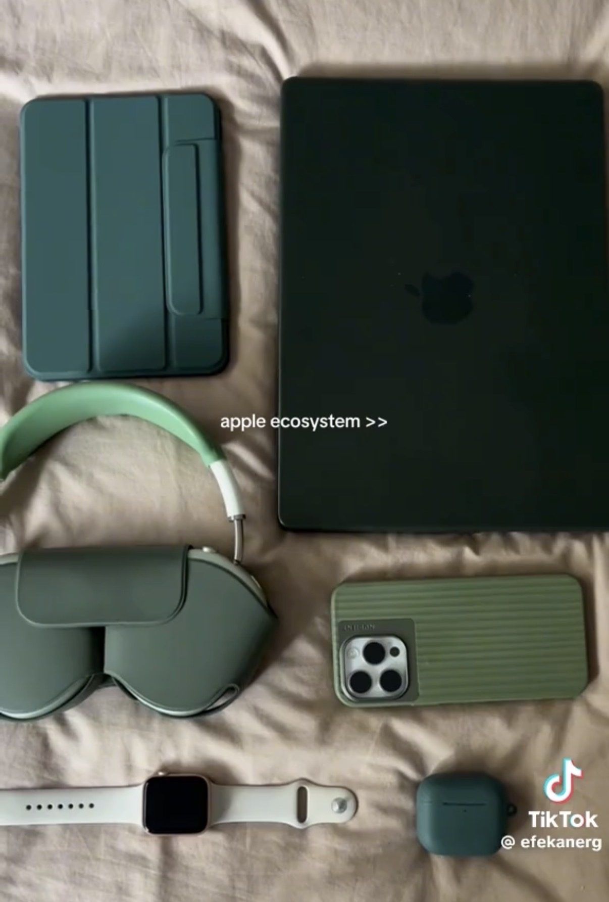
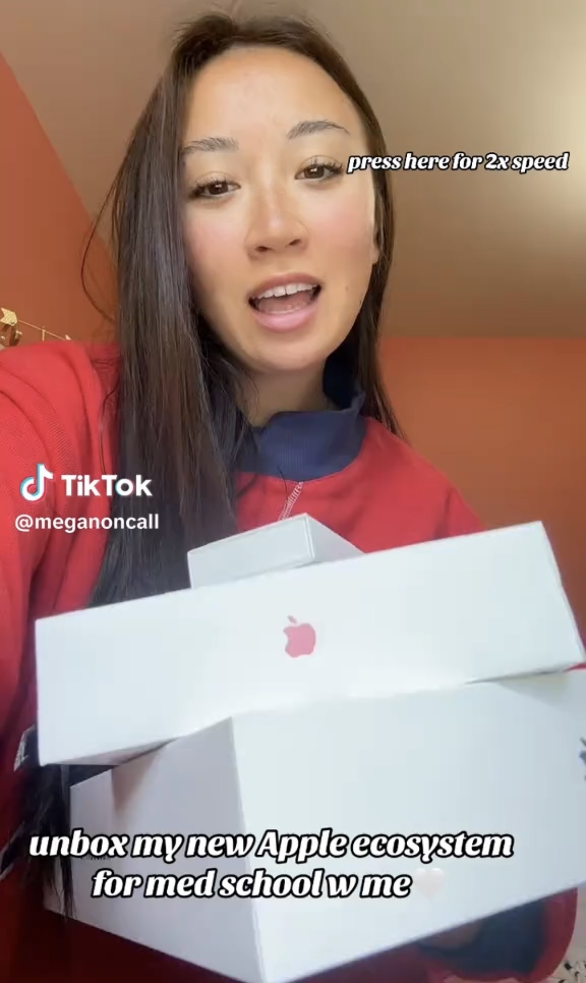
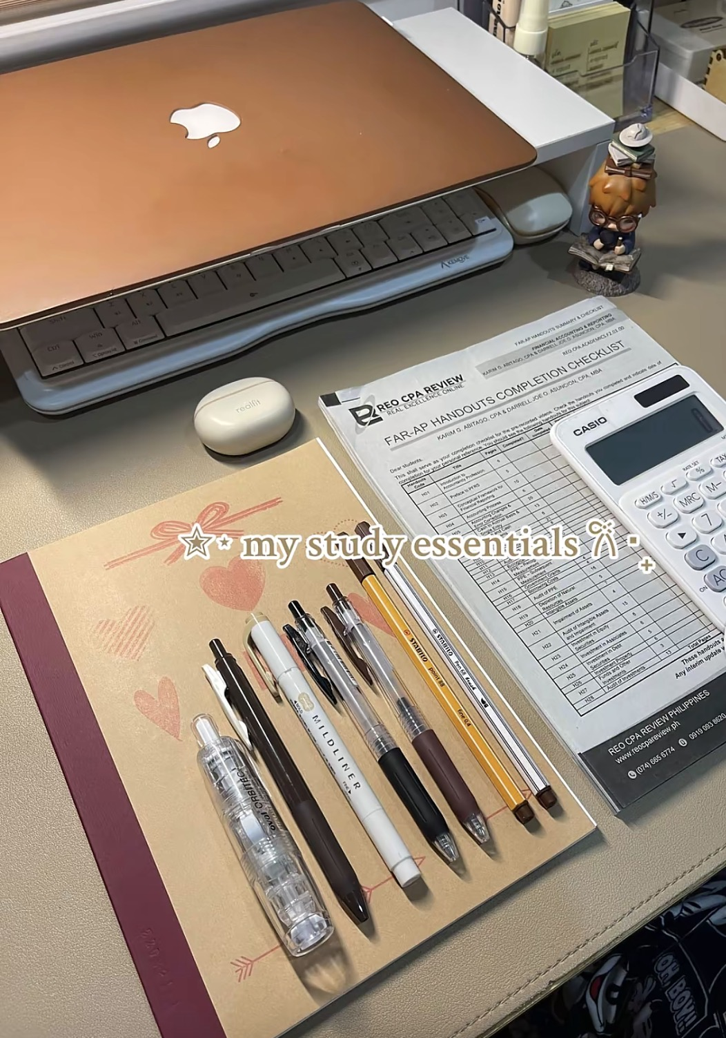
Strategic Recommendations
South Region 2026 — turning the special 2025 surge into a targeted strategy that yields benefits across more categories and locations
01 - Launch a "Study Ecosystem" Bundle
02 Close the Territory Gap (Florida-Texas)
Proposed Bundle: Laptop + discounted textbook + study guide + stationery, priced so buying together saves more to create a high transaction value sale.
Will this work?
Tech = 71% of revenue + 79% of 2025 growth.
Health Sciences = #2 textbook subcategory.
Study Guides = 38.3% of Books (General).
All pointing to the same large STEM customer base.
Keeping Up with the Trends: : TikTok's Apple ecosystem study aesthetic has normalized premium student setups as a “uni student” identity purchase.
Launch January 2026 — Q1 & Q2 average weakest at ~$1.90M with no spring trigger.
Q4 which is naturally driven by back-to-school and holiday spending , the spring semester has no structured purchasing moment pulling students into stores.
A January bundle launch created that trigger meeting students exactly when new semester motivation is highest and spending intent is at its peak.
The gap: Florida leads Texas $3.93M vs $3.42M despite equal store counts (11 each). Gap grew from $19K in 2022 to $274K in 2025. The counter-narrative: Beaumont, TX ($637K) is the #1 individual store region-wide, outperforming every Florida location. Its population is not impressive, so Its store execution carries their success.
Action: Audit Beaumont + Florida's flagship stores, extract the tactics, apply to underperforming Texas locations. Extend to South Carolina: South Carolina only has 2 stores, but it holds its own with Greenville ($337K), which is in the top 5 region-wide. This proves the model can work in small markets. Apply the model to neighboring store Charleston.

Slide 12
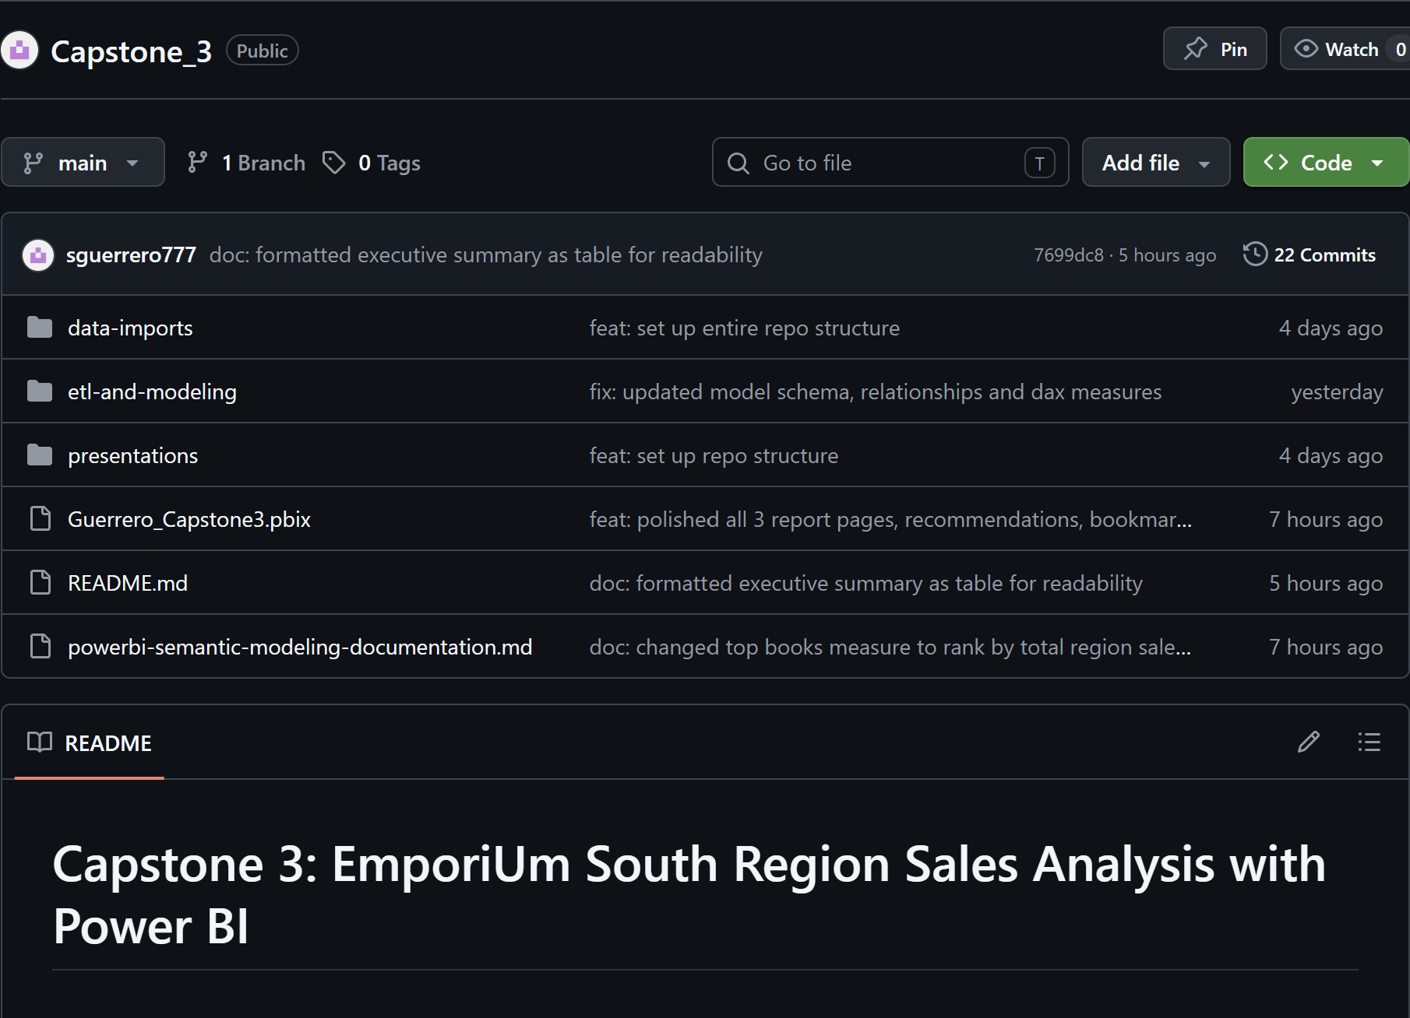
GitHub Repository
Capstone 3 GitHub Repository
Power BI Service Report Link
sguerrero@my.yearupunited.org
Thank you!

