Slide 1

EMPORIUM
Maryland Territory
Sales Analysis
Northeast Region • In-Store Sales • January 2022 – December 2025
Sales Manager: Shruti Reddy Regional Director: Michael Jarvis
Prepared by: Sharleen Guerrero • Jonathan Lopez • Yanuris Campusano • Kasaiah Antonio • Demy Melgar • Vesna Cari • Hamzah Alssoudi • Sha'Rya Weaver

Slide 2
Executive Summary
Maryland is the top-performing territory in the Northeast region
TOTAL REVENUE
NORTHEAST REGION RANK
TOP CATEGORY
TOP STORE
$11.45M
#1
Tech &
Accessories
North Harford
Jan 2022 – Dec 2025
47.25% of regional revenue
$7.8M in revenue
$8.7M • 69,530 transactions
Key Takeaway
Maryland drives nearly half of all Northeast revenue, led overwhelmingly by North Harford's transaction volume and strong Technology & Accessories sales — but Textbooks are declining and Stationery & Supplies shows untapped demand.

Slide 3
Revenue by Product Category
Technology & Accessories leads by a wide margin; Textbooks is the only category in decline
⚠ AT-RISK CATEGORY
Textbooks
Revenue declined twice — in 2023 and again in 2025, down $99,322. Second-largest category by revenue, but the only one trending down.
↑ GROWTH OPPORTUNITY
Stationery & Supplies
Ranks #2 in transaction volume (9,862 transactions) but lowest in revenue — high customer interest that isn't yet converting to dollars.

Slide 4
Store Performance
North Harford outperforms every other Maryland store combined
Store | Revenue | Transactions | Rank
Germantown | $584,675.92 | 4,363 | 2
Parkville | $320,441.24 | 2,192 | 3
Howard | $319,394.58 | 2,181 | 4
Ridgely | $318,511.04 | 2,341 | 5
Baltimore | $310,099.90 | 2,222 | 6
Back River | $303,433.61 | 2,228 | 7
Queen Anne's County | $298,074.49 | 2,202 | 8
Annapolis | $288,865.31 | 2,207 | 9
#1 STORE
North
Harford
$8.7M
total revenue
69,530
transactions — by far the highest volume in the territory
North Harford alone drives 76% of Maryland's total revenue, powered by transaction volume rather than higher basket size.

Slide 5
Recommendations for Next Quarter
01
02
Replicate North Harford's model
Invest in Stationery & Supplies
Study what drives North Harford's transaction volume (staffing, layout, foot traffic) and pilot those tactics at mid-tier stores like Germantown and Parkville.
High transaction interest (#2 in volume) isn't converting to revenue. Test bundling, endcap placement, or pricing changes to lift average basket size.
03
04
Diagnose the Textbooks decline
Protect Technology & Accessories momentum
Two down years (2023, 2025) signal a structural issue — investigate pricing, digital substitution, or assortment before it drags down overall category mix.
The top revenue driver ($7.8M, +$521,971 in 2025) should stay fully stocked and featured heading into the next quarter's peak buying season.

Slide 6
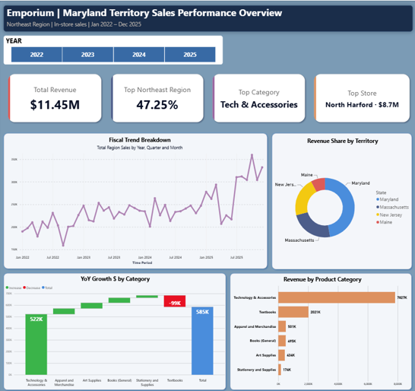
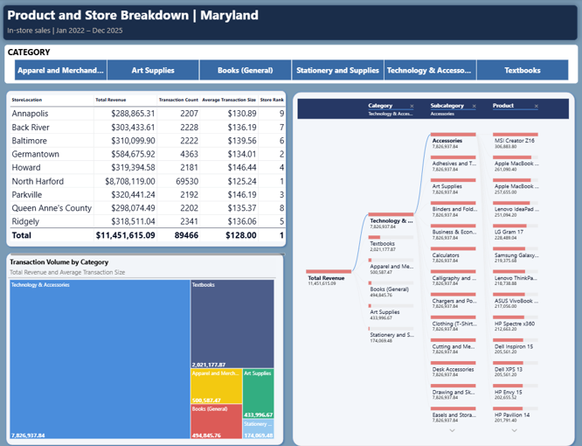
Explore the Full Project
Two views from the interactive Power BI report — sales overview and store & product breakdown
VIEW THE FULL PROJECT ON GITHUB
Github Repository

Slide 7
Thank You
Questions & Discussion
EmporiUm Maryland Territory Sales Analysis

