Slide 1
What’s New at AWS
Don Barber
Principal Solutions Architect
10/20/2020

Slide 2

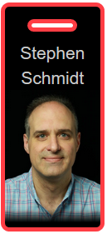
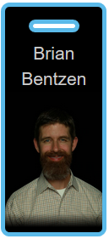
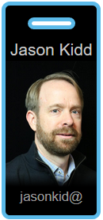
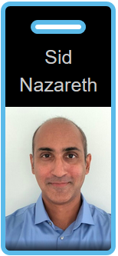
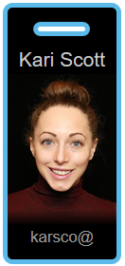
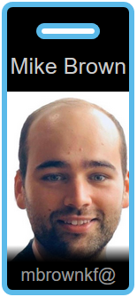
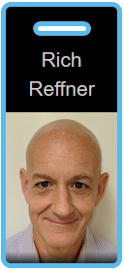
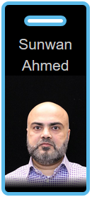
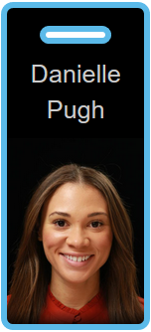
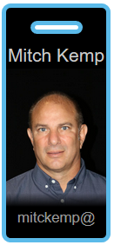
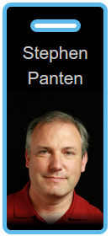
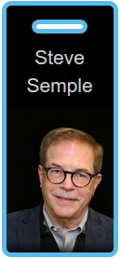
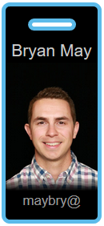
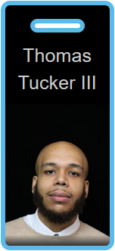
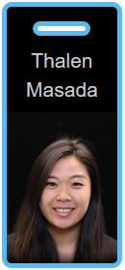
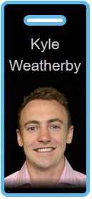
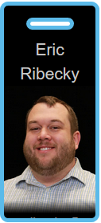
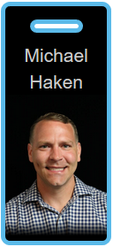
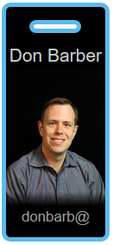
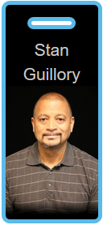
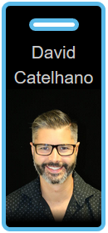
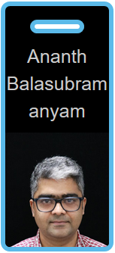
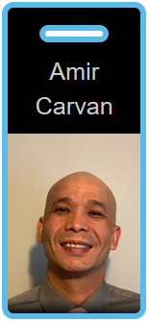
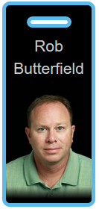
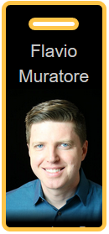
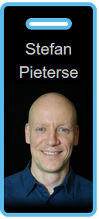
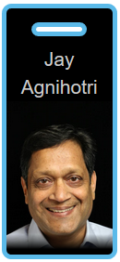
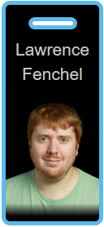
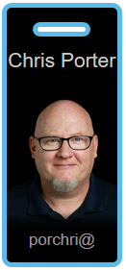
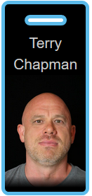
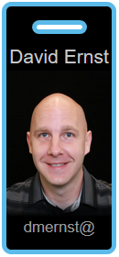
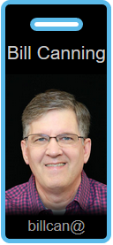
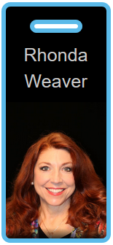

2
Executive Sponsor
Account Manager (AM)
Customer Solutions Manager (CSM)
Professional Services (ProServ)
Billing Support & Concierge (CS)
Drives service adoption, program execution, customer education, PFRs, and Reference/Analyst.
Partners with SA and customers to design and deploy solutions.
Provides support, analysis, and execution for purchasing & billing.
Strategy and direction.
Steward of the relationship & partnership between Capital One and Amazon.
awssteve@
Chief Information Security Officer
bentzen@
Client Director Sr. Manager
jasonkid@
Account Manager PowerUP, Cyber
sidnaz@
Account Manager
Card
karsco@
Account Manager
Commercial
mbrouwnkf@
Account Manager UK
rreffner@
Sr. Manager
sunwaa@
Lead CSM
dueling@
CSM
mitckemp@
Manager
panten@
Services Manager
ssemple@
Sr. Program Manager
maybry@
Reserved Instances
iiiati@
Sr. Concierge
thalem@
Custom Billing Analyst
weaky@
Demand Generation
Solutions Architect (SA)
Technical Account Manager (TAM)
Partner Success Manager (PSM)
Provide customers with technical direction, architectural guidance, and well-architected solutions.
Technical support & escalations, and customer advocate.
Managing consulting and technical partners.
eribecky@
Sr. Manager
mhaken@
Principal Technologist
donbarb@
Principal Solutions Architect
PowerUP, EP2T
stanaws@
Sr. Solutions Architect
FS, Retail
castelha@
Sr. Solutions Architect
Card, Cyber
baananth@
Sr. Solutions Architect
UK
amirnyc@
Sr. Solutions Architect
robbu@
Manager
muratore@
Sr. TAM
Cyber, PowerUP
pietes@
Sr. TAM
EP2T
pankagni@
Sr. TAM
FS, Retail, Commercial
fenchell@
TAM
TOC
porchri@
TAM
TOC
chappy@
Sr. TAM
Contact Centers
dmernst@
Sr. TAM
Card
billcan@
Sr. TAM
UK
rhoweave@
Sr. Program Manager
Account Team
Email addresses @amazon.com
Notes:
Insert next o Jeremy Thalen Masada – Custom Billing Analyst

Slide 3
Since Last PI
Last PI was March 10
30 Products and Features released
9 likely of interest
10 minutes
Talk more? donbarb@amazon.com

Slide 4
Thank you!

