Slide 1

Next-Generation Sequencing Analysis
Dr Alan Pittman and Dionysios Grigoriadis
SGUL Bioinformatics Unit
Friday 31st January 2020
A and D

Slide 2
Workshop set-up
Open the web browser
Go to :
https://github.com/sgul-genetics-centre-bioinformatics/NGS-bioinformatics-workshop_SGUL_31-01-2020/blob/master/NGS_workshop.md
D

Slide 3
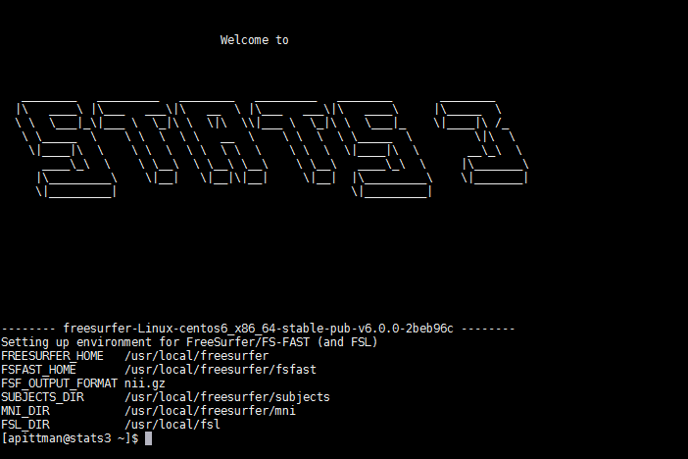
Workshop set-up
Accessible to all at SGUL with login via MobaXterm
Open MobaXterm
Login by typing:
ssh yourusername@stat3.sgul.ac.uk
Type password when prompted
Defaults to home (H) drive where we will be working
D

Slide 4
Workshop set-up
In MobaXterm
ONLY IF YOU ARE POSTGRAD OR UNDERGRAD:
Type this at the terminal:
cd /homedirs8/workshop/your_username
PhD STUDENTS AND STAFF:
Go to the next step.
D

Slide 5
Workshop set-up
Type this at the terminal:
git clone https://github.com/sgul-genetics-centre-bioinformatics/NGS-bioinformatics-workshop_SGUL_31-01-2020.git
Wait for the directory to download and then move inside it:
cd NGS-bioinformatics-workshop_SGUL_31-01-2020
…here we are downloading the needed files we will be working on in this workshop today
D

Slide 6
Learning Objectives
Quick overview of next generation sequencing
Linux command line
Next-generation sequencing software/tools
Genome reference download and index
Raw sequencing reads pre-processing and quality control
Reads alignment to the reference genome
Alignment quality control and refinement
Variant calling and filtration
Annotation of the called variants
Visualisation of alignments and called variants
A

Slide 7
Introduction
A

Slide 8




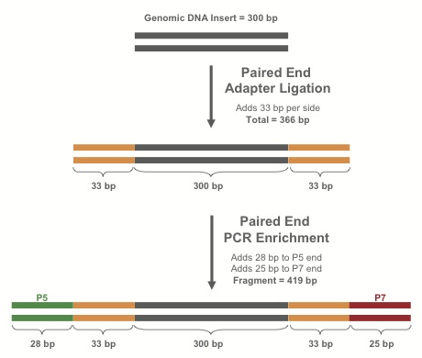
Library Preparation
Purify*
fragments
Fragments
DNA
RT-PCR
If RNA:
make cDNA
RNA
Extract nucleic acids from blood, tissue, saliva, etc.
Shear dsDNA into fragments
Attach adapters to fragments
Library
* Protocol varies depending on experimental design (WGS, exome, targeted sequencing etc)
A

Slide 9
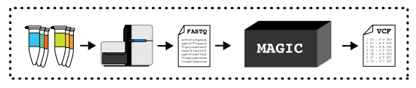
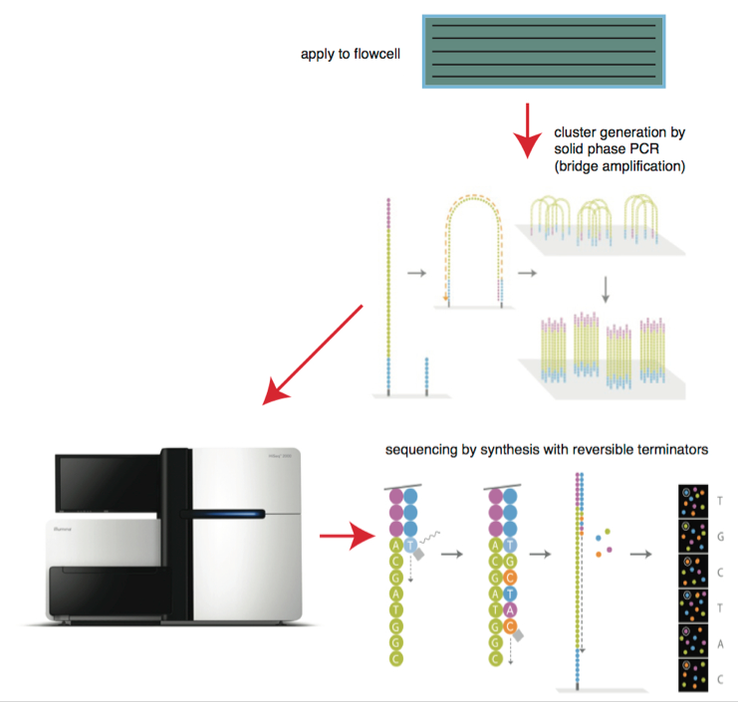

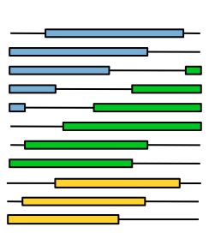
Sequencing the library I
DNA libraries
Bitesizebio.com
Flowcell
DNA libraries deposited on flowcell
-> amplified to form clusters
Lanes
Illumina
HTS machine processes a flowcell containing lanes
Each lane may contain multiple samples (indexed with a DNA barcode)
Read group (RG) specifies a combination of sample and flowcell
Enormous pile of short reads
A

Slide 10
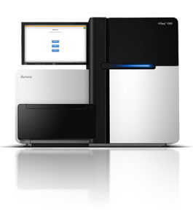
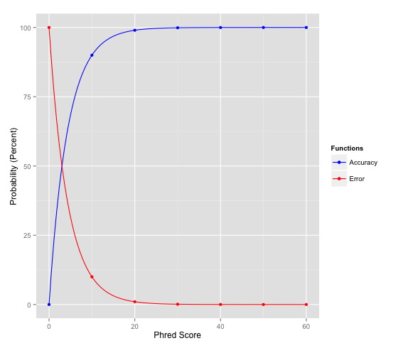
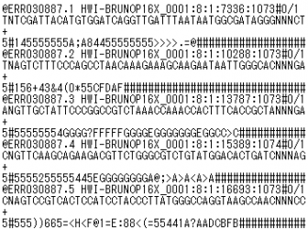
Sequencing the library II
FASTQ file
Accuracy
Big pile of reads!
20 and higher is generally a good score
Sequence Name (read name, group, etc.)
Sequence
+ (optional: Sequence name again)
Associated quality score
Phred value = −10 * log₁₀(ε)
Error
Q10 = 90% confidence (10% error rate)
Q20 = 99% confidence (1% error rate)
Q30 = 99.9% confidence (0.1% error rate)
Format specification http://maq.sourceforge.net/fastq.shtml
ASCII code translates to Phred-scale Q scores
A

Slide 11
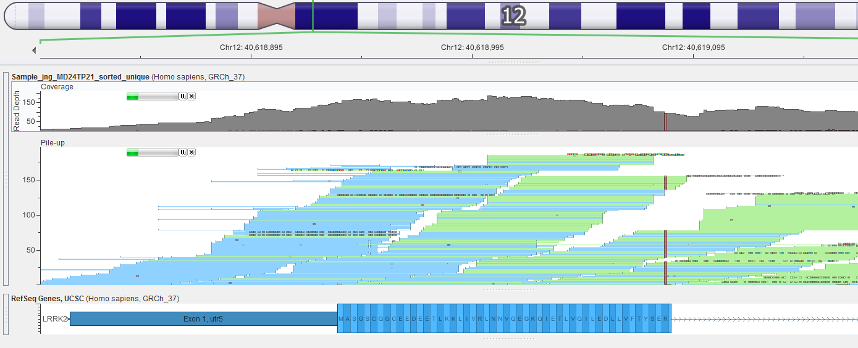
Mapping The Short Reads
Mapping and alignment algorithms
Short read sequences from the machine need to be re-assembled like a jigsaw
Mapped against the reference genome using the alignment algorithm BWA
BWA for DNA
Enormous pile of short reads from sequencer
Reference genome
Reads mapped to reference
A

Slide 12
Introduction to UNIX Command Line How to run simple commands and executable applications
This is where you specify which command/application you want to run and where it is.
This is where you set specific arguments for your application. Typically set with: “-”,”--“ or “=“ (see examples).
Terminal
[user@stats3 ~]$ command or /path/to/application [ARGUMENTS]
Shell
Examples of simple commands:
[user@stats3 ~]$ #Shell ignores everything that is written after the hash mark (#)
[user@stats3 ~]$ cd ~/software
[user@stats3 ~]$ ls ~/resources/etc
[user@stats3 ~]$ mkdir reference/
[user@stats3 ~]$ software/samtools view –Sb sample1.sam -o sample1.bam
[user@stats3 ~]$ software/fastp -i sample1_r1.fastq --html sample1_results.html --json sample1_results.json
The “\” character is used to indicate that the code line continues in the following line. Example:
[user@stats3 ~]$ software/fastp -i sample1_r1.fastq \
--html sample1_results.html \
--json sample1_results.json
D
Notes:
The shell: is a program that takes commands from the keyboard and gives them to the operating system to perform.
Terminal: is a program that opens a window and lets you interact with the shell.
shell prompt: contains your user name and the name of the machine followed by a dollar sign

Slide 13
Introduction to UNIX Command Line How to run simple commands and executable applications
This is where you specify which application you want to run and where it is. In this case is the compiler of the specific language.
This is where you set specific arguments for the compiler. Typically set with: “-”,”--“,“=“ or just a word or character (see examples).
This is where you set specific arguments for your script. Typically set with: “-”,”--“,“=“ or just a word or character (see examples).
Full path to the script.
[user@stats3 ~]$ /path/to/language/compiler [COMPILER’S ARGUMENTS] /path/to/script [SCRIPT’S ARGUMENTS]
Examples:
[user@stats3 ~]$ sh ~/software/linux_script.sh –i data1.csv –d 20
[user@stats3 ~]$ bash ~/software/linux_script.sh data1.csv
[user@stats3 ~]$ python ~/software/myscript.py –i sample1.vcf –o sample1.processed.vcf
[user@stats3 ~]$ Rscript ~/software/plot_samples.R --input table.txt –f 20 –d 9 --output plot.jpeg
[user@stats3 ~]$ java –jar gatk-4.0.4.0-local.jar HaplotypeCaller –I sample1.vcf
[user@stats3 ~]$ java –jar –Xms30g gatk-4.0.4.0-local.jar HaplotypeCaller –I sample1.vcf
D

Slide 14
Hands On Workshop
A

Slide 15
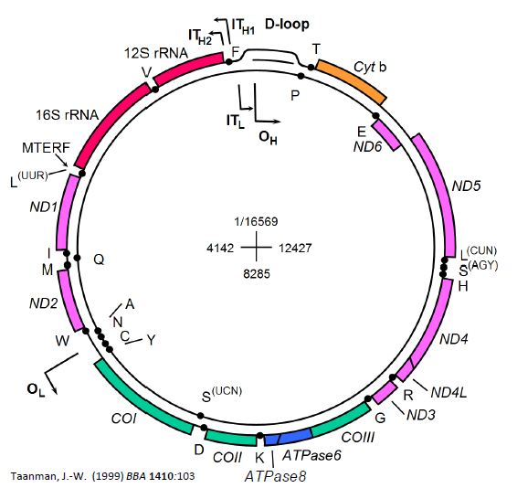
Analysis of the Human mtDNA Sequence
Mitochondrial DNA (mtDNA)
Closed- circular 16.6kb in size
mtDNA encodes 13 proteins
Essential subunits of oxidate phosphorylation
A

Slide 16
Part 1
Downloading and preparing our mitochondrial reference (chrM) fasta file.
At the Linux terminal type:
mkdir reference
wget –timestamping 'ftp://hgdownload.cse.ucsc.edu/goldenPath/hg38/chromosomes/chrM.fa.gz' -O reference/chrM.fa.gz
…here we are creating a new directory (called reference) with the linux mkdir command, then using the wget command to download chrM fasta file to that new directory
A

Slide 17
Part 1
Unzipping and viewing the compressed chrM fasta txt file.
At the Linux terminal type:
gunzip reference/chrM.fa.gz
head reference/chrM.fa
…the chrM reference fasta file is currently compressed and we are unzipping it to it’s text format. We can view the top 10 lines of the unzipped file with the head command.
A

Slide 18
Part 1
Generate the FM-index from the chrM reference fasta file for use in BWA
At the Linux terminal type:
software/bwa index reference/chrM.fa
…we are using the index function of the bwa software to make the FM-index of our reference fasta genome
A

Slide 19
Part 1
Prepare the index file for use in the Genome Analysis Toolkit (GATK)
Fasta index file (.faidx)
Sequence dictionary file (.dict)
At the Linux terminal type:
software/samtools faidx reference/chrM.fa
java -jar software/gatk-package-4.0.4.0-local.jar CreateSequenceDictionary -R reference/chrM.fa -O reference/chrM.dict
…..producing some more text files describing the contents of the chrM FASTA file for the genome analysis toolkit.
A

Slide 20
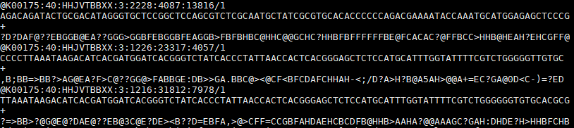
Part 2
Inspect sequencing reads in FASTQ format
At the Linux terminal type:
head –n 12 sample1_r1.fastq
Enormous pile of short reads
sample1_r1.fastq
sample1_r2.fastq
FASTQ file
Every new entry (read) is starting with an “@”.
Each entry (read) in a FASTQ file consists of four lines:
1st: Read identifier
2nd: Nucleotide sequence
3rd: Quality score identifier (is always a “+”)
4rd: Per base quality score
DG

Slide 21
Part 2
Quality control of our mitochondrial NGS sequence data prior to alignments
At the Linux terminal type:
software/fastp -i sample1_r1.fastq -I sample1_r2.fastq -o sample1_out.R1.fq.gz \ -O sample1_out.R2.fq.gz --html sample1_results.html \
--json sample1_results.json --report_title sample1_results
This step achieves 2 main goals
Process the reads prior to the alignment step:
Trim read bases that might be of low quality (usually on the tail end of the reads).
Remove any adapter sequences (have been artificially inserted during library preparation).
Report the reads quality in a human-readable format
At the Linux terminal type:
firefox sample1_results.html
To visualise the .HTML report using Mozilla Firefox
DG

Slide 22
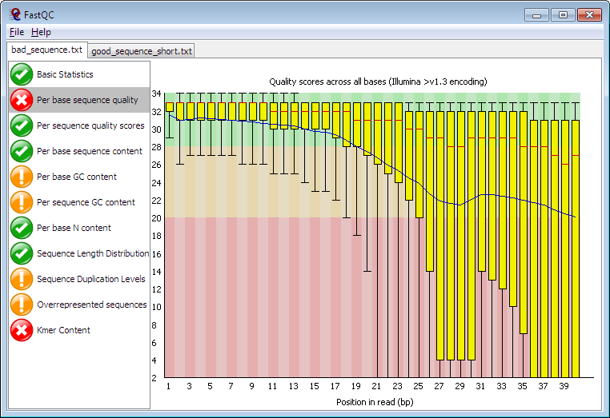
Part 2
An alternative way of visualising the reads quality before and after trimming.
At the Linux terminal type:
software/fastqc sample1_r1.fastq sample1_r2.fastq sample1_out.R1.fq.gz \ sample1_out.R2.fq.gz
Read more about how to interpret the FASTQC reports: http://www.bioinformatics.babraham.ac.uk/projects/fastqc/Help/3%20Analysis%20Modules/
DG

Slide 23
Part 3
Alignment of the mitochondrial fastq sequence data to the chrM using BWA
At the Linux terminal type:
software/bwa mem reference/chrM.fa sample1_out.R1.fq.gz sample1_out.R2.fq.gz -R '@RG\tID:sample1\tSM:sample1\tLB:sample1\tPL:ILLUMINA' -o sample1.sam
….. we are using the bwa alignment algorithm ‘mem’ to align our sample fastq data against the reference chrM fasta file
-o generating an output .sam (sequence alignment format) file
-R embedding the sample/sequence information in file
A

Slide 24
Part 3
Converting the sam output to a common binary alignment format (.bam)
At the Linux terminal type:
software/samtools view -Sb sample1.sam -o sample1.bam
….. we are using the samtools software ‘view’ command to print our .sam file into a different file format, in this case a .bam file (basically same as a .sam file but takes up much less disk space and retains all of the information)
A

Slide 25
Part 3
Sorting by genomic co-ordinate and indexing the .bam file
At the Linux terminal type:
software/samtools sort sample1.bam -o sample1_sorted.bam
software/samtools index sample1_sorted.bam
….. we are using the samtools software ‘sort’ command to sort the alignment .bam file by genomic coordinate
..then we are using the samtools ‘index’ command to create the .bai index – the .bam companion file that allows for faster read access for downstream steps
A

Slide 26
Part 3
Deduplicate with picardtools in GATK
At the Linux terminal type:
java -jar software/gatk-package-4.0.4.0-local.jar MarkDuplicates -I sample1_sorted.bam -O sample1_sorted_unique.bam -M sample1_picard_metrics.txt
…the deduplication step locates and tags duplicate reads in the .bam, where duplicate reads are defined as originating from a single fragment of DNA. Duplicates can arise during sample preparation e.g. library construction using PCR.
A

Slide 27
Part 3
Base quality score recalibration with GATK
At the Linux terminal type one after the other
java -jar software/gatk-package-4.0.4.0-local.jar BaseRecalibrator -I sample1_sorted_unique.bam -R reference/chrM.fa --known-sites software/common_all_chrM.vcf.gz -O recal_data_table.txt
java -jar software/gatk-package-4.0.4.0-local.jar ApplyBQSR -I sample1_sorted_unique.bam -R reference/chrM.fa --bqsr-recal-file recal_data_table.txt -O sample1_sorted_unique_recalibrated.bam
…we are performing base quality score recalibration to recalculate the base calling quality scores. The sequencing machines tend to overestimate the data quality (!) ..so we can model the actual data quality on the number mismatches in the observed data… and adjust them accordingly!
A

Slide 28
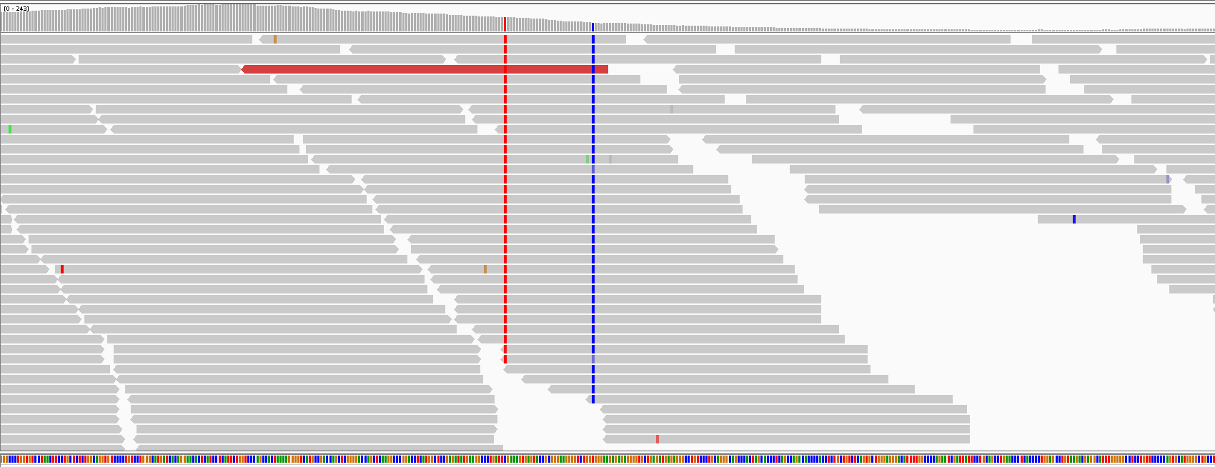
Part 4
Identifying single nucleotide variants and small indels in our aligned mtDNA
At the Linux terminal type:
java -jar software/gatk-package-4.0.4.0-local.jar HaplotypeCaller \ -I sample1_sorted_unique_recalibrated.bam \
-R reference/chrM.fa -G StandardAnnotation \
-bamout sample1_sorted_unique_recalibrated.bamout.bam \
-O sample1.vcf
HaplotypeCaller scans the aligned reads for mismatches against the reference genome
Read more here: https://gatk.broadinstitute.org/hc/en-us/articles/360035531412-HaplotypeCaller-in-a-nutshell
D

Slide 29
Part 4
Hard-Filtering of the previously called variants
At the Linux terminal type:
java -jar software/gatk-package-4.0.4.0-local.jar VariantFiltration -V sample1.vcf -R reference/chrM.fa --genotype-filter-expression "GQ < 30.0“ --genotype-filter-name "LowGQ" \ --filter-expression "QD < 1.5" --filter-name "LowQD" --filter-expression "DP < 6" --filter-name "LowCoverage" \ --filter-expression "SOR > 10.0" --filter-name "StrandBias" -O sample1.filtered.vcf
Filters used in this example
Genotype Quality less than 30.0: GQ < 30 to tag variants with low genotype quality
Approximate read depth less than 6: DP < 6 to tag variants with low read coverage
Quality of Depth less than 1.5: QD < 1.5 to tag variants with low quality of depth
Strand Odds Ratio more than 10: SOR > 10 to tag variants with strand bias
D

Slide 30
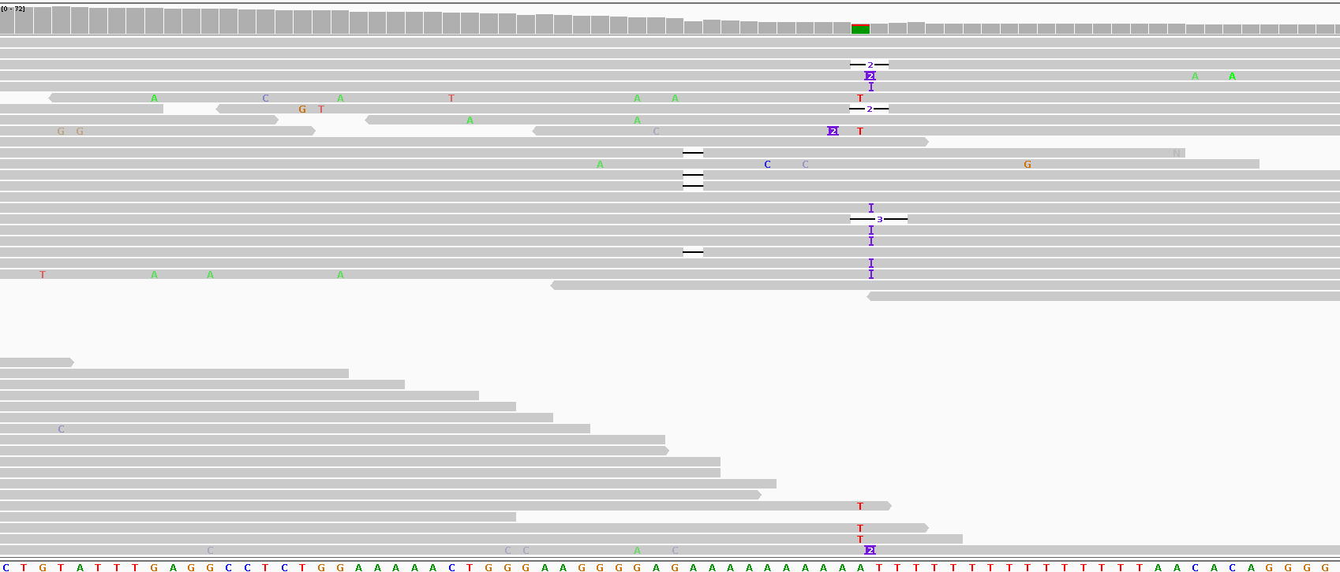
Part 4
Hard-Filtering of the previously called variants
At the Linux terminal type:
java -jar software/gatk-package-4.0.4.0-local.jar VariantFiltration -V sample1.vcf -R reference/chrM.fa --genotype-filter-expression "GQ < 30.0“ --genotype-filter-name "LowGQ" \ --filter-expression "QD < 1.5" --filter-name "LowQD" --filter-expression "DP < 6" --filter-name "LowCoverage" \ --filter-expression "SOR > 10.0" --filter-name "StrandBias" -O sample1.filtered.vcf
D

Slide 31
Part 5
Functional annotation of the called genetic variants
Gene annotations
Region annotations
Filter annotations
Variant information that you want to annotate
D

Slide 32
Part 5
Functional annotation of the called genetic variants
Variant information that you want to annotate
D

Slide 33
Part 5
Functional annotation of the called genetic variants
We are using an online freely available annotation tool: (ensemble VEP)
Open an internet browser (Mozilla Firefox, Google Chrome)
Navigate to https://www.ensembl.org/Multi/Tools/VEP
! Double check the human genome build you are using ! (Here, we are using hg38/GRCh38)
Fill the job form using:
Name for this job: sgul_workshop_ followed by your initials (e.g. sgul_workshop_DG)
Input data -> Or upload file: -> Choose file -> Navigate and select your sample1.filtered.vcf file
Transcript database to use: Ensembl/GENCODE transcripts
Make sure you will leave Additional configurations field untouched using the pre-defined default fields.
Click
Wait for the job to finish
When finished, click [View results]
D

Slide 34

Part 6
Aligment & Variants visualisation with Integrative Genomics Viewer (IGV)
At the Linux terminal type:
software/igv.sh
Open IGV software.
Go to Genomes and then select “Load genomes from file…”.
Locate the chrM.fa file and open.
Go to “File” and then select “Load from file…”.
Locate the “sample1_sorted_unique_recalibrated.bam” and open.
You can also load a track showing the actual called variants:
Go to “File” and then select “Load from file…”.
Locate the “sample1.filtered.vcf” and open.
There is also an online version of IGV: https://igv.org/app/

Slide 35
Quiz
Don’t be shy! Seek advice from the demonstrators if you get stuck!
In the VEP annotation results table, find the genomic coordinates of the missense variant with the highest Polyphen score.
Download the annotated vcf file using the VCF download button on the upper-right corner.
Get the genomic position of the variant you selected in question 1 and extract this variant’s information from the sample1.filtered.vcf file (using the grep command) and save it into a new file (using the > symbol).
By looking into the new file you created:
Find out if the sequenced sample is homozygous or heterozygous for this variant.
Report the Strand Odds Ratio for this variant.
Report the Genotype Quality and the Quality of Depth values for this variant.
Hint! Check the .VCF specification here: https://samtools.github.io/hts-specs/VCFv4.2.pdf and Part4 of the workshop.
Load the IGV software with the alignment (.BAM) file and the variant calling (.VCF) file.
Point the IGV viewer to the previously selected variant
Does it seem real to you? What do you think?
Count the reads covering the position of the selected variants in the alignment file (.BAM) using the samtools tool.
Hint! You can find samtools in software/samtools).
Hint! Check samtools documentation here: http://www.htslib.org/doc/samtools.html
Hint! Use the samtools view function.

