Slide 1
Next-Generation Sequencing Analysis
Dr. Alan Pittman and Dr. Sara Dobbins
CSG Bioinformatics Unit
Friday 16th January 2026

Slide 2
Workshop set-up
Open a web browser
Go to: https://github.com/sgul-genetics-centre-bioinformatics/NGS-workshop_CSG_16-01-2026
Click on NGS_workshop.md to open instructions

Slide 3
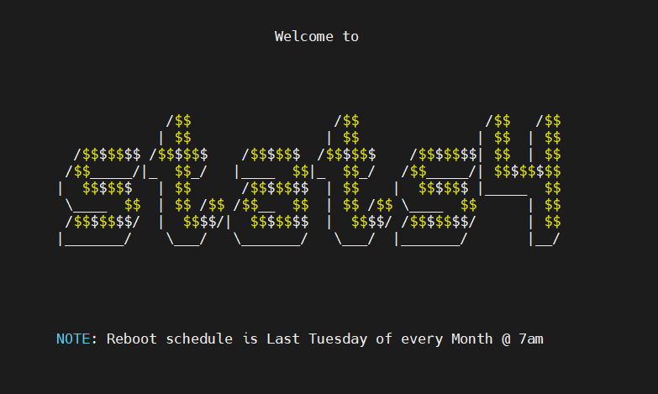
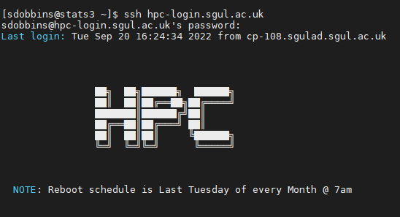

Workshop set-up
HYPERION
High Performance Computing Cluster
4 CPU nodes – 20 CPUs per node
2 GPU nodes – 40 GPUs per node
250 GB RAM
Requires special account
Queue Management software
STATS4 Cluster
96 CPUs
1TB RAM
3,500 CPUs with 30 TB RAM

Slide 4

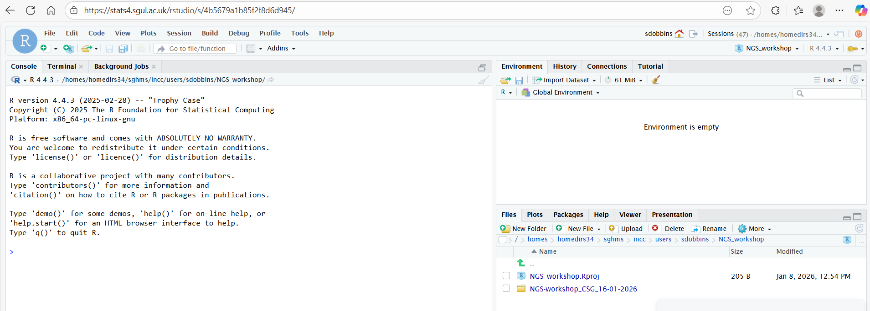
Workshop set-up
We’re going to use STATS4 via Rstudio
Open a web browser and navigate to https://stats4.sgul.ac.uk/rstudio/
Click "New Project“ and select "New Directory", "New Project" and call your directory "NGS_workshop" or something similar.
Navigate to the Terminal tab of the Console pane (on the left hand side of Rstudio).

Slide 5
Workshop set-up
Type this at the terminal:
git clone https://github.com/sgul-genetics-centre-bioinformatics/NGS-bioinformatics-workshop_SGUL_16-01-2026.git
Wait for the directory to download and then move inside it:
cd NGS-bioinformatics-workshop_SGUL_16-01-2026
Set up links to software :
bash setup_software.sh

Slide 6
Learning Objectives
Quick overview of next generation sequencing
Gain experience using Linux command line
Next-generation sequencing software/tools
Genome reference download and index
Raw sequencing reads pre-processing and quality control
Reads alignment to the reference genome
Alignment quality control and refinement
Variant calling and filtration
Annotation of the called variants
Visualisation of alignments and called variants

Slide 7
Introduction to UNIX Command Line How to run simple commands and executable applications
This is where you specify which command/application you want to run and where it is.
This is where you set specific arguments for your application. Typically set with: “-”,”--“ or “=“ (see examples).
Terminal
[user@stats4 ~]$ command or /path/to/application [ARGUMENTS]
Shell
Examples of simple commands:
[user@stats4 ~]$ #Shell ignores everything that is written after the hash mark (#)
[user@stats4 ~]$ cd ~/software
[user@stats4 ~]$ ls ~/resources/etc
[user@stats4 ~]$ mkdir reference/
[user@stats4 ~]$ software/samtools view –Sb sample1.sam -o sample1.bam
[user@stats4 ~]$ software/fastp -i sample1_r1.fastq --html sample1_results.html --json sample1_results.json
The “\” character is used to indicate that the code line continues in the following line. Example:
[user@stats4 ~]$ software/fastp -i sample1_r1.fastq \
--html sample1_results.html \
--json sample1_results.json
Notes:
The shell: is a program that takes commands from the keyboard and gives them to the operating system to perform.
Terminal: is a program that opens a window and lets you interact with the shell.
shell prompt: contains your user name and the name of the machine followed by a dollar sign

Slide 8
Introduction to UNIX Command Line How to run simple commands and executable applications
This is where you specify which application you want to run and where it is. In this case is the compiler of the specific language.
This is where you set specific arguments for the compiler. Typically set with: “-”,”--“,“=“ or just a word or character (see examples).
This is where you set specific arguments for your script. Typically set with: “-”,”--“,“=“ or just a word or character (see examples).
Full path to the script.
[user@stats4 ~]$ /path/to/language/compiler [COMPILER’S ARGUMENTS] /path/to/script [SCRIPT’S ARGUMENTS]
Examples:
[user@stats4 ~]$ sh ~/software/linux_script.sh –i data1.csv –d 20
[user@stats4 ~]$ bash ~/software/linux_script.sh data1.csv
[user@stats4 ~]$ python ~/software/myscript.py –i sample1.vcf –o sample1.processed.vcf
[user@stats4 ~]$ Rscript ~/software/plot_samples.R --input table.txt –f 20 –d 9 --output plot.jpeg
[user@stats4 ~]$ java –jar gatk-4.0.4.0-local.jar HaplotypeCaller –I sample1.vcf
[user@stats4 ~]$ java –jar –Xms30g gatk-4.0.4.0-local.jar HaplotypeCaller –I sample1.vcf

Slide 9
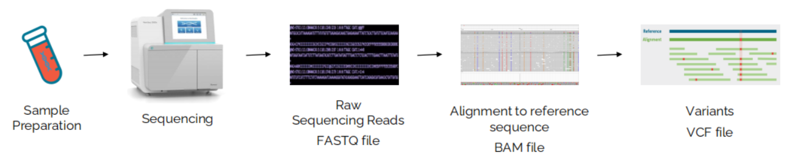
Introduction NGS

Slide 10




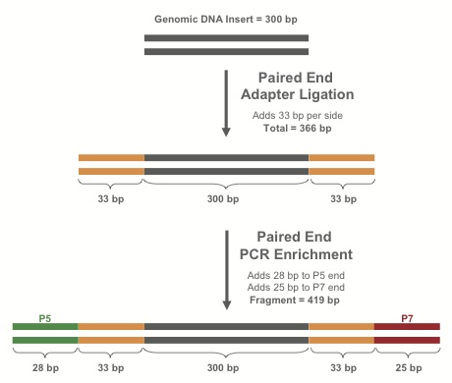
Library Preparation
Purify*
fragments
Fragments
DNA
RT-PCR
If RNA:
make cDNA
RNA
Extract nucleic acids from blood, tissue, saliva, etc.
Shear dsDNA into fragments
Attach adapters to fragments
Library
* Protocol varies depending on experimental design (WGS, exome, targeted sequencing etc)

Slide 11
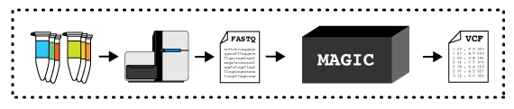
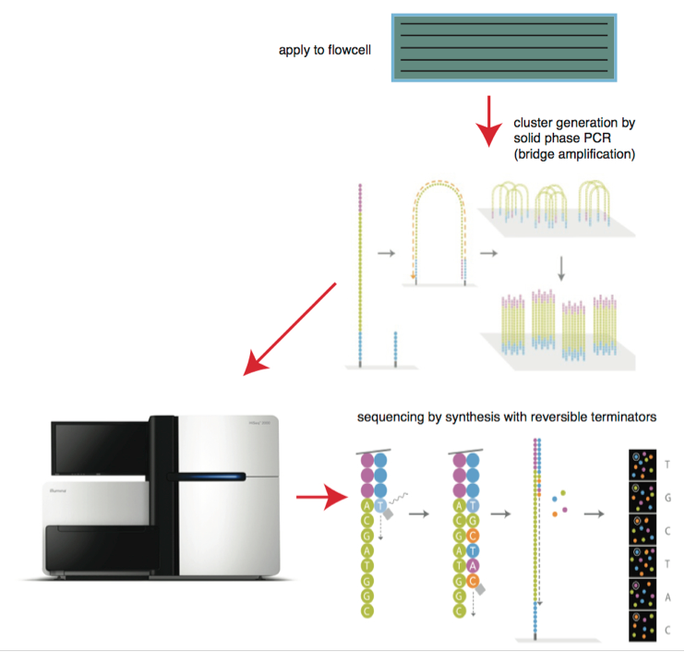

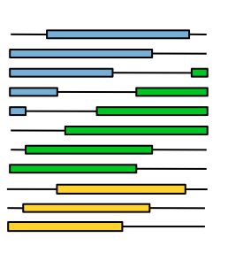
Sequencing the library – Part I
DNA libraries
Bitesizebio.com
Flowcell
DNA libraries deposited on flowcell
-> amplified to form clusters
Lanes
Illumina
HTS machine processes a flowcell containing lanes
Each lane may contain multiple samples (indexed with a DNA barcode)
Read group (RG) specifies a combination of sample and flowcell
Enormous pile of short reads

Slide 12
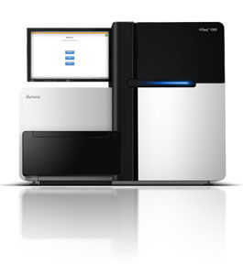
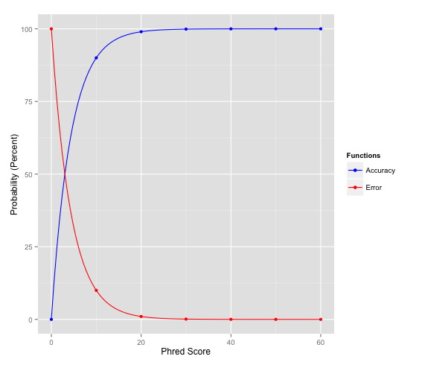
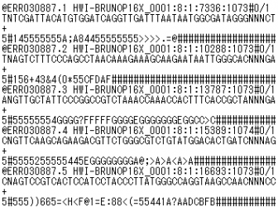
Sequencing the library – Part II
FASTQ file
Accuracy
Big pile of reads!
20 and higher is generally a good score
Sequence Name (read name, group, etc.)
Sequence
+ (optional: Sequence name again)
Associated quality score
Phred value = −10 * log₁₀(ε)
Error
Q10 = 90% confidence (10% error rate)
Q20 = 99% confidence (1% error rate)
Q30 = 99.9% confidence (0.1% error rate)
Format specification http://maq.sourceforge.net/fastq.shtml
ASCII code translates to Phred-scale Q scores

Slide 13
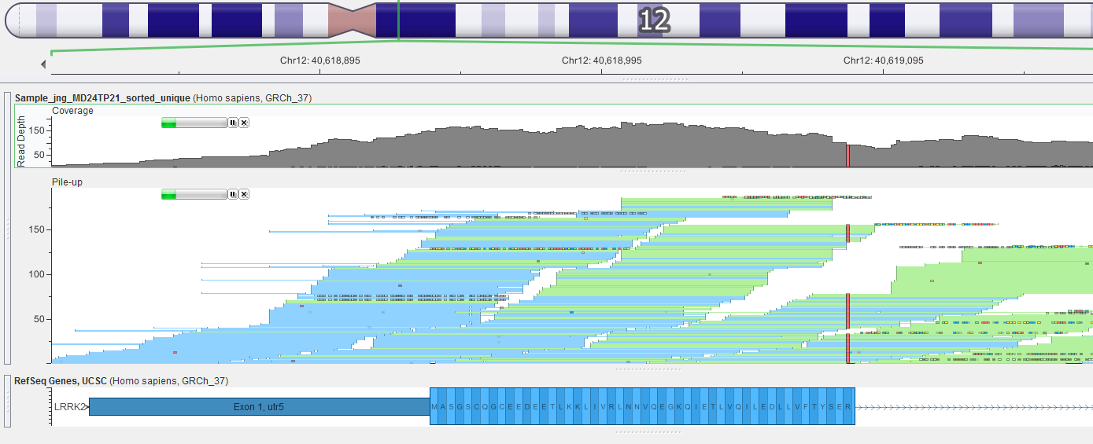
Mapping The Short Reads
Mapping and alignment algorithms
Short read sequences from the machine need to be re-assembled like a jigsaw
Mapped against the reference genome using the alignment algorithm BWA
BWA for DNA
Enormous pile of short reads from sequencer
Reference genome
Reads mapped to reference
More info : https://omics.sbs/blog/bwa/bwa.html

Slide 14
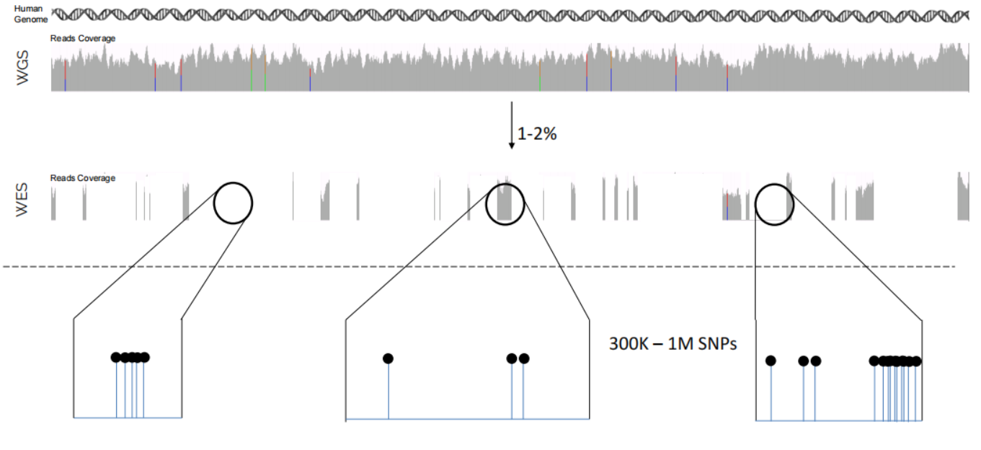
Genomics – Data Sizes
WGS
WES
SNP
GENOTYPING

Slide 15

Genomics – Data Sizes
WGS | 80-100 GB | 80-100 GB | 2-4 GB
WES | 3-4 GB | 3-4 GB | 200 MB
SNP arrays genotype |  |  | 1-2 MB
Coverage?
Number of samples?

Slide 16
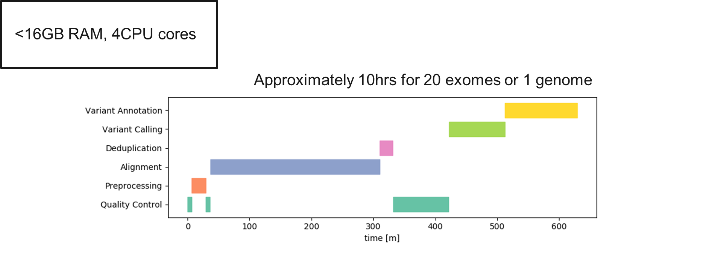
NGS– Processing Time

Slide 17







Genomic Data - Practical Challenges
Sample 1
Sample 2
…
Sample N
Parallelisation
Data Integrity
Sample Mix-ups
Optimising Resources
WORKFLOW CREATION:
GITHUB

Slide 18
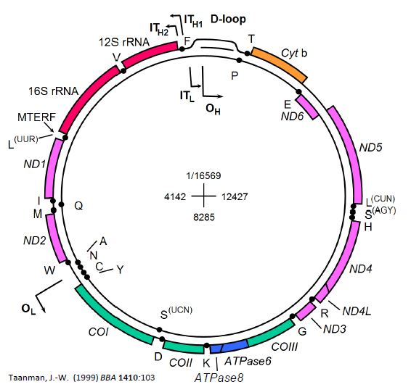
Analysis of the Human mtDNA Sequence
Mitochondrial DNA (mtDNA)
Closed- circular 16.6kb in size
mtDNA encodes 13 proteins
Essential subunits of oxidate phosphorylation
16569 base pairs compared to 3,300,000,000 bp entire genome
30,000,000 bp exome
Small file sizes
Quick processing times!

Slide 19
Part 1 – Preparing reference
Downloading and preparing our mitochondrial reference (chrM) fasta file.
At the Linux terminal type:
mkdir reference
wget –timestamping 'ftp://hgdownload.cse.ucsc.edu/goldenPath/hg38/chromosomes/chrM.fa.gz' -O reference/chrM.fa.gz
…here we are creating a new directory (called reference) with the linux mkdir command, then using the wget command to download chrM fasta file to that new directory

Slide 20
Part 1 – Preparing reference
Unzipping and viewing the compressed chrM fasta txt file.
At the Linux terminal type:
gunzip reference/chrM.fa.gz
head reference/chrM.fa
…the chrM reference fasta file is currently compressed and we are unzipping it to it’s text format. We can view the top 10 lines of the unzipped file with the head command.

Slide 21
Part 1 – Preparing reference
Generate the FM-index from the chrM reference fasta file for use in BWA
At the Linux terminal type:
software_update/bwa index reference/chrM.fa
…we are using the index function of the bwa software to make the FM-index of our reference fasta genome

Slide 22

Part 1 – Preparing Reference
Samtools is a suite of programs for interacting with high-throughput sequencing data. It includes:
https://www.htslib.org/
Samtools – read/write/edit/index/view SAM/CRAM/BAM format
BCFtools – read/write/view BCF/VCF files and filtering SNP / short indels
HTSlib – C library for reading/writing high-throughput sequencing data
At the Linux terminal type:
software_update/samtools faidx reference/chrM.fa

Slide 23

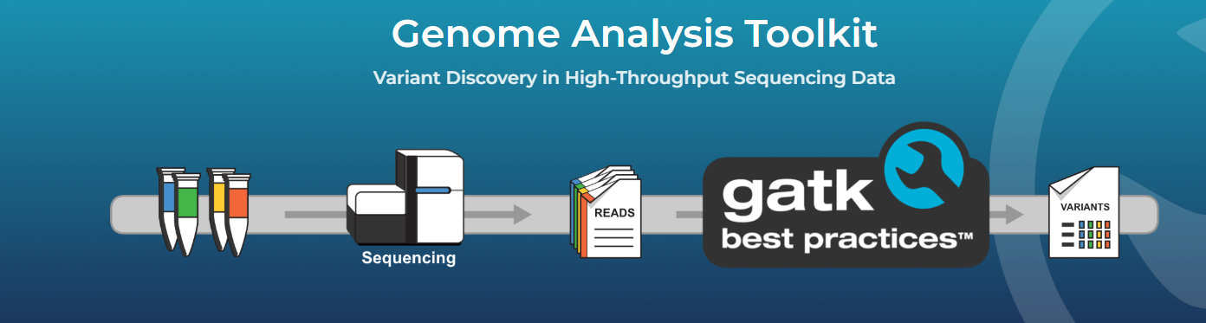
Part 1 – Preparing Reference
https://gatk.broadinstitute.org/
Developed at Broad Institute
Go-to pipeline for identifying SNP and indels in germline DNA and RNAseq
At the Linux terminal type:
java -jar software_update/gatk-package-4.0.4.0-local.jar CreateSequenceDictionary -R reference/chrM.fa -O reference/chrM.dict

Slide 24
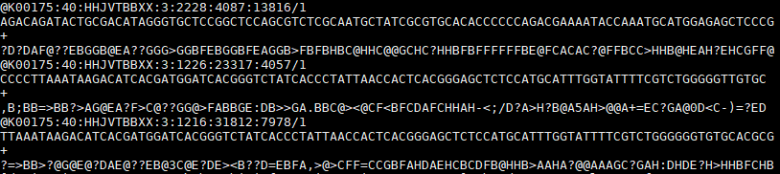
Part 2 - FASTQ files QC
At the Linux terminal type:
head –n 12 sample1_r1.fastq
Enormous pile of short reads
sample1_r1.fastq
sample1_r2.fastq
FASTQ file
Every new entry (read) is starting with an “@”.
Each entry (read) in a FASTQ file consists of four lines:
1st: Read identifier
2nd: Nucleotide sequence
3rd: Quality score identifier (is always a “+”)
4rd: Per base quality score

Slide 25
Part 2 – FASTQ files QC
Quality control of our mitochondrial NGS sequence data prior to alignments
At the Linux terminal type:
software_update/fastp -i sample1_r1.fastq -I sample1_r2.fastq –o sample1_out.R1.fq.gz -O sample1_out.R2.fq.gz --html sample1_results.html
--json sample1_results.json --report_title sample1_results
This step achieves 2 main goals
Process the reads prior to the alignment step:
Trim read bases that might be of low quality (usually on the tail end of the reads).
Remove any adapter sequences (have been artificially inserted during library preparation).
Report the reads quality in a human-readable format
Open sample1_results.html in web browser

Slide 26
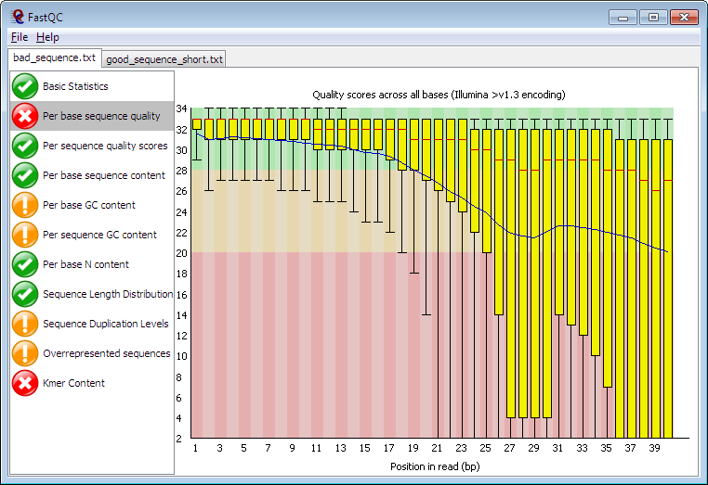
Part 2 – Fastq files QC
An alternative way of visualising the reads quality before and after trimming.
At the Linux terminal type:
software_update/fastqc sample1_r1.fastq sample1_r2.fastq sample1_out.R1.fq.gz \ sample1_out.R2.fq.gz
Read more about how to interpret the FASTQC reports: http://www.bioinformatics.babraham.ac.uk/projects/fastqc/Help/3%20Analysis%20Modules/

Slide 27
Part 3 - Alignment
Alignment of the mitochondrial fastq sequence data to the chrM using BWA
At the Linux terminal type:
software_update/bwa mem reference/chrM.fa sample1_out.R1.fq.gz sample1_out.R2.fq.gz -R '@RG\tID:sample1\tSM:sample1\tLB:sample1\tPL:ILLUMINA' -o sample1.sam
….. we are using the bwa alignment algorithm ‘mem’ to align our sample fastq data against the reference chrM fasta file
-o generating an output .sam (sequence alignment format) file
-R embedding the sample/sequence information in file

Slide 28
Part 3 - Alignment
Converting the sam output to a common binary alignment format (.bam)
At the Linux terminal type:
software_update/samtools view -Sb sample1.sam -o sample1.bam
….. we are using the samtools software ‘view’ command to print our .sam file into a different file format, in this case a .bam file (basically same as a .sam file but takes up much less disk space and retains all of the information)

Slide 29
Part 3 - Alignment
Sorting by genomic co-ordinate and indexing the .bam file
At the Linux terminal type:
software_update/samtools sort sample1.bam -o sample1_sorted.bam
software_update/samtools index sample1_sorted.bam
….. we are using the samtools software ‘sort’ command to sort the alignment .bam file by genomic coordinate
..then we are using the samtools ‘index’ command to create the .bai index – the .bam companion file that allows for faster read access for downstream steps

Slide 30
Part 3 - Alignment
Deduplicate with picardtools in GATK
At the Linux terminal type:
java -jar software_update/gatk-package-4.0.4.0-local.jar MarkDuplicates -I sample1_sorted.bam -O sample1_sorted_unique.bam -M sample1_picard_metrics.txt
…the deduplication step locates and tags duplicate reads in the .bam, where duplicate reads are defined as originating from a single fragment of DNA. Duplicates can arise during sample preparation e.g. library construction using PCR.

Slide 31
Part 3 - Alignment
Base quality score recalibration with GATK
At the Linux terminal type one after the other
java -jar software_update/gatk-package-4.0.4.0-local.jar BaseRecalibrator -I sample1_sorted_unique.bam -R reference/chrM.fa --known-sites software_update/common_all_chrM.vcf.gz -O recal_data_table.txt
java -jar software_update/gatk-package-4.0.4.0-local.jar ApplyBQSR -I sample1_sorted_unique.bam -R reference/chrM.fa --bqsr-recal-file recal_data_table.txt -O sample1_sorted_unique_recalibrated.bam
…we are performing base quality score recalibration to recalculate the base calling quality scores. The sequencing machines tend to overestimate the data quality (!) ..so we can model the actual data quality on the number of mismatches in the observed data… and adjust them accordingly!

Slide 32
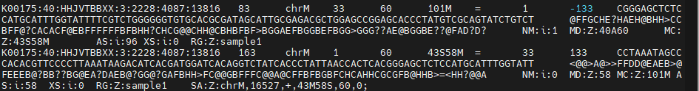
BAM FILE
At the Linux terminal type:
software_update/samtools view sample1.bam
Ref mate
(= means matches)
MAPQ
Map quality
Insert size
Read name
Sam flag
Chr
CIGAR
Pos
Pos mate
Sequence
QUAL
CIGAR 101M : 101 read bases are aligned to 101 reference bases with no gaps
MD:Z:40A60 of those 101 aligned positions, the first 40 are matches, then there is a mismatch where reference base is A, then 60 more matches.

Slide 33
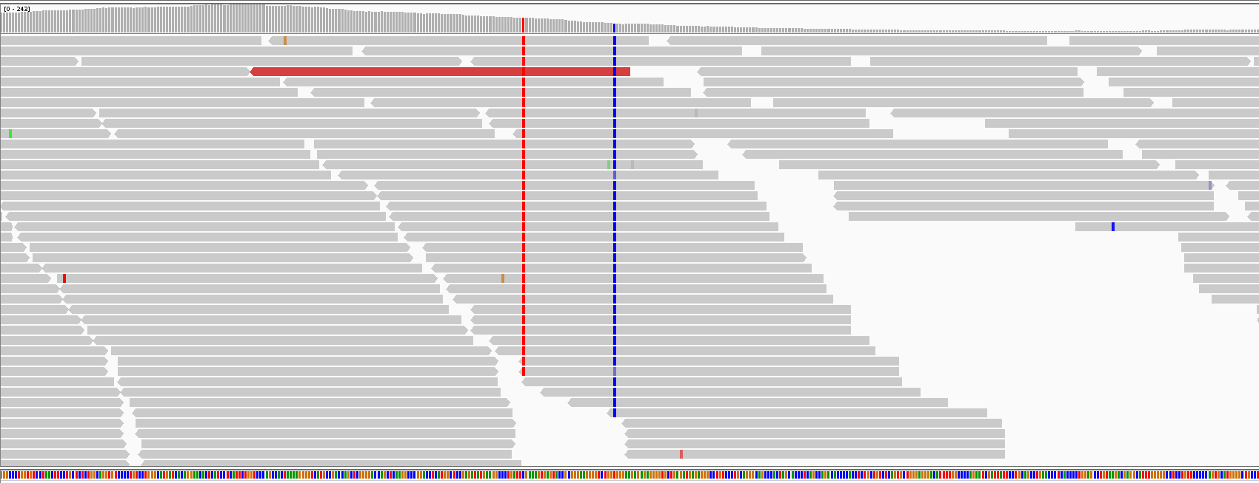
Part 4 – Variant Calling
Identifying single nucleotide variants and small indels in our aligned mtDNA
At the Linux terminal type:
java -jar software_update/gatk-package-4.0.4.0-local.jar HaplotypeCaller \ -I sample1_sorted_unique_recalibrated.bam \
-R reference/chrM.fa -G StandardAnnotation \
-bamout sample1_sorted_unique_recalibrated.bamout.bam \
-O sample1.vcf
HaplotypeCaller scans the aligned reads for mismatches against the reference genome
Read more here: https://gatk.broadinstitute.org/hc/en-us/articles/360035531412-HaplotypeCaller-in-a-nutshell

Slide 34
Part 4 – Variant calling
Hard-Filtering of the previously called variants
At the Linux terminal type:
java -jar software_update/gatk-package-4.0.4.0-local.jar VariantFiltration -V sample1.vcf -R reference/chrM.fa --genotype-filter-expression "GQ < 30.0“ --genotype-filter-name "LowGQ" \ --filter-expression "QD < 1.5" --filter-name "LowQD" --filter-expression "DP < 6" --filter-name "LowCoverage" \ --filter-expression "SOR > 10.0" --filter-name "StrandBias" -O sample1.filtered.vcf
Filters used in this example
Genotype Quality less than 30.0: GQ < 30 to tag variants with low genotype quality
Approximate read depth less than 6: DP < 6 to tag variants with low read coverage
Quality of Depth less than 1.5: QD < 1.5 to tag variants with low quality of depth
Strand Odds Ratio more than 10: SOR > 10 to tag variants with strand bias

Slide 35
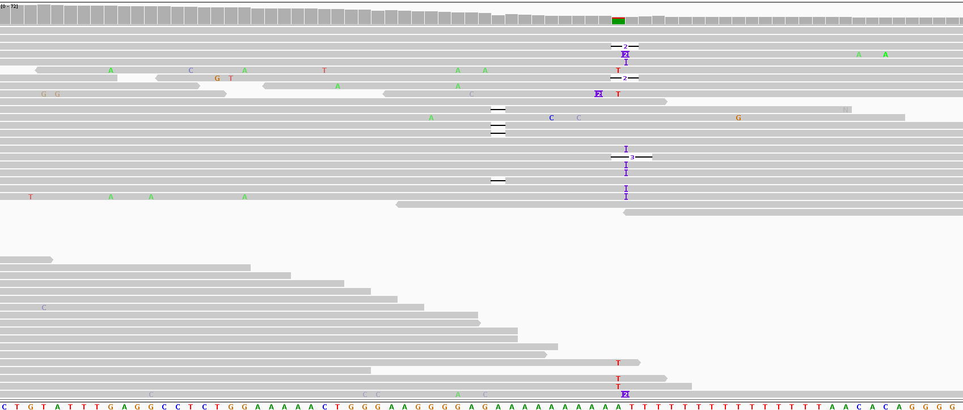
Part 4 – Variant Calling
Hard-Filtering of the previously called variants
At the Linux terminal type:
java -jar software_update/gatk-package-4.0.4.0-local.jar VariantFiltration -V sample1.vcf -R reference/chrM.fa --genotype-filter-expression "GQ < 30.0“ --genotype-filter-name "LowGQ" \ --filter-expression "QD < 1.5" --filter-name "LowQD" --filter-expression "DP < 6" --filter-name "LowCoverage" \ --filter-expression "SOR > 10.0" --filter-name "StrandBias" -O sample1.filtered.vcf

Slide 36
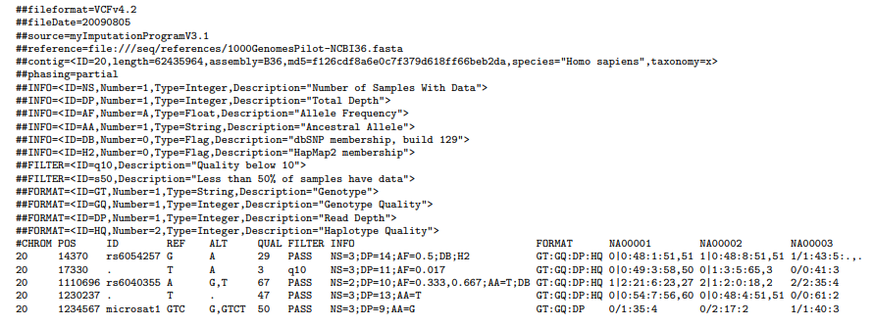
VCF File
Sample IDs
Genotype : Genotype Quality : Depth : Haplotype Quality
GT:GQ:DP:HQ 0|0:54:7:56,60
Get more information about VCF format VCFv4.2.pdf

Slide 37




Part 5 – Functional Annotation
chr7:100807375 G>A
Web based resources :

Slide 38
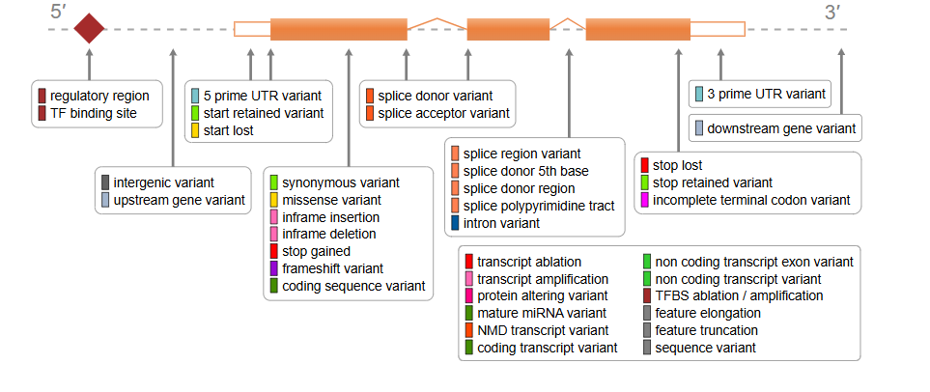
Part 5 – Functional Annotation
chr7:100807375 G>A
What is the impact?
https://www.ensembl.org/

Slide 39

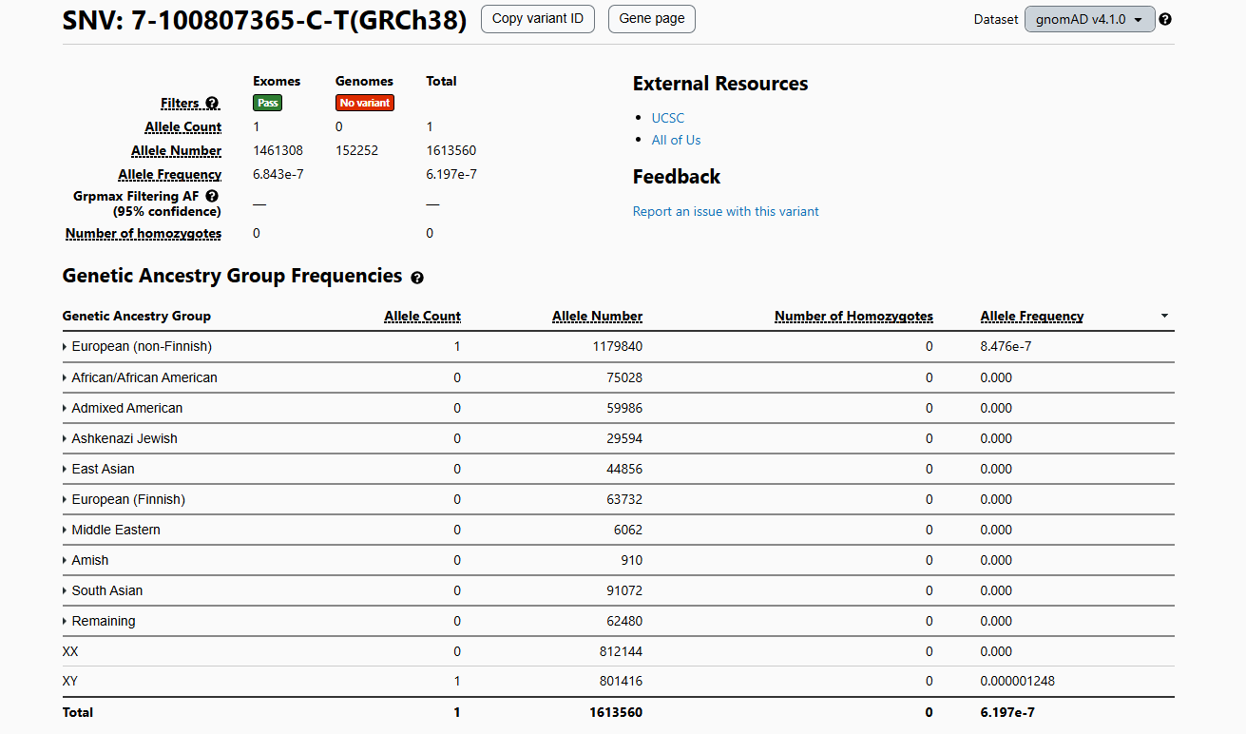
Part 5 – Functional Annotation
chr7:100807375 G>A
Interpreting missense variants – AlphaMissense, REVEL, CADD, Sift, PolyPhen etc.
Understanding frequency in general population – gnomAD
ACMG Guidelines - Standards and guidelines for the interpretation of sequence variants: a joint consensus recommendation of the American College of Medical Genetics and Genomics and the Association for Molecular Pathology

Slide 40
Part 5
Functional annotation of the called genetic variants
We are using an online freely available annotation tool: (ensemble VEP)
Open an internet browser (Mozilla Firefox, Google Chrome)
Navigate to https://www.ensembl.org/Multi/Tools/VEP
Double check the human genome build you are using (Here, we are using hg38/GRCh38)
Fill the job form using:
Name for this job: sgul_workshop_ followed by your initials (e.g. sgul_workshop_SED)
Input data -> Or upload file: -> Choose file -> Navigate and select your sample1.filtered.vcf file
Transcript database to use: Ensembl/GENCODE transcripts
Make sure you will leave Additional configurations field untouched using the pre-defined default fields.
Click [Run]
Wait for the job to finish
When finished, click [View results]
D

Slide 41

Part 6
Aligment & Variants visualisation with Integrative Genomics Viewer (IGV)
Open a web browser and navigate to IGV : https://igv.org/app/
Go to 'Genome' and select 'Human (GRCh38/hg38)’
Go to Tracks and then select Local File
Locate the "sample1_sorted_unique_recalibrated.bam" "sample1_sorted_unique_recalibrated.bai" file in your project directory and open.
You can also load a track showing the actual called variants:
Go to Tracks and then select Local File
Locate the sample1.filtered.vcf and open.
In the bar at the top select a position to view (e.g. chrM:8860) to view the read alignments at this position.
There is also an stand alone version of IGV

Slide 42
Quiz
Don’t be shy! Seek advice if you get stuck!
In the VEP annotation results table, find the genomic coordinates of the missense variant with the highest Polyphen score.
Download the annotated vcf file using the VCF download button on the upper-right corner.
Get the genomic position of the variant you selected in question 1 and extract this variant’s information from the sample1.filtered.vcf file (using the grep command) and save it into a new file (using the > symbol).
By looking into the new file you created:
Find out if the sequenced sample is homozygous or heterozygous for this variant.
Report the Strand Odds Ratio for this variant.
Report the Genotype Quality and the Quality of Depth values for this variant.
Hint! Check the .VCF specification here: https://samtools.github.io/hts-specs/VCFv4.2.pdf and Part4 of the workshop.
Load the IGV software with the alignment (.BAM) file and the variant calling (.VCF) file.
Point the IGV viewer to the previously selected variant
Does it seem real to you? What do you think?
Count the reads covering the position of the selected variants in the alignment file (.BAM) using the samtools tool.
Hint! You can find samtools in software_update/samtools).
Hint! Check samtools documentation here: http://www.htslib.org/doc/samtools.html
Hint! Use the samtools view function.

