Slide 1







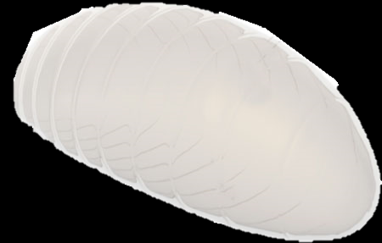

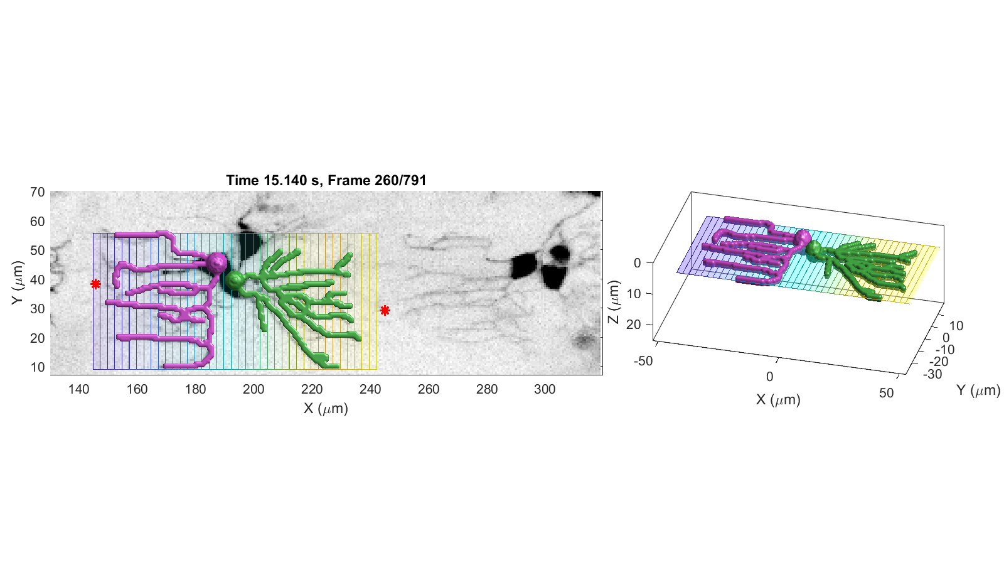
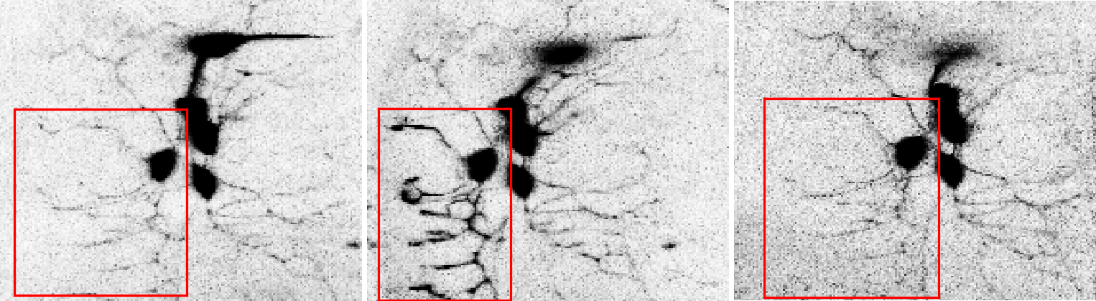
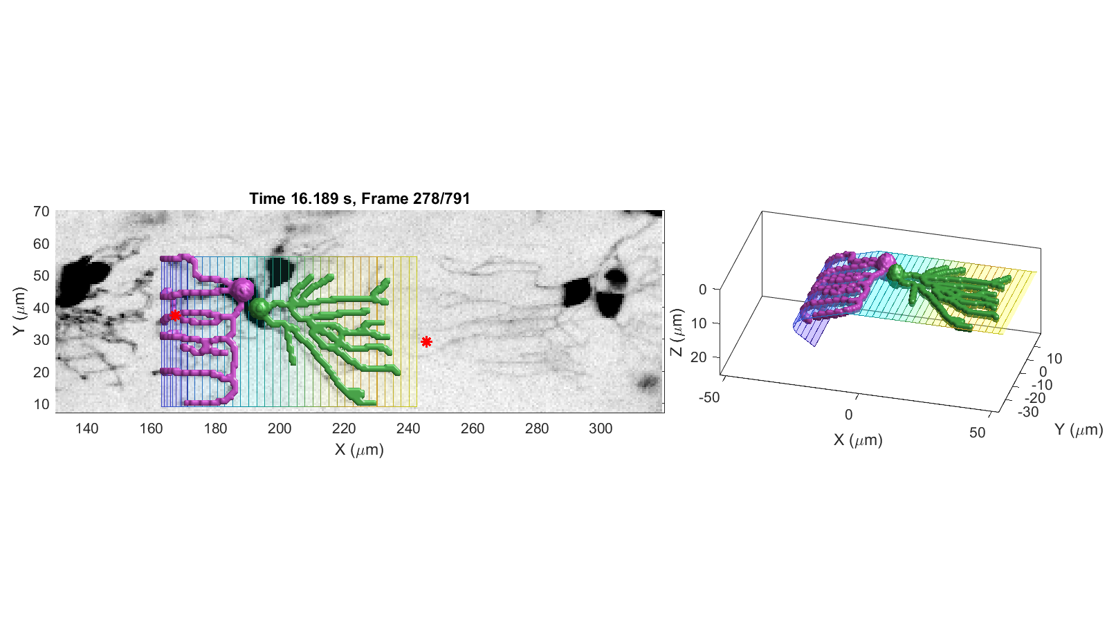
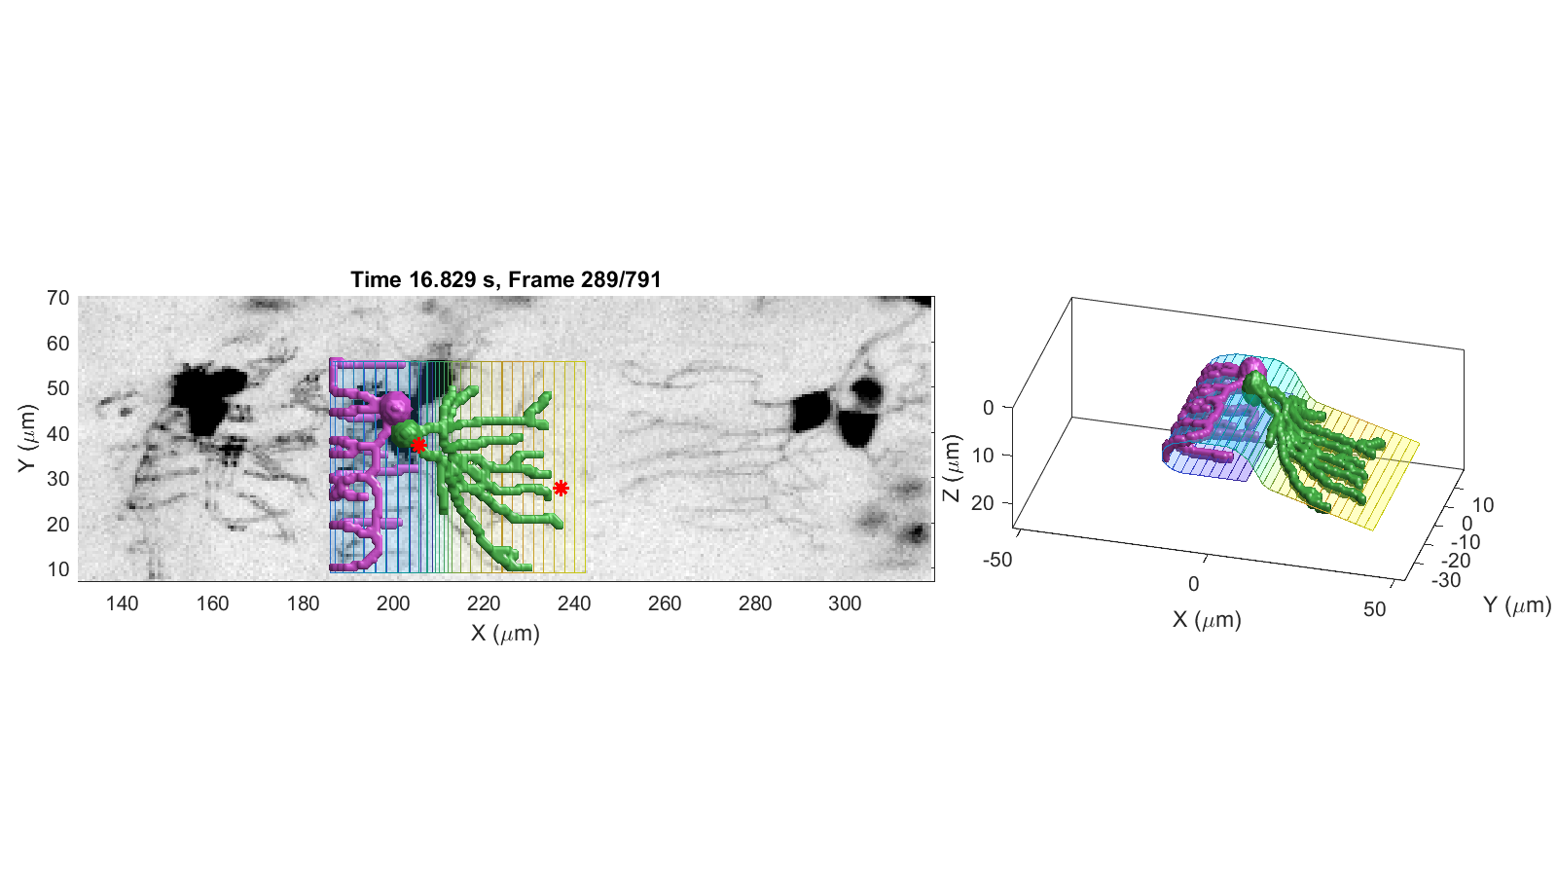
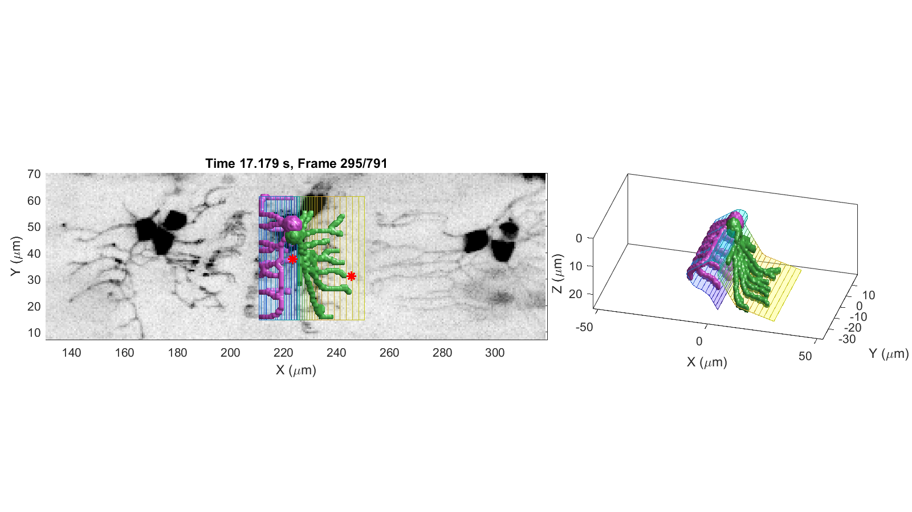
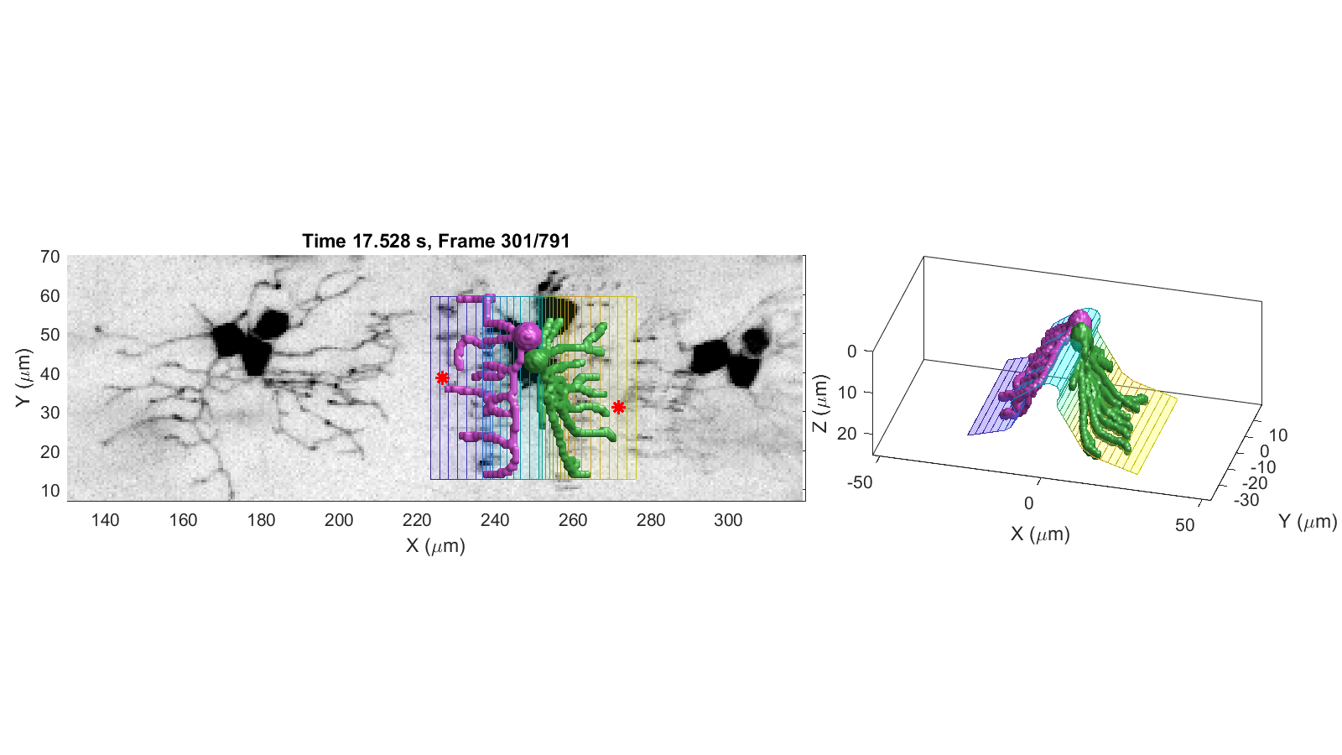
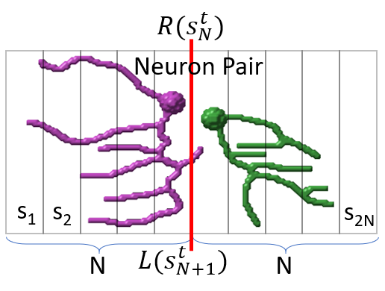
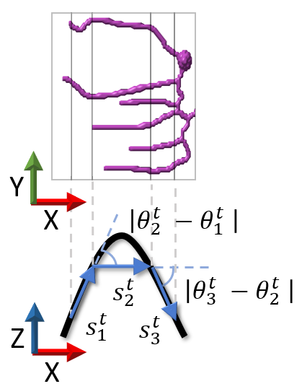
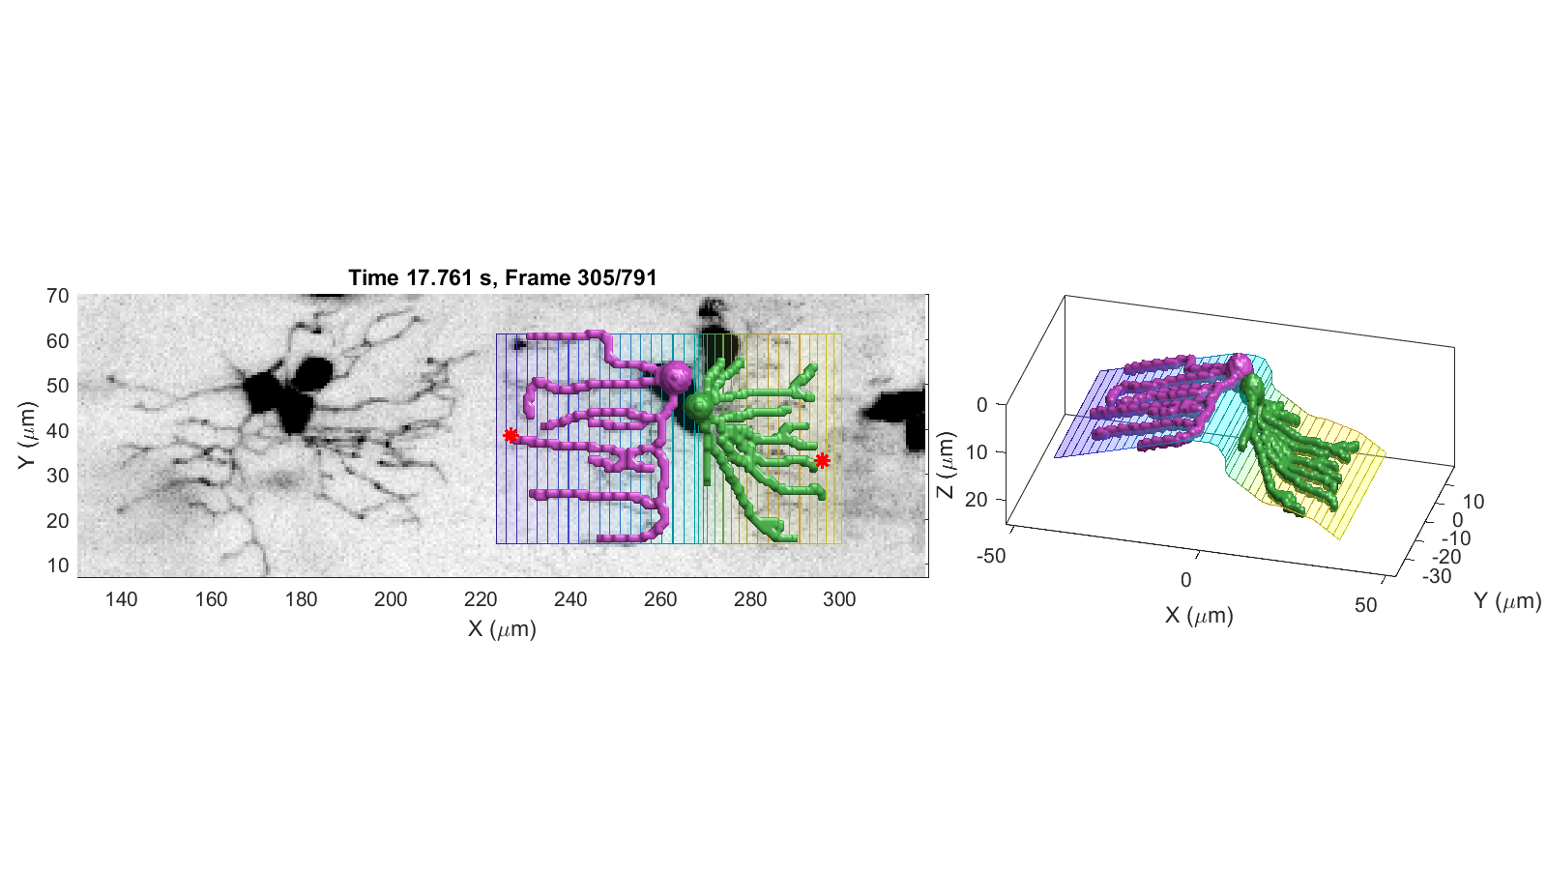
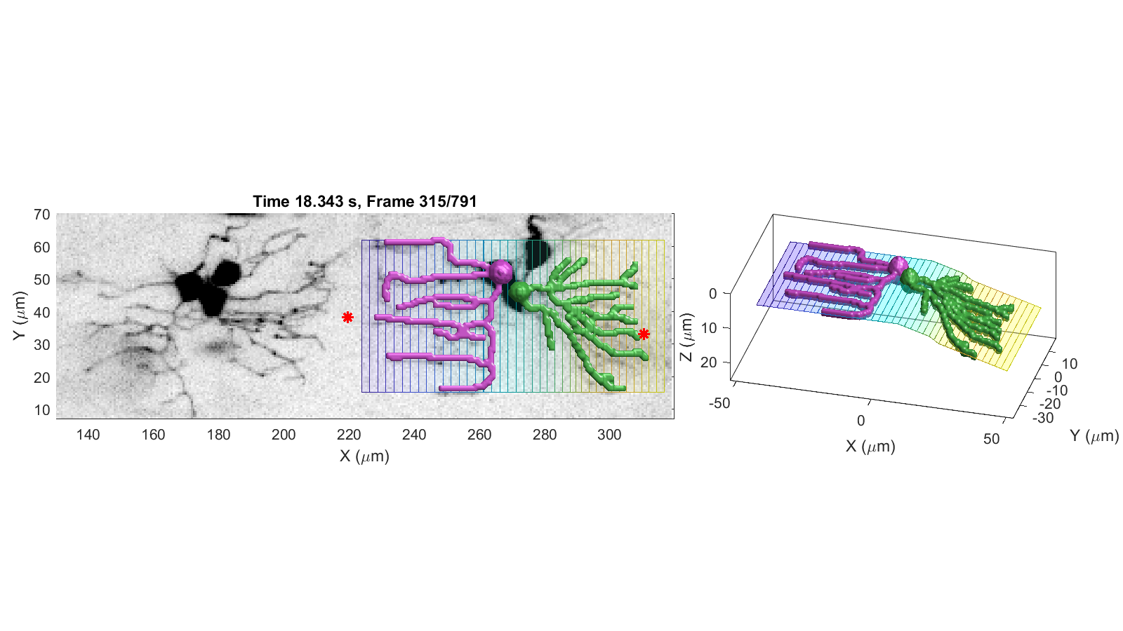
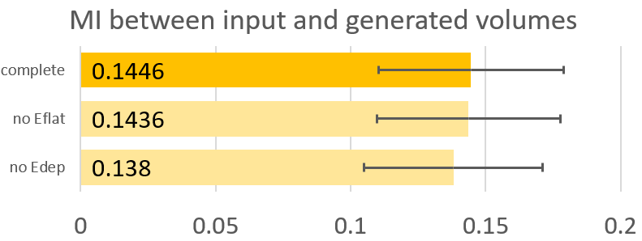



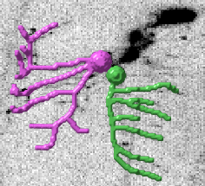
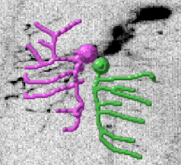



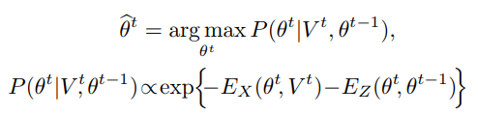

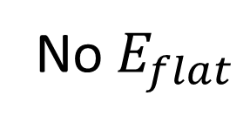
NEURON TRACKING IN CALCIUM IMAGE STACKS USING ACCORDION ARTICULATIONS S. Gulyanon¹, L. He², W. D. Tracey², and G. Tsechpenakis³ ¹Data Science and Innovation Program, Faculty of Science and Technology, Thammasat University, Thailand; ²Department of Biology, Indiana University, USA; ³Computer and Information Science Department, Indiana University-Purdue University Indianapolis, USA
Goal:
Study the molecular mechanisms of proprioceptive sensory neurons that control the locomotion.
Quantify changes in morphology and neuronal activity simultaneously to reveal their relationship.
Track sensory neurons of the Drosophila larva in time-lapse calcium volume sequences.
Issues:
Imaging-specific attributes: low axial (Z) resolution, noise, and low intensity over dendrites depicted by inactive neurons
Movement-specific characteristics: severe deformations and large local displacements, followed by short pauses
High degrees of freedom structure of neurite
Method:
Generate a prototype model of the extracted dendritic traces from non-moving, stationary time points.
Projected on a surface called the “accordion” model.
Find the best configuration based on image features, local shape constraints, and global morphology characteristics.
Dataset:
Time-lapse calcium volumes of larval Drosophila dda-E and dda-D sensory neurons.
Observed in high-speed 4D confocal microscopy imagery.
Accordion model:
Given a volume sequence,
The accordion model of a neuron pair at time $t$ consists of 2N equal-width strips,
is the orientation in XZ-axis of a strip $i$ at time $t$.
At $t = 0$, the initial phase has no local strain:
$L(s_{i}^{t})$ and $R(s_{i}^{t})$ indicate the leftmost and rightmost locations along the X axis of the strip $s_{i}^{t}$, respectively.
Transformation term yields the configuration that:
best fits the input volume, and
enforces spatial shape smoothness constraints
Axial dynamics term tunes the model configuration in the XZ-plane based on our domain knowledge about the morphology and locomotion characteristics,
Trace deformations via volume FFD:
Experiments:
Conclusion:
We introduced the novel neuron accordion model, an articulated surface that embeds the neuronal traces for robustness under low Z-resolution, high noise, and low intensity contrast.
Drosophila Larva
,
crawling
15.14s
16.19s
16.83s
17.18s
17.53s
dda-E
dda-D
17.76s
18.34s
Mean MI between input and generated volumes
complete
No $E_{flat}$

