Slide 1
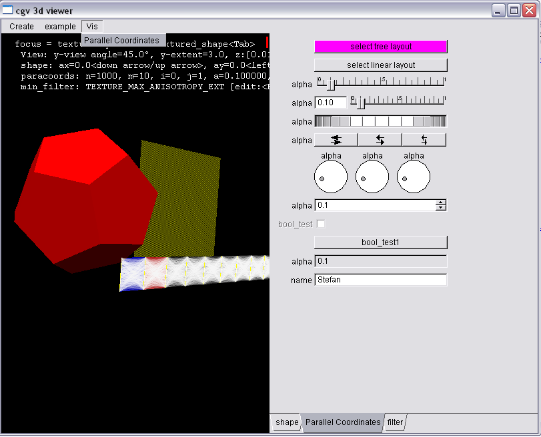
Simple GUI

Slide 2
Gui Programmierung in cgv
Ziele
Plattform und gui-Toolkit unabhängig
Erweiterbarkeit, Flexibilität, einfache Handhabung
Unterstützung von Andocken
(nutze auf System installiertes gui-Toolkit)
Voll dynamisch (alles kann zu Laufzeit einfach geändert werden)
automatische Speicherverwaltung
wenige mächtige Konzepte, die konsequent und konsistent verwendet werden
  signals
  multiple inheritance
  model-view controller
  reference counting
globale Variablen nur wenn unbedingt notwendig (Registrierung)
einfaches Beschriften (am besten mit Zwang)
VR Unterstützung:
  3D-Graphik
  Fullscreen

Slide 3
Wo befindet sich das gui Framework?
Sourcen
  abstrahiert: cgv/gui
  fltk Spezialisierung: cgv/gui/fltk
Beispiele / Tests
  apps/fltk_viewer/plugins/example/
  parallel_coords.cxx
  textured_shape.cxx
  shape.cxx

Slide 4
Abstract GUI Interface – Elements
public methods
protected methods
public signals
string valued arguments
element
void redraw()
void set<T>(property, const T& value)
T get<T>(property)
void multi_set(assignments)
button
abst_view
abst_control
void click(button&)
bool shows(void*)
bool controls(void*)
view<T>
control<T>
const T& get_value()
bool check_value(control<T>&)
void value_changed(control<T>&)
const T& get_value()
T& ref_new_value()
const T& get_old_value()

Slide 5
Abstract GUI Interface – Construction
provider
string get_menu_path()
shortcut get_shortcut()
void create_gui() = 0
button* add_button(label,options,align)
view<T>* add_view(label,const T& value,gui_type,options,align)
control<T>* add_control(label,T& value,gui_type,options,align)
void remove_element(element*)
void remove_all_elements()
view<T>* find_view(const T& value, int* idx_ptr)
control<T>* find_control(T& value, int* idx_ptr)
re-implement using
driver
void* create_group_element(name);
button* add_button(void*,label,options,align)
abst_view* add_view(void*,label,const void* value_ptr,value_type,gui_type,options,align)
abst_control* add_control(void*,label,void* value_ptr,value_type,gui_type,options,align)
void remove_element(void* handle, element* e)
void remove_all_elements(void* handle)
abst_view* find_view(void* handle, const void* value_ptr, int* idx_ptr)
abst_control* find_control(void*, void* value_ptr, int* idx_ptr)
fltk_driver
cgv/gui/fltk_driver.h, fltk_driver.cxx,
fltk_button.cxx, fltk_views.cxx,
fltk_valuator.cxx

Slide 6
The String Arguments
element::set/get<T>(property)
  element … x:int,y:int,w:int,h:int,
  label:string,color:int,
  active:bool,show:bool
  control<T> … min:T, max:T, step:T
  slider … ticks:bool, log:bool
element::multi_set(assignments)
  colon separated list of assignments
  „w=100;h=25;min=0.5;max=2;active=false“
provider::add_button/view/control(label)
provider::add_button/view/control(options)
  equivalent to a multi_set after construction
provider::add_view/control(gui_type)
  button … no choice
  view<T> … no choice
  control<T> … slider, value_slider,
  wheel, dial,
  adjuster, value_input (default)
  control<bool> … check, toggle
provider::add_button/view/control(align)
  „\n“ (default) … start new line after this element
  „“ … continue on this line, put labels on top of element and
  align on upper edge of element

Slide 7
Future Work
provider::add_decorator(label,gui_type,options,align
  gui types … label, line, image
control<enum> … gui type = „radio/list:a=5,b=7,c,d“
control<string> … gui type = „line/editor“
dialog : public provider
void set_modal(bool)
void show()
void hide()
simple_dialog : public dialog
simple_dialog(description, bool modal);
file_dialog
color_dialog
consistent support for shortcuts
add support for groups, gl_views, painter abstraction
automatic generation from type reflection

Slide 8
Future Work
rebinding of signal arguments
void shape::select_shape(Shape s) { shp=s;post_redraw(); }
connect_copy(add_button("cube", "w=40","")->click,
rebind<button&>(this, &shape::select_shape, CUBE)
);
void shape::select_shape(Shape s, button& b)
{ shp=s;post_redraw();b->set(“active”, false); }
connect_copy(add_button("cube", "w=40","")->click,
rebind<button&>(this, &shape::select_shape, CUBE, _0)
);

Slide 9
Future Work
improve alignment features (vertical, tabbing, stretch horizontal, …)
Current syntax:
add_button("cube“, ”w=40”, ””);
add_button(“tet“, ”w=40”, ””);
add_button(“prism“,”w=40”, ”\n”);
Corresponds to:
add_button("cube“, ”w=40”);
add_button(“tet“, ”w=40”);
add_button(“prism“,”w=40”);
layout(“%e%e%e\n”);
More layout features:
  table syntax:
  layout(“%e & %e\n%e & %e”);
  tabbing syntax:
  layout(“%w \> %e\n\+> %e\n\->”);
  element resize:
  layout(“%30w.e %70w.e\n”);

