Slide 1
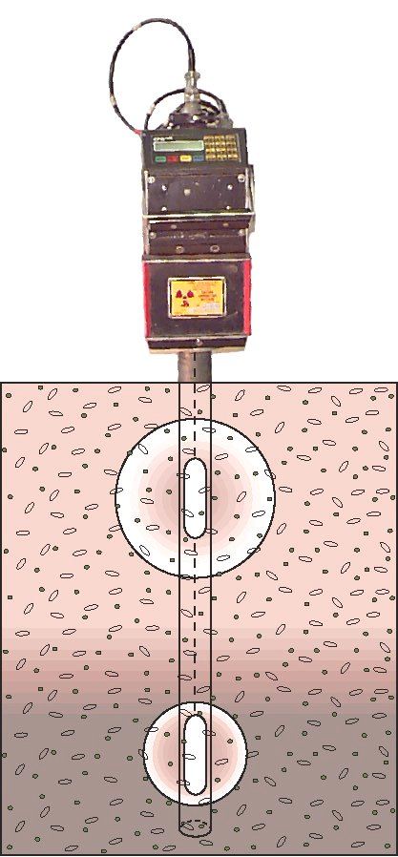
Characterization of the Soil Liquid Phase

Slide 2
Characterization of the soil liquid phase
The two most important attributes of the soil liquid phase are:
The amount of water in a soil (soil water content)
The forces by which water is held in a soil matrix (matric potential)
These two attributes are related through the SOIL WATER CHARACTERISTIC (SWC) a highly nonlinear function.
Changes in soil water content and matric potential effect many soil transport and mechanical properties, such as (1) ability to transfer liquid and gases; (2) mechanical properties such as soil strength, compactibility, penetrability, and bulk density in swelling soils.

Slide 3
Soil Water Content – Measurement Methods
GRAVIMETRIC WATER CONTENT:
Samples obtained by digging, augering, or coring are weight (moist sample), and weight again after oven drying (105 ºC).
VOLUMETRIC WATER CONTENT:
Samples with known volume (core samples) may be processed the same way as in the gravimetric water content method.
The conversion between gravimetric and volumetric water content requires knowledge of the dry bulk density.

Slide 4
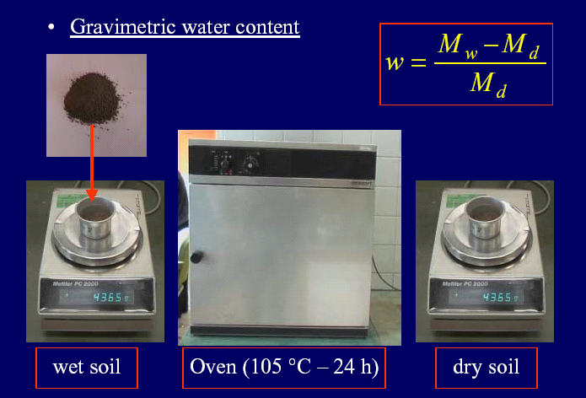
Soil water content – Gravimetric determination

Slide 5
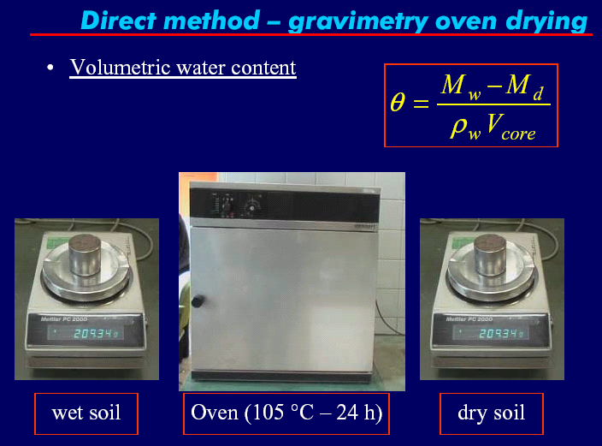
Soil water content – volumetric

Slide 6
Nondestructive methods- Neutron scattering
Neutron
Probe
Neutron Scattering (or Neutron probe) is a widely used field method for repetitive measurement of volumetric soil water content.
It is based on the propensity of water molecules to slow down (thermalize) high energy fast neutrons emitted from a radio active source (Americium-241 – Beryllium).
Thermalized neutrons are counted by a detector present in the access tube (along with the source).
Sphere of
Influence
Access
Tube
r_{D}
Dry
Probe
(Source and
Detector)
Wet
r_{w}

Slide 7
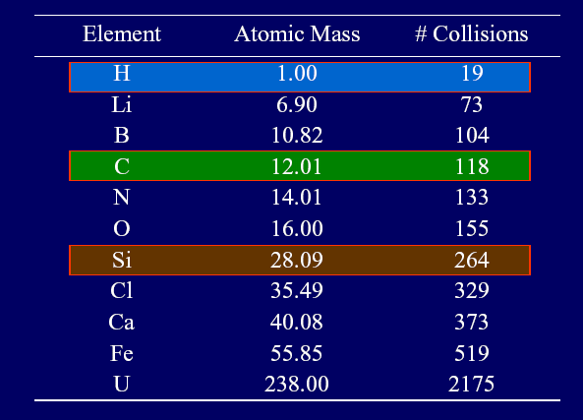
Neutron scattering method
Fast neutrons are emitted radially into the soil and collide with various atomic nuclei. Collisions with most nuclei are virtually elastic with only minor loss of kinetic energy.
Collisions with hydrogen nuclei causes significant loss of kinetic energy and slow down of the fast neutrons (thermalization).
Dry
Wet

Slide 8
Neutron Scattering Method
When the speed of fast neutrons (1600 km/s with corresponding energy of 2-4 MeV) diminishes to that of particles at ambient temperature (2.7 km/s with corresponding energy of 0.03 eV) they are called thermalized or slow neutrons.
Thermalized neutrons rapidly form a cloud of nearly constant density near the probe, where the flux (number) of slow neutrons is measured by the detector.
The number of slow neutrons is proportional to the number of hydrogen nuclei (water content)
The sphere of influence about the radiation source can be approximated with:
~ 15 cm in wet soils
~ 70 cm in very dry soil

Slide 9
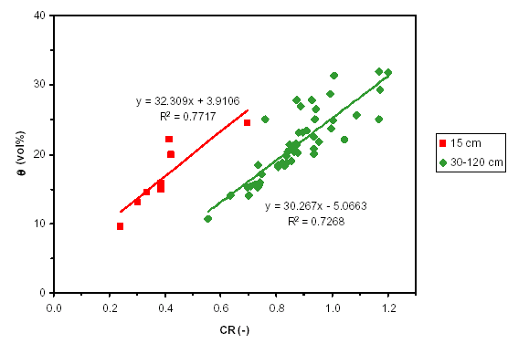
Neutron Scattering Method
Calibration of the Neutron Probe is necessary to account for background hydrogen sources and other local effects like bulk density.
Calibration is achieved by simultaneously measuring soil water content and count ratio CR - ratio of slow neutrons to standard count obtained with the radiation source in the shield.

Slide 10
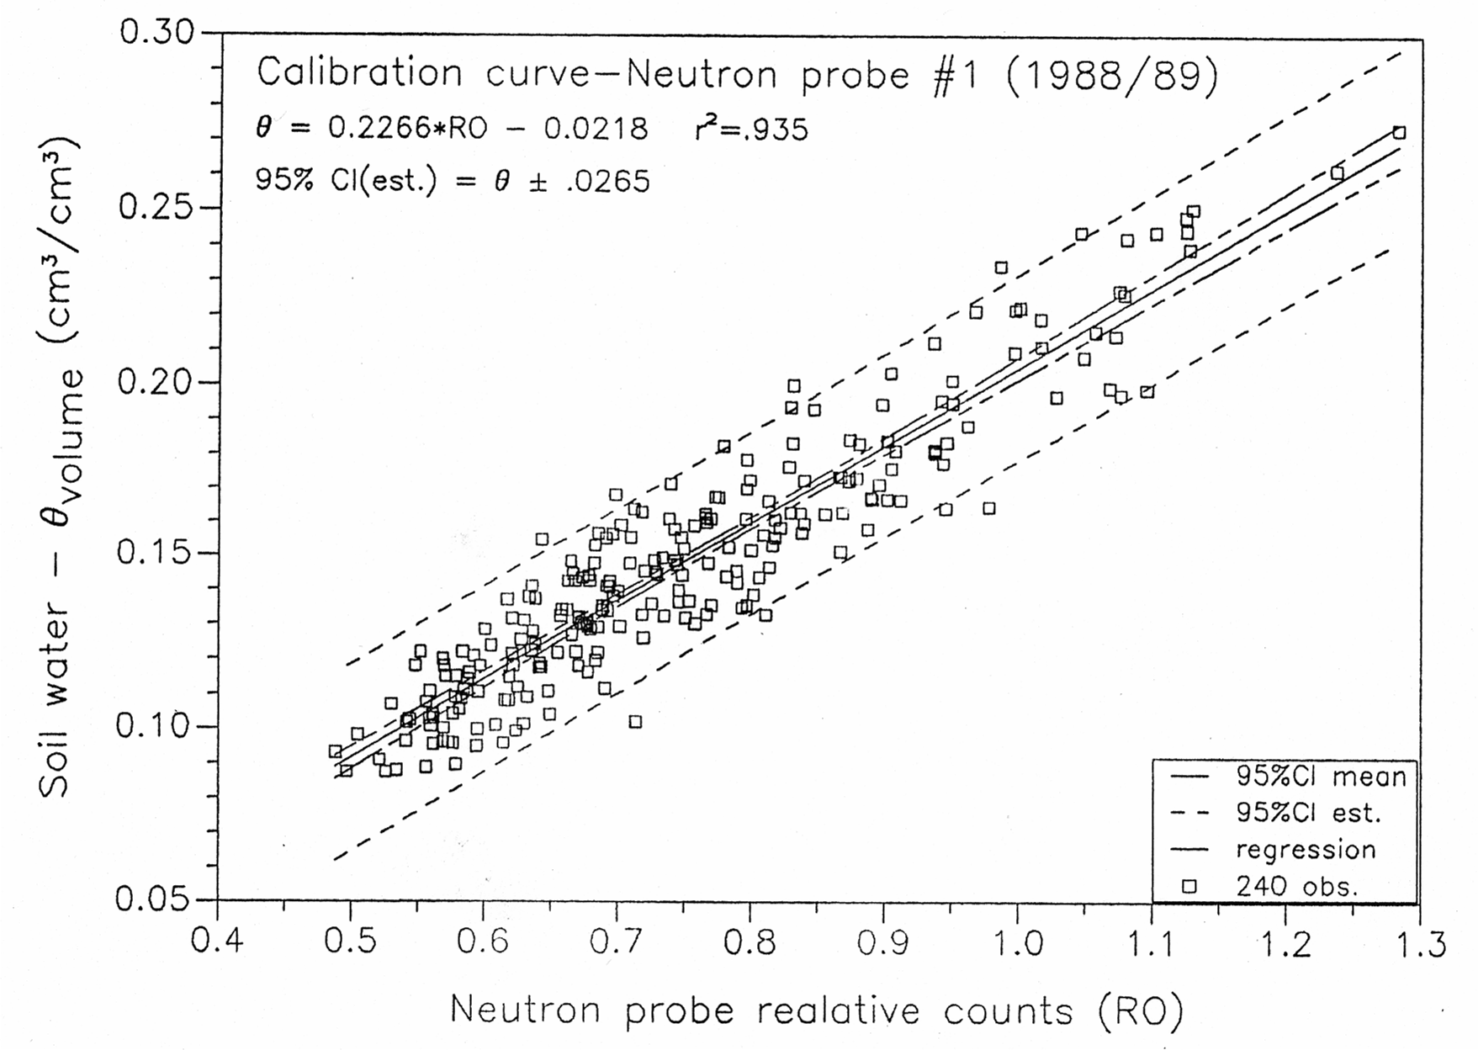
Instrument and calibration errors
A calibration curve is establish via linear regression - a statistical procedure that assumes linear relationships between two variables enabling prediction of one (dependent variable) from knowledge of the other (independent variable).
Uncertainty in calibration parameters (a and b) due to errors in gravimetric water content determination, bulk density errors, changes in soil texture, and instrument errors.
Dependent Variable
Independent Variable

Slide 11
Limitations of Neutron Scattering Method
Radiation hazards
Requires site specific calibration
Variable volume of measurement
Not suitable for near-surface measurements
Provides “snap shots”, difficult to automate
Installation and measurements are labor intensive
Limited accuracy

Slide 12
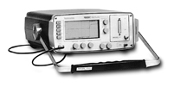

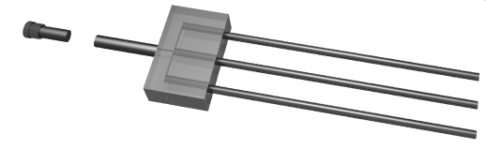
Time Domain Reflectometry (TDR)

Slide 13
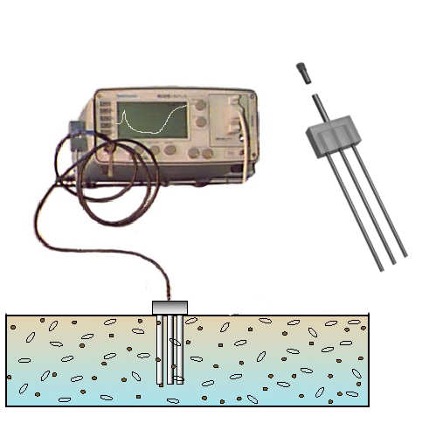
Time Domain Reflectometry (TDR)
TDR Cable Tester
(Tektronix 1502B)
BNC
Connector
Time Domain Reflectometry (TDR) is a relatively new technique for measurement of volumetric soil water content using electromagnetic waves propagating along embedded waveguides.
Waveform
3-Rod
Probe

Slide 14
Time Domain Reflectometry (TDR)
Advantages:
Superior accuracy to within 1-2% of volumetric water content
Minimal calibration requirements (usually no soil specific calibration necessary)
No radiation hazard such as associated with neutron probe or gamma ray attenuation techniques
Excellent spatial and temporal resolution
Continuous measurements through automation and multiplexing
Limitations:
Expensive – typical system costs ~ $4000
Limited performance in saline soils
Specialized – no “off the self” systems; requires training

Slide 15
Time Domain Reflectometry TDR
The propagation velocity v of an electromagnetic field along a transmission line (waveguide) of length L embedded in the soil is determined from the time response of the system to a pulse generated by the TDR cable tester. The propagation velocity (v=2L/t) is a function of the soil bulk dielectric constant given by:
C…. Speed of light, velocity of the electromagnetic wave in vacuum (3x10⁸ m/s)
t…. travel time of the wave along the waveguide back and forth (2L)
Coaxial Cable
Epoxy
Stainless Steel Rods

Slide 16
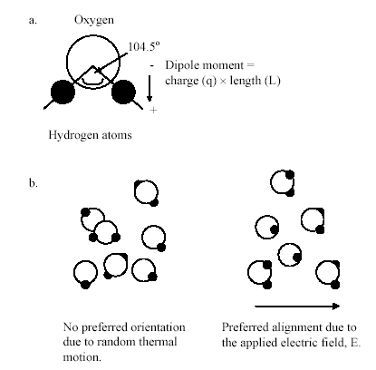
Time Domain Reflectometry TDR
The dielectric constant ε results from interactions between electromagnetic waves and material properties, it determines the relative speed by which an electromagnetic signal travels through a material.
Low ε ← rapid signal propagation (fastest ε=1)
High ε ← slow signal propagation
Water ε_{w} = 81 Soil Minerals ε_{s} = 3 to 5 Soil Air ε_{a} = 1

Slide 17
Time Domain Reflectometry TDR
Low ε ← rapid signal propagation (fastest ε=1)
High ε ← slow signal propagation
The large disparity between dielectric constant of water and other soil constituents results in dominance of soil bulk dielectric constant ε_{b} by the volume fraction of liquid water ε_{w} hence dielectric measurements are ideal for soil water content determination.
Water ε_{w} = 81 Soil Minerals ε_{s} = 3 to 5 Soil Air ε_{a} = 1

Slide 18
Time Domain Reflectometry TDR

Slide 19
TDR – Basic Principles
A TDR waveform marks reflections produced by an electromagnetic pulse as it traverses the length of an embedded waveguide (2L).
These reflections or “marks” enable determination of “apparent” distance or travel time used to deduce soil bulk dielectric constant:
x₁
x₂
Vp is a preset relative propagation velocity (often set as Vp=0.99)

Slide 20
TDR – Basic Principles
2
1
3
1: Reflection Coaxial Cable – Epoxy handle
2: Transition Rods (Epoxy) – Rods in Soil
3: Reflection end of rods
1
2
Coaxial Cable
3
Epoxy
Stainless Steel Rods

Slide 21
TDR probe design and spatial sensitivity
TDR sensor designs seek fewer conductors to reduce disturbance to the porous medium.
Measurement volume and sensitivity varies with design.
Concentration of field lines near conductors emphasize permittivity of soil conditions in this region.

Slide 22
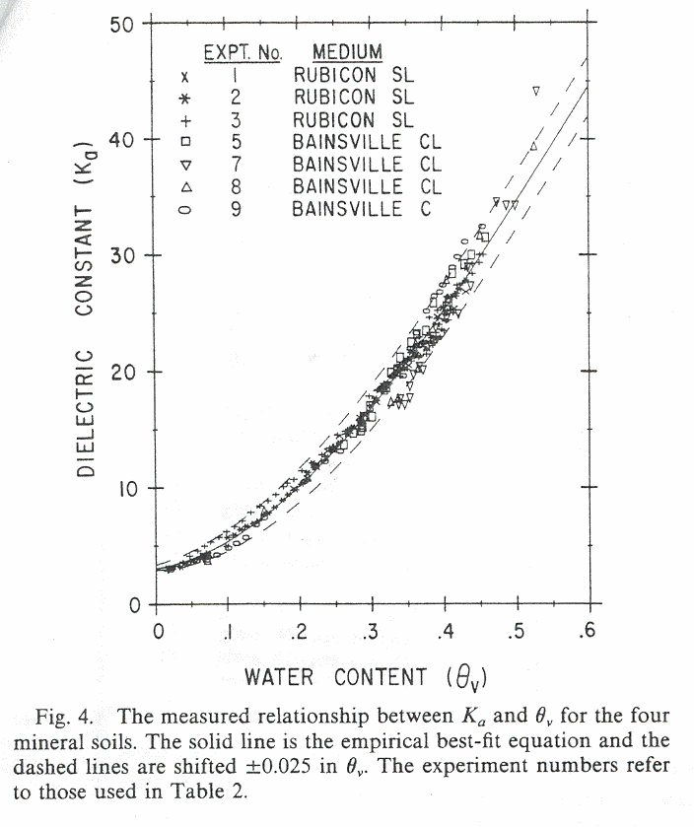
Soil Bulk Dielectric Constant to Water Content
Two basic approaches are used to relate Soil bulk dielectric constant ε_{b} to volumetric water content θ_{v}:
Empirical or calibation relationships: such as the 3rd order polynomial proposed by Topp et al. [1980] that seems to fit data for many mineral soils.
Topp’s Equation

Slide 23
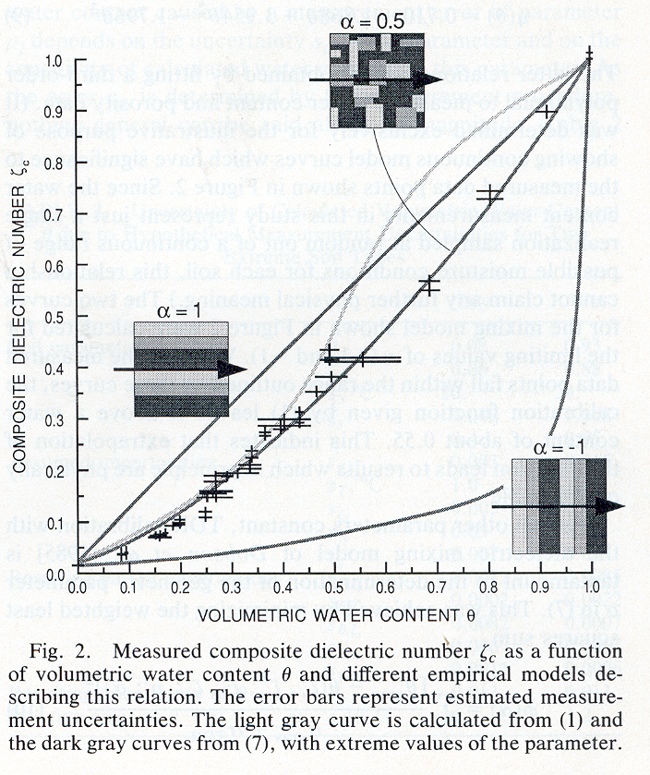
Physically Based Dielectric Mixing Models
Maxwell was among the first to employ a physically based dielectric mixing model that incorporates volume fractions and geometrical arrangement of soil constituents to predict bulk dielectric constant of the mixture [Roth et al. 1990] :
n is soil porosity, and -1<α<1 summarizes applied EM field direction relative to medium (axial direction of waveguide). α = 1 for an EM field parallel to soil layering α = -1 for EM field perpendicular to layering α = 0.5 for an isotropic two phase mixed medium

Slide 24
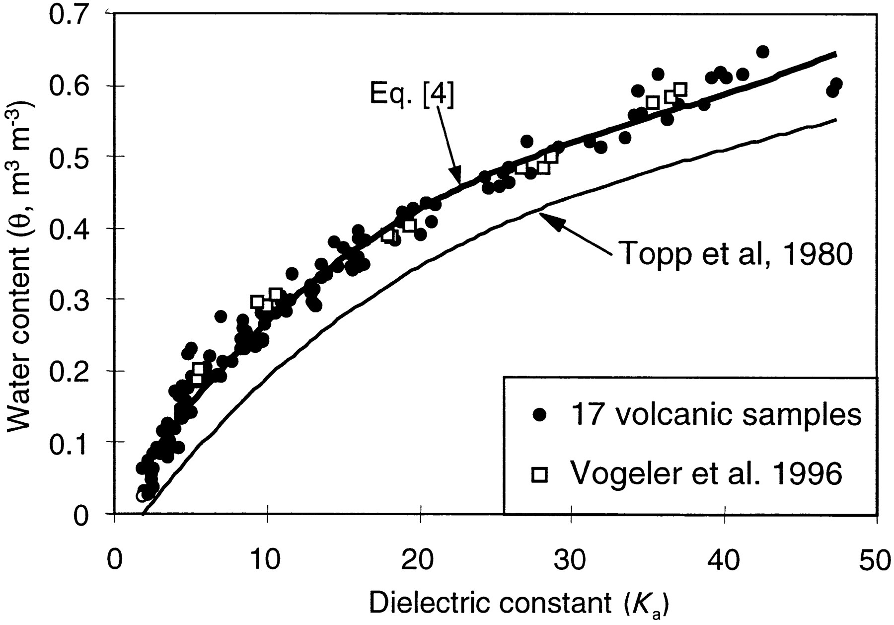
Dielectric Mixing Models
The mixing model can be simplified using β=0.5 and the dielectric constants of the constituents: ε_{w}=81; ε_{s}=4; and ε_{a}=1

Slide 25
Mixing Model: Example
What is ε_{b} of a soil having θ_{v} = 0.2 and bulk density of 1325 kg/m³? What if the soil contained the same volume fraction of ethanol rather than water?
First we estimate the porosity for this soil as:
Then we use β = 0.5 and the dielectric constants of the constituents ε_{w} = 81; ε_{s} = 4; and ε_{a} = 1 to solve the mixing model for the bulk dielectric constant ε_{b}:

Slide 26
Mixing Model: Example
For ethanol and assuming 25ºC we substitute the appropriate dielectric of 24.3 (classnotes table 1-4) into the mixing model and receive:
Note that because ethanol undergoes relaxation (a change in dielectric constant) within the TDR frequency bandwidth, the apparent dielectric ε_{ethanol} as measured using TDR is closer to 16. This means that some caution is required in attempting to model the apparent bulk dielectric of soils or other complex mixtures based on tabular values of the component dielectric constants.

Slide 27
Limitations of Empirical Relationships
Topp’s model works well for the water content range < 0.5 m³/m³ which covers the entire range of interest in most mineral soils. However it fails for water contents higher 0.5 m³/m³,and for organic soils or mineral soils with high organic matter content.
The physically based models work well for the entire range of water content. Note that the soil’s porosity needs to be known!

Slide 28
Limitations of TDR
Relatively expensive equipment
Limited applicability under highly saline conditions, due to signal attenuation.
Soil specific calibration may be required for soils having large amount of bound water or high organic matter content (large surface area).
Requires training and experience.
No “off the self” systems (yet)

Slide 29
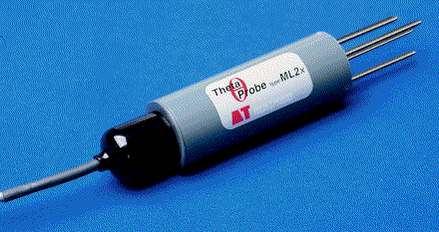
Other electrical w.c. measurement methods
CAPACITANCE SENSORS
Capacitance sensors use an oscillator to generate an AC field which is applied to the soil in order to detect changes in soil dielectric properties linked to variations in soil water content. The sensors essentially consist of a pair of electrodes (either an array of parallel spikes or circular metal rings) which form a capacitor with the soil acting as the dielectric in between. This capacitor works with the oscillator to form a tuned circuit, and changes in soil water content are detected by changes in the operating frequency.

Slide 30
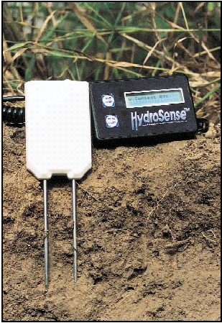
Other electrical w.c. measurement methods
HydroSense – Transmission line oscillator (TLO)
The Hydrosense probe has electronic components that generate high frequency electromagnetic energy along the length of the probe rods.

Slide 31
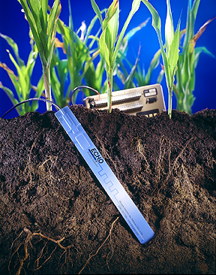
Other electrical w.c. measurement methods
ECHO PROBES: The Echo probe measures the dielectric constant of a medium by finding the rate of change of voltage applied to the sensor once it is buried in the soil. (TDR measures the dielectric constant by finding the travel time of an electromagnetic wave that traverses a wave guide).

Slide 32
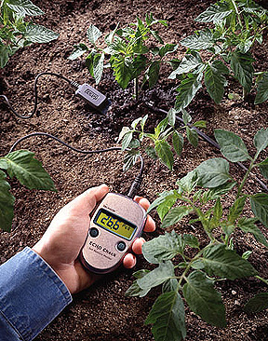
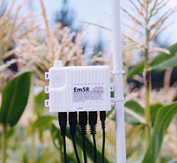
Other electrical w.c. measurement methods
Advantages of the ECHO probe are the insensitivity for saline conditions, and low expenses. Only a Datalogger or Hand Read Out is required to send excitation voltage and record the rate of voltage change.

Slide 33
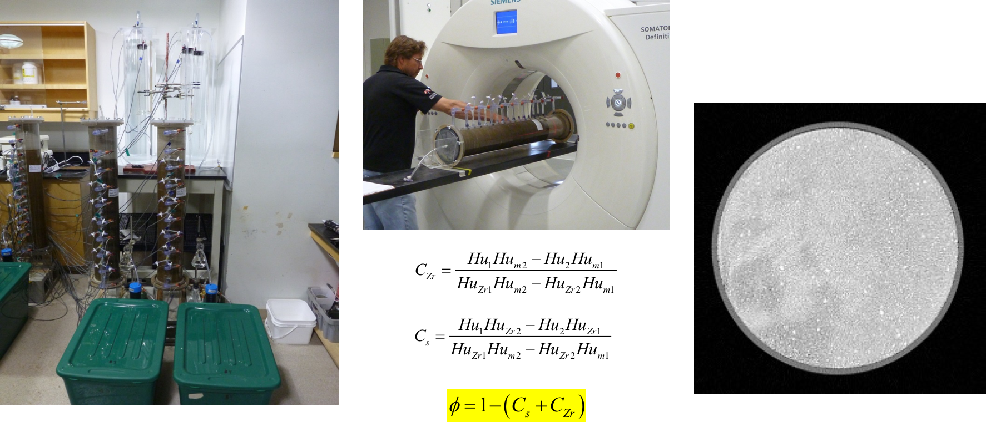
Other methods for soil w.c. measurement
OTHER METHODS
- X-Ray Computed Tomography (CT) - Nuclear Magnetic Resonance NMR
- Ground Penetrating Radar GPR

Slide 34
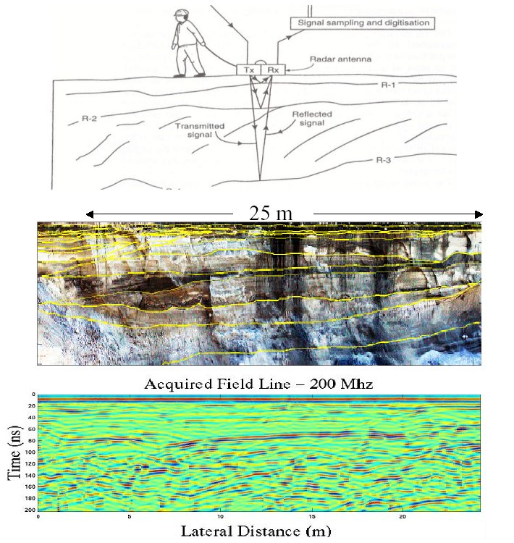
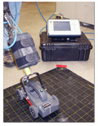
Other methods for soil w.c. measurement
Ground Penetrating Radar (GPR)

Slide 35
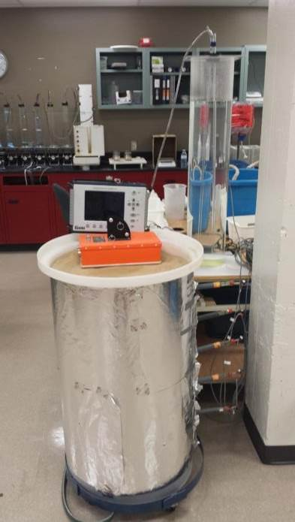
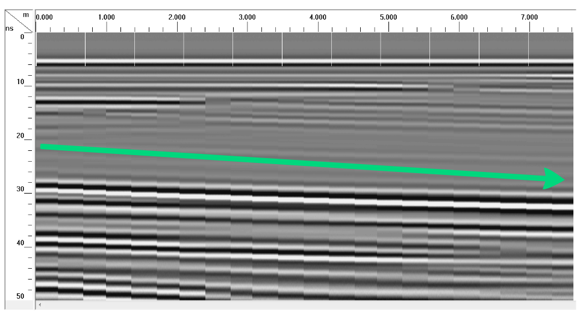
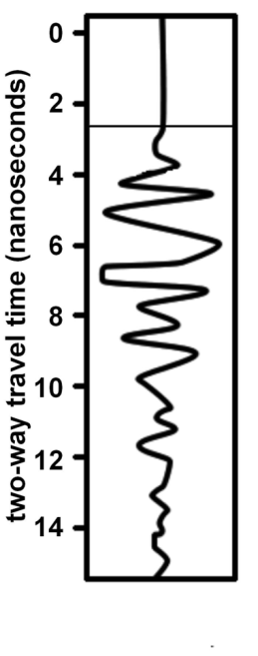
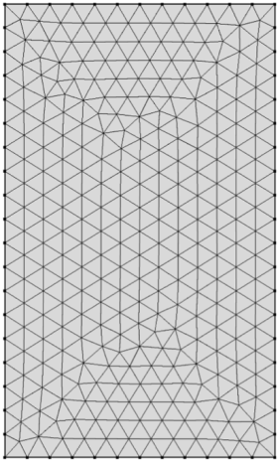
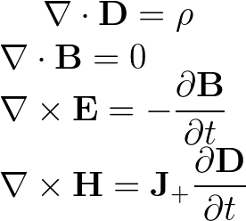
Calibration and validation in controlled conditions
Maxwell equations solution with FEM
soil
water

Slide 36
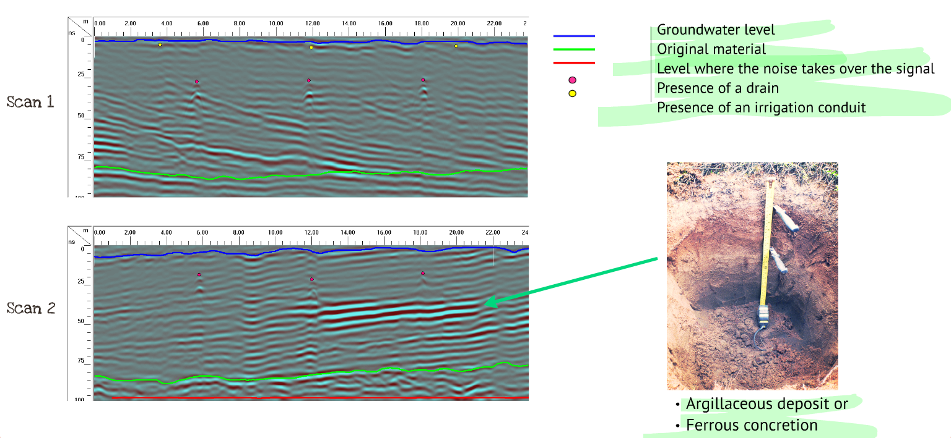
Results: Objects and soil layers

Slide 37
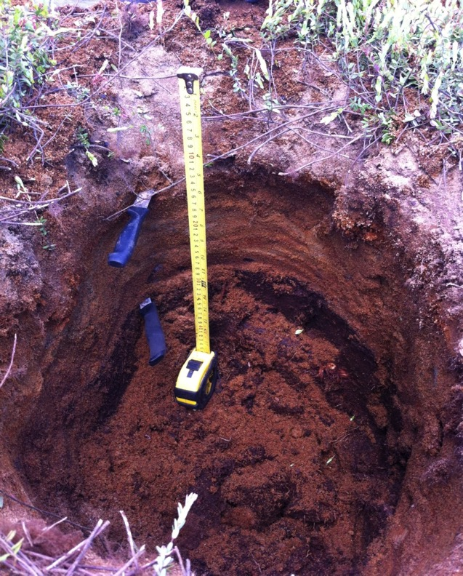
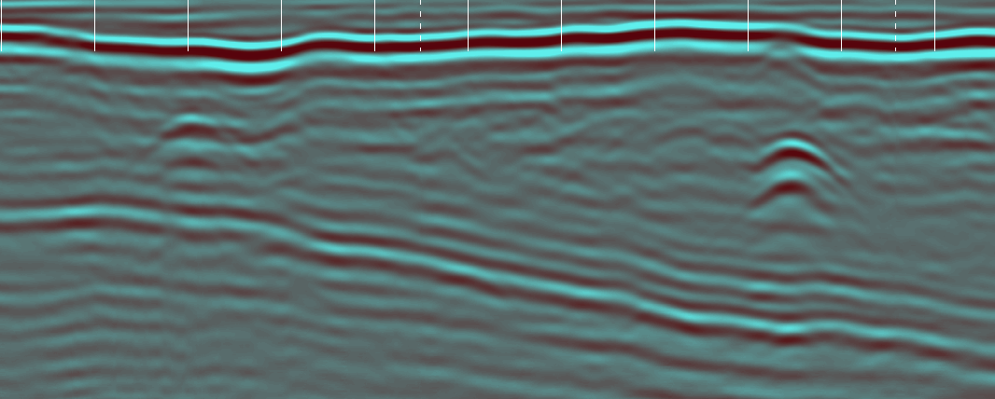
Results: Objects and soil layers
Interface ←→ pit
drain
Mineral layer

Slide 38
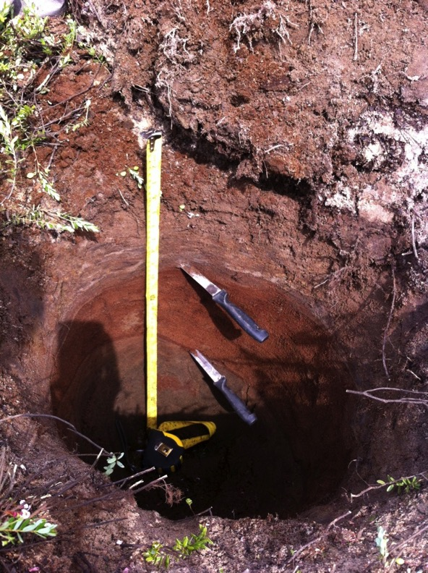
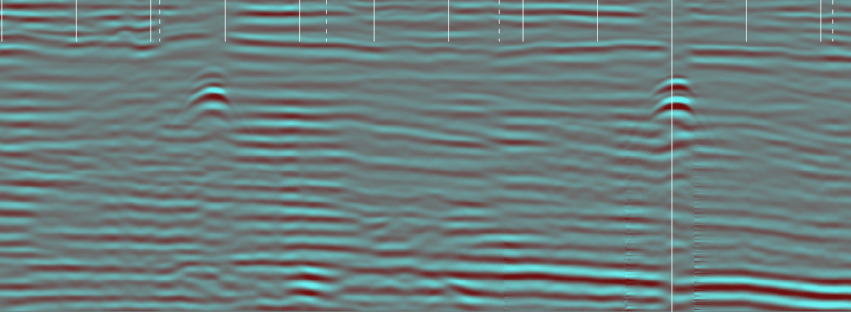
Results: Objects and soil layers
Ferric layer

Slide 39
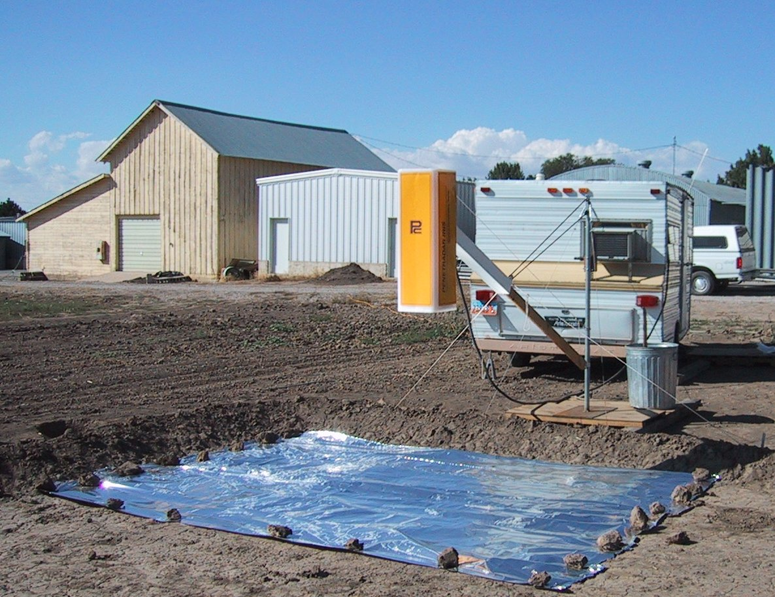
Other methods for soil w.c. measurement
Ground Penetrating Radar GPR – suspended horn antenna

Slide 40
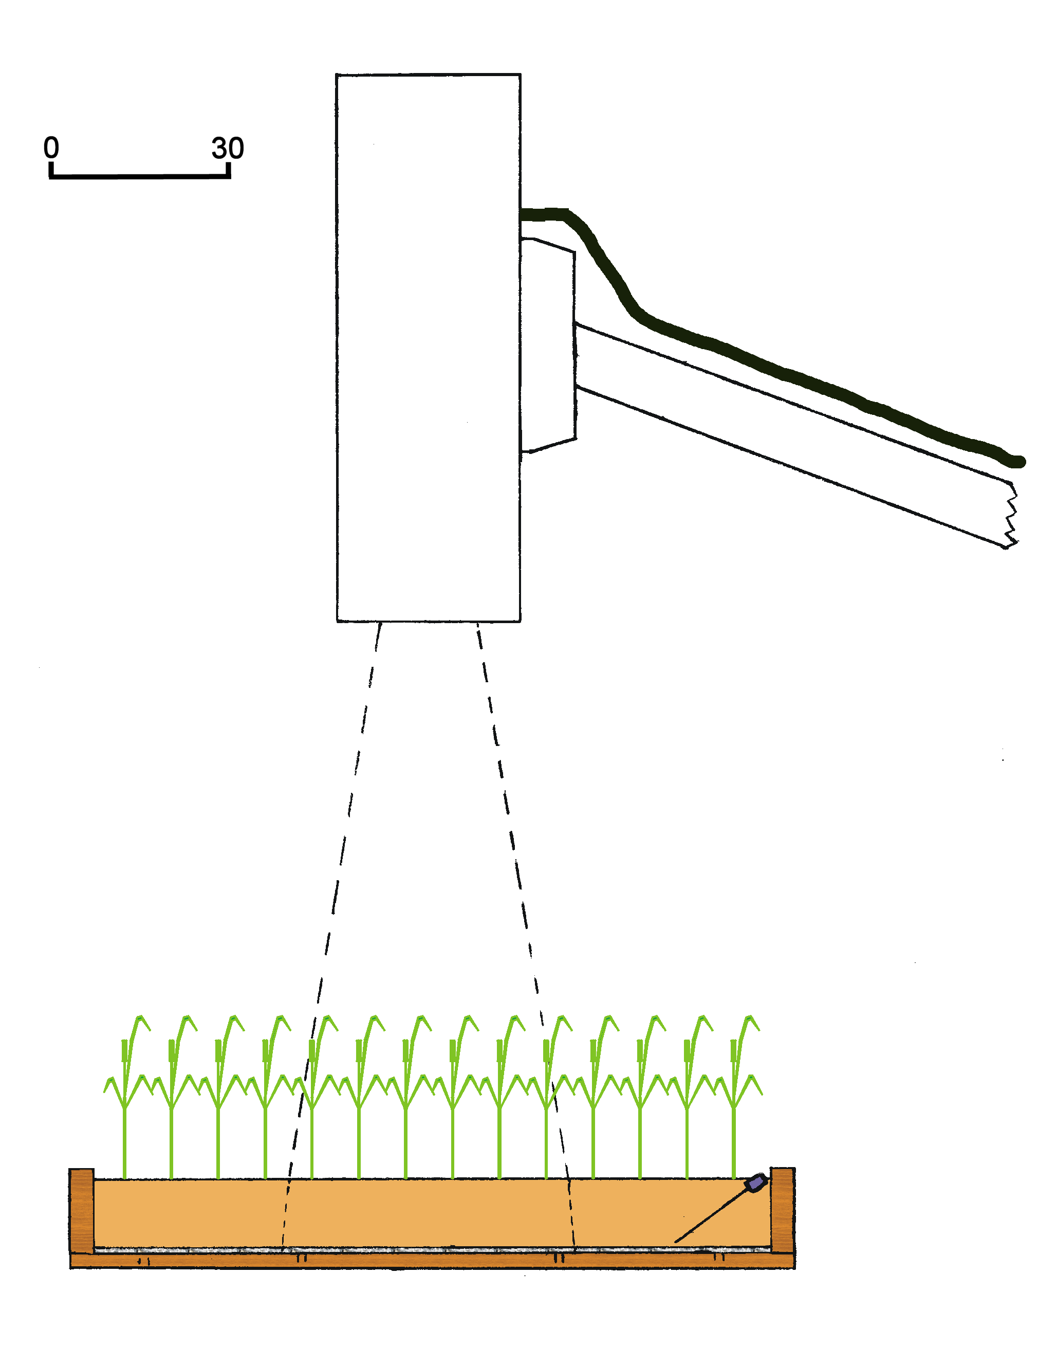
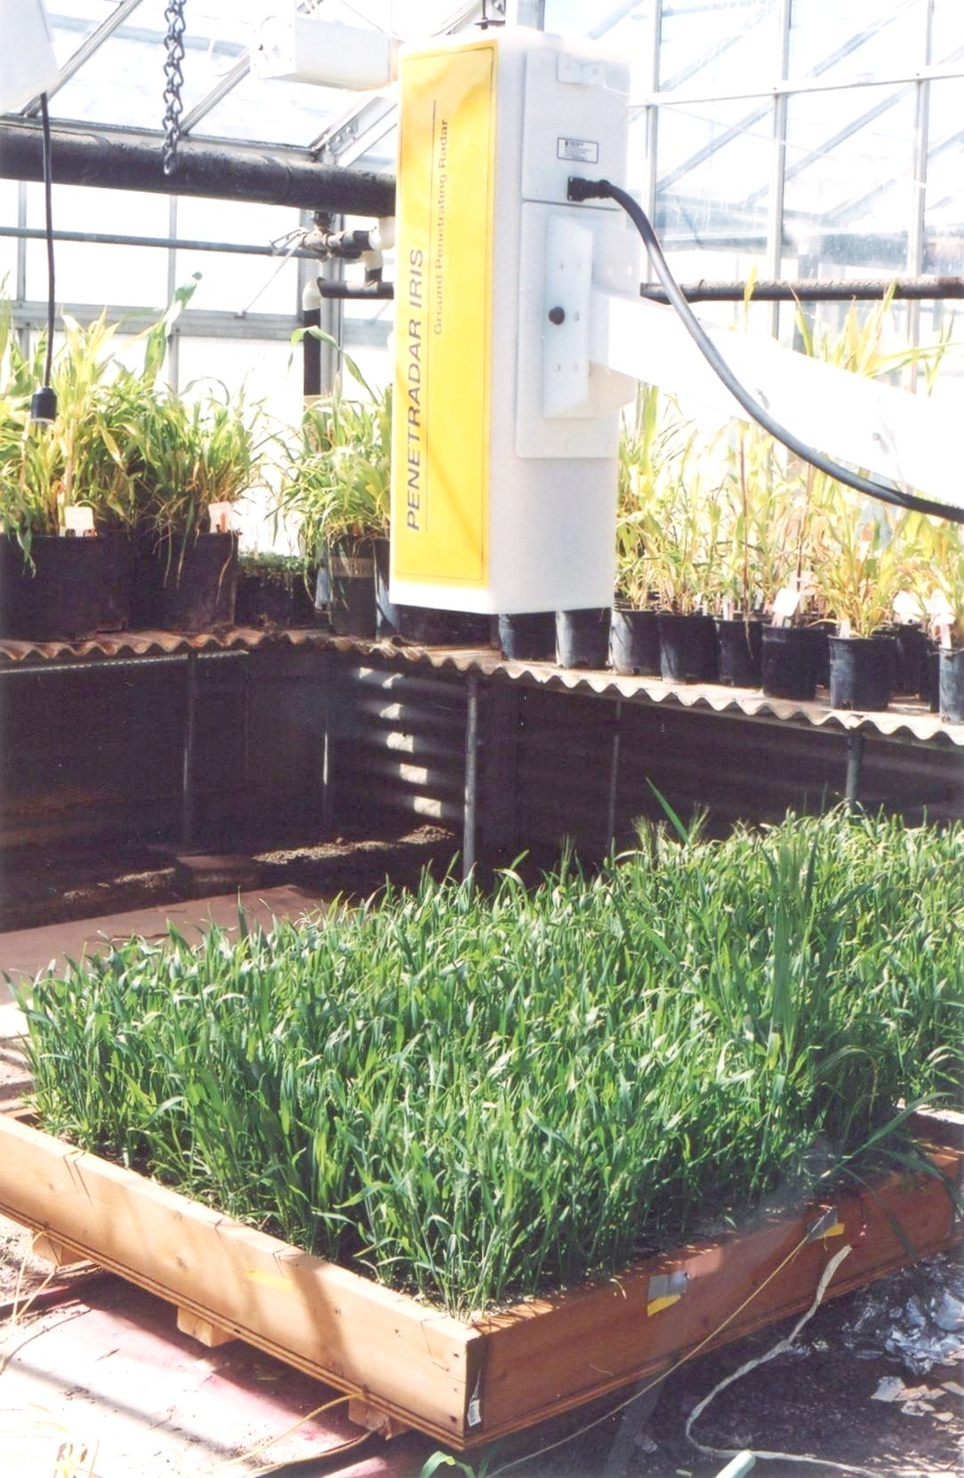
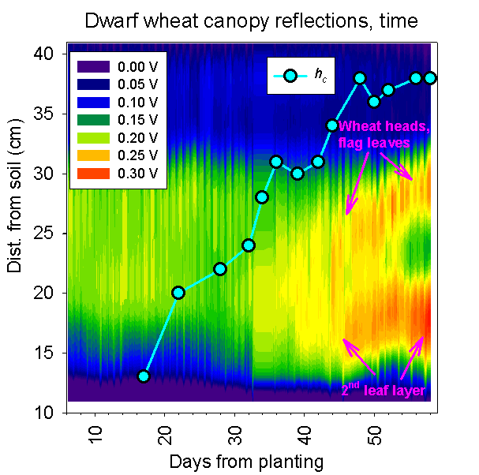
Other methods for soil w.c. measurement
Ground Penetrating Radar GPR – measurements over wheat canopy
Scale (cm)
GPR
antenna
Reflecting canopy layers
illuminated
region
SR
TDR
probe
PT
Al termination

