Slide 1
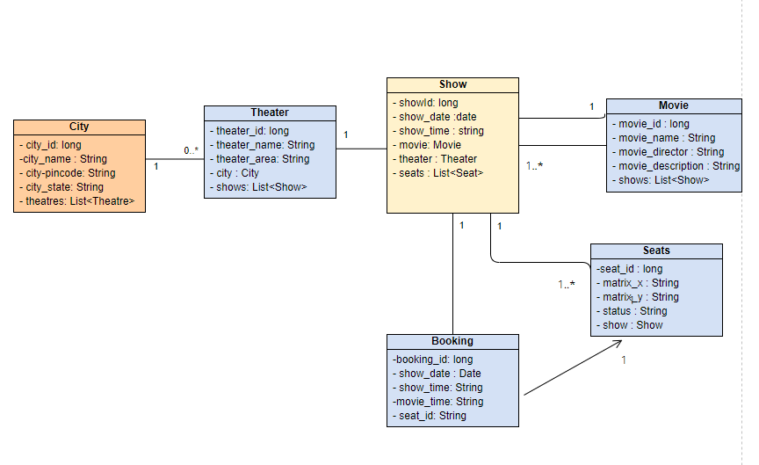
Data Modelling

Slide 2
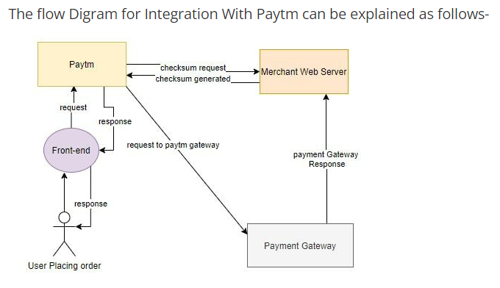
Integration with Payment gateway - PAYTM
Get the API keys from Paytm dashboard and properties to configure in application properties.
Add the paytm dependency Jar to po.xml
Set the controller methods to send the payment request using the checksum and /pgresponse controller mapping method and validate the checksum again

