Slide 1
Project 1
FINA 6333 – Spring 2024

Slide 2
Introduction
The purpose of this project is to evaluate the best investment strategy and subsequently recommend the best one, according to us. The strategies that are considered in this project are:
Buy-and-hold the SPY exchange-traded fund (ETF)
Hold SPY intraday only (i.e., buy at open and sell at close)
Hold SPY overnight only (i.e., buy at close and sell at open)
Buy-and-hold SPY except for worst n days and best n days each year, where n =1,2,3
The project focuses on maximizing returns from a $10,000 investment in the SPY ETF, which tracks the S&P 500 Index. It examines four investment horizons: 30 days, 1 year, 10 years, and the ETF’s entire lifespan. The study aims to identify the strategy that offers the highest return, considering the impact of capital gains tax from the brokerage account used for the investment. By calculating and comparing cumulative returns across different timeframes, the project seeks to provide a comprehensive analysis of short-term and long-term investment strategies to determine the most effective approach for investing in the SPY ETF.

Slide 3
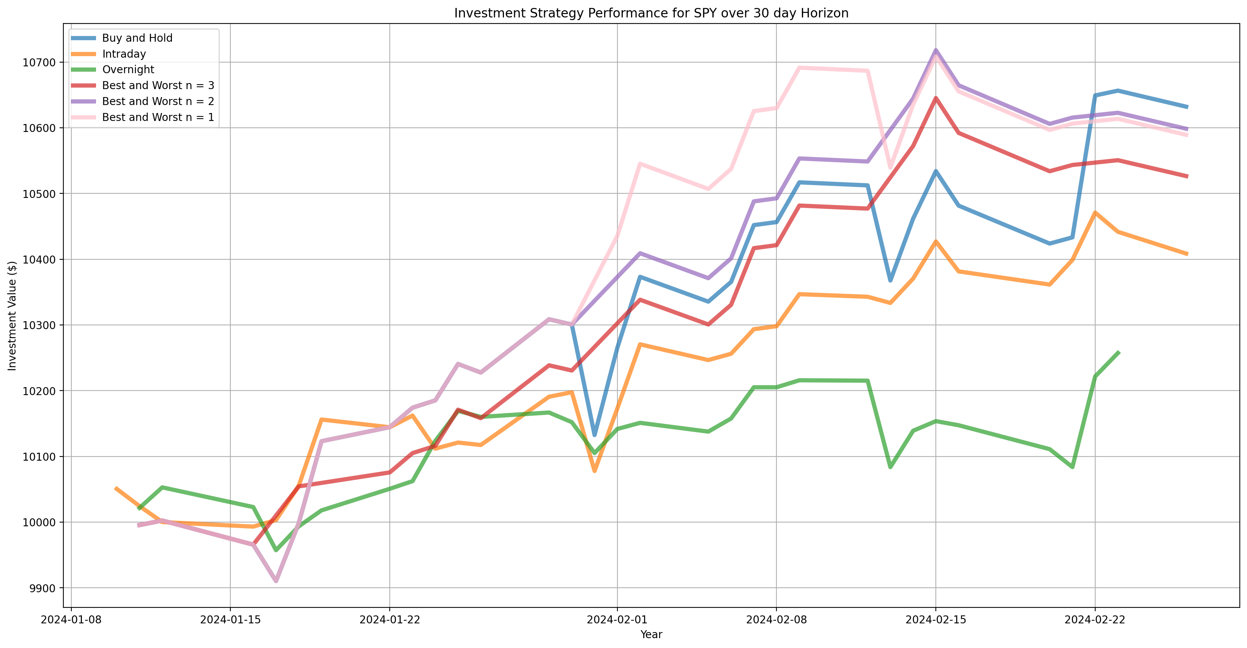
30 Day Returns
Performance of Trading Strategies for 30 Day Horizon
Comparing all the 4 strategies, we can see that each strategy provided a positive return at the end of the 30 Day investment horizon.
The best returns were provided by the Buy and Hold strategy (7.17%) with relatively lesser volatility throughout this period. Similarly the lowest returns were provided by the Overnight strategy (2.28%) which also saw a lot of volatility when compared to the rest of the strategies.
However, all the returns are subject to the capital gain tax which makes it difficult to conclude and give out a final number.

Slide 4
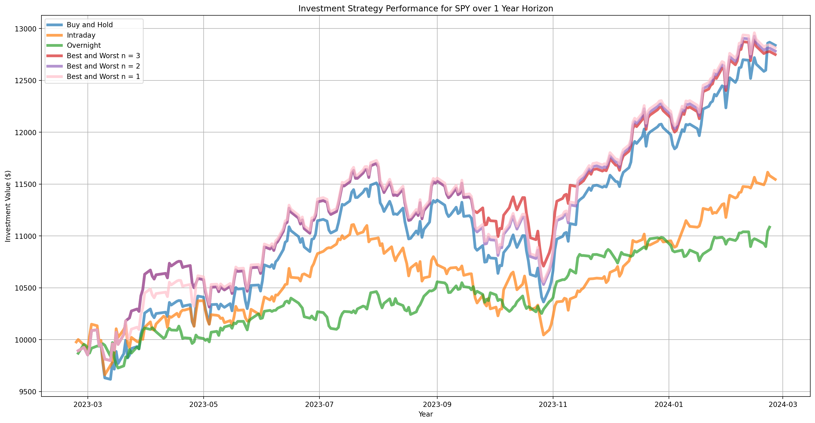
1 Year Returns
Performance of Trading Strategies for 1 Year Horizon
On comparing all the 4 strategies over our horizon period of 1 year, all strategies yielded positive returns.
However, the Buy & Hold strategy provided the highest return at 29.36% with lower volatility, transactional costs and taxes as compared to intraday and overnight strategies.
While the modified Buy & Hold strategy shows similar results, excluding days can be subjective and unrealistic.

Slide 5
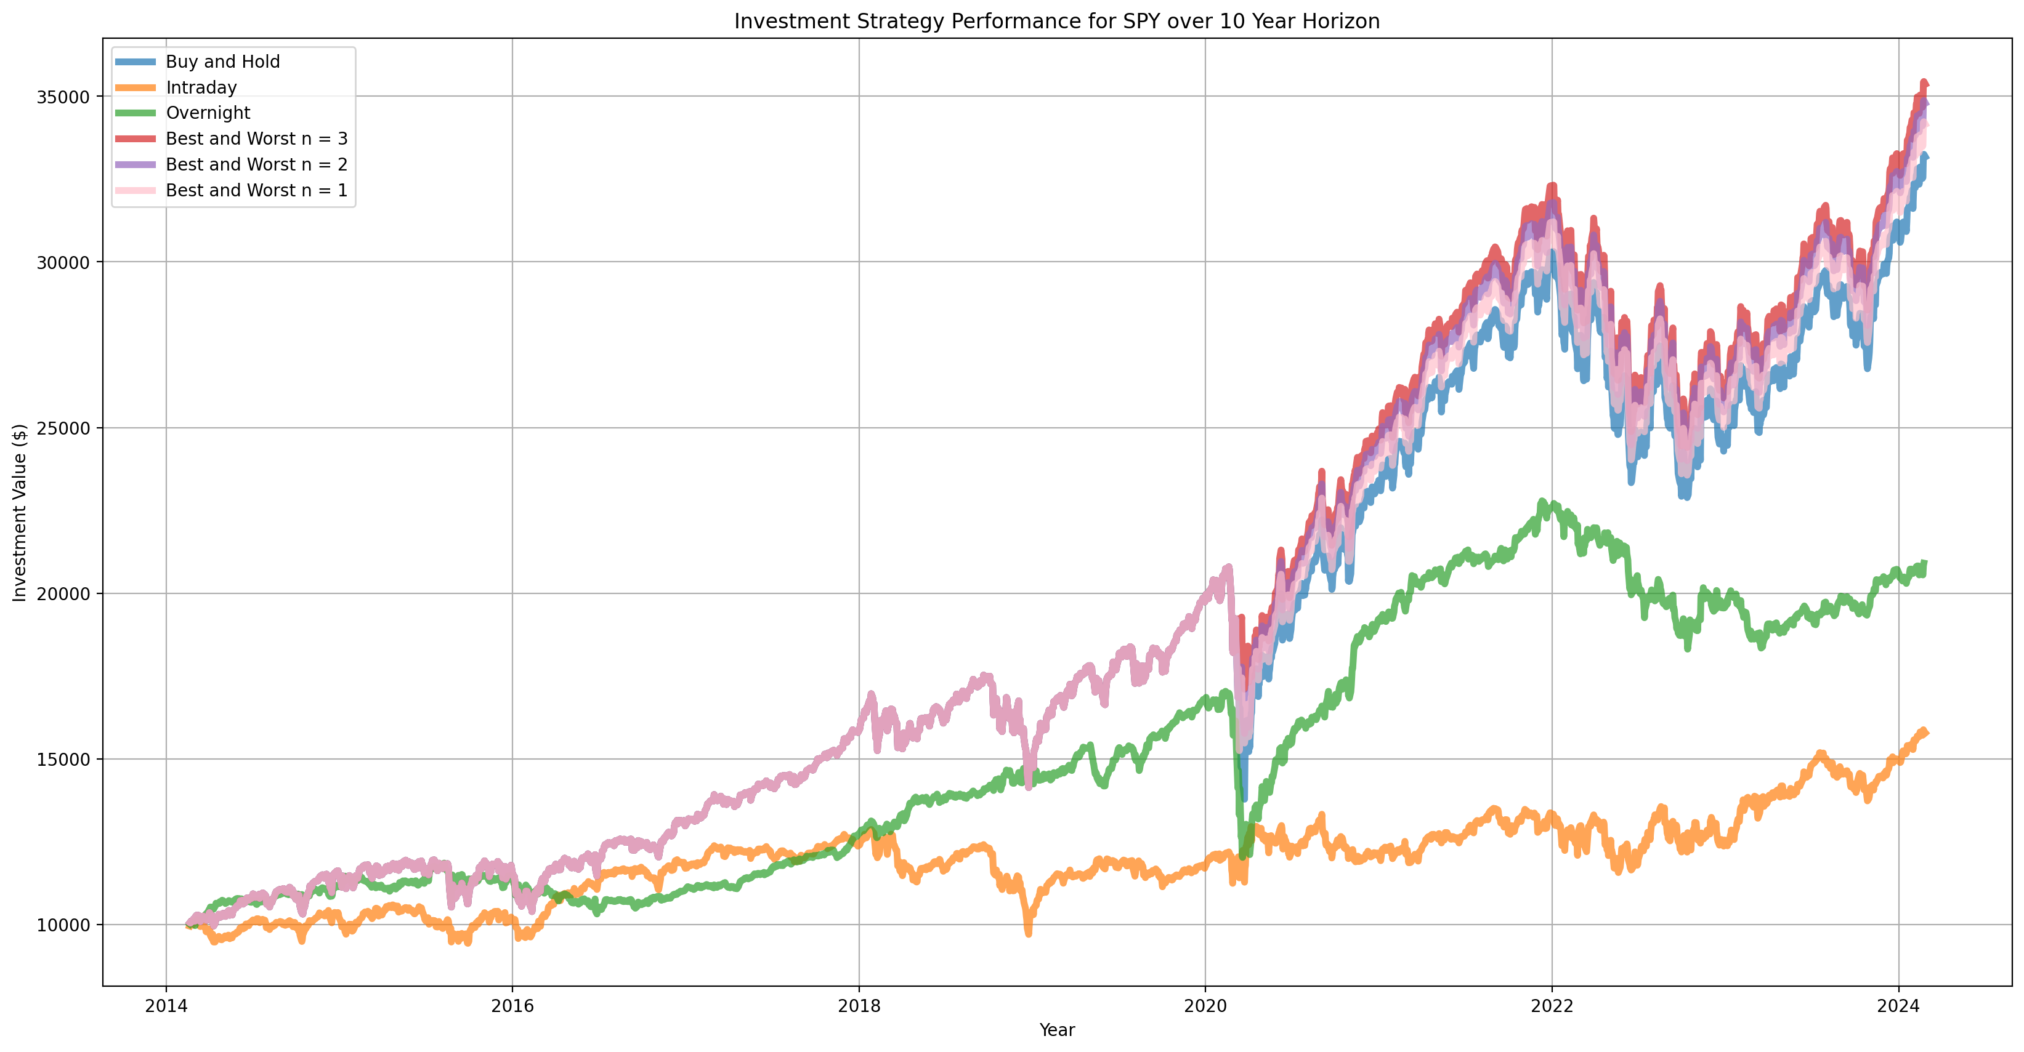
10 Year Returns
Performance of Trading Strategies for 10 Year Horizon
In comparison, all 4 strategies lead to positive cumulative returns at the end of the 10 year investment horizon.
The cumulative returns from the buy and hold strategy except for the worst and best 3 days were the highest. However it is difficult to say so conclusively due to the impact of capital gains tax.
The intraday strategy was the worst strategy to invest in, even without considering the tax on the returns.

Slide 6
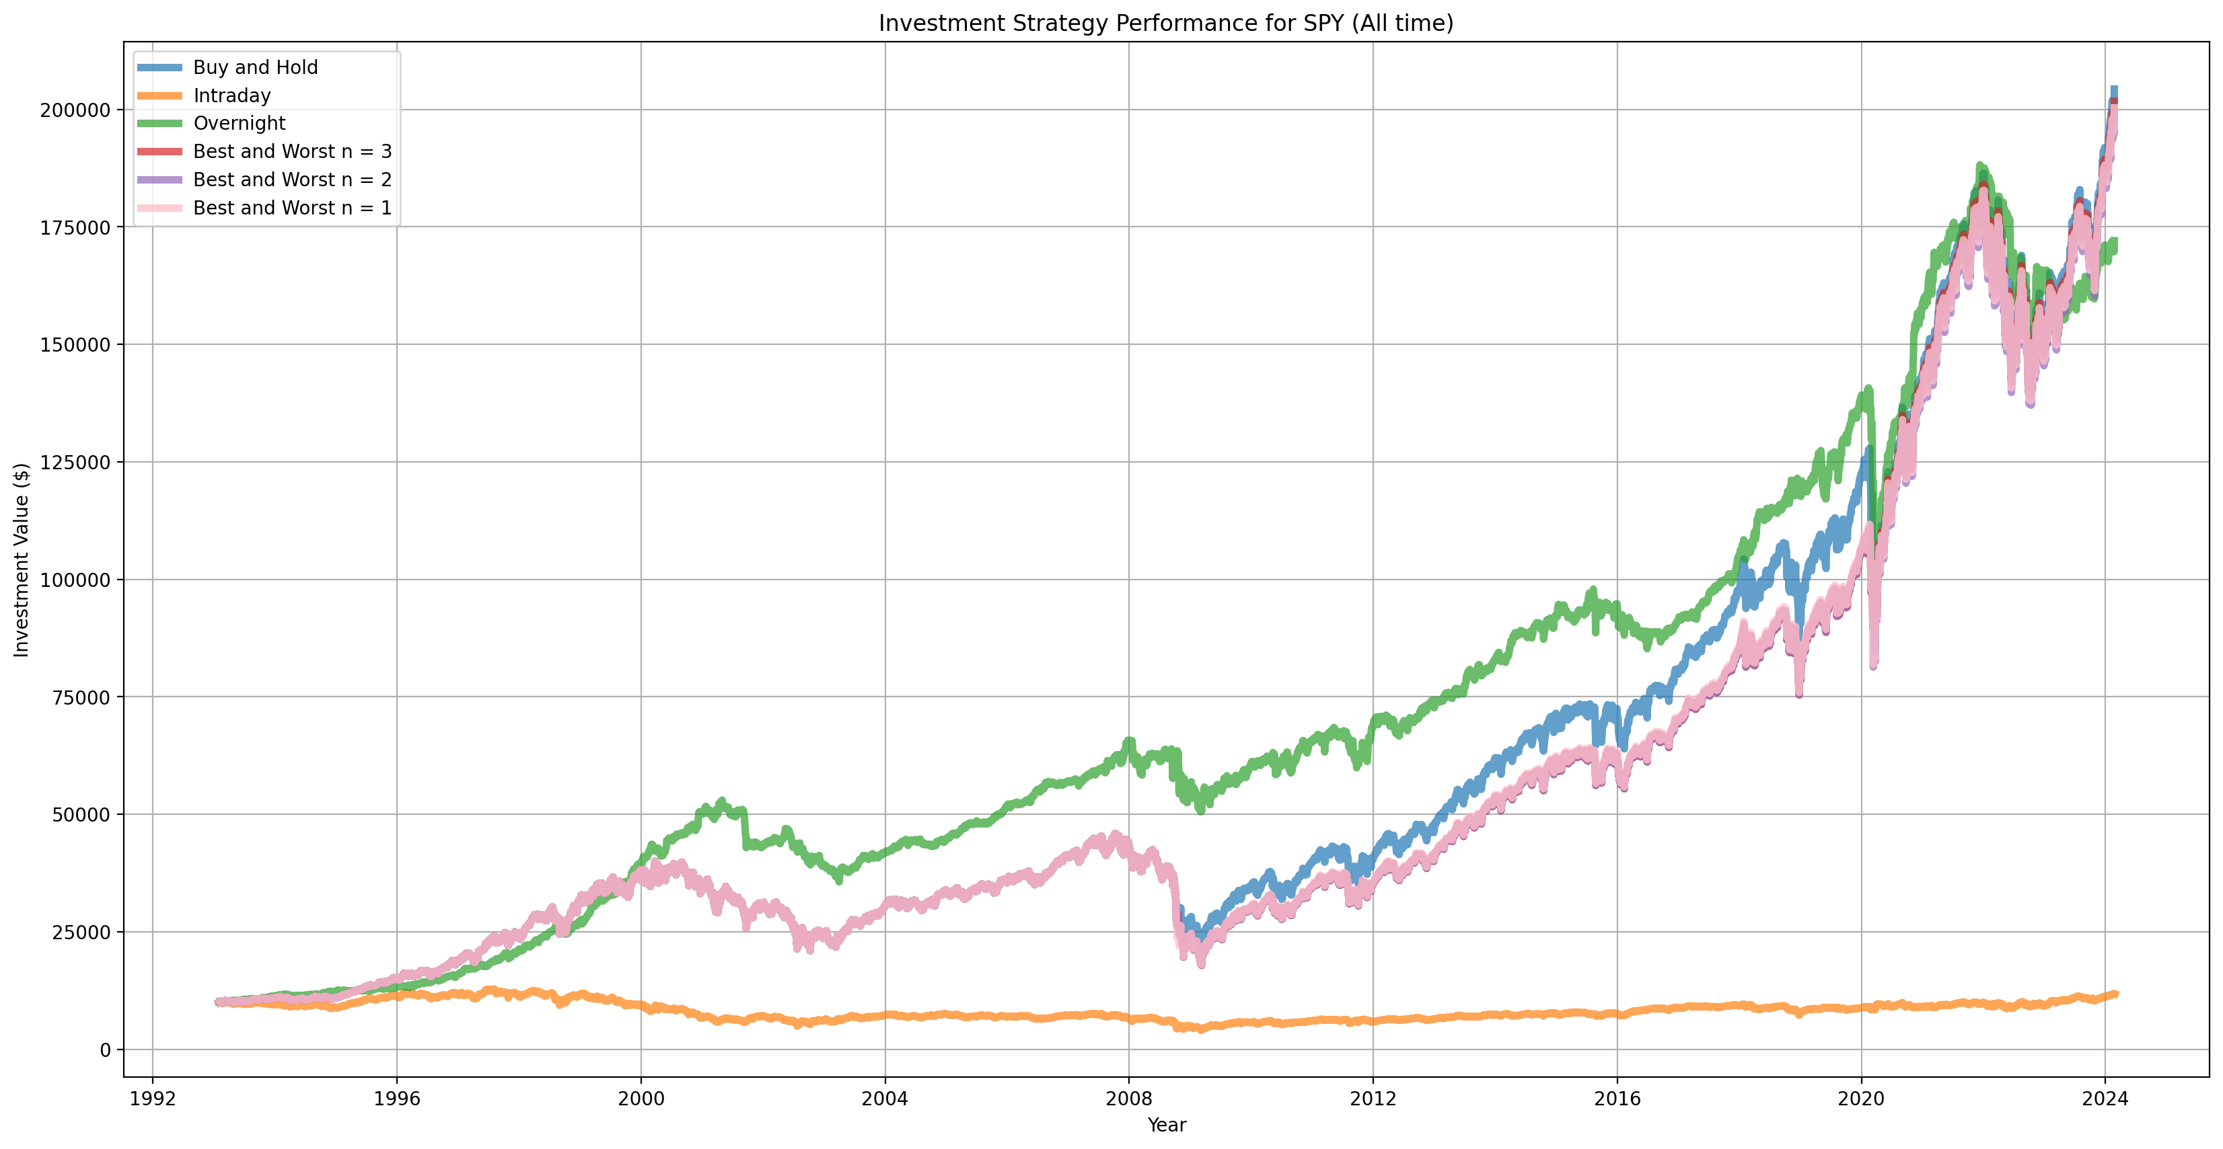
All time Returns
Performance of Trading Strategies (All Time)
Comparing all the 4 strategies for the period of 30 years, we can conclude that the buy and hold strategy provided the highest returns over the period. Intraday provided least returns in comparison with the other strategies.
Except for Intraday, every other strategy observed a significant drop in overall returns during 2020 and a huge spike in returns right after that. But all the four strategies yielded positive returns at the end of 30 years.

Slide 7
Sharpe Ratio
30 Day Sharpe ratio
Best Strategy for 30 Days: Buy & Hold
0.5347
2nd Best Strategy for 30 Days: Excluding Best & Worst 2 days
1.0999
Interpretations: The 30-day Sharpe ratio reveals that the Buy and Hold strategy outperforms, suggesting a more proficient utilization of risk for return generation, whereas the alternative strategy’s negative Sharpe ratio hints at a suboptimal risk engagement, potentially eroding value.

Slide 8
Sharpe Ratio
1 Year Sharpe Ratio
Best Strategy for 1 Year: Buy & Hold
1.9723
2nd Best Strategy for 1 Year: Excluding Best & Worst 1 day
2.0138
Interpretations: The marginal increase in the Sharpe ratio for the one-year strategy that tactically omits the most volatile days hints at a refined balance of risk and return, challenging the traditional buy-and-hold method’s perceived reliability over this period.

Slide 9
Sharpe Ratio
10 Year Sharpe Ratio
Best Strategy for 10 Year: Excluding Best & Worst 3 day
0.8467
2nd Best Strategy for 10 Year: Excluding Best & Worst 2 day
0.8217
Interpretations: The subtle divergence in Sharpe ratios for the 10-year horizon suggests that the strategy eliminating the top and bottom three days of trading nuances the investment profile, offering an incrementally optimized balance between risk and return compared to its close counterpart strategy.

Slide 10
Sharpe Ratio
All Time
Best Strategy for All Time: Buy & Hold
0.5985
Best Strategy for All Time: Excluding Best & Worst 3 day
0.5339
Interpretations: The superior Sharpe ratio of 0.5985 for the Buy & Hold strategy indicates a more efficient utilization of risk to generate returns over the long term, compared to the marginally less efficient approach of omitting the most volatile days, which resulted in a Sharpe ratio of 0.5339, reflecting the potential cost of attempting to time market fluctuations.

Slide 11
Limitations
Using the 4 diverse strategies, we calculated the returns and concluded that the best investment strategy is Buy and Hold as it provided us with the highest returns out of the lot. However, there are still some flaws that need to be addressed:
1. Assuming no transactional costs Transactional costs are incurred when purchasing or selling assets over their actual value. They consist of commissions, fees, taxes, and other transaction-related costs. To maximize profitability, you must ensure that you minimize the transaction cost. It’s something which cannot be eliminated however, we’ve assumed no transactional costs for our analysis.
2. Backward facing data This usually refers to information or data from the past that relates to past conditions or events, and to get optimum returns it’s also necessary to consider any future information that might affect our portfolio. Backward facing data contrasts with “forward-facing data,” which pertains to information that is future-focused or projected.
3. Possibility of biases Biases can be referred to as the systematic errors in judgement which could lead to suboptimal investment choices, market inefficiencies or mispricing of assets. These can arise from various cognitive, emotional, or social factors.
4. Selecting the best and the worst 3 days In our analysis, while working with the buy and hold strategy where we eliminate the best and the worst 3 days each year (n = 1,2, and 3), we found out that it is not something which can be practically performed in real life and thus the picture that it provides us is not 100% reliable in terms of using it as an investment strategy.
5. Overnight strategy We may see reduced stock liquidity, which could result in larger bid-ask spreads and higher transaction costs. Another thing to consider is the volatility that we may see between the open and close, prices can move in large swing which could result in potential losses.

Slide 12
Conclusion
In conclusion, our comprehensive analysis of the SPY ETF’s performance across four distinct time periods and employing four different trading strategies has yielded valuable insights into its investment potential.
Across the broad timeline of 30 years, the Buy and Hold strategy demonstrated the strength of long-term investment, capturing the market’s overall upward trend despite periods of volatility. Similarly, the analysis from 2014 to 2024 reaffirmed the effectiveness of this strategy, showcasing consistent returns over a decade marked by various economic conditions. Zooming into shorter timeframes, our examination of the year 2023 to 2024 shed light on the significance of timing within the market, with the Intraday strategy demonstrating the potential for capitalizing on daily fluctuations. Moreover, the application of Buy and Hold strategies where we excluded the three best and worst days based on returns, highlighted the impact of outlier events on overall portfolio performance and even though we can see positive returns through this strategy, this approach can be subjective and unrealistic.
Hence, after comparing all the four strategies, keeping in mind the returns generated and the limitations, we would suggest using the Buy and Hold strategy in order to obtain the highest returns.

