Slide 1
Python Basics
Samarth Gupta

Slide 2
Basic operations
Assignment:
  size = 40
  a = b = c = 3
Numbers
  integer, float
  complex numbers: 1j+3, abs(z)
Strings
  'hello world', 'it\'s hot'
  "bye world"
  continuation via \ or use """ long text """"

Slide 3
String operations
concatenate with + or neighbors
  word = 'Help' + x
  word = 'Help' 'a'
subscripting of strings
  'Hello'[2] → 'l'
  slice: 'Hello'[1:2] → 'el'
  word[-1] → last character
  len(word) → 5
  immutable: cannot assign to subscript

Slide 4
Lists
lists can be heterogeneous
  a = ['spam', 'eggs', 100, 1234, 2*2]
Lists can be indexed and sliced:
  a[0] → spam
  a[:2] → ['spam', 'eggs']
Lists can be manipulated
  a[2] = a[2] + 23
  a[0:2] = [1,12]
  a[0:0] = []
  len(a) → 5

Slide 5
Basic programming
a,b = 0, 1
# non-zero = true
while b < 10:
# formatted output, without \n
print b,
# multiple assignment
a,b = b, a+b

Slide 6
Control flow: if
x = int(raw_input("Please enter #:"))
if x < 0:
x = 0
print 'Negative changed to zero'
elif x == 0:
print 'Zero'
elif x == 1:
print 'Single'
else:
print 'More'
no case statement

Slide 7
Control flow: for
a = ['cat', 'window', 'defenestrate']
for x in a:
print x, len(x)
no arithmetic progression, but
  range(10) → [0, 1, 2, 3, 4, 5, 6, 7, 8, 9]
  for i in range(len(a)):
  print i, a[i]
do not modify the sequence being iterated over

Slide 8
Loops: break, continue, else
break and continue like C
else after loop exhaustion
for n in range(2,10):
for x in range(2,n):
if n % x == 0:
print n, 'equals', x, '*', n/x
break
else:
# loop fell through without finding a factor
print n, 'is prime'

Slide 9
Do nothing
pass does nothing
syntactic filler
while 1:
pass

Slide 10
Defining functions
def fib(n):
"""Print a Fibonacci series up to n."""
a, b = 0, 1
while b < n:
print b,
a, b = b, a+b
>>> fib(2000)
First line is docstring
first look for variables in local, then global
need global to assign global variables

Slide 11
Functions: default argument values
def ask_ok(prompt, retries=4, complaint='Yes or no, please!'):
while 1:
ok = raw_input(prompt)
if ok in ('y', 'ye', 'yes'): return 1
if ok in ('n', 'no'): return 0
retries = retries - 1
if retries < 0: raise IOError, 'refusenik error'
print complaint
>>> ask_ok('Really?')

Slide 12
Keyword arguments
last arguments can be given as keywords
def parrot(voltage, state='a stiff', action='voom', type='Norwegian blue'):
print "-- This parrot wouldn't", action,
print "if you put", voltage, "Volts through it."
print "Lovely plumage, the ", type
print "-- It's", state, "!"
parrot(1000)
parrot(action='VOOOM', voltage=100000)

Slide 13
Lambda forms
anonymous functions
may not work in older versions
  def make_incrementor(n):
  return lambda x: x + n
  f = make_incrementor(42)
  f(0)
  f(1)

Slide 14
List methods
append(x)
extend(L)
  append all items in list (like Tcl lappend)
insert(i,x)
remove(x)
pop([i]), pop()
  create stack (FIFO), or queue (LIFO) → pop(0)
index(x)
  return the index for value x

Slide 15
List methods
count(x)
  how many times x appears in list
sort()
  sort items in place
reverse()
  reverse list

Slide 16
Functional programming tools
filter(function, sequence)
  def f(x): return x%2 != 0 and x%3 0
  filter(f, range(2,25))
map(function, sequence)
  call function for each item
  return list of return values
reduce(function, sequence)
  return a single value
  call binary function on the first two items
  then on the result and next item
  iterate

Slide 17
List comprehensions (2.0)
Create lists without map(), filter(), lambda
= expression followed by for clause + zero or more for or of clauses
>>> vec = [2,4,6]
>>> [3*x for x in vec]
[6, 12, 18]
>>> [{x: x**2} for x in vec}
[{2: 4}, {4: 16}, {6: 36}]

Slide 18
List comprehensions
cross products:
>>> vec1 = [2,4,6]
>>> vec2 = [4,3,-9]
>>> [x*y for x in vec1 for y in vec2]
[8,6,-18, 16,12,-36, 24,18,-54]
>>> [x+y for x in vec1 and y in vec2]
[6,5,-7,8,7,-5,10,9,-3]
>>> [vec1[i]*vec2[i] for i in range(len(vec1))]
[8,12,-54]

Slide 19
List comprehensions
can also use if:
>>> [3*x for x in vec if x > 3]
[12, 18]
>>> [3*x for x in vec if x < 2]
[]

Slide 20
del – removing list items
remove by index, not value
remove slices from list (rather than by assigning an empty list)
>>> a = [-1,1,66.6,333,333,1234.5]
>>> del a[0]
>>> a
[1,66.6,333,333,1234.5]
>>> del a[2:4]
>>> a
[1,66.6,1234.5]

Slide 21
Tuples and sequences
lists, strings, tuples: examples of sequence type
tuple = values separated by commas
>>> t = 123, 543, 'bar'
>>> t[0]
123
>>> t
(123, 543, 'bar')

Slide 22
Tuples
Tuples may be nested
>>> u = t, (1,2)
>>> u
((123, 542, 'bar'), (1,2))
kind of like structs, but no element names:
  (x,y) coordinates
  database records
like strings, immutable → can't assign to individual items

Slide 23
Tuples
Empty tuples: ()
>>> empty = ()
>>> len(empty)
0
one item → trailing comma
>>> singleton = 'foo',

Slide 24
Tuples
sequence unpacking → distribute elements across variables
>>> t = 123, 543, 'bar'
>>> x, y, z = t
>>> x
123
packing always creates tuple
unpacking works for any sequence

Slide 25
Dictionaries
like Tcl or awk associative arrays
indexed by keys
keys are any immutable type: e.g., tuples
but not lists (mutable!)
uses 'key: value' notation
>>> tel = {'hgs' : 7042, 'lennox': 7018}
>>> tel['cs'] = 7000
>>> tel

Slide 26
Dictionaries
no particular order
delete elements with del
>>> del tel['foo']
keys() method → unsorted list of keys
>>> tel.keys()
['cs', 'lennox', 'hgs']
use has_key() to check for existence
>>> tel.has_key('foo')
0

Slide 27
Conditions
can check for sequence membership with is and is not:
  >>> if (4 in vec):
  ... print '4 is'
chained comparisons: a less than b AND b equals c:
  a < b == c
and and or are short-circuit operators:
  evaluated from left to right
  stop evaluation as soon as outcome clear

Slide 28
Conditions
Can assign comparison to variable:
  >>> s1,s2,s3='', 'foo', 'bar'
  >>> non_null = s1 or s2 or s3
  >>> non_null
  foo
Unlike C, no assignment within expression

Slide 29
Comparing sequences
unlike C, can compare sequences (lists, tuples, ...)
lexicographical comparison:
  compare first; if different → outcome
  continue recursively
  subsequences are smaller
  strings use ASCII comparison
  can compare objects of different type, but by type name (list < string < tuple)

Slide 30
Comparing sequences
(1,2,3) < (1,2,4)
[1,2,3] < [1,2,4]
'ABC' < 'C' < 'Pascal' < 'Python'
(1,2,3) == (1.0,2.0,3.0)
(1,2) < (1,2,-1)

Slide 31
Modules
collection of functions and variables, typically in scripts
definitions can be imported
file name is module name + .py
e.g., create module fibo.py
def fib(n): # write Fib. series up to n
...
def fib2(n): # return Fib. series up to n

Slide 32
Modules
import module:
  import fibo
Use modules via "name space":
  >>> fibo.fib(1000)
  >>> fibo.__name__
  'fibo'
can give it a local name:
  >>> fib = fibo.fib
  >>> fib(500)

Slide 33
Modules
function definition + executable statements
executed only when module is imported
modules have private symbol tables
avoids name clash for global variables
accessible as module.globalname
can import into name space:
  >>> from fibo import fib, fib2
  >>> fib(500)
can import all names defined by module:
  >>> from fibo import *

Slide 34
Module search path
current directory
list of directories specified in PYTHONPATH environment variable
uses installation-default if not defined, e.g., .:/usr/local/lib/python
uses sys.path
  >>> import sys
  >>> sys.path
  ['', 'C:\\PROGRA~1\\Python2.2', 'C:\\Program Files\\Python2.2\\DLLs', 'C:\\Program Files\\Python2.2\\lib', 'C:\\Program Files\\Python2.2\\lib\\lib-tk', 'C:\\Program Files\\Python2.2', 'C:\\Program Files\\Python2.2\\lib\\site-packages']

Slide 35
Random
Library for functions related to random number Generation

Slide 36
Compiled Python files
include byte-compiled version of module if there exists fibo.pyc in same directory as fibo.py
only if creation time of fibo.pyc matches fibo.py
automatically write compiled file, if possible
platform independent
doesn't run any faster, but loads faster
can have only .pyc file → hide source

Slide 37
Standard modules
system-dependent list
always sys module
  >>> import sys
  >>> sys.p1
  '>>> '
  >>> sys.p2
  '... '
  >>> sys.path.append('/some/directory')

Slide 38
Module listing
use dir() for each module
  >>> dir(fibo)
  ['___name___', 'fib', 'fib2']
  >>> dir(sys)
  ['__displayhook__', '__doc__', '__excepthook__', '__name__', '__stderr__', '__st
  din__', '__stdout__', '_getframe', 'argv', 'builtin_module_names', 'byteorder',
  'copyright', 'displayhook', 'dllhandle', 'exc_info', 'exc_type', 'excepthook', '
  exec_prefix', 'executable', 'exit', 'getdefaultencoding', 'getrecursionlimit', '
  getrefcount', 'hexversion', 'last_type', 'last_value', 'maxint', 'maxunicode', '
  modules', 'path', 'platform', 'prefix', 'ps1', 'ps2', 'setcheckinterval', 'setpr
  ofile', 'setrecursionlimit', 'settrace', 'stderr', 'stdin', 'stdout', 'version',
  'version_info', 'warnoptions', 'winver']

Slide 39
Handling exceptions
while 1:
try:
x = int(raw_input("Please enter a number: "))
break
except ValueError:
print "Not a valid number"
First, execute try clause
if no exception, skip except clause
if exception, skip rest of try clause and use except clause
if no matching exception, attempt outer try statement

Slide 40
Handling exceptions
try.py
import sys
for arg in sys.argv[1:]:
try:
f = open(arg, 'r')
except IOError:
print 'cannot open', arg
else:
print arg, 'lines:', len(f.readlines())
f.close
e.g., as python try.py *.py

Slide 41
Hangman
The word to guess is represented by a row of dashes, representing each letter of the word.
If the guessing player suggests a letter which occurs in the word, the other player writes it in all its correct positions. If the suggested letter does not occur in the word, the other player draws one element of a hanged stick figure as a tally mark.

Slide 42
Cases to be considered
1. Difficulty levels: Beginner, Intermediate (default), Advanced
a. Difference is in the word selection: on the basis of length, rarity, total number of options in the word list
b. Total number of guesses allowed
2. Pictorial representation of hangman

Slide 43
Cases to be considered (cont.)
3. Error cases:
a. If non-numeric difficulty level entered, it is set by program to beginner
b. If difficulty level entered not in expected range, it is set by program to intermediate

Slide 44
Cases to be considered (cont.)
c. Program checks and asks the user to enter again
i. If multiple characters are entered during guess of the word
ii. If non-alphabet is enetered
iii. If the character has alreday been tried
4. Displays all the previous tried characters

Slide 45
Cases to be considered (cont.)
5. Maximum number of trails has an upper bound
6. Maximum number of failed attempts has an upper bound
7. The program is not case sensitive
8. Solution is displayed in case of failure to better the knowledge of the user

Slide 46
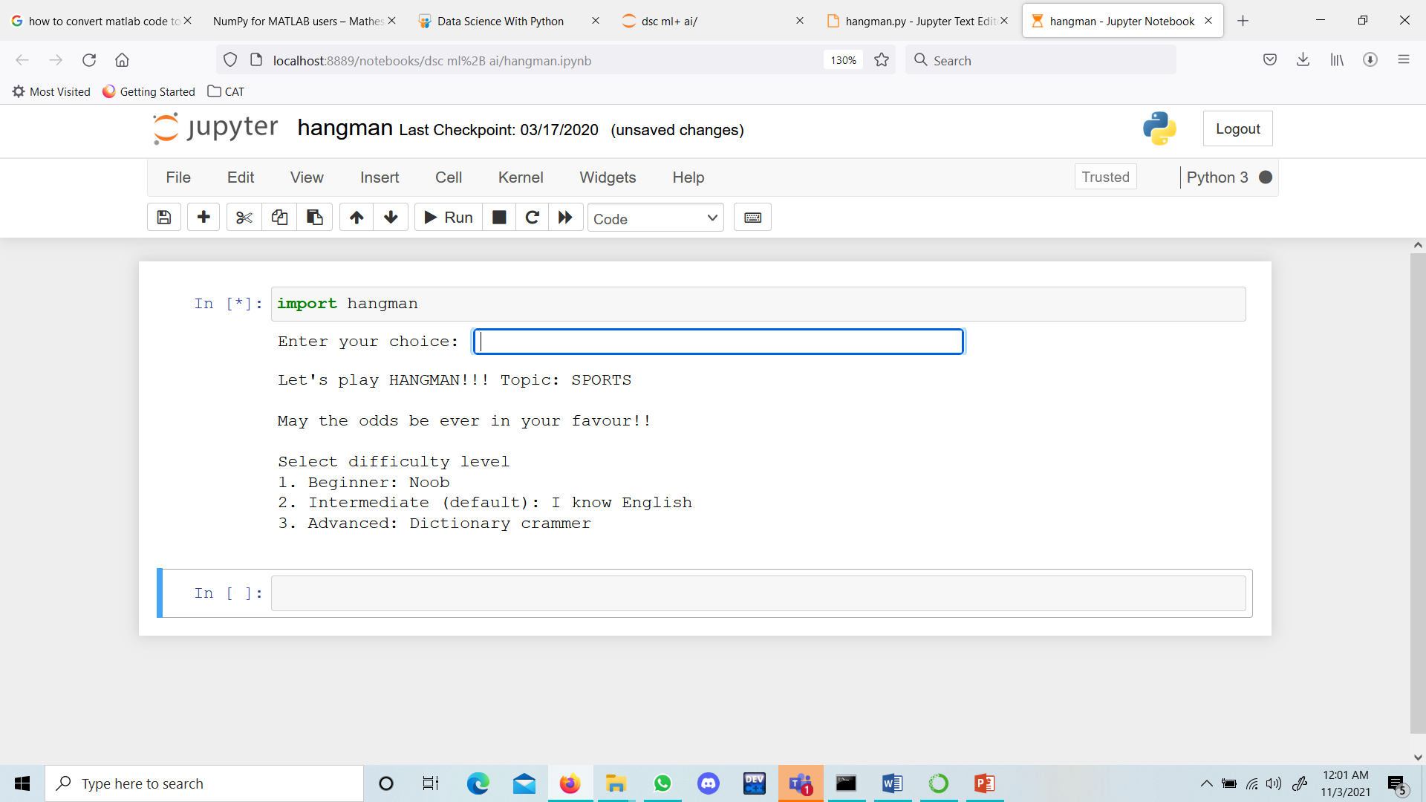
Input/output

Slide 47
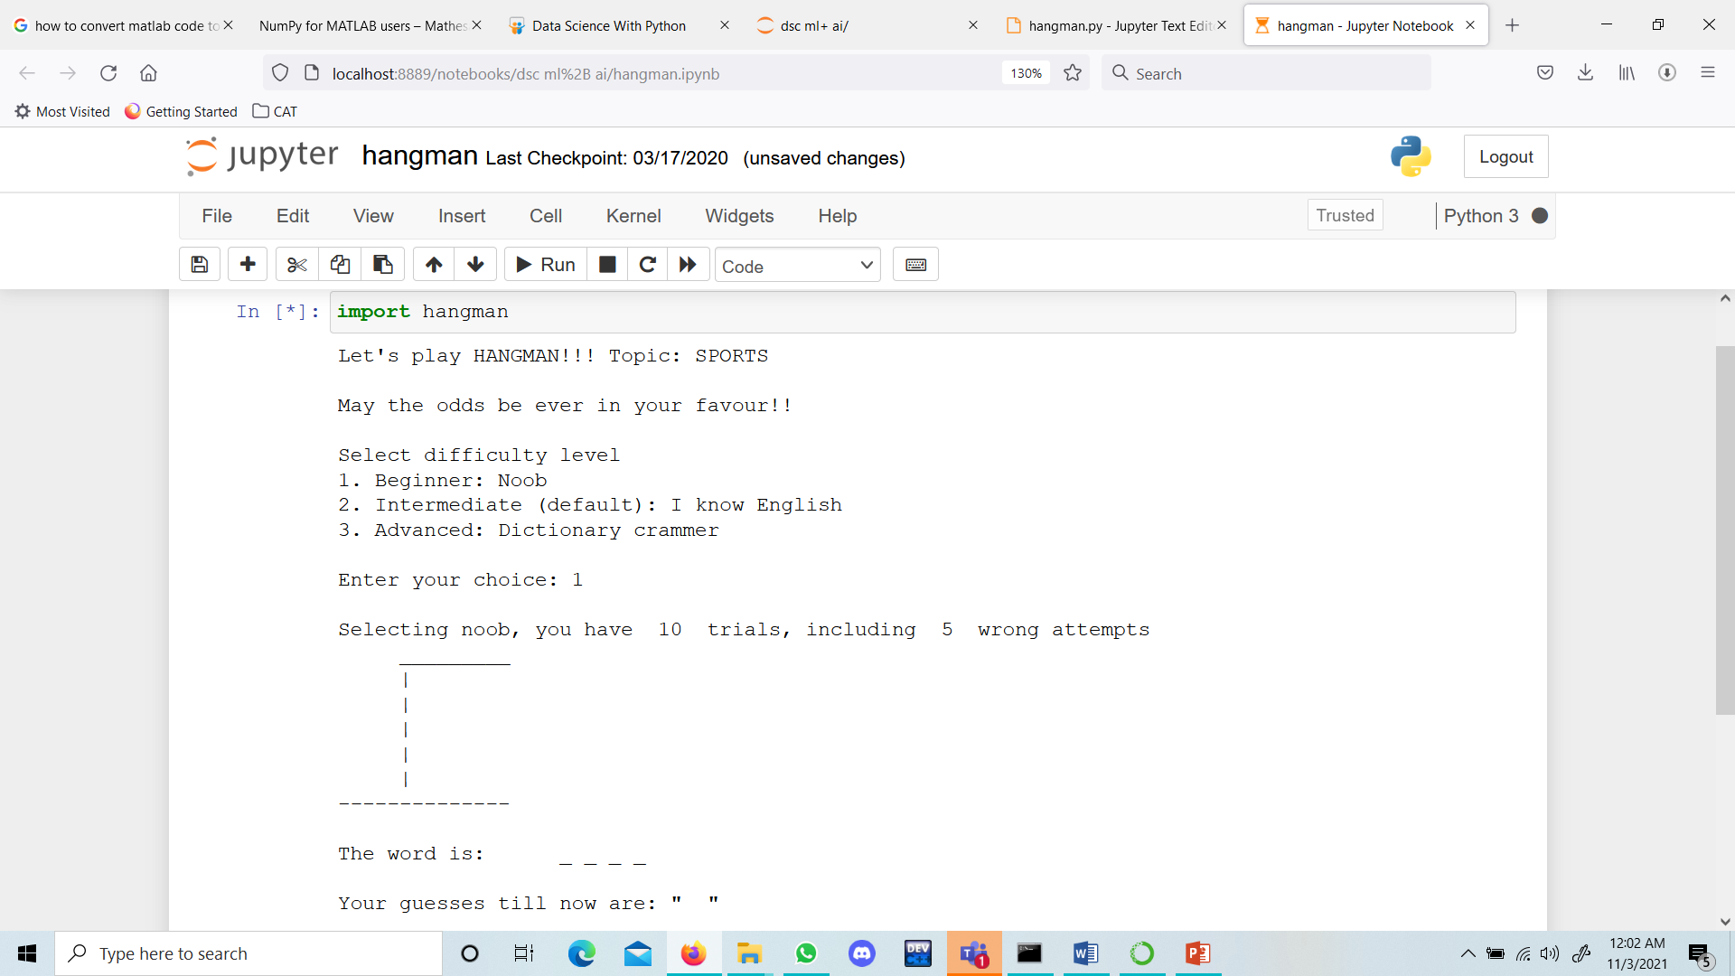
Input/output

Slide 48
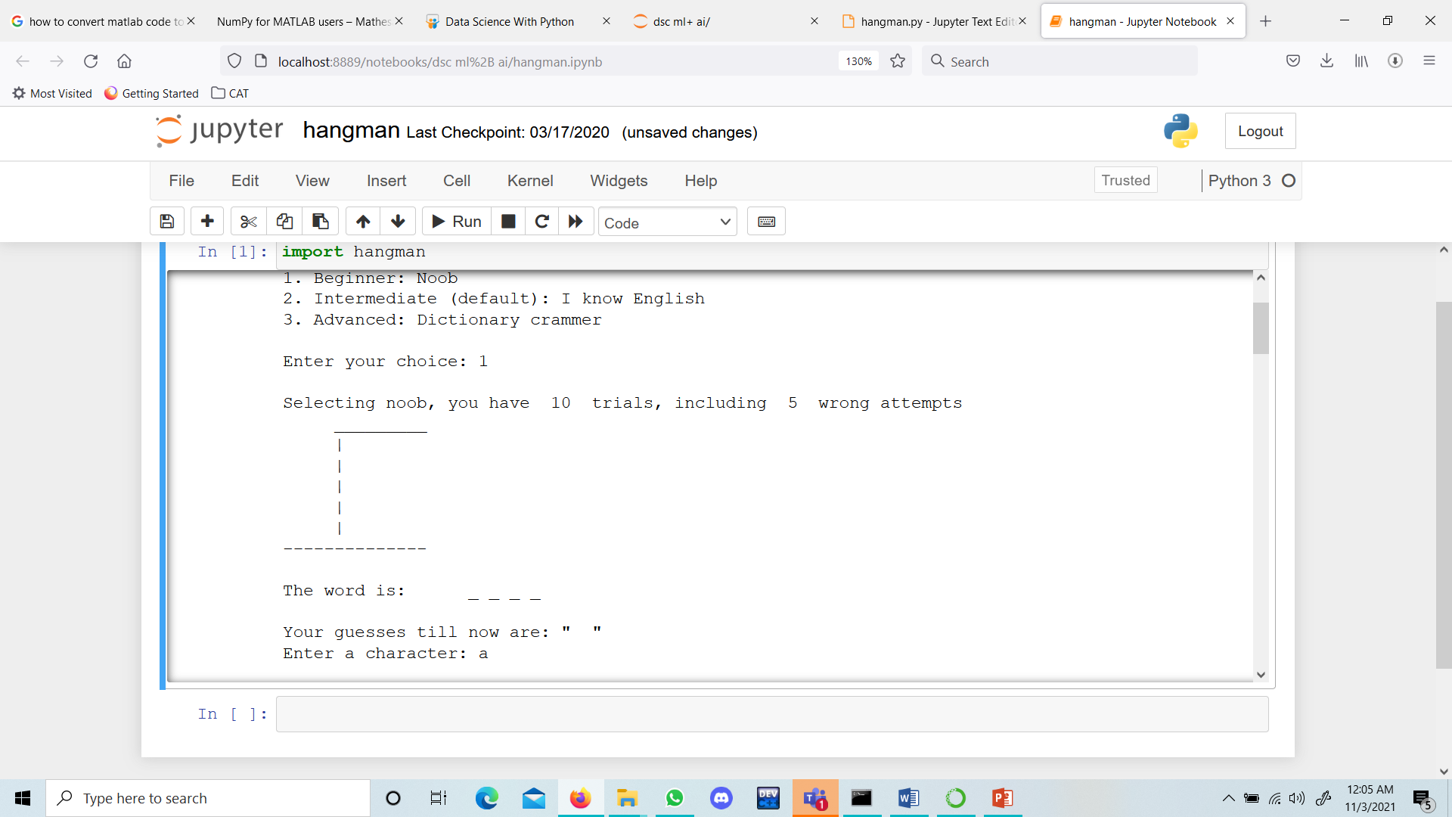
Input/output

Slide 49
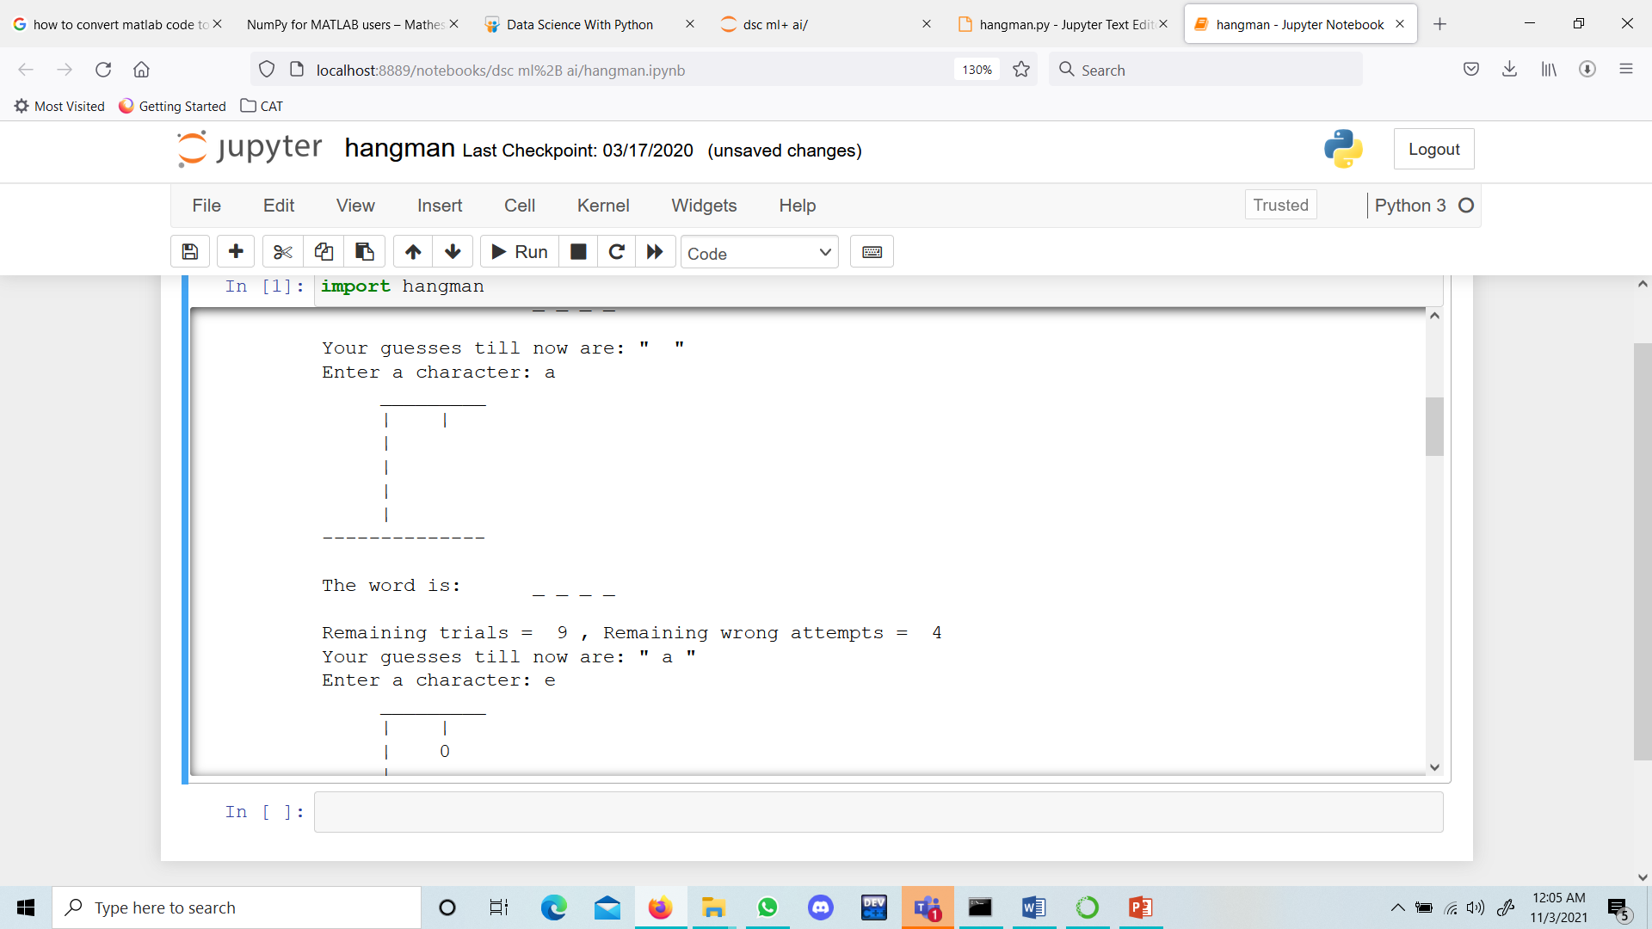
Input/output

Slide 50
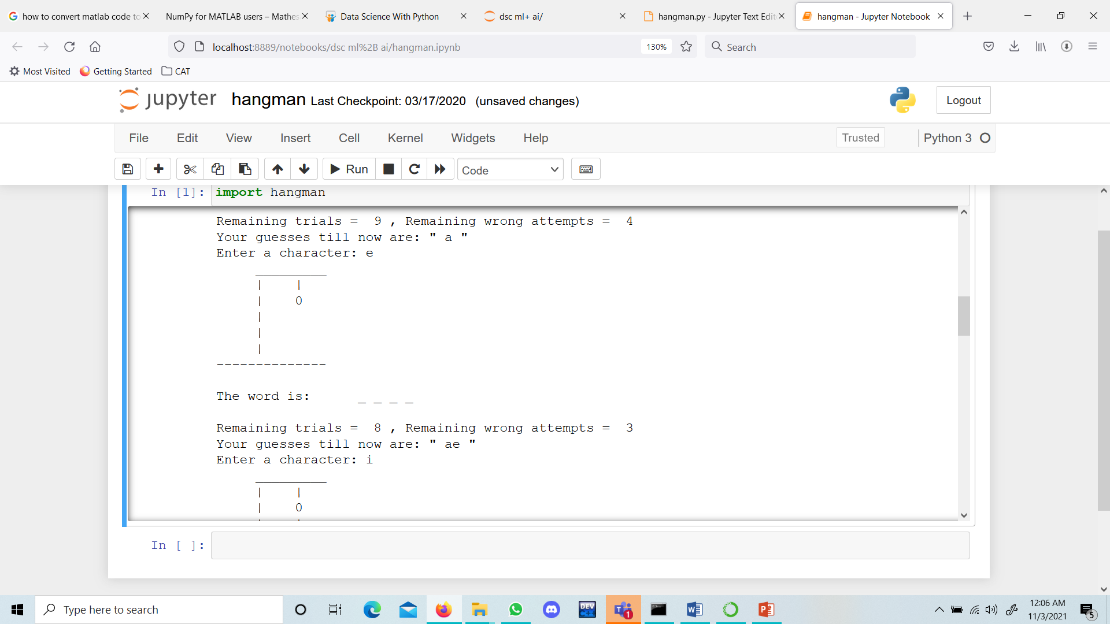
Input/output

Slide 51

Input/output

Slide 52

Input/output

Slide 53
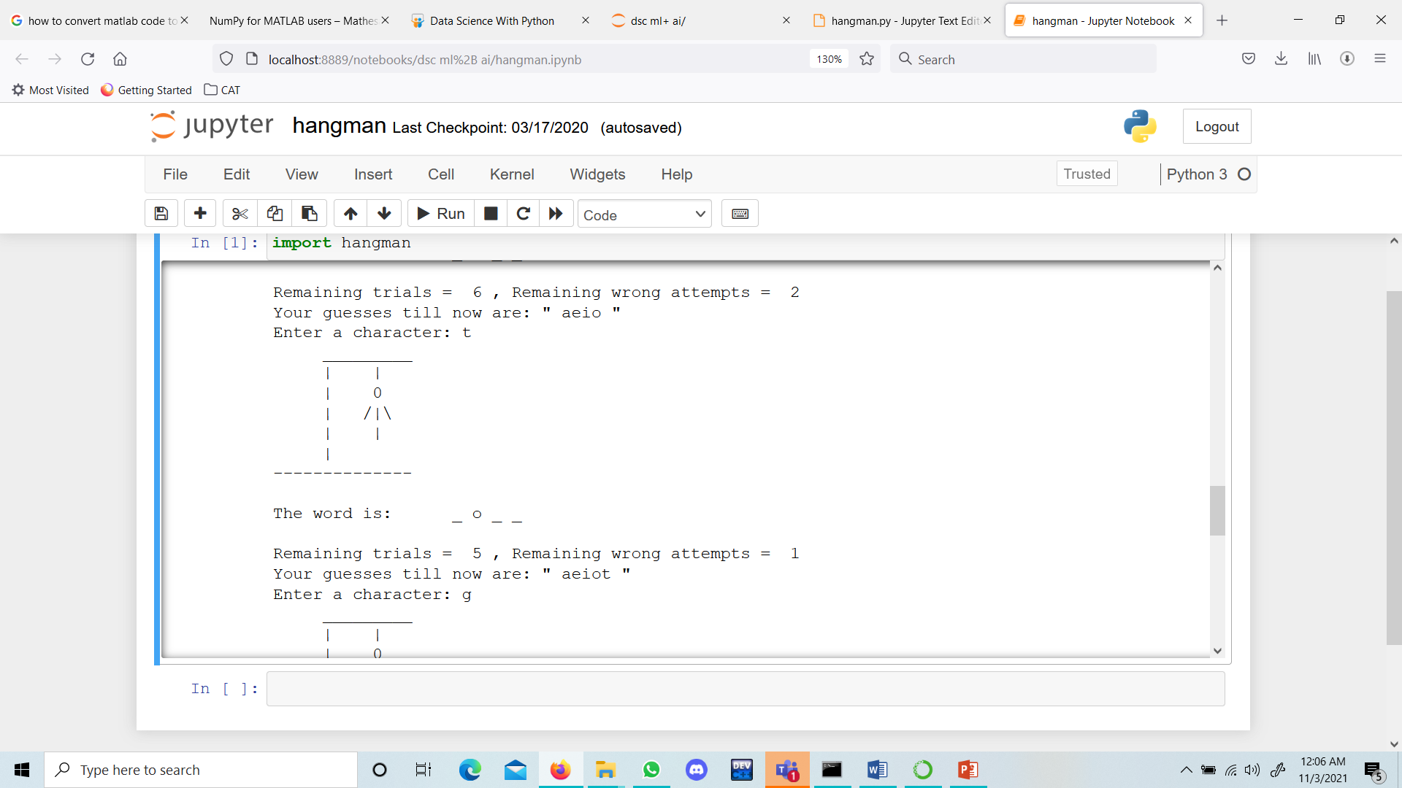
Input/output

Slide 54

Input/output

Slide 55

Input/output

Slide 56
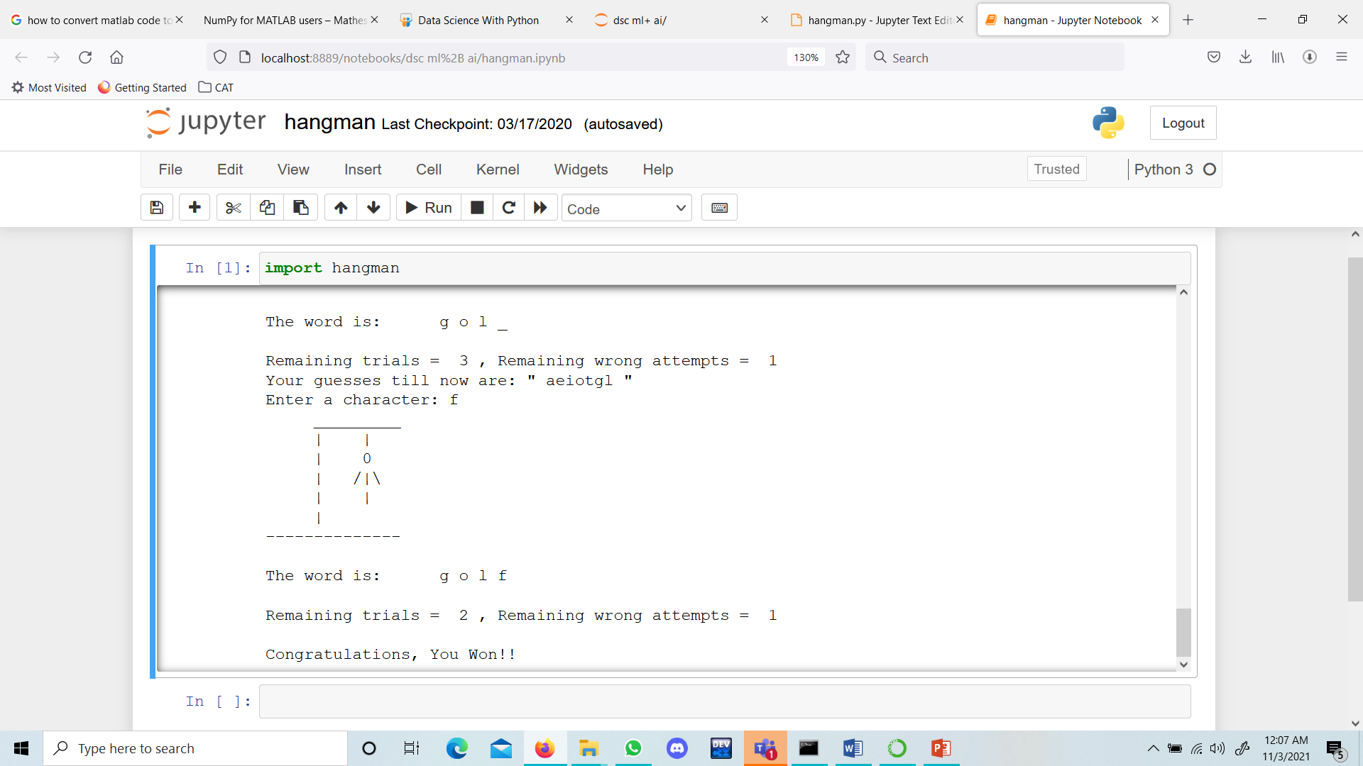
Input/output

