Slide 1
EMF QUERY PROCESSOR
CS 562 Database Management System II

Slide 2
Agenda
01
Project Description
Idea behind the project.
02
Input File Structure
Parameters of Phi and how I have provided the input
03
Flow of Program
What is happening in the background?
04
Technology Used and Limitation
Running environment and technical limitation.
05
Project Demo
Let's run the code.

Slide 3

Project Description
Problem
SQL queries involve high degree of redundancy by repeated selection, grouping and aggregation over the same groups.
Solution
Research paper propose a new relational operator that perform several level of aggregation over the same groups.
Framework
Two framework MF queries and EMF queries are proposed to solve the issue.
Implementation
Developed query processing engine for Ad-Hoc OLAP queries bases on EMF framework.

Slide 4
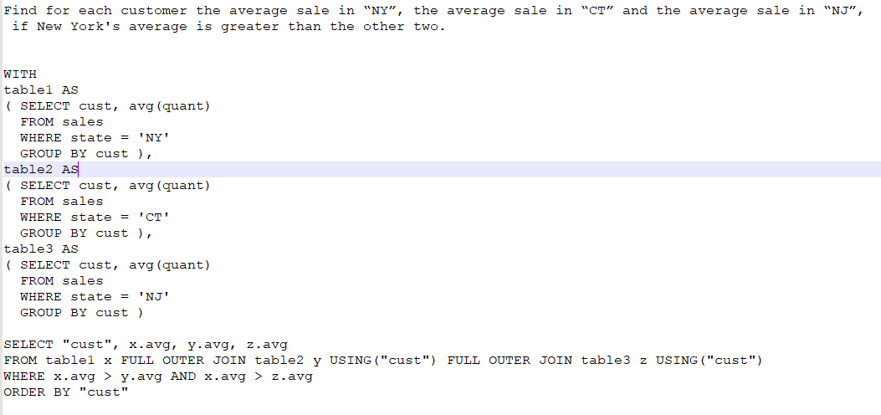
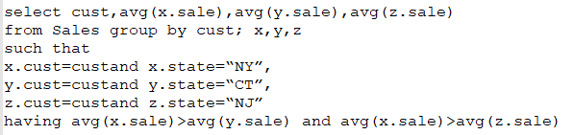
Example

Slide 5
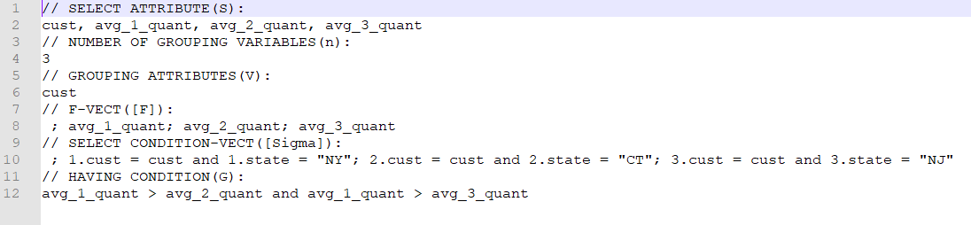
Input File Structure

Slide 6
Program Flow
Step 1
Step 2
Step 3
Step 4
Step 5
Final
Set up database connection with postgresSQL.
Find column name data type using information schema.
Read input file line by line.
Use input modifier to change SQL operator to JAVA and change AVG to SUM and COUNT
Use FileWeiter to generate a new program with execution plan for query.
Run the GeneratedQuery.java to produce final output

Slide 7
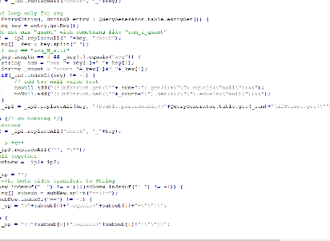
Environment
Windows 10 Pro 64 bit
PostgresSQL 11
.
JDBC Driver Ver 42.2.5
JDK 12.0.1

Slide 8
Limitation
Where clause is not supported.
Standard SQL input is not supported.
Result in table is not sorted.
Null values are not omitted.

Slide 9
Summary
Our main aim is to produce an efficient algorithm for query processing.
Such that clause help us to write complex SQL queries in a succinct
manner that help query processing system to efficiently evaluate such queries.
Improvement:
Implement code for handling Where clause.
Take input from console in form of such that query.
Apply optimization.

Slide 10
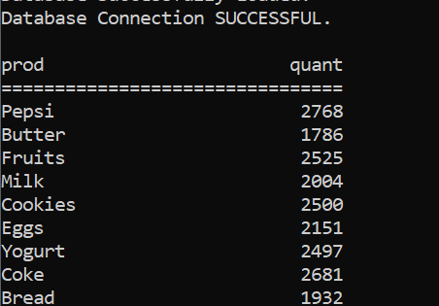

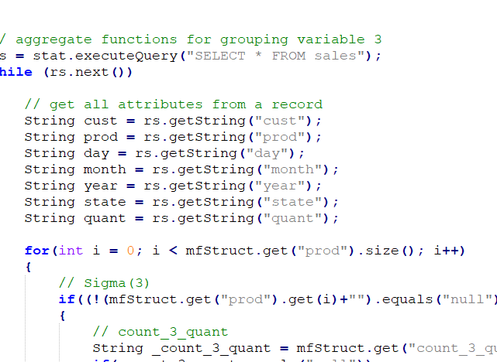
Let's Start the Demo

