Slide 1

StanDrop
BY:
Mukesh S B
Jeet Patel
Sumit Gupta

Slide 2
What is StanDrop?
Standrop is the collection of 2 words stand and drop.
We provide linestanders who stand in line for you.
We provide delivery of domestic items from one location to another.

Slide 3

Website purpose
To digitalize the concept of hiring a tasker to stand in line
To provide service of pickup/drop domestic item to destination
To provide assistantship in handy ineffective yet time consuming household works
To provide a service to get the to-do list set by customers within the timeframe provided

Slide 4
Software requirememts
HTML
CSS
Nodejs
mongoDB
Express server
Ajax
Bootstrap

Slide 5
Target Audience
Busy personnel’s
Teens
Old aged
And obviously me

Slide 6
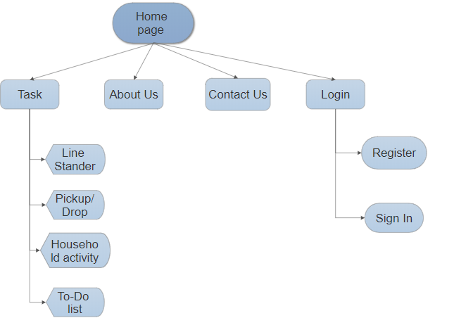
Site map
The above site map is proposed. The site can change during development of the website.
Home Page: Home, About Us, Contact Us, Login, Few Task, Rewards.
Task page: Complete information on each task.

Slide 7
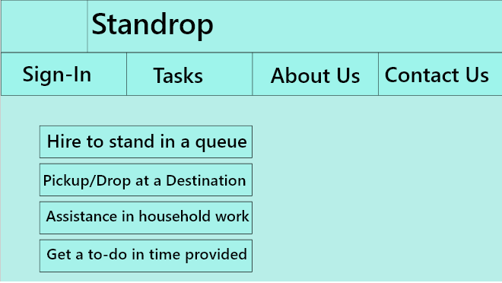
Wire Frame

Slide 8
Engaging influencers
New customers don’t generate nearly the same revenue as repeat customers.
Customer loyalty programs are a way of rewarding your repeat customers and encourage them to stay loyal.
It’s based on a simple principle: spend more to get more.
Every time a customer book a service on your website, they get a certain amount of points depending on the service.
These points can then be redeemed for discounts on future booking.

Slide 9
Time frame and pricing
The line standers price is decided based on time taken by the user to reach the store. The lesser the time higher the price will be.
The price of the pickup/drop service is decided based on distance, More the distance higher will be price.
The price of the household assistant is standard pricing set based on demand per hour.
The price of the To do list calculated by priority and amount of work. If the priority of work is asap, price will be higher than done with a larger timeframe.

Slide 10

Questions

Slide 11

Thanks!

