Slide 1
Problems
Technical Debt:
If a team is working on some new technology, there is high chance most of the people in that team won’t have good grip on that technology. The use “learning by doing” strategy, which is expeted but it impacts the quality of delivery in early phases(first 2-3 sprints).
Technical Knowledge Sharing:
There are many people with technical expertise, but people can’t reach out to them because they don’t know them.
Mentoring:
There are people who wants to mentor but some time they don’t get the opportunity within the team.

Slide 2
Objective
Catalyst Team:
Identify team members who has technical expertise and create a team who wants to volunteer.
The team will get Involved with the project team in their early phases to –
Provide Training
Setup the best practices
Review their progress
Once done they will move on to a new project.
Knowledge Sharing Platform:
Tech Talks:
Creating a platform where people can share their technical expertise. The actual challenges they have faced during the project execution.
Forum:
Having a forum where people can post their queries and get help like stack overflow.

Slide 3




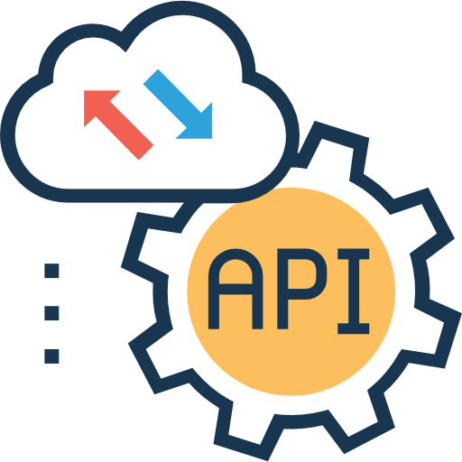

Framework
Access to Learning Resource
Recognition
Budget Allocation for R&D
Cloud Team
Data and Analytics
AI and ML
Frontend Development
Backend Development
Low Code No Code
Team Member 1
Team Member 1
Team Member 1
Team Member 1
Team Member 1
Team Member 1
Team Member 2
Team Member 2
Team Member 2
Team Member 3
Team Member 2
Team Member 4

