Slide 1




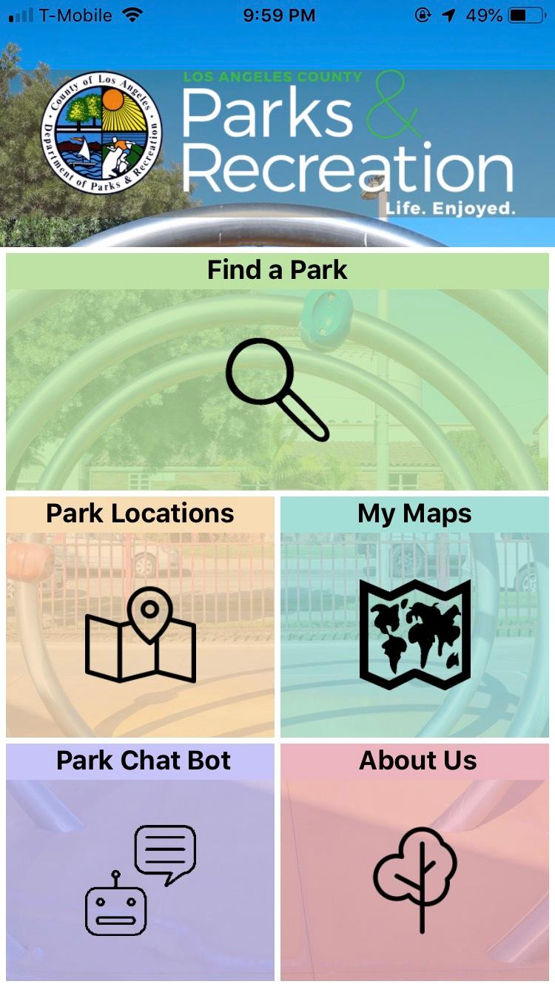
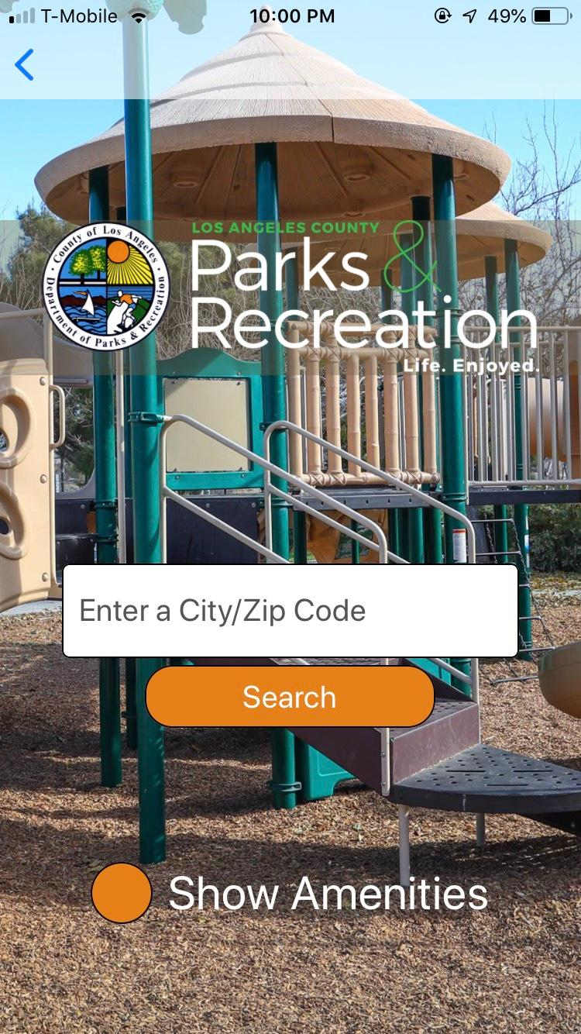
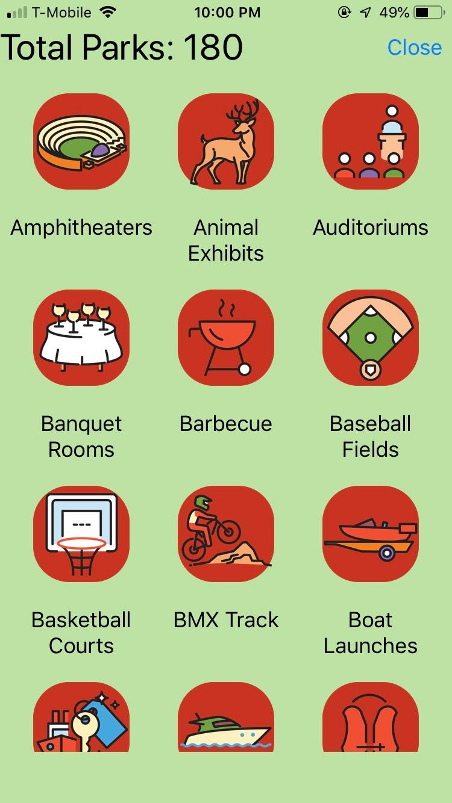

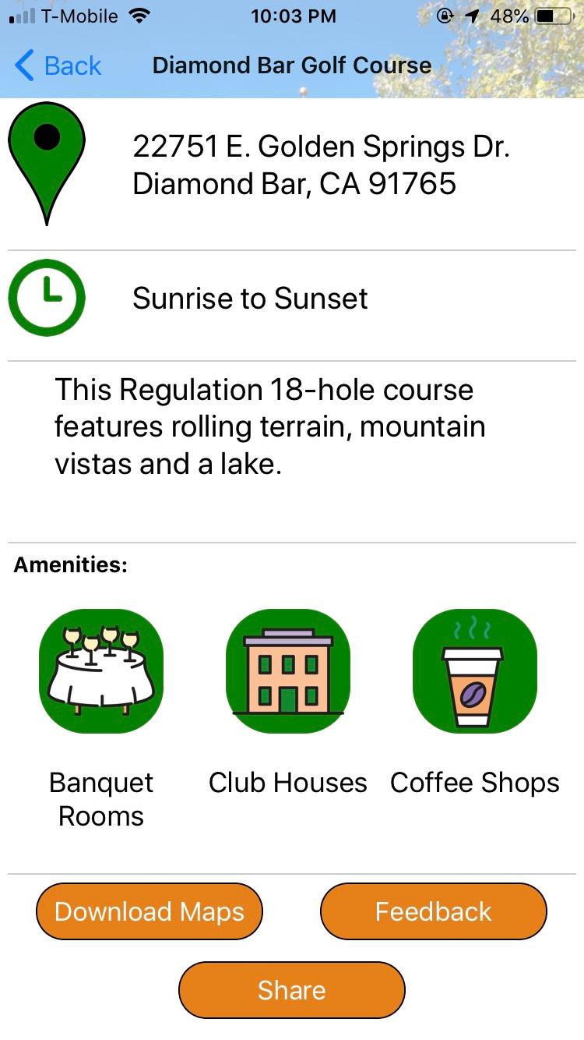
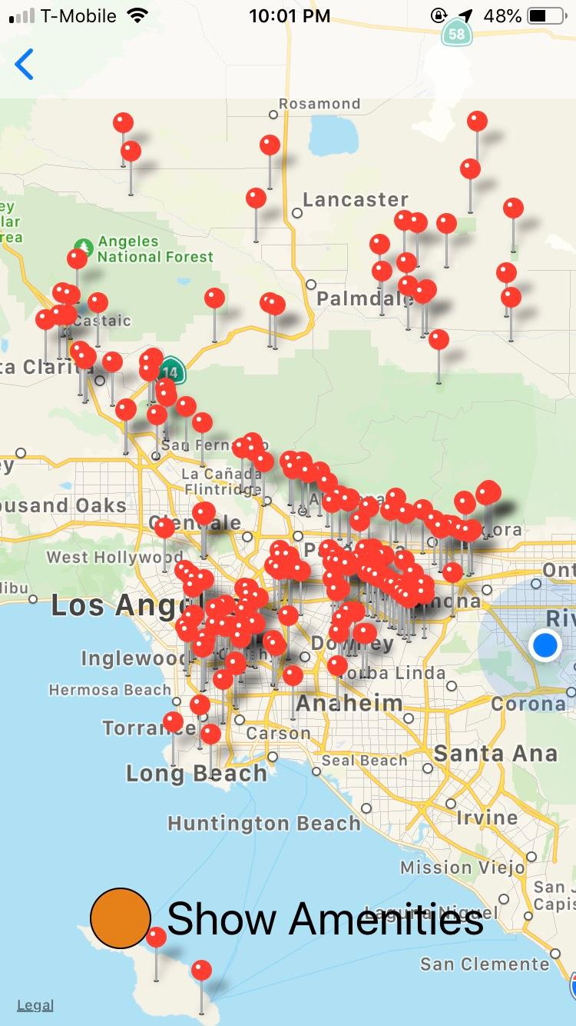




Parks & Recreations Mobile App
Team Members: Narciso Ramirez, Abel Salinas, Jarly Arciniega,
Luis Tejada, Sudarshan Guttula
Faculty Advisors: Dr. Russ Abbott, Dr. Jungsoo (Sue) Lim
County of Los Angeles, Department of Parks & Recreations
Liaison: Ashwini Padukone
Department of Computer Science
College of Engineering, Computer Science, and Technology
California State University, Los Angeles
Background:
Difficulty of finding and locating the various park nearby a users’ current location
Database and search engine that will compress the users’ difficulty
Filter searched parks with different features associated with each park
Objective:
Allow users a more sophisticated way of searching for parks nearby ranging from their precise location or by city/zip code
Allow users to select amenities and filter out their uninterested parks
Allow users to view important information about the specific park
Mobile Application
Home Page
Find a Park
Select Amenities
Selected Park
Park Locations
Conclusion:
This year round project has given us a real world experience with the County and have acquired professional working skills while working in that environment. This app increases the population of users to visit parks around the LA County because it is simple, efficient and professional.
Notes:
Have students check that the logo is the appropriate one to use.

