Slide 2
TO CREATE A DATABASE
CREATE DATABASE STUDENTMANAGEMENT;
USE DATABSE FOR FUTURE QUERIES:
USE STUDENTMANAGEMENT;

Slide 3
TO CREATE A TABLE
CREATE TABLE STUDENTINFO ( ROLLNO INT NOT NULL, STUDENTNAME VARCHAR(30), EMAIL VARCHAR(30), GRADE FLOAT, DOB DATE, STUDENTADDRESS VARCHAR(100), PRIMARY KEY(ROLLNO) );

Slide 4
INSERT INTO TABLE
INSERT INTO STUDENTINFO VALUES(11,'PALLAVI','PALLAVI@GMAIL.COM',88,'12-12-2000','BEL ROAD')
INSERT INTO STUDENTINFO VALUES(12,'VARSHITH','VARSHITH@GMAIL.COM',89,'2000-12-17','JPNAGAR')
SELECT * FROM STUDENTINFO;
INSERTING INTO SPECIFIC COLUMNS INSERT INTO STUDENTINFO(ROLLNO,STUDENTNAME,EMAIL,GRADE) VALUES(14,'SESHA','SESHA@GMAIL.COM',91)

Slide 5
INSERT INTO STUDENTINFO VALUES(15,'VISHAL','VISHAL@GMAIL.COM',88,'1999-11-12','ABC NAGAR')
INSERT INTO STUDENTINFO VALUES(16,'MURUGAN','MURUGAN@GMAIL.COM',82,'1999-8-8','XYZ NAGAR')
INSERT INTO STUDENTINFO VALUES(17,'AJAY','AJAY@GMAIL.COM',71,'1999-11-18','ABC NAGAR')
INSERT INTO STUDENTINFO VALUES(18,'KUSUM','KUSUM@GMAIL.COM',78,'1999-6-22','MNO NAGAR')
INSERT INTO STUDENTINFO VALUES(19,'NAGESHWAR','NAGESHWAR@GMAIL.COM',75,'1999-9-8','QRS NAGAR')
INSERT INTO STUDENTINFO VALUES(20,'NAGESH','NAGESH@GMAIL.COM',89,'1999-7-25','DEF NAGAR')

Slide 6
ROLLNO STUDENTNAME EMAIL GRADE DOB STUDENTADDRESS
11 PALLAVI PALLAVI@GMAIL.COM 88 2000-12-12 BEL ROAD
12 VARSHITH VARSHITH@GMAIL.COM 89 2000-12-17 JPNAGAR
13 VINOD VINOD@GMAIL.COM 88 2000-11-22 BEL ROAD
14 SESHA SESHA@GMAIL.COM 91 NULL NULL
15 VISHAL VISHAL@GMAIL.COM 88 1999-11-12 ABC NAGAR
16 MURUGAN MURUGAN@GMAIL.COM 82 1999-08-08 XYZ NAGAR
17 AJAY AJAY@GMAIL.COM 71 1999-11-18 ABC NAGAR
18 KUSUM KUSUM@GMAIL.COM 78 1999-06-22 MNO NAGAR
19 NAGESHWAR NAGESHWAR@GMAIL.COM 75 1999-09-08 QRS NAGAR
20 NAGESH NAGESH@GMAIL.COM 89 1999-07-25 DEF NAGAR

Slide 7
--COUNT THE ENTRIES WHO SCORED ABOVE 80 SELECT COUNT(*) FROM STUDENTINFO WHERE GRADE>80
(No column name)
7
--ALIASINGNAME
SELECT COUNT(*) AS RECORDS FROM STUDENTINFO WHERE GRADE>80
RECORDS
7

Slide 8
--SUM OF GRADES OF ALL STUDENTS SELECT SUM(GRADE) FROM STUDENTINFO;
--SUM OF GRADES OF ALL STUDENTS > 85
SELECT SUM(GRADE) FROM STUDENTINFO WHERE GRADE>85;
--AVG OF GRADES OF ALL STUDENTS SELECT AVG(GRADE) AS ALLSTUDENTS FROM STUDENTINFO; SELECT AVG(GRADE) AS STUDENTS85 FROM STUDENTINFO WHERE GRADE>85;

Slide 9
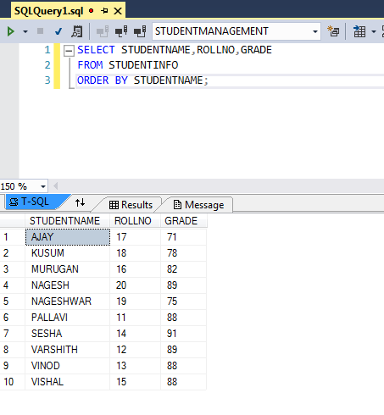

Slide 10
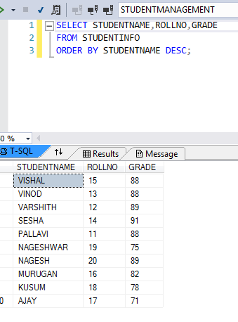

Slide 11
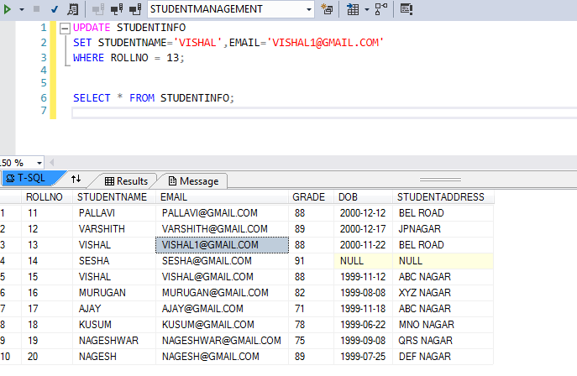
UPDATE

Slide 12
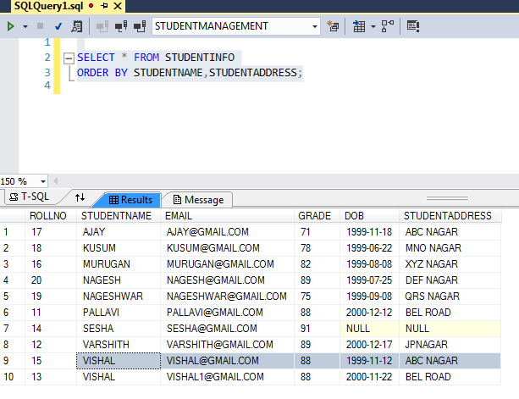

Slide 13
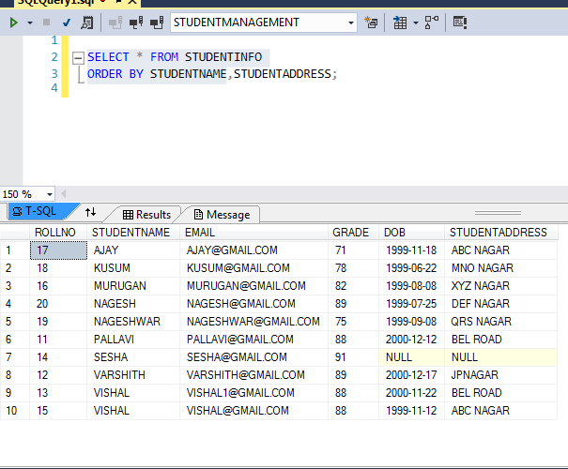

Slide 14
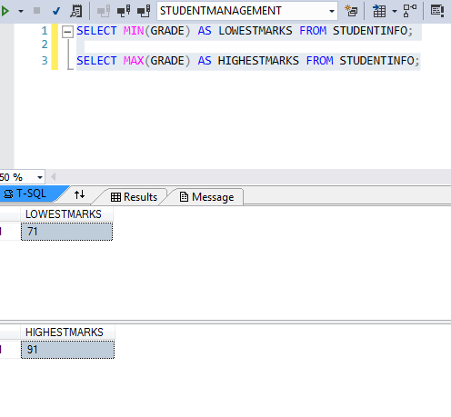

Slide 15
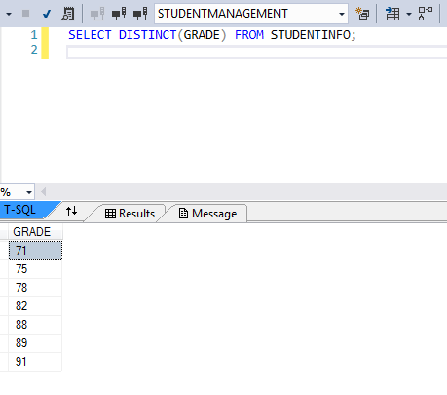
DISTINCT

Slide 16
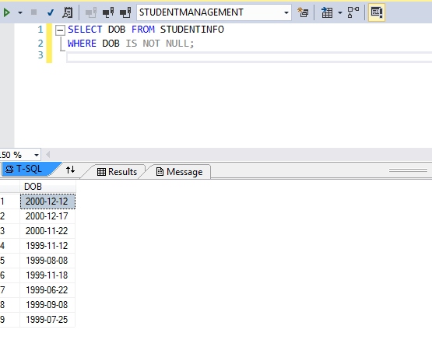

Slide 17
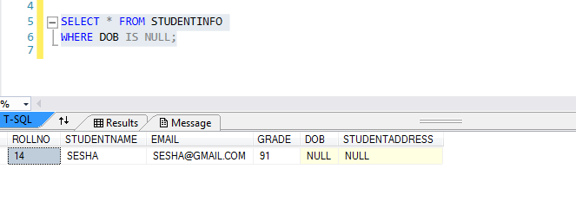
NULL

Slide 18
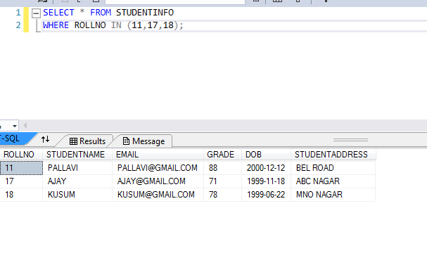
IN

Slide 19
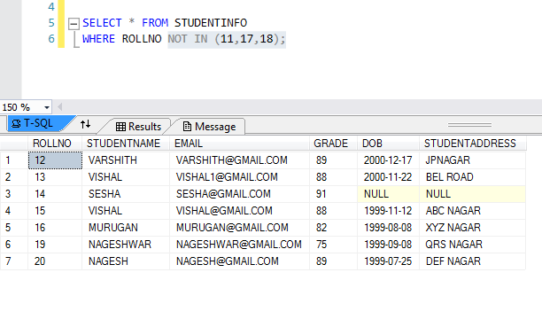
NOT IN

Slide 20
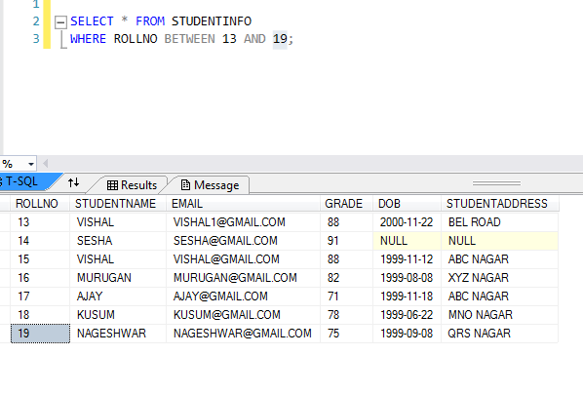
BETWEEN

Slide 21
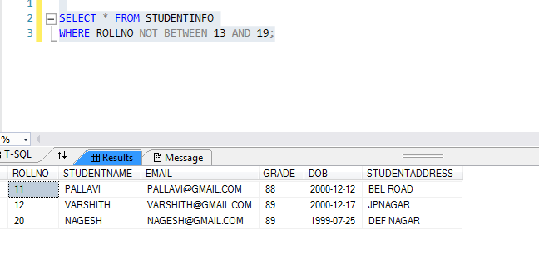
NOT BETWEEN

Slide 22
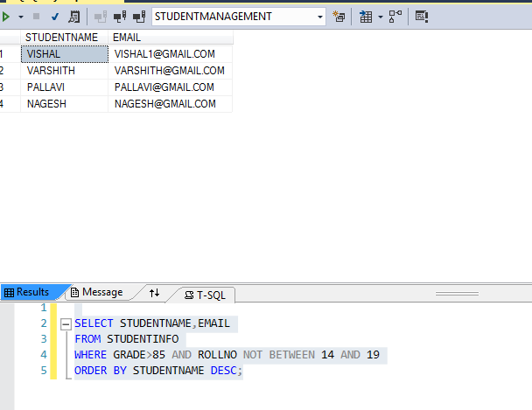

Slide 23
PRODUCTS
PID
PNAME
PRICE
CID
CATEGORIES
CID
CNAME
CDESCRIPTION
ORDERS
ORDERID
CUSTID
PID
QUANTITY
CUSTOMERS
CUSTID
CUSTNAME
EMAIL
ORDERID

Slide 24
ALTER
CREATE TABLE EXAMPLES
( EXAMPLEID INT,
EXAMPLENAME VARCHAR(30),
EXAMPLEFEES FLOAT );
--WE ADDED NOT NULL CONSTRAINT
ALTER TABLE EXAMPLES ALTER COLUMN EXAMPLEID INT NOT NULL;
--WE CHANGED VARCHAR(30) TO VARCHAR(50)
ALTER TABLE EXAMPLES ALTER COLUMN EXAMPLENAME VARCHAR(50);

Slide 25
UNIQUE KEY
--ADD EXAMPLEINDEX COLUMN
ALTER TABLE EXAMPLES ADD EXAMPLEINDEX INT; ALTER TABLE EXAMPLES ADD CONSTRAINT UNIQUEINDEX UNIQUE(EXAMPLEINDEX)
INSERT INTO EXAMPLES VALUES(11,'AAA',44,1);
INSERT INTO EXAMPLES VALUES(11,'AAA',44,2);
INSERT INTO EXAMPLES VALUES(11,'AAA',44,3);
SELECT * FROM EXAMPLES;

Slide 26
PRIMARY KEY CONSTRAINT
--ADD PRIMARY (MAKE SURE EXAMPLEID HAS UNIQUE VALUES
ALTER TABLE EXAMPLES ADD PRIMARY KEY(EXAMPLEID)
SELECT * FROM EXAMPLES;

Slide 27
rename
--rename the column name exec sp_rename 'EXAMPLES.EXAMPLEINDEX','INDEXEXAMPLE','COLUMN';

