Slide 1
Ado .net

Slide 2
intro
ADO stands for ActiveX Data Object
Provides access to the data sources
Endow multiple providers for different databases
Root classes are found in System.Data
Xml integration is provided by System.Xml

Slide 3
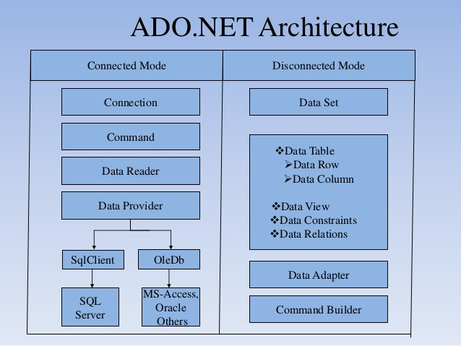

Slide 4
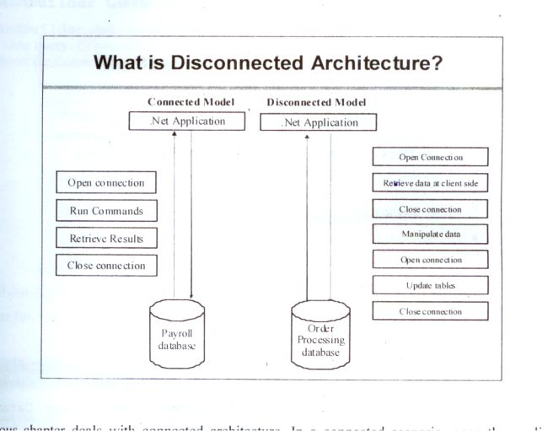

Slide 5
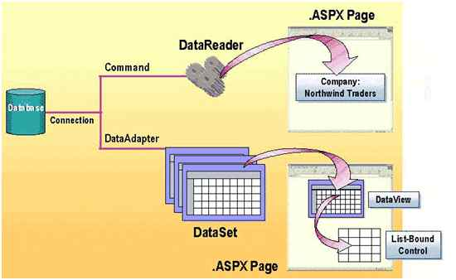

Slide 6
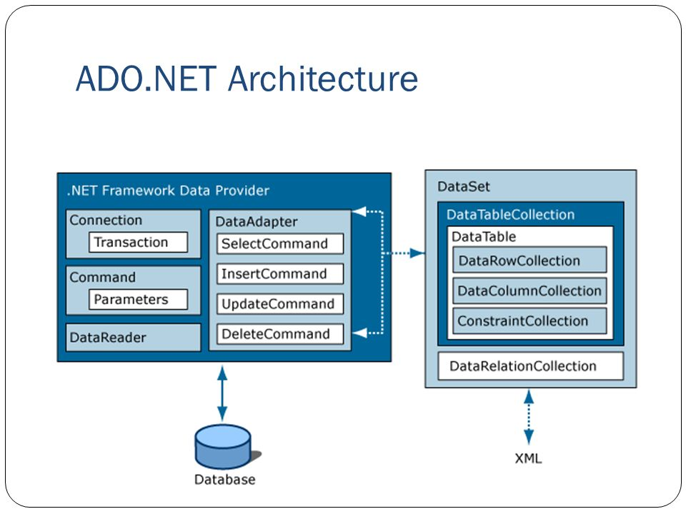

Slide 7
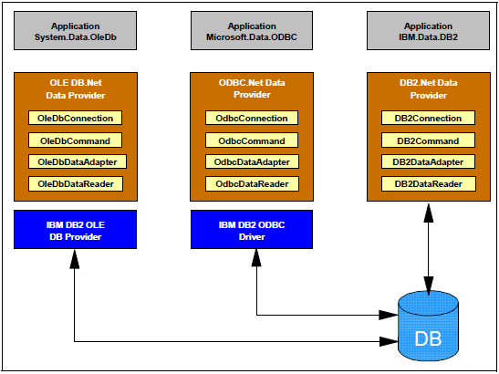
Different connectors

Slide 8
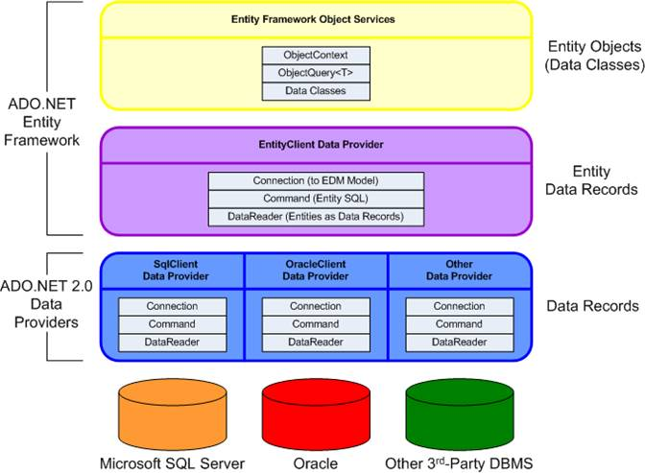

Slide 9
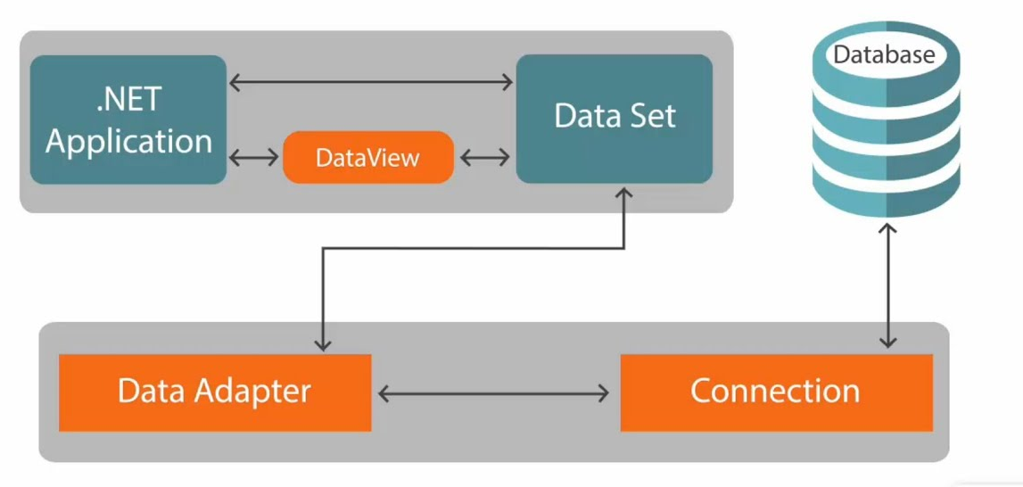
Disconnected architecture

Slide 10
Disconnected data
Is the storage and management of data without connection.
Data is stored in client’s machine
System.Data provides the required classes
DataTable, DataColumn, DataRow are few common classes
Data is stored in tabular format only

Slide 11
The ADO.NET Framework supports two models of Data Access Architecture, Connection Oriented Data Access Architecture and Disconnected Data Access Architecture. The ADO.NET Disconnected Data Access Architecture far more flexible and powerful than ADOs Connection Oriented Data Access.
In Connection Oriented Data Access Architecture the application makes a connection to the Data Source and then interact with it through SQL requests using the same connection. In this case the application stays connected to the database system even when it is not using any Database Operations. On the other hand the disconnected approach makes no attempt to maintain a connection to the data source.
ADO.Net provides a new solution by introduce a new component called Dataset.
The DataSet is the central component in the ADO.NET Disconnected Data Access Architecture.
A DataSet is an in-memory data store that can hold multiple tables at the same time.
DataSets only hold data and do not interact with a Data Source.
One of the key characteristics of the DataSet is that it has no knowledge of the underlying Data Source that might have been used to populate it.

Slide 12
Will create datatable
Create a windows - application.
Drag and drop data grid over the form

Slide 13
using System;
using System.Data;
using System.Windows.Forms;
namespace Ado_net1
{
public partial class Form1 : Form
{
DataTable dt;
DataColumn dc;
DataRow dr;
DataTable GetStudentDetails()
{
dt = new DataTable("Students");
//#region directive in C#? It lets you specify a block of code that you can expand or collapse when using the outlining feature of the Visual Studio Code Editor. It should be terminated with #endregion.

Slide 14
#region Students DataTable
dc = new DataColumn("RollNumber",typeof(int));
dt.Columns.Add(dc);
dt.PrimaryKey = new DataColumn[] { dc };
dc = new DataColumn("FullName", typeof(string));
dt.Columns.Add(dc);
dc = new DataColumn("Subject", typeof(string));
dt.Columns.Add(dc);
dc = new DataColumn("Fees", typeof(float));
dt.Columns.Add(dc);
dc = new DataColumn("DeptId", typeof(int));
dt.Columns.Add(dc);

Slide 15
//Populate data in each row
dr = dt.NewRow();
dr[0] = 111;
dr[1] = "Shilpa Vaidya";
dr[2] = "Dot Net";
dr[3] = 35000;
dr[4] = 301;
//add row to the data table
dt.Rows.Add(dr);
dr = dt.NewRow();
dr[0] = 222;
dr[1] = "Shreya Rai";
dr[2] = "Python";
dr[3] = 20000;
dr[4] = 302

Slide 16
//add row to the data table
dt.Rows.Add(dr);
dr = dt.NewRow();
dr["RollNumber"] = 333;
dr["FullName"] = "Yash P";
dr["Subject"] = "Robotics";
dr["Fees"] = 37000;
dr["DeptId"] = 301;
//add row to the data table
dt.Rows.Add(dr);
#endregion
return dt;
}

Slide 17
public Form1()
{
InitializeComponent();
}
private void Form1_Load(object sender, EventArgs e)
{
DataTable stu = GetStudentDetails();
dataGridView1.DataSource = stu;
}
}
}

Slide 18
dataset
Is a collection of data tables
Data adapters get the data from database and fill the
dataset
Relationships can be maintained
Can synchronise the database

Slide 19
DataTable GetDepttDetails()
{
dt = new DataTable("Department");
//#region directive in C#? It lets you specify a block of code that you can expand or collapse when using the outlining feature of the Visual Studio Code Editor. It should be terminated with #endregion.
#region Department DataTable
dc = new DataColumn("DeptId", typeof(int));
dt.Columns.Add(dc);
dt.PrimaryKey = new DataColumn[] { dc };
dc = new DataColumn("DepartmentName", typeof(string));
dt.Columns.Add(dc);
//Populate data in each row
dr = dt.NewRow();
dr[0] = 300;
dr[1] = "CSE";
//add row to the data table
dt.Rows.Add(dr);

Slide 20
dr = dt.NewRow();
dr[0] = 301;
dr[1] = "ISE";
//add row to the data table
dt.Rows.Add(dr);
dr = dt.NewRow();
dr[0] = 302;
dr[1] = "ECE";
//add row to the data table
dt.Rows.Add(dr);
#endregion
return dt;
}

Slide 21
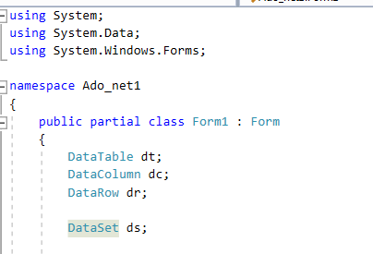
Add this line and block createdataset
DataSet CreateDataset()
{
DataTable stu = GetStudentDetails();
DataTable dep = GetDepttDetails();
ds = new DataSet("Mydataset");
ds.Tables.Add(stu); //like the columns we have index associated here 0 is index
ds.Tables.Add(dep); //1 index
//ds.Tables[1].Columns[0]
DataColumn colPrimKey = ds.Tables["Department"].Columns["DeptId"];
DataColumn colForeignkey = ds.Tables["Students"].Columns["DeptId"];
DataRelation depsturel = new DataRelation("Student_Department", colPrimKey, colForeignkey);
ds.Relations.Add(depsturel);
return ds;
}

Slide 22
private void Form1_Load(object sender, EventArgs e)
{
DataSet dataset = CreateDataset();
//or dataset.Tables["Students"];
dataGridView1.DataSource = dataset.Tables[0];
dataGridView2.DataSource = dataset.Tables[1];
}

Slide 23
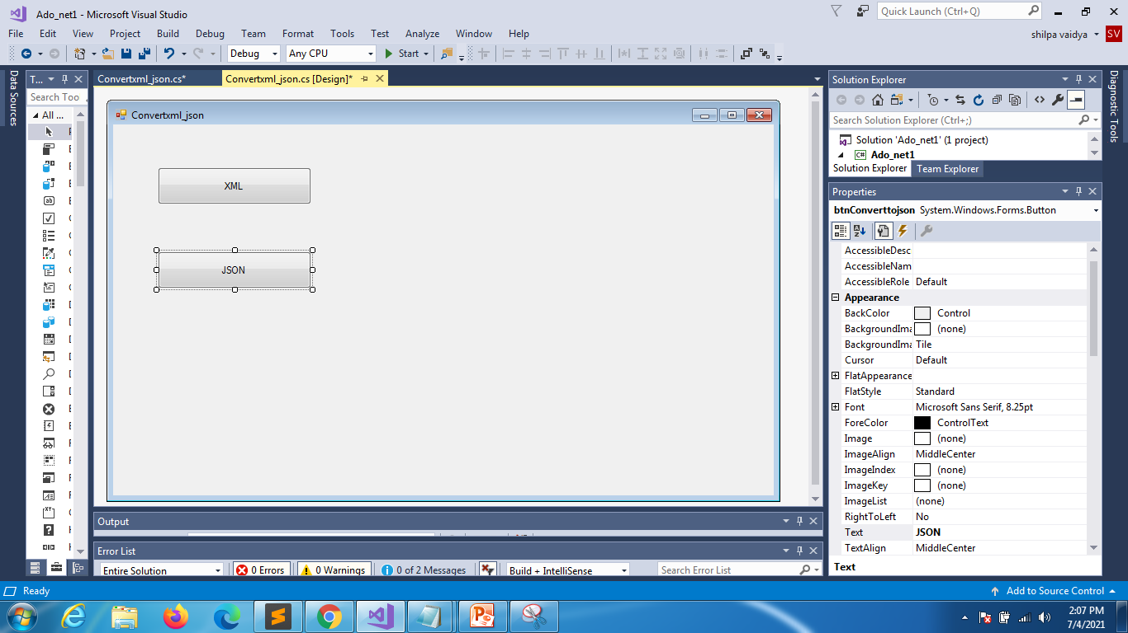
SERIALIZATION
CONVERT TO
XML
JSON

Slide 24
For xml
private void button1_Click(object sender, EventArgs e)
{
DataTable emp = GetStudentDetails();
emp.WriteXml("E:\\MyStudentdetails.xml");
}

Slide 25
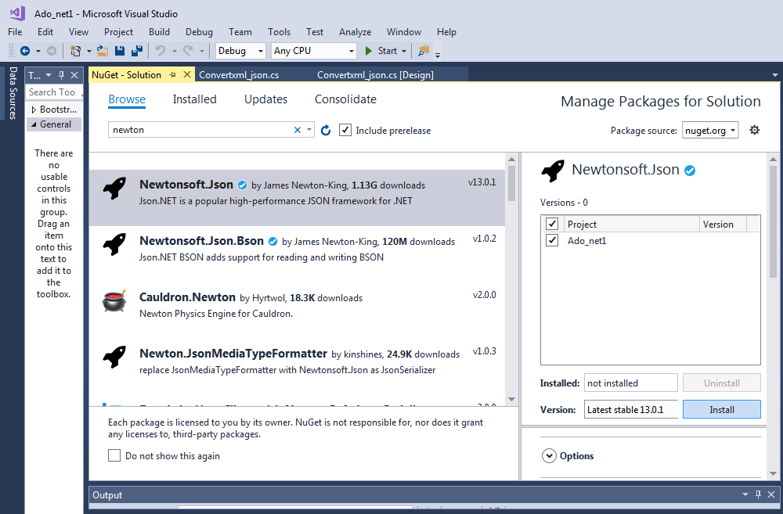
For json
install

Slide 26
private void btnConverttojson_Click(object sender, EventArgs e)
{
DataTable emp = GetStudentDetails();
string json = JsonConvert.SerializeObject(emp);
StreamWriter ob = File.CreateText(@"E:\jsonformat.json");
ob.WriteLine(json);
ob.Close();
}

Slide 27
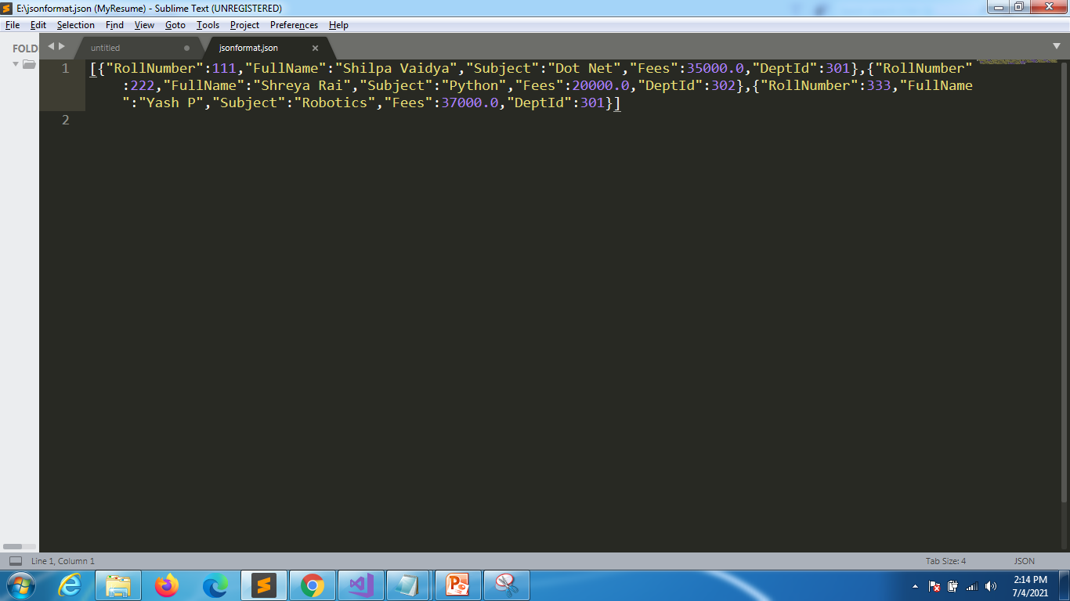
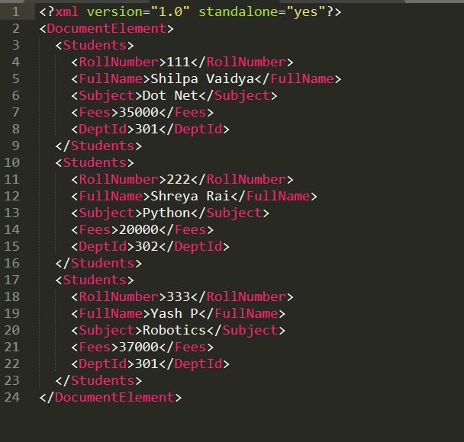
JSON
XML

Slide 28
CONNECTED ARCHITECHTURE
Constructors | Description
SqlConnection() | It is used to initializes a new instance of the SqlConnection class.
SqlConnection(String)0 | It is used to initialize a new instance of the SqlConnection class and takes connection string as an argument.
SqlConnection(String, SqlCredential) | It is used to initialize a new instance of the SqlConnection class that takes two parameters. First is connection string and second is sql credentials.

Slide 29
BeginTransaction()
It is used to start a database transaction.
ChangeDatabase(String)
It is used to change the current database for an open SqlConnection.
ChangePassword(String, String)
It changes the SQL Server password for the user indicated in the connection string.
Close()
It is used to close the connection to the database.
CreateCommand()
It enlists in the specified transaction as a distributed transaction.
GetSchema()
It returns schema information for the data source of this SqlConnection.
Open()
It is used to open a database connection.
ResetStatistics()
It resets all values if statistics gathering is enabled.

Slide 30
Connection class establishes the database connection
Command class executes the command against connection
DataReader reads data one by one from the database in
forward only manner
DataAdaptor behaves as a bridge between connected and
disconnected architecture

