Slide 1
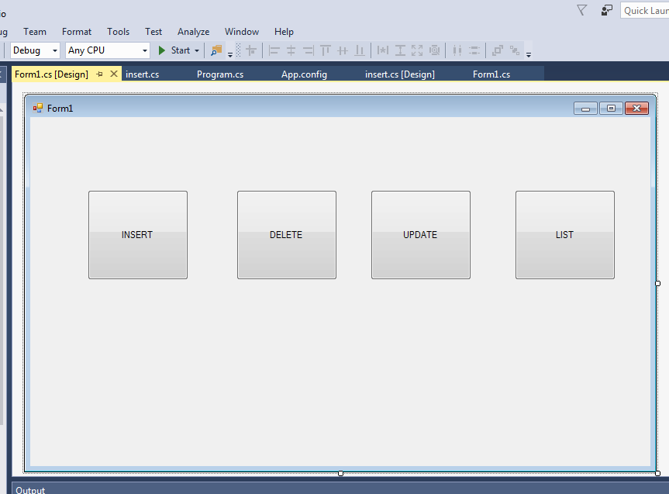

Slide 2
using System;
using System.Data;
using System.Data.SqlClient;
using System.Windows.Forms;
namespace Connectionbased
{
public partial class Form1 : Form
{
public Form1()
{
InitializeComponent();
}
private void Form1_Load(object sender, EventArgs e)
{
}
//insert
private void button1_Click(object sender, EventArgs e)
{
insert ob = new insert();
ob.Show();
this.Hide();
}
}
}

Slide 3
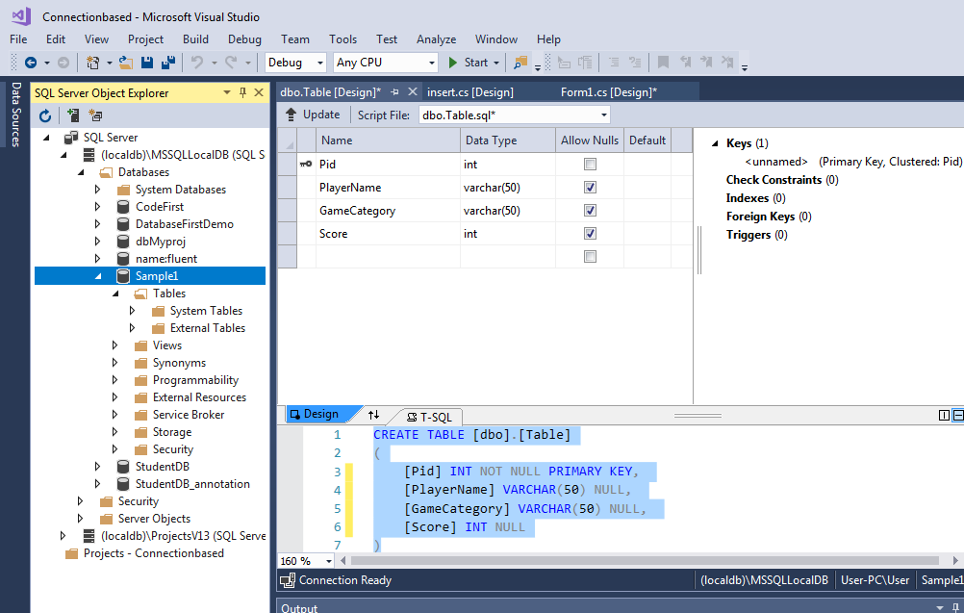
Create database and table

Slide 4
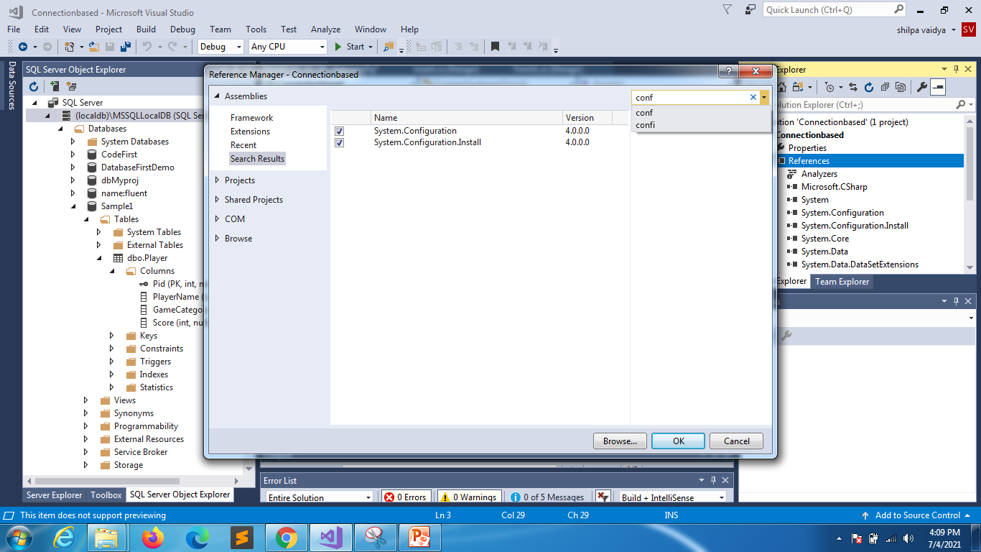
Add configuration

Slide 5
Appconfig file
<?xml version="1.0" encoding="utf-8" ?>
<configuration>
<startup>
<supportedRuntime version="v4.0" sku=".NETFramework,Version=v4.6.1" />
</startup>
<connectionstrings>
<add name="players" connectionstring="Data Source=(localdb)\MSSQLLocalDB;Initial Catalog=Sample1;Integrated Security=True;Connect Timeout=30;Encrypt=False;TrustServerCertificate=False;ApplicationIntent=ReadWrite;MultiSubnetFailover=False" providername="System.Data.SqlClient"></add>
</connectionstrings>
</configuration>

Slide 6
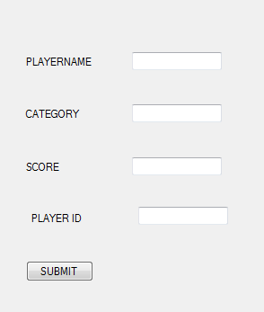

Slide 7
using System;
using System.Data;
using System.Data.SqlClient;
using System.Configuration;
using System.Windows.Forms;
namespace Connectionbased
{
public partial class insert : Form
{
SqlConnection conn;
public insert()
{
InitializeComponent();
conn = new SqlConnection(ConfigurationManager.ConnectionStrings["mydb"].ConnectionString);
}

Slide 8
public void setid()
{
try
{
string query = "Select max(Pid)+1 from Player";
SqlCommand command = new SqlCommand(query,conn);
conn.Open();
string id = command.ExecuteScalar().ToString();
conn.Close();
textBox4.Text = id;
}
catch
{
MessageBox.Show("Couldnt connect");
}
}

Slide 9
private void button1_Click(object sender, EventArgs e)
{
try
{
string playername, category, score,pid;
playername = textBox1.Text;
category = textBox2.Text;
score = textBox3.Text;
pid = textBox4.Text;
string query = "insert into Player values("+pid+",'"+playername+"','" + category + "'," +score + ")";
MessageBox.Show(query);
conn.Open();
SqlCommand cmd= new SqlCommand(query,conn);
cmd.ExecuteNonQuery();
MessageBox.Show("INSERTED SUCCESSFULLY");
conn.Close();
this.Close();
Form1 ob = new Form1();
ob.Show();
}
catch(Exception ob)
{
MessageBox.Show("Data couldnt be inserted");
}
}

Slide 10
private void insert_Load(object sender, EventArgs e)
{
setid();
}
private void button2_Click(object sender, EventArgs e)
{
textBox1.Text = "";
textBox2.Text = "";
textBox3.Text = "";
textBox4.Text = "";
}
}
}

