Slide 1
Csharp basics
Theory/interview/mcq purpose

Slide 2
.NET FRAMEWORK
It is used to develop applications for web, Windows, phone. Moreover, it provides a broad range of functionalities and support.
This framework contains a large number of class libraries known as Framework Class Library (FCL). The software programs written in .NET are executed in the execution environment, which is called CLR (Common Language Runtime). These are the core and essential parts of the .NET framework.
This framework provides various services like memory management, networking, security, memory management, and type-safety.
The .Net Framework supports more than 60 programming languages such as C#, F#, VB.NET, J#, VC++, JScript.NET, APL, COBOL, Perl, Oberon, ML, Pascal, Eiffel, Smalltalk, Python, Cobra, ADA, et

Slide 3
The .NET Framework (4 main components):
Common Language Runtime (CLR)
Framework Class Library (FCL),
Core Languages (WinForms, ASP.NET, and ADO.NET), and
Other Modules (WCF, WPF, WF, Card Space, LINQ, Entity Framework, Parallel LINQ, Task Parallel Library, etc.)

Slide 4
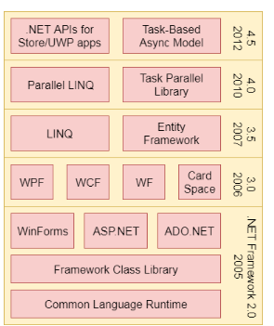
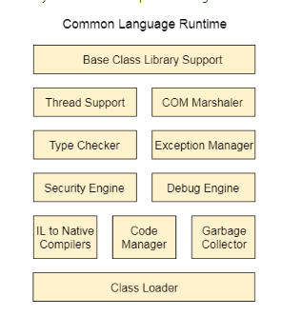
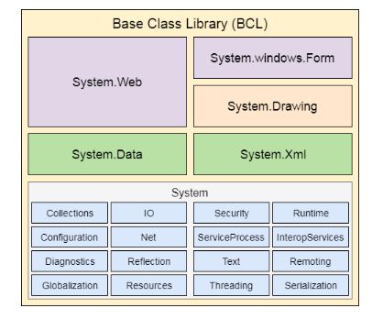
EVOLUTION

Slide 5
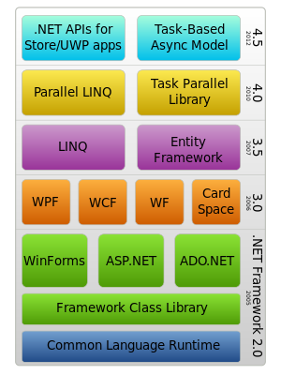
.NET FRAMEWORK

Slide 6
WinForms
Windows Forms is a smart client technology for the .NET Framework, a set of managed libraries that simplify common application tasks such as reading and writing to the file system.
ASP.NET
ASP.NET is a web framework designed and developed by Microsoft. It is used to develop websites, web applications, and web services. It provides a fantastic integration of HTML, CSS, and JavaScript. It was first released in January 2002.
ADO.NET
ADO.NET is a module of .Net Framework, which is used to establish a connection between application and data sources. Data sources can be such as SQL Server and XML. ADO .NET consists of classes that can be used to connect, retrieve, insert, and delete data.
WPF (Windows Presentation Foundation)
Windows Presentation Foundation (WPF) is a graphical subsystem by Microsoft for rendering user interfaces in Windows-based applications. WPF, previously known as "Avalon", was initially released as part of .NET Framework 3.0 in 2006. WPF uses DirectX.

Slide 7
WCF (Windows Communication Foundation)
It is a framework for building service-oriented applications. Using WCF, you can send data as asynchronous messages from one service endpoint to another.WF (Workflow Foundation)
Windows Workflow Foundation (WF) is a Microsoft technology that provides an API, an in-process workflow engine, and a rehostable designer to implement long-running processes as workflows within .NET applications.
LINQ (Language Integrated Query)
It is a query language, introduced in .NET 3.5 framework. It is used to make the query for data sources with C# or Visual Basics programming languages.
Entity Framework
It is an ORM based open source framework which is used to work with a database using .NET objects. It eliminates a lot of developers effort to handle the database. It is Microsoft's recommended technology to deal with the database.
Parallel LINQ
Parallel LINQ or PLINQ is a parallel implementation of LINQ to objects. It combines the simplicity and readability of LINQ and provides the power of parallel programming.
It can improve and provide fast speed to execute the LINQ query by using all available computer capabilities.
Apart from the above features and libraries, .NET includes other APIs and Model to improve and enhance the .NET framework.
In 2015, Task parallel and Task parallel libraries were added. In .NET 4.5, a task-based asynchronous model was added.

Slide 8
NET Common Language Runtime (CLR)
It converts the program into native code.
Handles Exceptions
Provides type-safety
Memory management
Provides security
Improved performance
Language independent
Platform independent
Garbage collection
Provides language features such as inheritance, interfaces, and overloading for object-oriented programming.

Slide 9
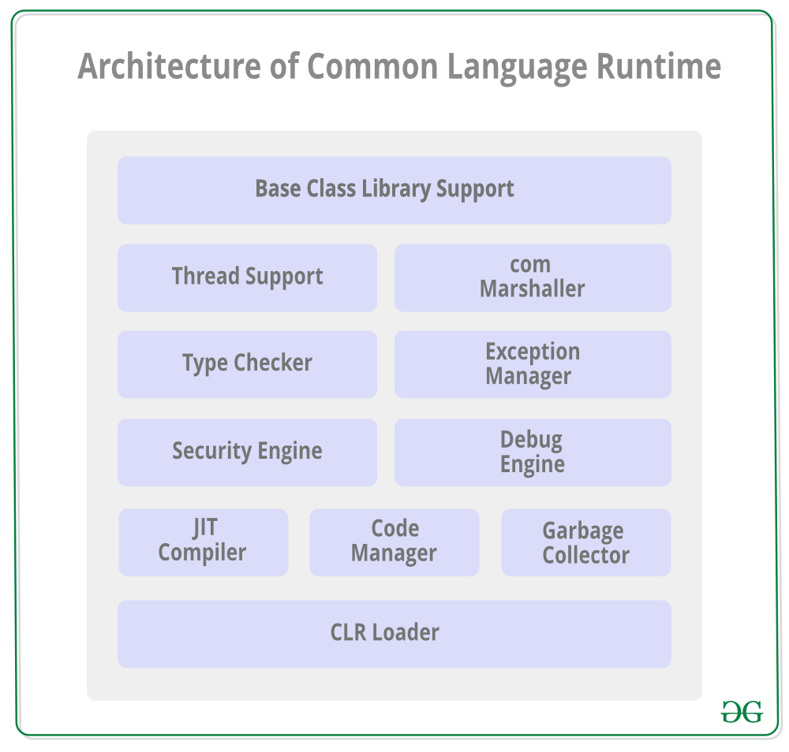
CLR
It is a program execution engine that loads and executes the program. It converts the program into native code. It acts as an interface between the framework and operating system. It does exception handling, memory management, and garbage collection. Moreover, it provides security, type-safety, interoperability, and portablility. A list of CLR components are given below:

Slide 10
Base Class Library Support
SQL CREATE TABLE
It is a class library that provides support of classes to the .NET application.
Thread Support
It manages the parallel execution of the multi-threaded application.
COM Marshaler
It provides communication between the COM objects and the application.
Type Checker
It checks types used in the application and verifies that they match to the standards provided by the CLR.
Code Manager
It manages code at execution run-time.
Garbage Collector
It releases the unused memory and allocates it to a new application.
Exception Handler
It handles the exception at runtime to avoid application failure.
ClassLoader
It is used to load all classes at run time.

Slide 11
.NET Framework Class Library
.NET Framework Class Library is the collection of classes, namespaces, interfaces and value types that are used for .NET applications.
It contains thousands of classes that supports the following functions.
Base and user-defined data types
Support for exceptions handling
input/output and stream operations
Communications with the underlying system
Access to data
Ability to create Windows-based GUI applications
Ability to create web-client and server applications
Support for creating web services

Slide 12
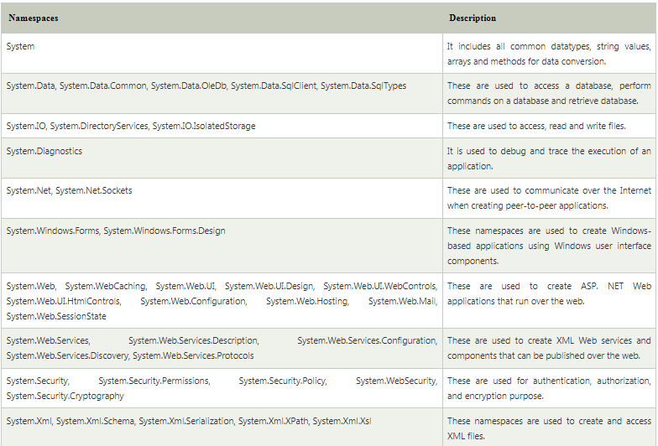
.NET Framework Class Library Namespaces

Slide 13
.NET Framework Class Library Namespaces

Slide 14
C#
Window applications
Web applications
Distributed applications
Web service applications
Database applications etc.

Slide 15
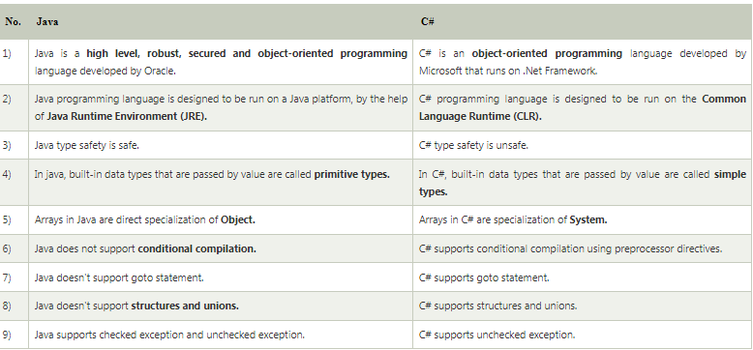
JAVA VS CSHARP

Slide 16
C# Features
1) Simple
C# is a simple language in the sense that it provides structured approach (to break the problem into parts), rich set of library functions, data types etc.
2) Modern Programming Language
C# programming is based upon the current trend and it is very powerful and simple for building scalable, interoperable and robust applications.
3) Object Oriented
C# is object oriented programming language. OOPs makes development and maintenance easier where as in Procedure-oriented programming language it is not easy to manage if code grows as project size grow.
4) Type Safe
C# type safe code can only access the memory location that it has permission to execute. Therefore it improves a security of the program.
5) Interoperability
Interoperability process enables the C# programs to do almost anything that a native C++ application can do.
Hello Java Program for Beginners
6) Scalable and Updateable
C# is automatic scalable and updateable programming language. For updating our application we delete the old files and update them with new ones.
7) Component Oriented
C# is component oriented programming language. It is the predominant software development methodology used to develop more robust and highly scalable applications.
8) Structured Programming Language
C# is a structured programming language in the sense that we can break the program into parts using functions. So, it is easy to understand and modify.
9) Rich Library
C# provides a lot of inbuilt functions that makes the development fast.
10) Fast Speed
The compilation and execution time of C# language is fast.

