Slide 1
ADO .NET
BASICS

Slide 2
Introduction
It is a module of .Net Framework which is used to establish connection between application and data sources. Data sources can be such as SQL Server and XML. ADO.NET consists of classes that can be used to connect, retrieve, insert and delete data.
All the ADO.NET classes are located into System.Data.dll and integrated with XML classes located into System.Xml.dll.
ADO.NET has two main components that are used for accessing and manipulating data are the .NET Framework data provider and the DataSet.

Slide 3
.NET Framework Data Providers
These are the components that are designed for data manipulation and fast access to data. It provides various objects such as
Connection,
Command,
DataReader and DataAdapter
that are used to perform database operations. We will have a detailed discussion about Data Providers in new topic.

Slide 4
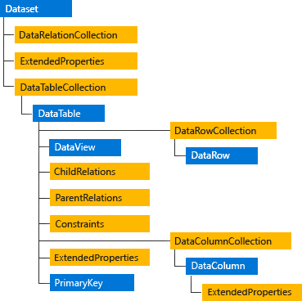
DataSet
It is used to access data independently from any data resource. DataSet contains a collection of one or more DataTable objects of data. The following diagram shows the relationship between .NET Framework data provider and DataSet.

Slide 5
Which one should we use DataReader or DataSet?
We should consider the following points to use DataSet.
It caches data locally at our application, so we can manipulate it.
It interacts with data dynamically such as binding to windows forms control.
It allows performing processing on data without an open connection. It means it can work while connection is disconnected.
If we required some other functionality mentioned above, we can use DataReader to improve performance of our application.
DataReader does not perform in disconnected mode. It requires DataReader object to be connected.

Slide 6
ADO.NET Framework Data Providers
.NET Framework data provider | Description
.NET Framework Data Provider for SQL Server | It provides data access for Microsoft SQL Server. It requires the System.Data.SqlClient namespace.
.NET Framework Data Provider for OLE DB | It is used to connect with OLE DB. It requires the System.Data.OleDb namespace.
.NET Framework Data Provider for ODBC | It is used to connect to data sources by using ODBC. It requires the System.Data.Odbc namespace.
.NET Framework Data Provider for Oracle | It is used for Oracle data sources. It uses the System.Data.OracleClient namespace.
EntityClient Provider | It provides data access for Entity Data Model applications. It requires the System.Data.EntityClient namespace.
.NET Framework Data Provider for SQL Server Compact 4.0. | It provides data access for Microsoft SQL Server Compact 4.0. It requires the System.Data.SqlServerCe namespace.
Data provider is used to connect to the database, execute commands and retrieve the record. It is lightweight component with better performance. It also allows us to place the data into DataSet to use it further in our application.

Slide 7
.NET Framework Data Providers Objects
Object | Description
Connection | It is used to establish a connection to a specific data source.
Command | It is used to execute queries to perform database operations.
DataReader | It is used to read data from data source. The DbDataReader is a base class for all DataReader objects.
DataAdapter | It populates a DataSet and resolves updates with the data source. The base class for all DataAdapter objects is the DbDataAdapter class.

Slide 8
.NET Framework Data Provider for SQL Server
Data provider for SQL Server is a lightweight component. It provides better performance because it directly access SQL Server without any middle connectivity layer. In early versions, it interacts with ODBC layer before connecting to the SQL Server that created performance issues.
The .NET Framework Data Provider for SQL Server classes is located in the System.Data.SqlClient namespace. We can include this namespace in our C# application by using the following syntax.
using System.Data.SqlClient;

Slide 9
.NET Framework Data Provider for SQL Server
Class | Description
SqlConnection | It is used to create SQL Server connection. This class cannot be inherited.
SqlCommand | It is used to execute database queries. This class cannot be inherited.
SqlDataAdapter | It represents a set of data commands and a database connection that are used to fill the DataSet. This class cannot be inherited.
SqlDataReader | It is used to read rows from a SQL Server database. This class cannot be inherited.
SqlException | This class is used to throw SQL exceptions. It throws an exception when an error is occurred. This class cannot be inherited.

Slide 10
. NET Framework Data Provider for Oracle
It is used to connect with Oracle database through Oracle client. The data provider supports Oracle client software version 8.1.7 or a later version. This data provider supports both local and distributed transactions.
Oracle Data Provider classes are located into System.Data.OracleClient namespace. We must use both System.Data.OracleClient and System.data to connect our application with the Oracle database.
using System.Data;
using System.Data.OracleClient;

Slide 11
.NET Framework Data Provider is better
Data Provider | Note
.NET Framework Data Provider for SQL Server | It is good for middle-tier applications, single-tier applications that use Microsoft SQL Server.
.NET Framework Data Provider for OLE DB | It is good for single-tier applications that use Microsoft Access databases.
.NET Framework Data Provider for ODBC | It is good for middle and single-tier applications that use ODBC data sources.
.NET Framework Data Provider for Oracle | It is good for middle and single-tier applications that use Oracle data sources.

Slide 12
Sql server connectivity

Slide 13
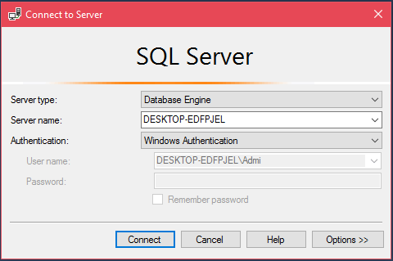
ADO.NET SQL Server Connection
To connect with SQL Server, we must have it installed in our system. We are using Microsoft SQL Server Management Tool to connect with the SQL Server. We can use this tool to handle database. Now, follow the following steps to connect with SQL Server.
Open Microsoft SQL Server Management Tool
It will prompt for database connection. Provide the server name and authentication.
After successful connection, it displays the following window.

Slide 14
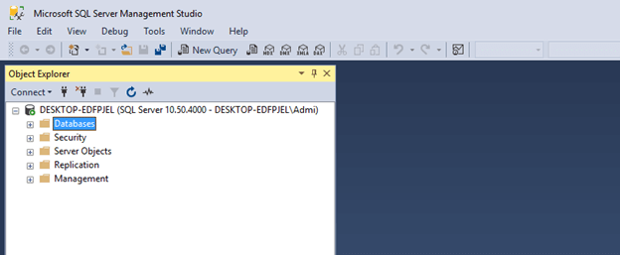
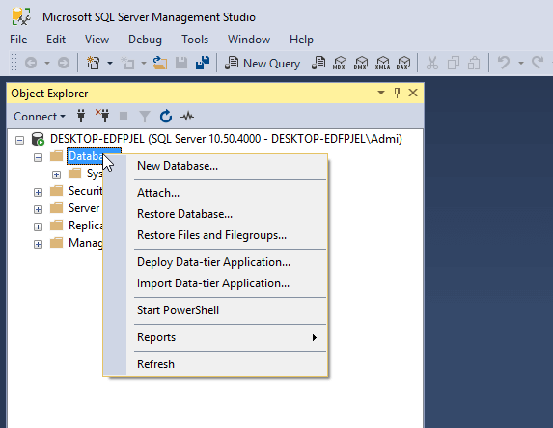
After successful connection, it displays the following window.
Creating Database
Now, create database by selecting database option then right click on it. It pops up an option menu and provides couple of options.

Slide 15
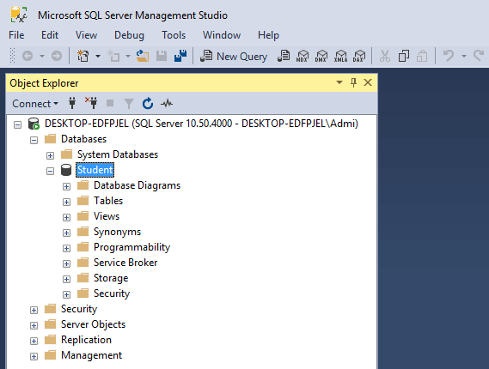
Click on the Ok button then it will create a database that we can see in the left window of the below screenshot.

Slide 16
Establish connection and create a table
After creating database, now, let's create a table by using the following C# code. In this source code, we are using created student database to connect.
In visual studio 2017, we created a .NET console application project that contains the following C# code.

Slide 17
Program.cs
using System;
using System.Data.SqlClient;
namespace AdoNetConsoleApplication
{
class Program
{
static void Main(string[] args)
{
new Program().CreateTable();
}
public void CreateTable()
{
SqlConnection con = null;
try
{
// Creating Connection
con = new SqlConnection("data source=.; database=student; integrated security=SSPI");
// writing sql query
SqlCommand cm = new SqlCommand("create table student(id int not null,
name varchar(100), email varchar(50), join_date date)", con);
// Opening Connection
con.Open();
// Executing the SQL query
cm.ExecuteNonQuery();
// Displaying a message
Console.WriteLine("Table created Successfully");
}
catch (Exception e)
{
Console.WriteLine("OOPs, something went wrong."+e);
}
// Closing the connection
finally
{
con.Close();
}
}
}
}

Slide 18
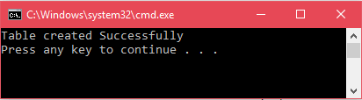
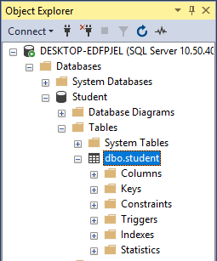
Run Program.cs
Will be created

Slide 19
Insert data
using System;
using System.Data.SqlClient;
namespace AdoNetConsoleApplication
{
class Program
{
static void Main(string[] args)
{
new Program().CreateTable();
}
public void CreateTable()
{
SqlConnection con = null;
try
{
// Creating Connection
con = new SqlConnection("data source=.; database=student; integrated security=SSPI");
// writing sql query
SqlCommand cm = new SqlCommand("insert into student
(id, name, email, join_date)values('101','Ronald Trump','ronald@example.com','1/12/2017')", con);
// Opening Connection
con.Open();
// Executing the SQL query
cm.ExecuteNonQuery();
// Displaying a message
Console.WriteLine("Record Inserted Successfully");
}
catch (Exception e)
{
Console.WriteLine("OOPs, something went wrong."+e);
}
// Closing the connection
finally
{
con.Close();
}
}
}
}

Slide 20
Retrieve data
using System;
using System.Data.SqlClient;
namespace AdoNetConsoleApplication
{
class Program
{
static void Main(string[] args)
{
new Program().CreateTable();
}
public void CreateTable()
{
SqlConnection con = null;
try
{
// Creating Connection
con = new SqlConnection("data source=.; database=student; integrated security=SSPI");
// writing sql query
SqlCommand cm = new SqlCommand("Select * from student", con);
// Opening Connection
con.Open();
// Executing the SQL query
SqlDataReader sdr = cm.ExecuteReader();
// Iterating Data
while (sdr.Read())
{
Console.WriteLine(sdr["id"] + " " + sdr["name"]+" "+sdr["email"]); // Displaying Record
}
}
catch (Exception e)
{
Console.WriteLine("OOPs, something went wrong.\n"+e);
}
// Closing the connection
finally
{
con.Close();
}
}
}
}

Slide 21
Delete data
using System;
using System.Data.SqlClient;
namespace AdoNetConsoleApplication
{
class Program
{
static void Main(string[] args)
{
new Program().CreateTable();
}
public void CreateTable()
{
SqlConnection con = null;
try
{
// Creating Connection
con = new SqlConnection("data source=.; database=student; integrated security=SSPI");
// writing sql query
SqlCommand cm = new SqlCommand("delete from student where id = '101'", con);
// Opening Connection
con.Open();
// Executing the SQL query
cm.ExecuteNonQuery();
Console.WriteLine("Record Deleted Successfully");
}
catch (Exception e)
{
Console.WriteLine("OOPs, something went wrong.\n"+e);
}
// Closing the connection
finally
{
con.Close();
}
}
}
}

