Slide 1
search

Slide 2
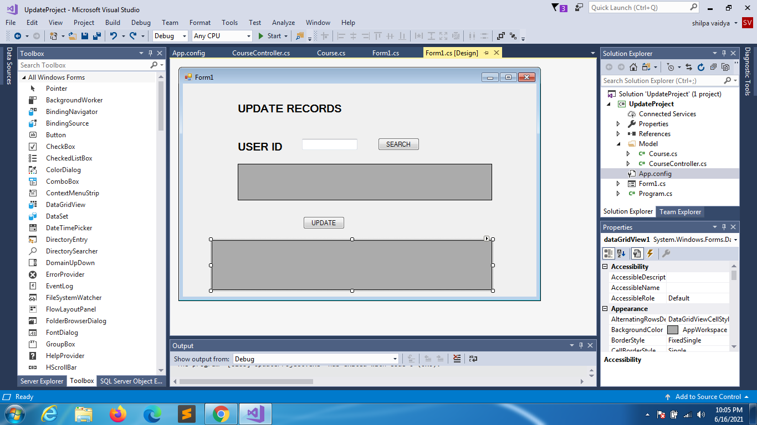

Slide 3
using System;
using System.Collections.Generic;
using System.ComponentModel;
using System.Data;
using System.Drawing;
using System.Linq;
using System.Text;
using System.Threading.Tasks;
using System.Windows.Forms;
using UpdateProject.Model;
namespace UpdateProject
{
public partial class Form1 : Form
{
public Form1()
{
InitializeComponent();
}
private void Form1_Load(object sender, EventArgs e)
{
CourseController ob = new CourseController();
dataGridView1.DataSource = ob.getAllCourse();
dataGridView2.Visible = false;
}

Slide 4
private void button2_Click(object sender, EventArgs e)
{
CourseController ob = new CourseController();
int id = Convert.ToInt32(textBox1.Text);
Course c = ob.getCourseById(id);
if (c == null)
{
dataGridView2.Visible = false;
MessageBox.Show("not found");
}
else
{
List<Course> li = new List<Course>();
li.Add(c);
dataGridView2.Visible = true;
dataGridView2.DataSource = li;
}
textBox1.Text = "";
}
}
}
Form.cs

Slide 5
using System;
using System.Collections.Generic;
using System.Linq;
using System.Text;
using System.Threading.Tasks;
namespace UpdateProject.Model
{
class Course
{
public int Cid { get; set; }
public string CName { get; set; }
public string Category { get; set; }
}
}
Course.cs

Slide 6
namespace UpdateProject.Model
{
class CourseController
{
private string conStr = ConfigurationManager.ConnectionStrings["db"].ConnectionString;
public List<Course> getAllCourse()
{
List<Course> li = new List<Course>();
SqlConnection conn = new SqlConnection(conStr);
string sql = "select * from Course";
try
{
conn.Open();
SqlCommand cmd = new SqlCommand(sql, conn);
SqlDataReader sqr = cmd.ExecuteReader();
while(sqr.Read())
{
Course ob = new Course();
ob.Cid = Convert.ToInt32(sqr.GetValue(0));
ob.CName = sqr.GetValue(1).ToString();
ob.Category = sqr.GetValue(2).ToString();
li.Add(ob);
}
}
catch(Exception)
{
MessageBox.Show("Connection could not be established");
}
finally
{
conn.Close();
}
return li;
}
using System;
using System.Collections.Generic;
using System.Linq;
using System.Text;
using System.Threading.Tasks;
using System.Data;
using System.Data.SqlClient;
using System.Configuration;
using System.Windows.Forms;
CourseController.cs

Slide 7
public Course getCourseById(int id)
{
Course c = new Course();
SqlConnection conn = new SqlConnection(conStr);
string sql = "select * from Course where Cid = " + id;
try
{
conn.Open();
SqlCommand cmd = new SqlCommand(sql, conn);
SqlDataReader sqr = cmd.ExecuteReader();
if (sqr.HasRows)
{
while (sqr.Read())
{
Course ob = new Course();
ob.Cid = Convert.ToInt32(sqr.GetValue(0));
ob.CName = sqr.GetValue(1).ToString();
ob.Category = sqr.GetValue(2).ToString();
c = ob;
}
}
else
c = null;
}
catch(Exception)
MessageBox.Show("Connection failed............");
finally
conn.Close();
return c;
}
}
}
CourseController.cs

Slide 8
update
create procedure spUpdateCourse
(
@id int,@cname varchar(50),@cat varchar(50)
)
as
begin
update Course set CourseName = @cname,CourseCategory = @cat
where Cid = @id
end

Slide 9
private void button1_Click(object sender, EventArgs e)
{
CourseController ob = new CourseController();
int id = Convert.ToInt32(CID.Text);
Course c = ob.getCourseById(id);
Course cupdate = new Course();
if (c == null)
{
dataGridView2.Visible = false;
MessageBox.Show("not found hence cannot be updated");
}
else
{
cupdate.Cid = id;
cupdate.CName = CNAME.Text;
cupdate.Category = CAT.Text;
ob.updatewithsp(cupdate);
dataGridView1.DataSource = ob.getAllCourse();
CID.Text = "";
CNAME.Text = "";
CAT.Text = "";
}
}
Form.cs

Slide 10
public string updatewithsp(Course c)
{
string msg = null;
SqlConnection conn = new SqlConnection(conStr);
try
{
conn.Open();
SqlCommand cmd = new SqlCommand("spUpdateCourse", conn);
cmd.CommandType = CommandType.StoredProcedure;
cmd.Parameters.Add("@id", SqlDbType.Int).Value = c.Cid;
cmd.Parameters.Add("@cname", SqlDbType.VarChar,50).Value = c.CName;
cmd.Parameters.Add("@cat", SqlDbType.VarChar,50).Value = c.Category;
cmd.ExecuteNonQuery();
msg = "Data updated";
}
catch (Exception)
{
msg = "Data could not be updated";
}
finally
{
conn.Close();
}
return msg;
}
Coursecontroller.cs

