Slide 1
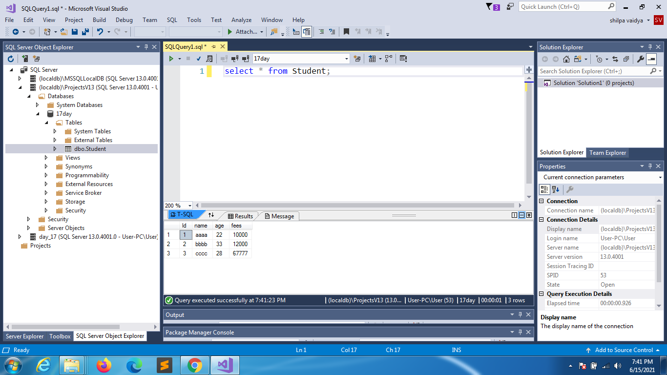

Slide 2
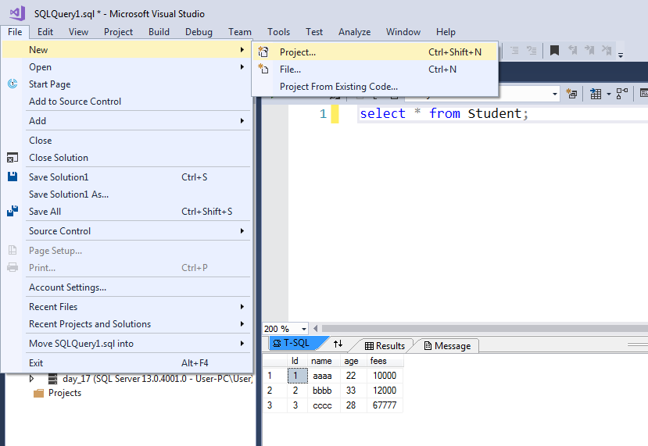

Slide 3
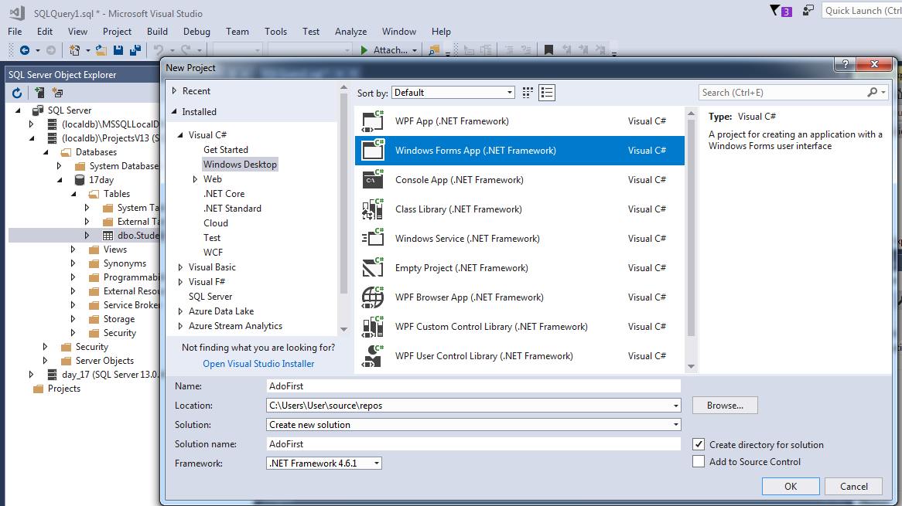

Slide 4
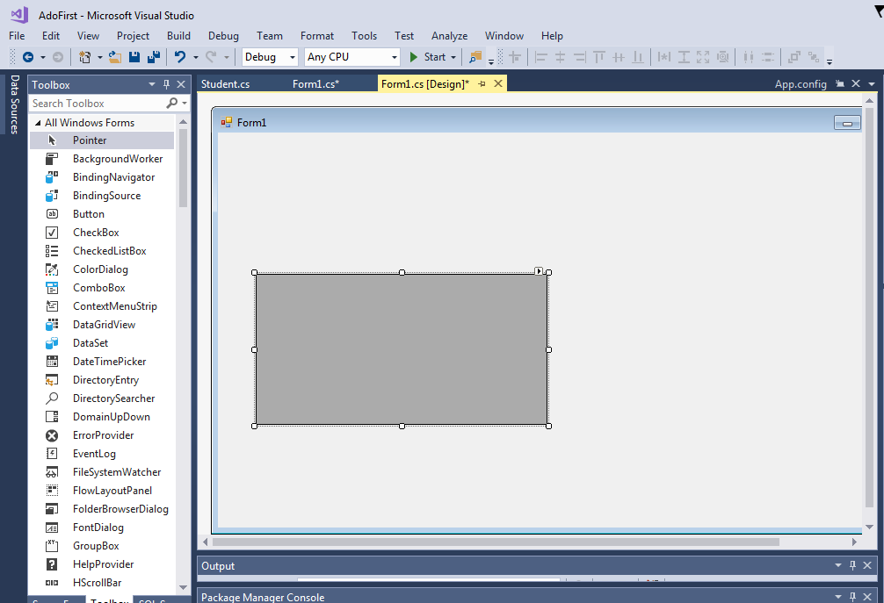
Add datagrid from toolbox

Slide 5
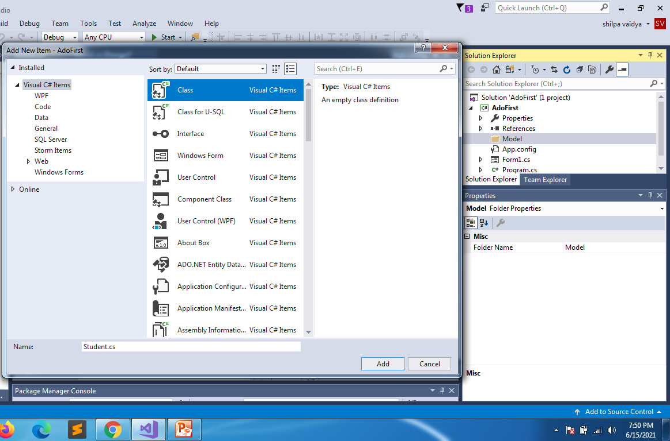

Slide 6
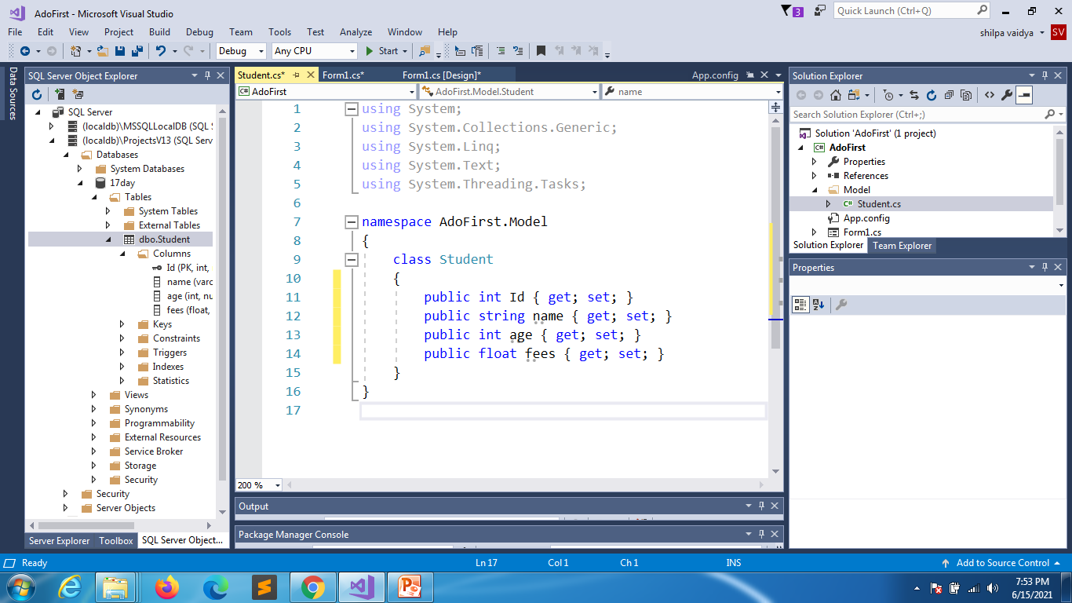
Student.cs
Make necessary changes

Slide 7
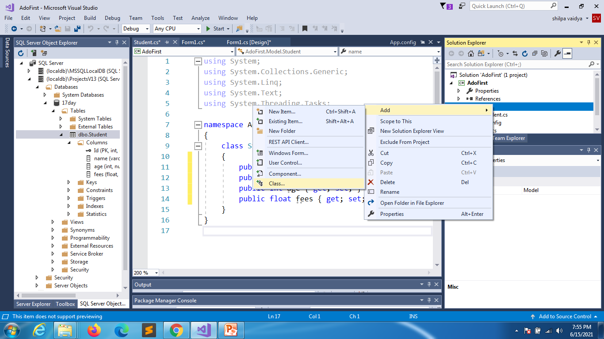

Slide 8
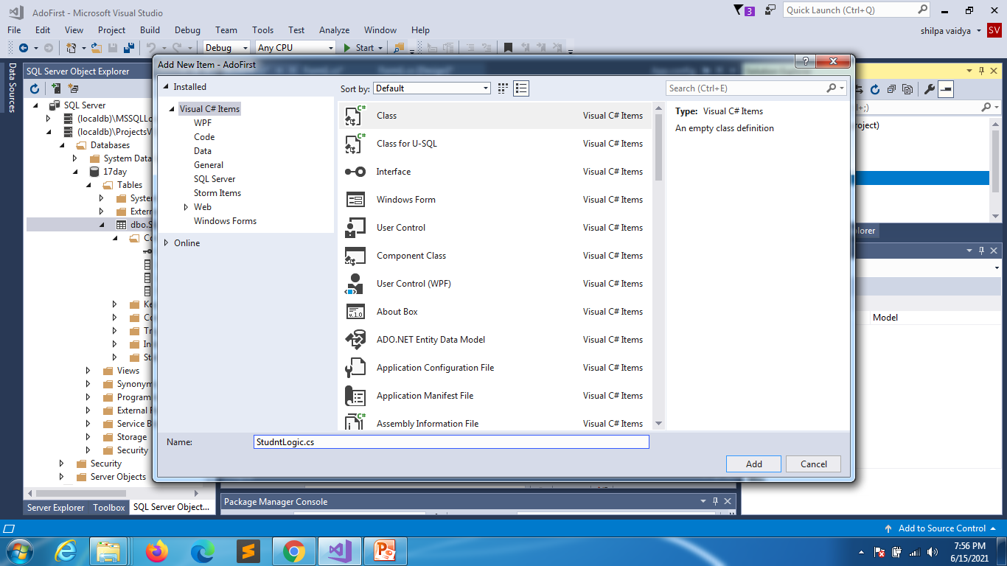

Slide 9
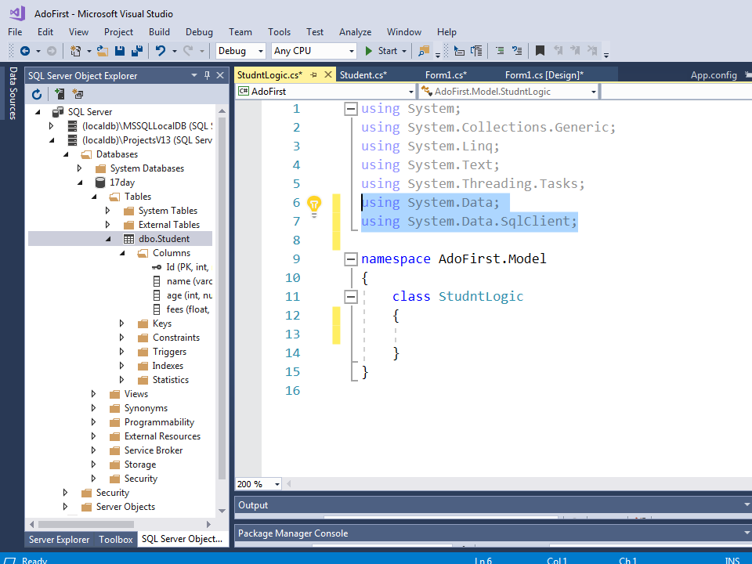

Slide 10
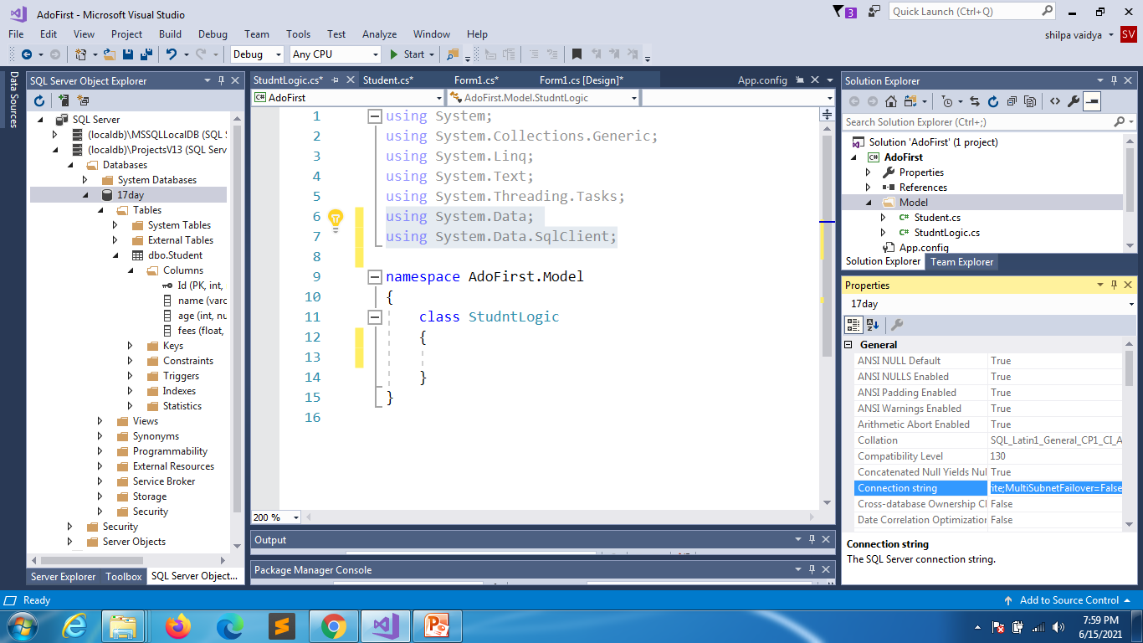

Slide 11
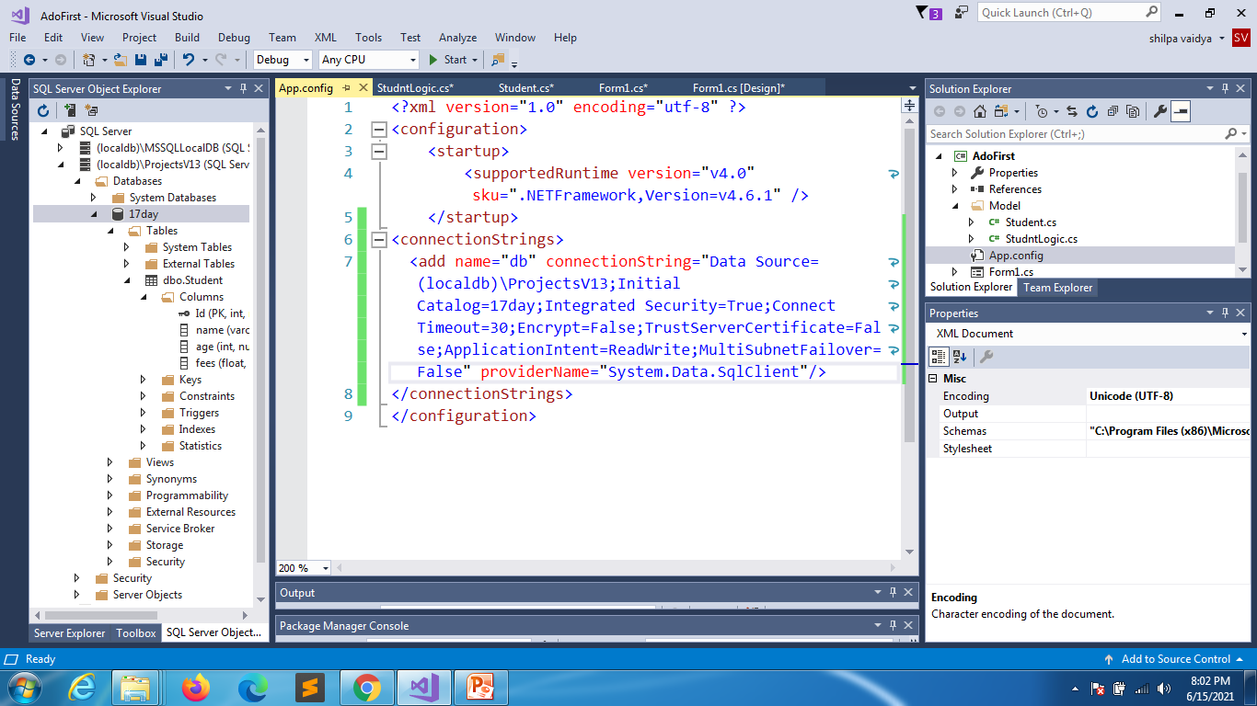

Slide 12
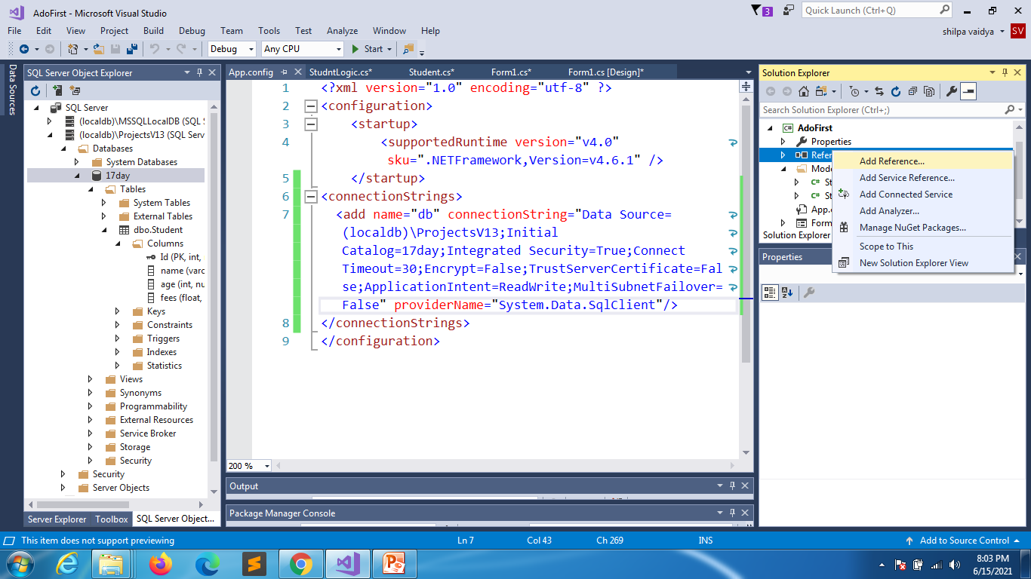

Slide 13
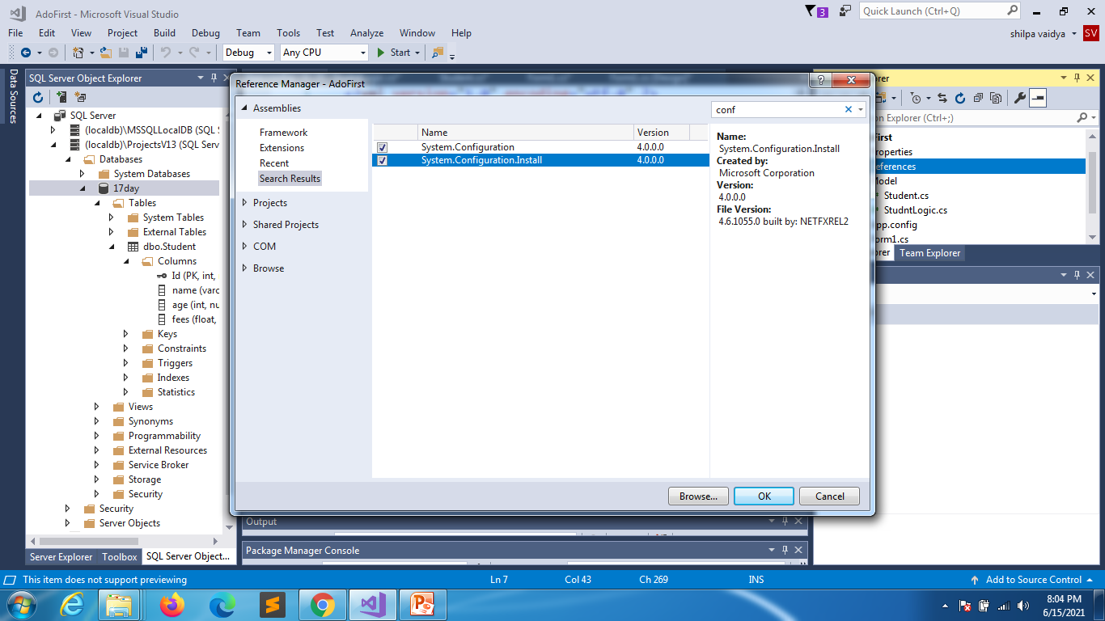

Slide 14
using System;
using System.Collections.Generic;
using System.Linq;
using System.Text;
using System.Threading.Tasks;
using System.Data;
using System.Data.SqlClient;
using System.Configuration;
namespace AdoFirst.Model
{
class StudntLogic
{
private string connectionString = ConfigurationManager.ConnectionStrings["db"].ConnectionString;
public List<Student> getAllStudents()
{
List<Student> li = new List<Student>();
try
{
//create connection
SqlConnection conn = new SqlConnection(connectionString);
//query
string sql = "select * from Student";
StudentLogic.cs

Slide 15
StudentLogic.cs
//established connection opens
conn.Open();
//execute query
SqlCommand cmd = new SqlCommand(sql, conn);
//reads each record
SqlDataReader reader = cmd.ExecuteReader();
while(reader.Read())
{
Student stu = new Student();
stu.Id =Convert.ToInt32(reader.GetValue(0));
stu.name = reader.GetValue(1).ToString();
stu.age = Convert.ToInt32(reader.GetValue(2));
stu.fees = float.Parse(reader.GetValue(3).ToString());
li.Add(stu);
}
}
catch(Exception)
{
}
return li;
}
}
}

Slide 16
using System;
using System.Collections.Generic;
using System.ComponentModel;
using System.Data;
using System.Drawing;
using System.Linq;
using System.Text;
using System.Threading.Tasks;
using System.Windows.Forms;
using AdoFirst.Model;
namespace AdoFirst
{
public partial class Form1 : Form
{
public Form1()
{
InitializeComponent();
}
private void Form1_Load(object sender, EventArgs e)
{
StudntLogic stud = new StudntLogic();
dataGridView1.DataSource= stud.getAllStudents();
}
}
}

Slide 17
Additional reading

Slide 18
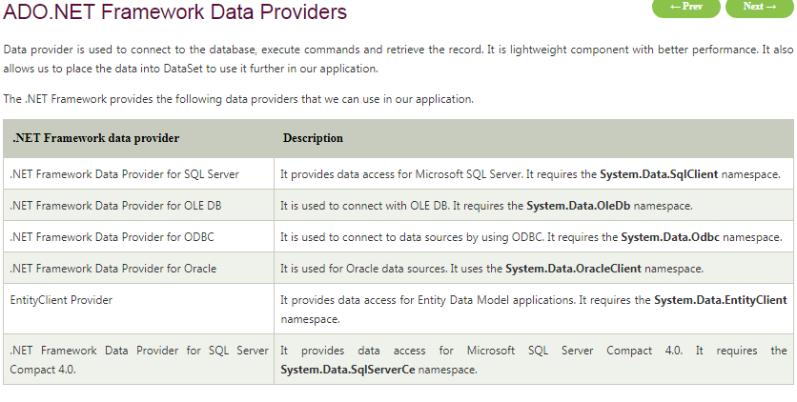

Slide 19
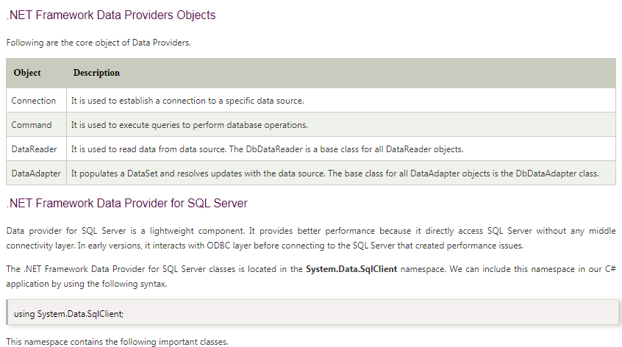

Slide 20
