Slide 1
using System;
using System.Collections.Generic;
using System.Linq;
using System.Text;
using System.Threading.Tasks;
using System.Data;
using System.Data.SqlClient;
using System.Configuration;
namespace AdoFirst.Model
{
class StudntLogic
{
private string connectionString = ConfigurationManager.ConnectionStrings["db"].ConnectionString;
public List<Student> getAllStudents()
{
//last file we have already written
}

Slide 2
public DataSet GetAllData()
{
DataSet ds = new DataSet();
//create connection
SqlConnection conn = new SqlConnection(connectionString);
try
{
//query
string sql = "select * from Student";
//established connection opens
conn.Open();
SqlDataAdapter sqadapter = new SqlDataAdapter(sql,conn);
sqadapter.Fill(ds);
}
catch (Exception)
{
}
return ds;
}
}
}

Slide 3
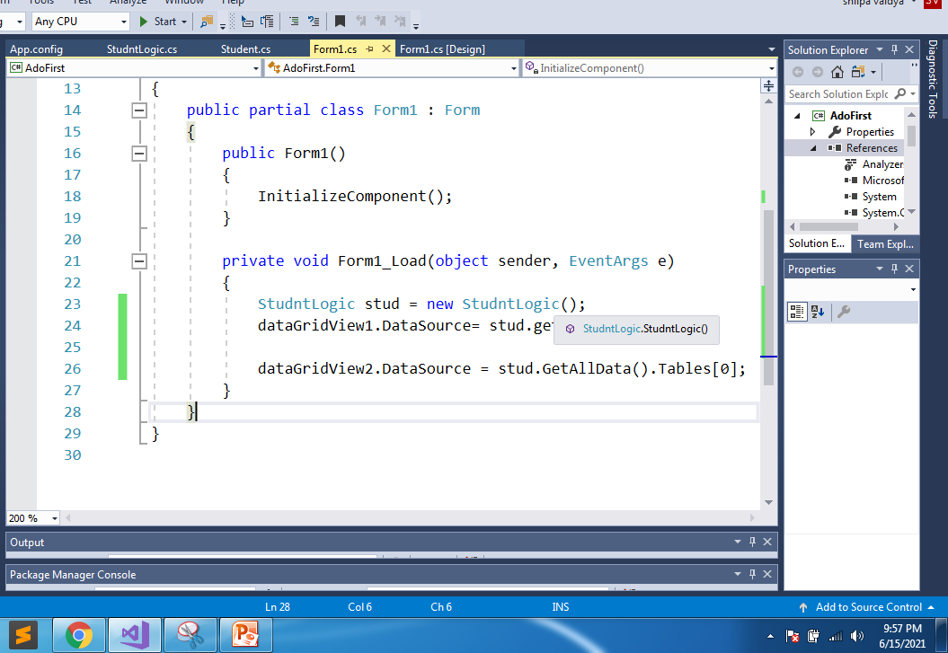

Slide 4
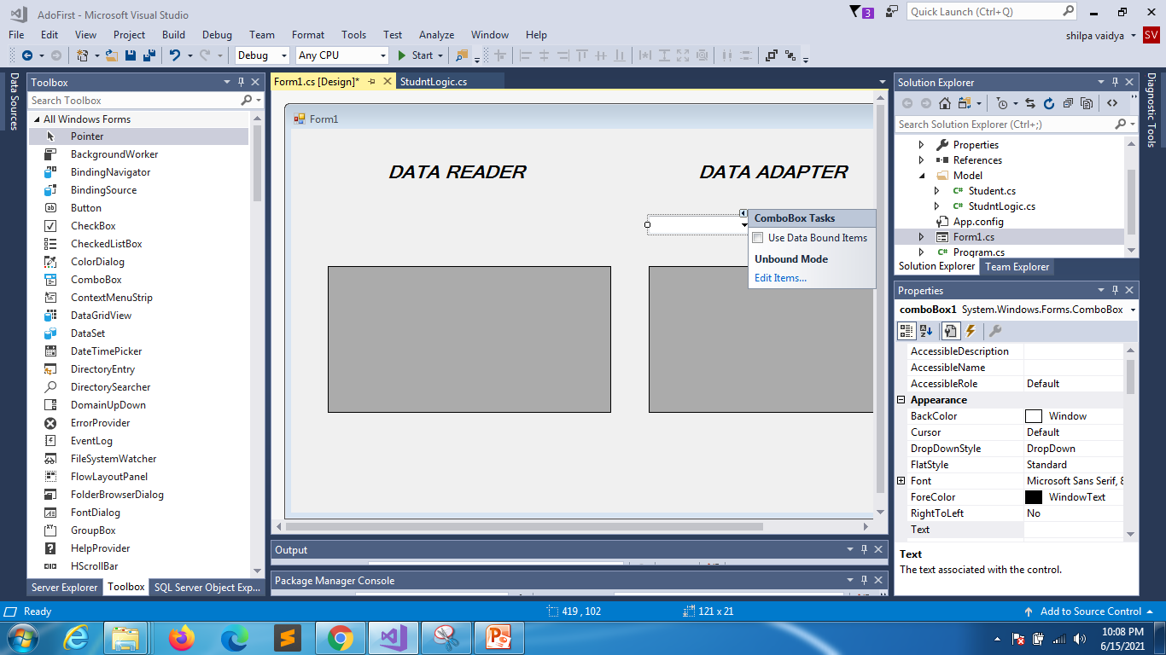

Slide 5
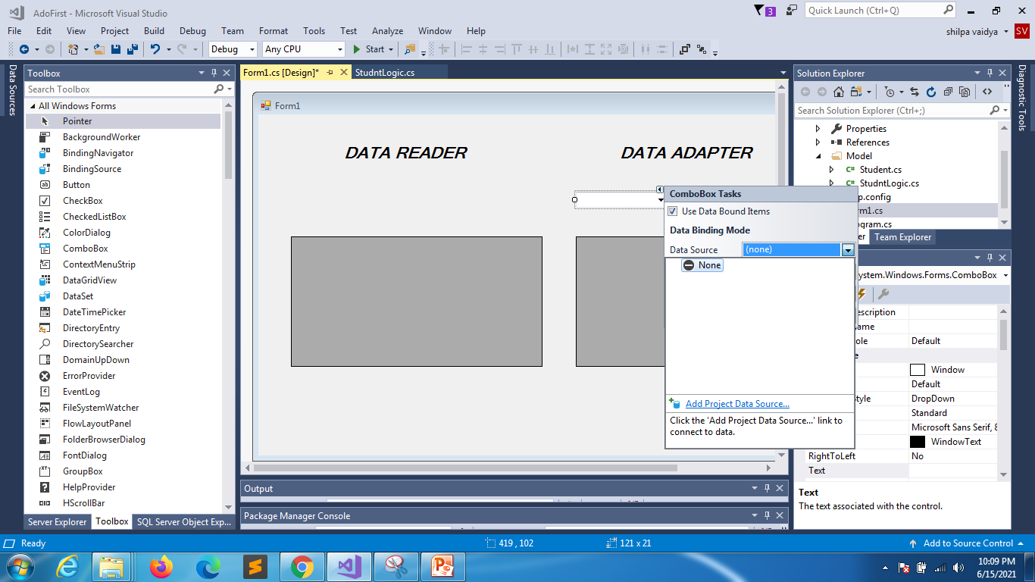

Slide 6
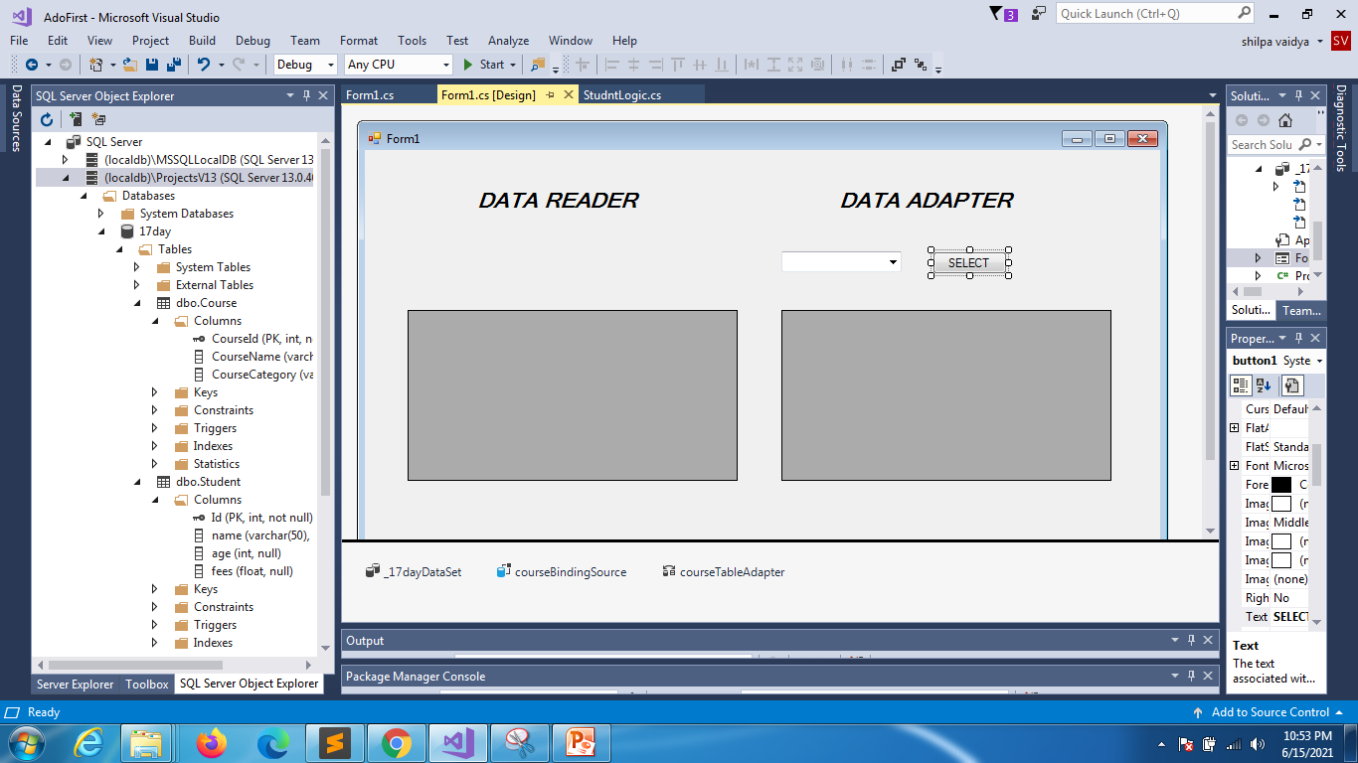

Slide 7
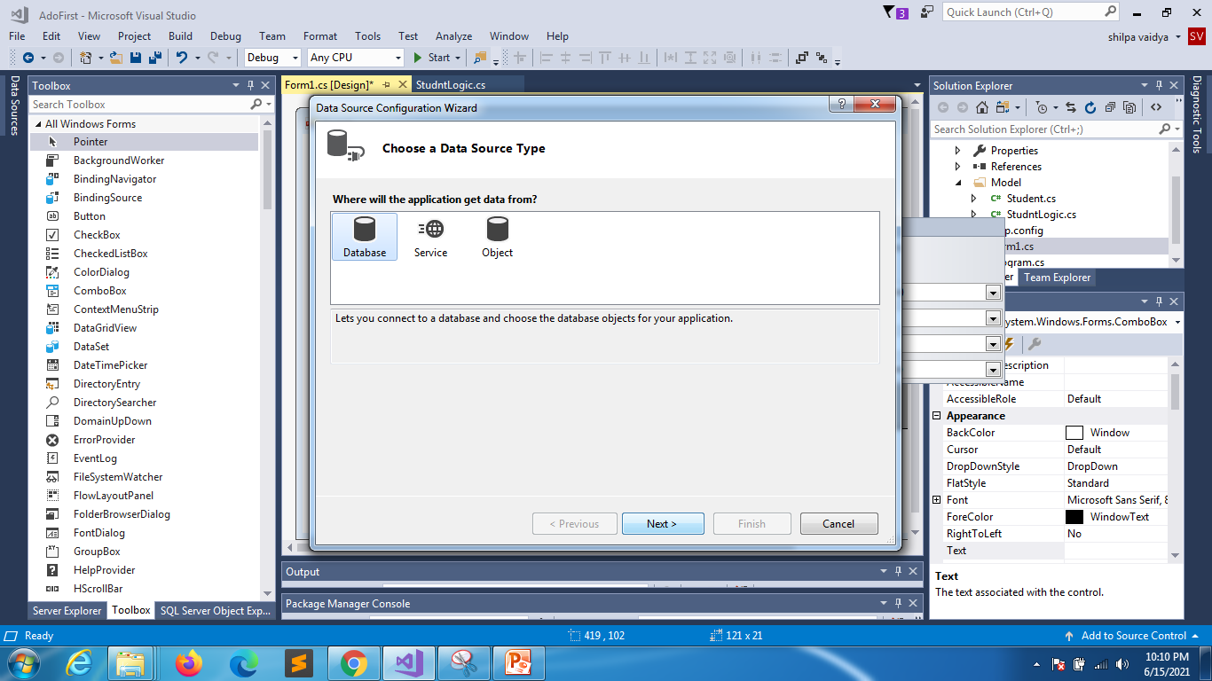

Slide 8
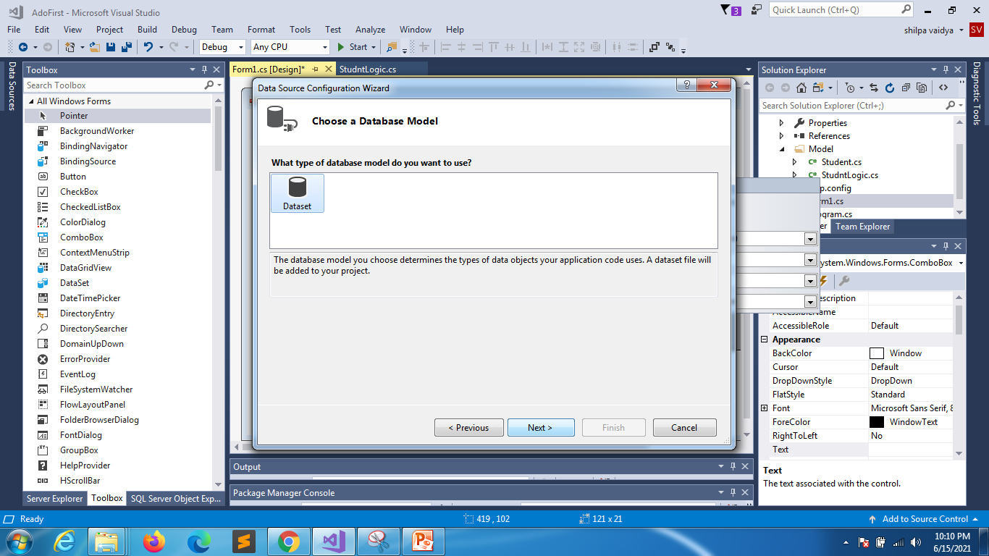

Slide 9
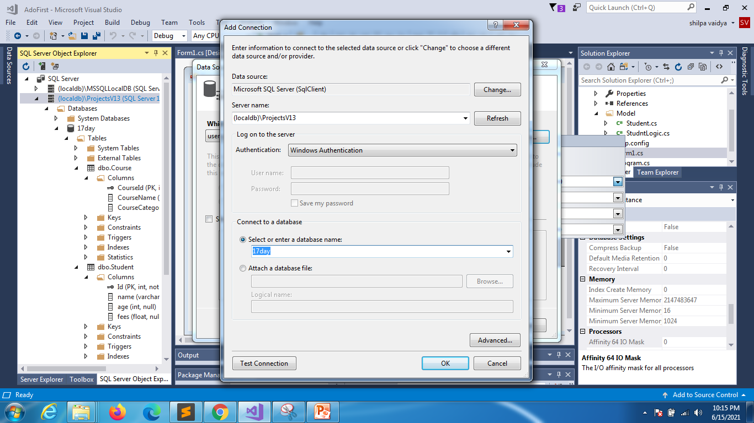

Slide 10
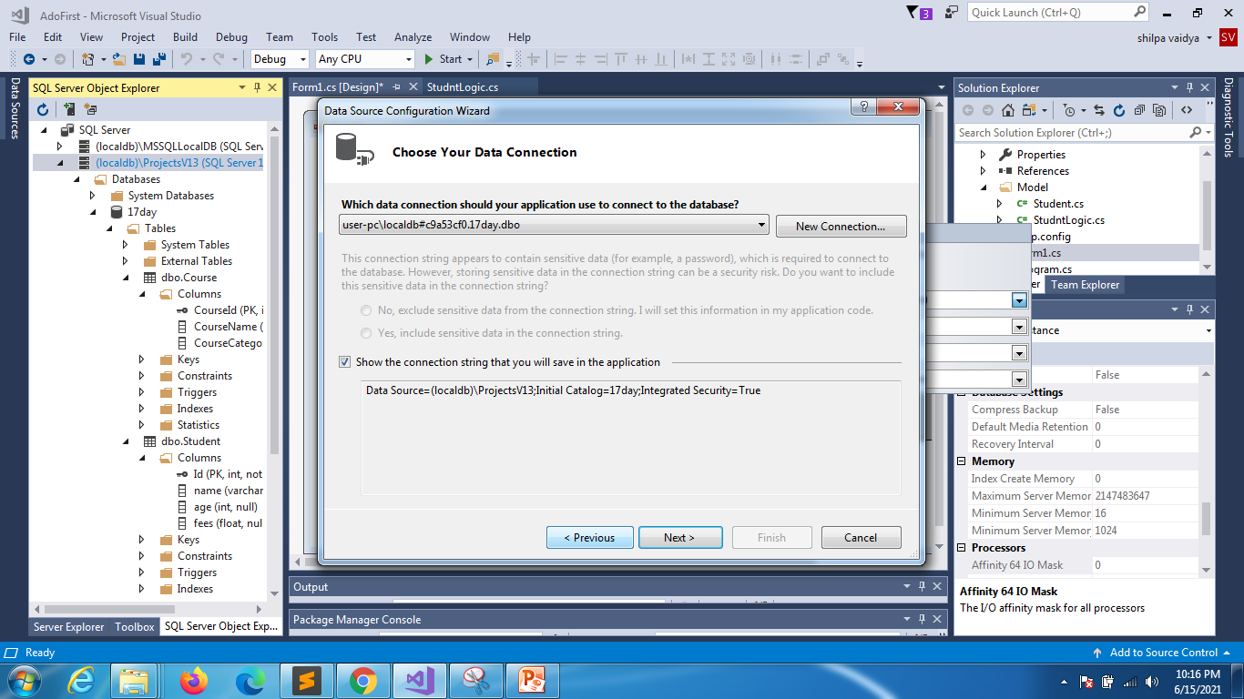

Slide 11
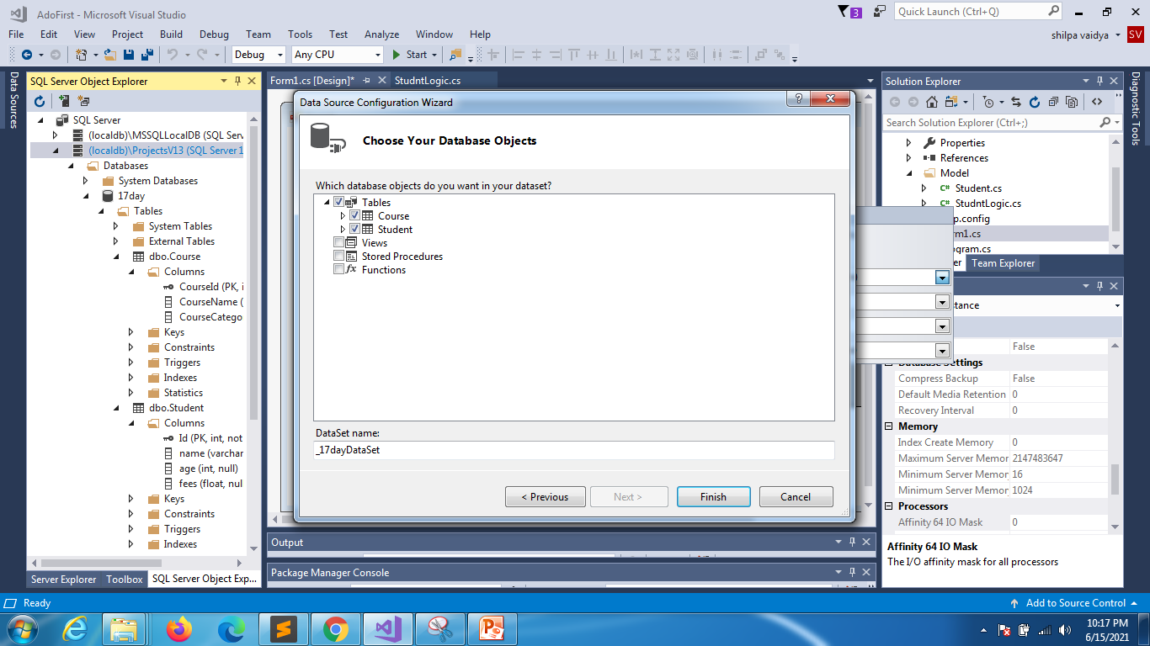

Slide 12
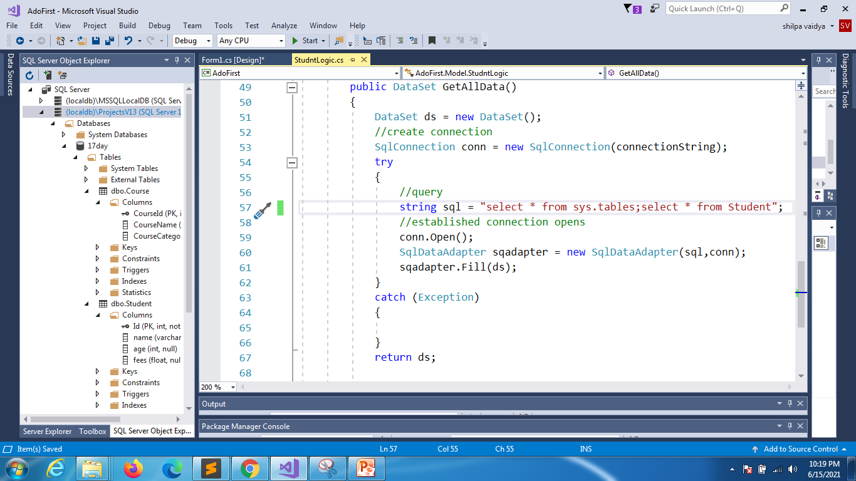

Slide 13
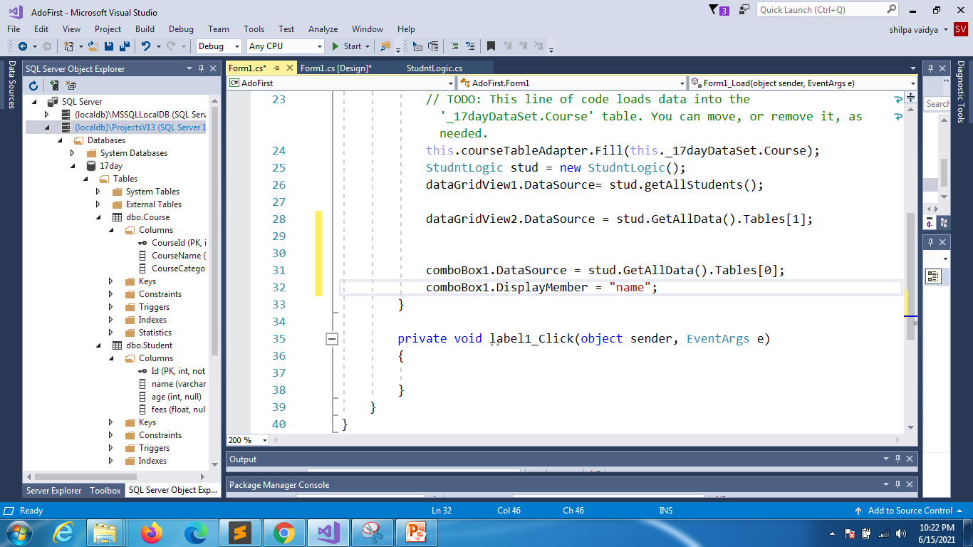

Slide 14
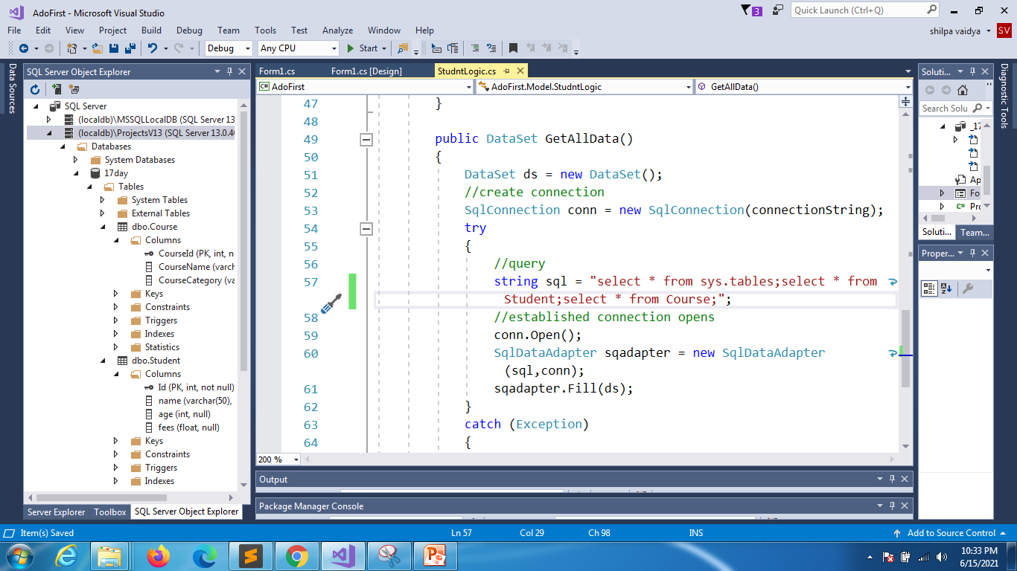

Slide 15
namespace AdoFirst
{
public partial class Form1 : Form
{
StudntLogic stud = new StudntLogic();
public Form1()
{
InitializeComponent();
}
private void Form1_Load(object sender, EventArgs e)
{
dataGridView1.DataSource= stud.getAllStudents();
dataGridView2.DataSource = stud.GetAllData().Tables[1];
comboBox1.DataSource = stud.GetAllData().Tables[0];
comboBox1.DisplayMember = "name";
}
private void button1_Click(object sender, EventArgs e)
{
int i = comboBox1.SelectedIndex;
i++;
dataGridView2.DataSource = stud.GetAllData().Tables[i];
}
}
}
Form.cs

