Slide 1
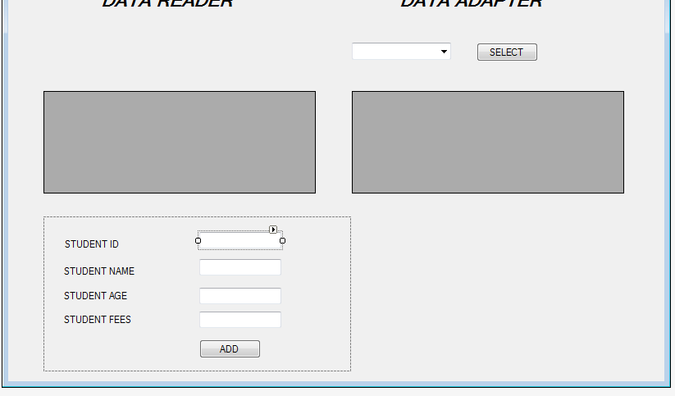

Slide 2
private void button2_Click(object sender, EventArgs e)
{
StudntLogic ob = new StudntLogic();
Student st = new Student();
st.Id =Convert.ToInt32( textBox1.Text);
st.name = textBox2.Text;
st.age = Convert.ToInt32(textBox3.Text);
st.fees = float.Parse(textBox4.Text);
MessageBox.Show(ob.Add(st));
textBox1.Text = "";
textBox2.Text = "";
textBox3.Text = "";
textBox4.Text = "";
dataGridView1.DataSource = stud.getAllStudents();
dataGridView2.DataSource = stud.GetAllData().Tables[1];
}
Insert
FORM.CS

Slide 3
public string Add(Student st)
{
string str = null;
string sql = "insert into Student values(" + st.Id + ",'" + st.name + "'," + st.age + "," + st.fees + ")";
MessageBox.Show(sql);
SqlConnection conn = new SqlConnection(connectionString);
try
{
conn.Open();
SqlCommand cmd = new SqlCommand(sql,conn);
cmd.ExecuteNonQuery();
str = "data inserted successfully ...........";
}
catch(Exception)
{
str = "Sorry couldnt insert ";
}
return str;
}

