Slide 1
scalar

Slide 2
public string getScalar(string s)
{
string str = null;
SqlConnection conn = new SqlConnection(connectionString);
try
{
conn.Open();
SqlCommand cmd = new SqlCommand(s, conn);
str = cmd.ExecuteScalar().ToString();
}
catch (Exception)
{
str = "Sorry couldnt insert ";
}
finally
{
conn.Close();
}
return str;
}
studentLogic.cs

Slide 3
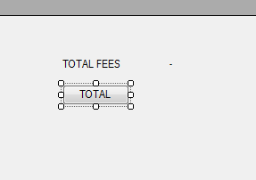
Form.cs
private void button3_Click(object sender, EventArgs e)
{
StudntLogic ob = new StudntLogic();
label8.Text =ob.getScalar("select sum(fees) from Student");
}

