Slide 1
topics
sum of natural numbers
sum of individual numbers till user hits 999
factorial -->do while
sum of digits of given number
string = abcs11g55c6 -> 11556
64-->perfect square.. 34-->not a perfect square
Prime
functions
swap by reference
swap by value
Arrays single dimensional
Bubble
Find Minimum
sending array to functions

Slide 2
using System;
using System.Collections.Generic;
using System.Linq;
using System.Text;
using System.Threading.Tasks;
namespace day19
{
class Program
{
static void Main(string[] args)
{
int i=1, num,sum=0;
Console.WriteLine("Enter the number");
num = Convert.ToInt32(Console.ReadLine());
do
{
sum = sum + i++;
} while (i <= num);
Console.WriteLine("the sum = "+sum);
}
}
}

Slide 3
using System;
using System.Collections.Generic;
using System.Linq;
using System.Text;
using System.Threading.Tasks;
namespace day19
{
class Program
{
static void Main(string[] args)
{
int num,sum=0;
do
{
Console.WriteLine("Enter the number");
num = Convert.ToInt32(Console.ReadLine());
sum = sum + num;
} while (num!=999);
Console.WriteLine("the sum = "+sum);
}
}
}

Slide 4
using System;
using System.Collections.Generic;
using System.Linq;
using System.Text;
using System.Threading.Tasks;
namespace day19
{
class Program
{
static void Main(string[] args)
{
int num,fact=1,i=1;
Console.WriteLine("Enter the number");
num = Convert.ToInt32(Console.ReadLine());
do
{
fact = fact * i++;
} while (i<=num);
Console.WriteLine("the factorial = "+fact);
}
}
}

Slide 5
using System;
namespace day19
{
class Program
{
static void Main(string[] args)
{
int num;
string str,numstr="";
Console.WriteLine("Enter the string");
str = Console.ReadLine();
foreach(char c in str)
{
// if ((c >= 65 && c <= 90) || c >= 97 && c <= 120)
// continue;
if(c>=48 && c<=57)
numstr += c;
}
num = Convert.ToInt32(numstr);
Console.WriteLine("NUM = " + num);
}
}
}

Slide 6
using System;
using System.Collections.Generic;
using System.Linq;
using System.Text;
using System.Threading.Tasks;
namespace day19
{
class Program
{
static void Main(string[] args)
{
int num;
double i,x;
Console.WriteLine("Enter the string");
num =Convert.ToInt32( Console.ReadLine());
i = Math.Sqrt(num);
x = Math.Floor(i);
if(i-x == 0)
Console.WriteLine("Perfect square");
else
Console.WriteLine("Not perfect square");
}
}
}

Slide 7
using System;
using System.Collections.Generic;
using System.Linq;
using System.Text;
using System.Threading.Tasks;
namespace day19
{
class Program
{
static void Main(string[] args)
{
int num,i;
Console.WriteLine("Enter the num");
num =Convert.ToInt32( Console.ReadLine());
for(i=2;i<=num/2;i++)
{
if(num%i == 0)
{
Console.WriteLine("Not a prime number");
break;
}
}
if(i>num/2)
Console.WriteLine("Prime number");
}
}
}

Slide 8
using System;
using System.Collections.Generic;
using System.Linq;
using System.Text;
using System.Threading.Tasks;
namespace day19
{
class Program
{
public void add()
{
int a, b;
Console.WriteLine("Enter a ");
a = Convert.ToInt32(Console.ReadLine());
Console.WriteLine("Enter b ");
b = Convert.ToInt32(Console.ReadLine());
Console.WriteLine("Sum = " + (a+b));
}
static public void sub(int a, int b)
{
Console.WriteLine("Difference = " + (a - b));
}
static void Main(string[] args)
{
Program ob = new Program();
ob.add();
sub(44,66);
}
}
}

Slide 9
using System;
using System.Collections.Generic;
using System.Linq;
using System.Text;
using System.Threading.Tasks;
namespace day19
{
class Program
{
static public void swap(int a, int b)
{
int temp;
temp = a;
a = b;
b = temp;
Console.WriteLine(" SWAP a=" + a + " b=" + b);
}
static void Main(string[] args)
{
int a=10, b=20;
Console.WriteLine("MAIN BEFORE SWAP a="+a+" b="+b);
swap(a, b);
Console.WriteLine("MAIN AFTER SWAP a=" + a + " b=" + b);
}
}
}

Slide 10
using System;
using System.Collections.Generic;
using System.Linq;
using System.Text;
using System.Threading.Tasks;
namespace day19
{
class Program
{
static public void swap(ref int a,ref int b)
{
int temp;
temp = a;
a = b;
b = temp;
Console.WriteLine(" SWAP a=" + a + " b=" + b);
}
static void Main(string[] args)
{
int a=10, b=20;
Console.WriteLine("MAIN BEFORE SWAP a="+a+" b="+b);
swap(ref a, ref b);
Console.WriteLine("MAIN AFTER SWAP a=" + a + " b=" + b);
}
}
}

Slide 11
using System;
using System.Collections.Generic;
using System.Linq;
using System.Text;
using System.Threading.Tasks;
namespace day19
{
class Program
{
static void Main(string[] args)
{
int n;
Console.WriteLine("Enter n =");
n = Convert.ToInt32(Console.ReadLine());
int[] a = new int[n];
Console.WriteLine("Enter array elements");
for(int i=0;i<a.Length;i++)
{
a[i] =Convert.ToInt32(Console.ReadLine());
}
Console.WriteLine("array elements area =");
foreach(int x in a)
Console.WriteLine(x);
}
}
}

Slide 12
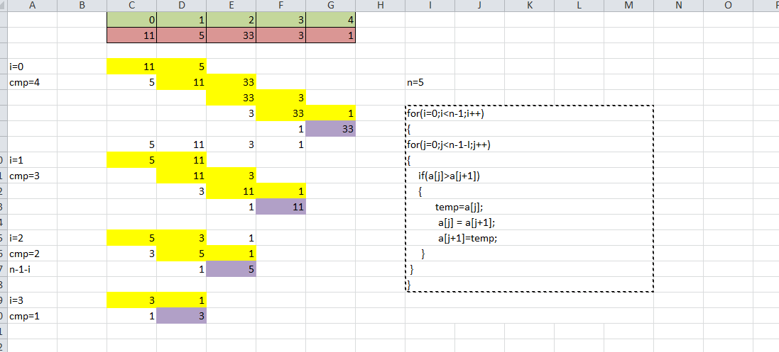

Slide 13
using System;
namespace day19
{​​​​​​​
class Program
{​​​​​​​
//Arrays...
//bubble sort-compares every elements with element
static void Main(string[] args)
{​​​​​​​
int n,i,j,temp;
Console.WriteLine("Enter N =");
n = Convert.ToInt32(Console.ReadLine());
int[] a = new int[n];
Console.WriteLine("Enter array elements");
for( i=0;i<a.Length;i++)
{​​​​​​​
a[i]= Convert.ToInt32(Console.ReadLine());
}​​​​​​​

Slide 14
for (i =0; i < n - 1; i++)
{​​​​​​​
for(j=0;j<n-1-i;j++)
{​​​​​​​
if(a[j] > a[j+1])
{​​​​​​​
temp = a[j];
a[j] = a[j + 1];
a[j + 1] = temp;
}​​​​​​​
}​​​​​​​
}​​​​​​​
Console.WriteLine(" array elements area=");
foreach(int x in a)
Console.WriteLine(x);
}​​​​​​​
}​​​​​​​
}​​​​​​​

Slide 15
using System;
using System.Collections.Generic;
using System.Linq;
using System.Text;
using System.Threading.Tasks;
namespace day19
{
class Program
{
static void bubble(int[] a)
{
int i, j, temp, n;
n = a.Length;
for (i = 0; i < n - 1; i++)
{
for (j = 0; j < n - 1 - i; j++)
{
if (a[j] > a[j + 1])
{
temp = a[j];
a[j] = a[j + 1];
a[j + 1] = temp;
}
}
}
}

Slide 16
static void Main(string[] args)
{
int n,i;
Console.WriteLine("Enter n =");
n = Convert.ToInt32(Console.ReadLine());
int[] a = new int[n];
Console.WriteLine("Enter array elements");
for(i=0;i<a.Length;i++)
{
a[i] =Convert.ToInt32(Console.ReadLine());
}
bubble(a);
Console.WriteLine("array elements area =");
foreach(int x in a)
Console.WriteLine(x);
}
}
}

Slide 17
using System;
using System.Collections.Generic;
using System.Linq;
using System.Text;
using System.Threading.Tasks;
namespace day19
{
class Program
{
static int minimumindex(int[] a)
{
int min=a[0],ind=0;
for(int i=1;i<a.Length;i++)
{
if (a[i] < min)
{
min = a[i];
ind = i;
}
}
return ind;
}

Slide 18
static void Main(string[] args)
{
int n,i;
Console.WriteLine("Enter n =");
n = Convert.ToInt32(Console.ReadLine());
int[] a = new int[n];
Console.WriteLine("Enter array elements");
for(i=0;i<a.Length;i++)
{
a[i] =Convert.ToInt32(Console.ReadLine());
}
Console.WriteLine("array elements area =");
foreach (int x in a)
Console.WriteLine(x);
int minind = minimumindex(a);
Console.WriteLine("Minimum element = " + a[minind] + " is at index=" +minind);
}
}
}

