Slide 1
TOOLBOX CONTROLS
Presented by,
Ranjan P

Slide 2
HScrollBar
An HScrollBar is a supporting control that is used to add horizontal scrolling capability to a control that does not have built-in scrolling such as a container control.

Slide 3
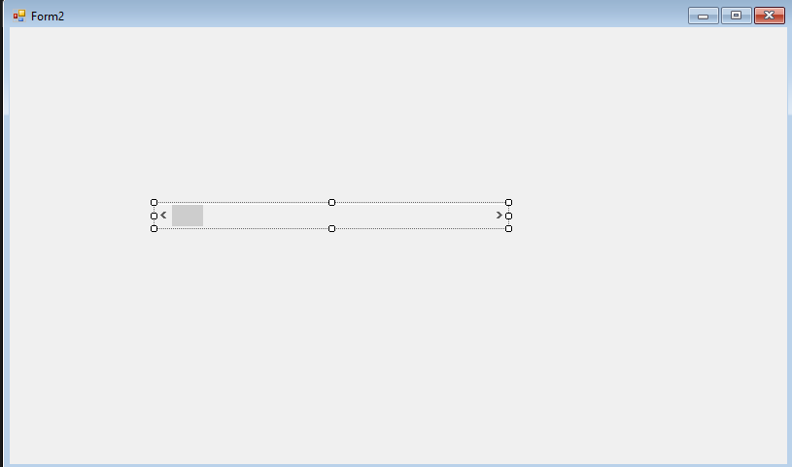
Creating an HScrollBar

Slide 4
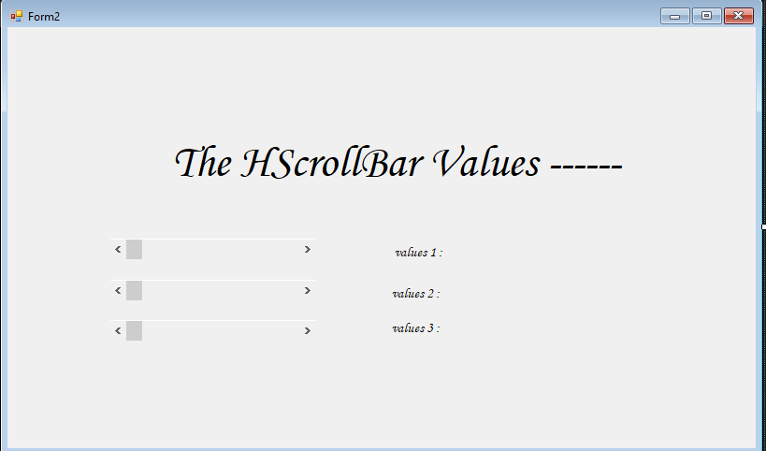
Desgin a Form

Slide 5
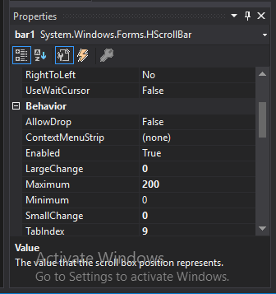
Setting HScrollBar Properties

Slide 6
Code part
private void bar1_Scroll(object sender, ScrollEventArgs e)
{
lbl1.Text = "values 1 : " + bar1.Value.ToString();
}
private void bar3_Scroll(object sender, ScrollEventArgs e)
{
lbl3.Text = "values 3 : " + bar3.Value.ToString();
}
private void bar2_Scroll(object sender, ScrollEventArgs e)
{
lbl2.Text = "values 2 : " + bar2.Value.ToString();
}

Slide 7
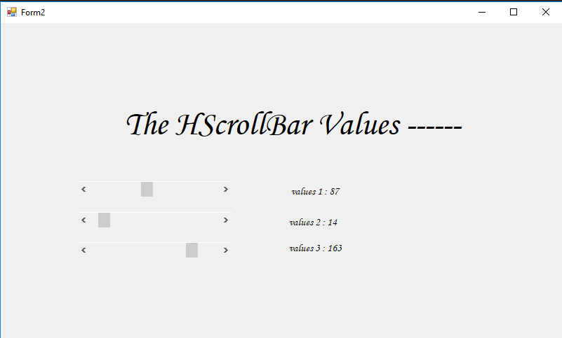
output :

Slide 8
HelpProvider
HelpProvider provides popup message or online help for a control.

Slide 9
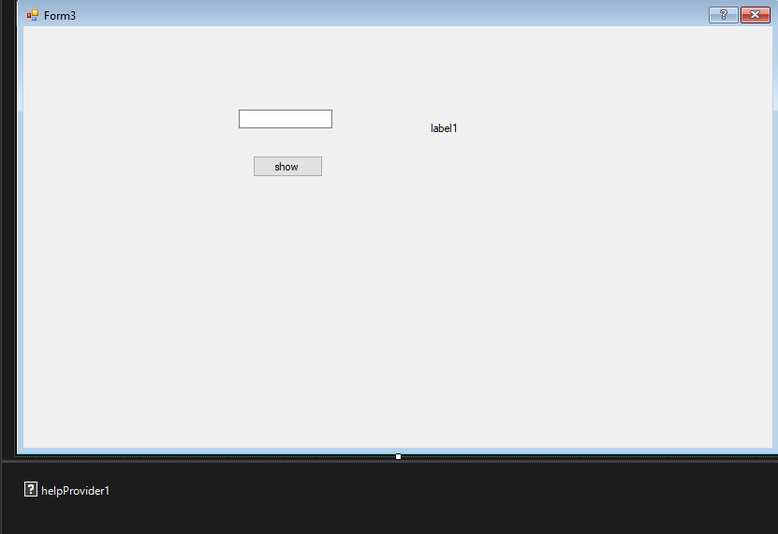
Creating a Help Provider

Slide 10
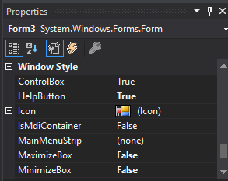
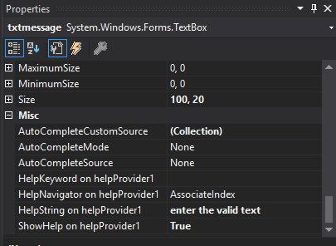
Changing the Properties

Slide 11
Code part
private void btnbutton_Click(object sender, EventArgs e)
{
lblshow.Text = txtmessage.Text;
}

Slide 12
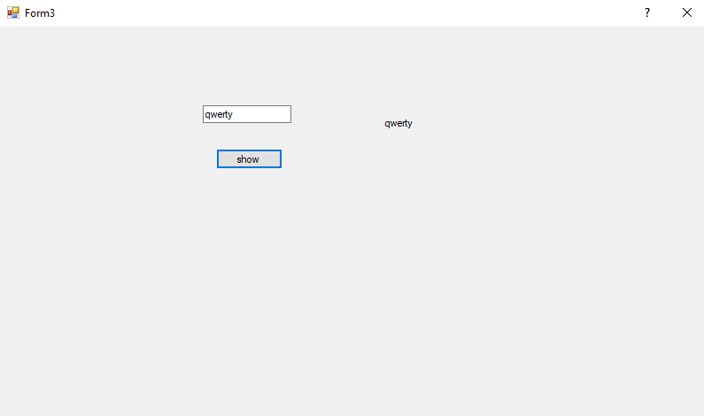
Output :

Slide 13
THANKYOU

