Slide 1
Listview

Slide 2
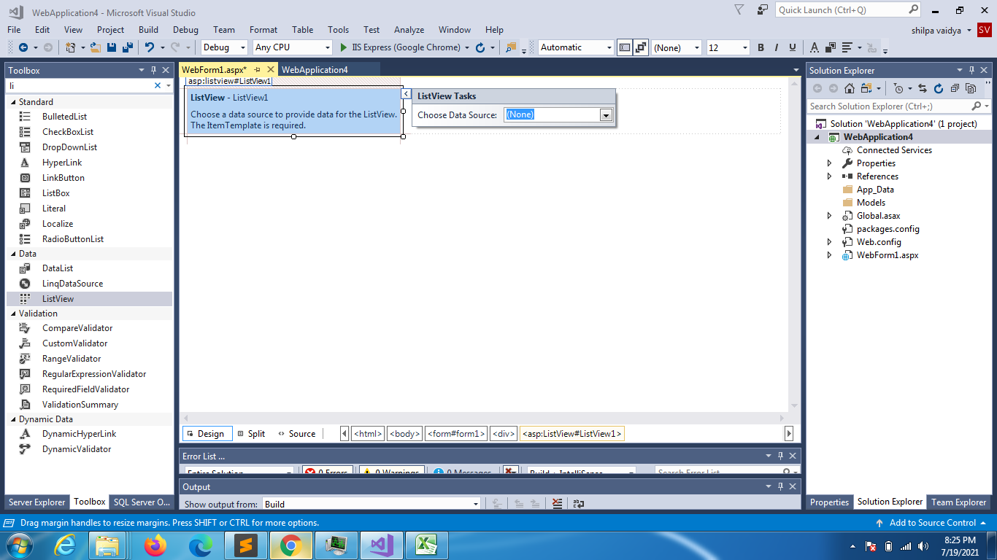

Slide 3
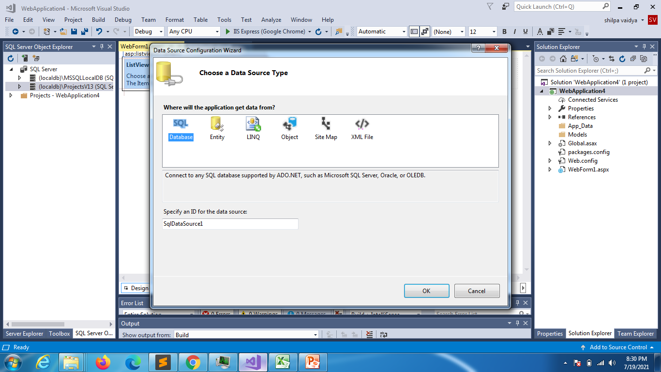

Slide 4
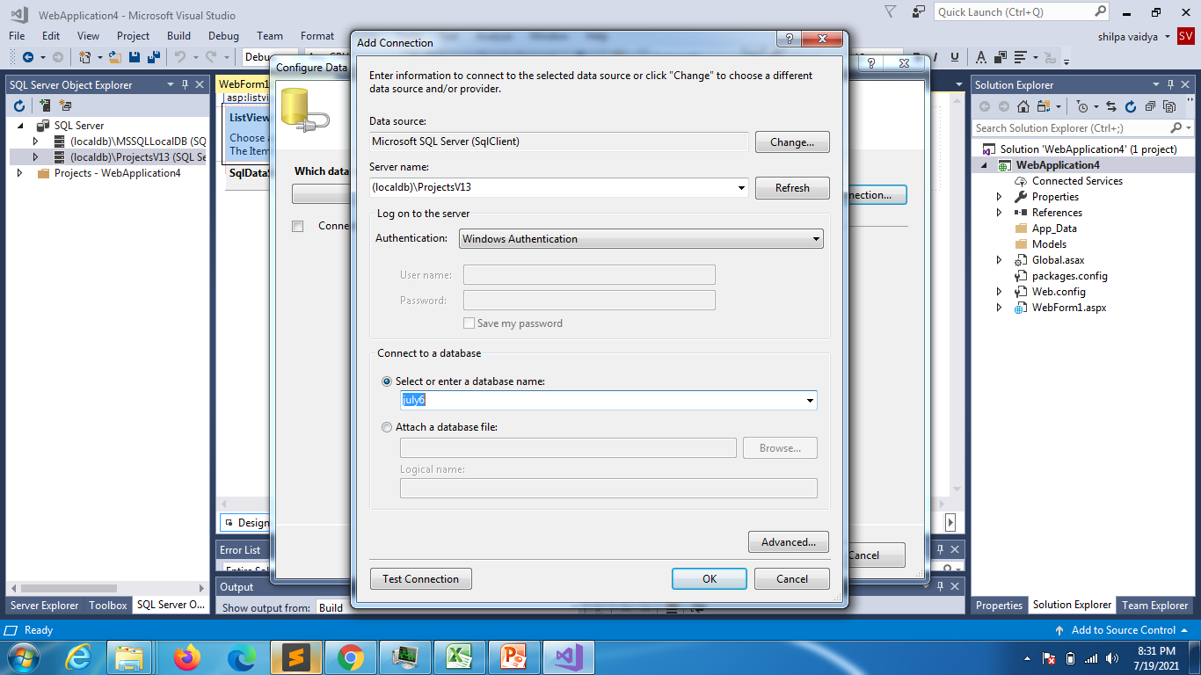

Slide 5
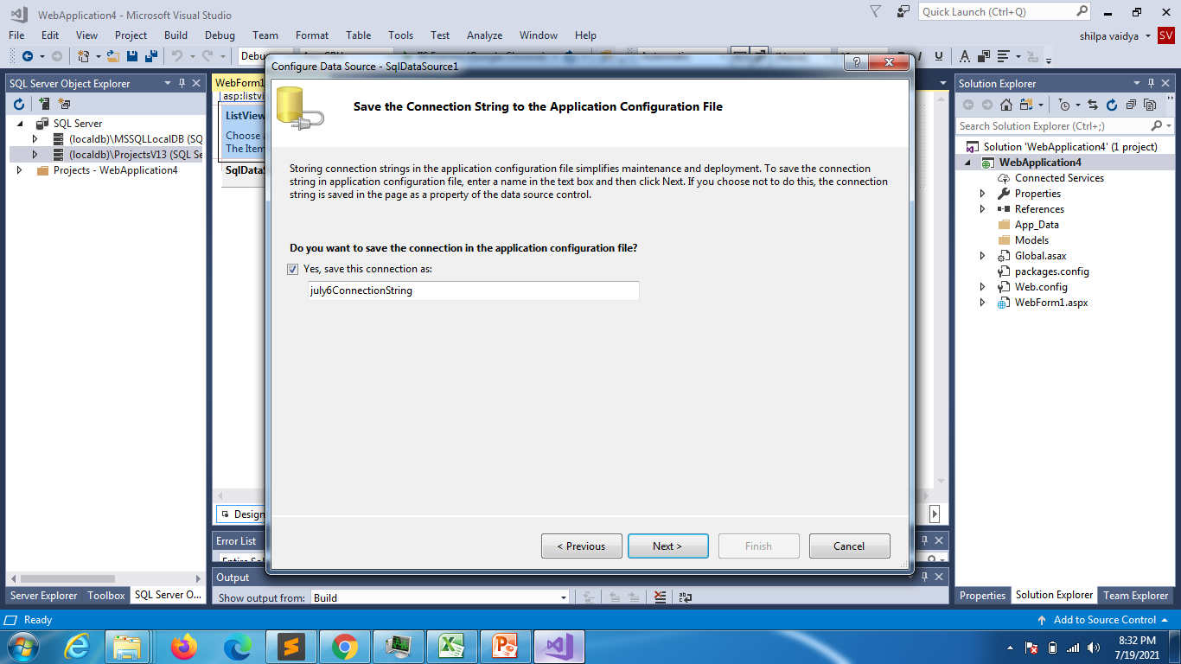

Slide 6
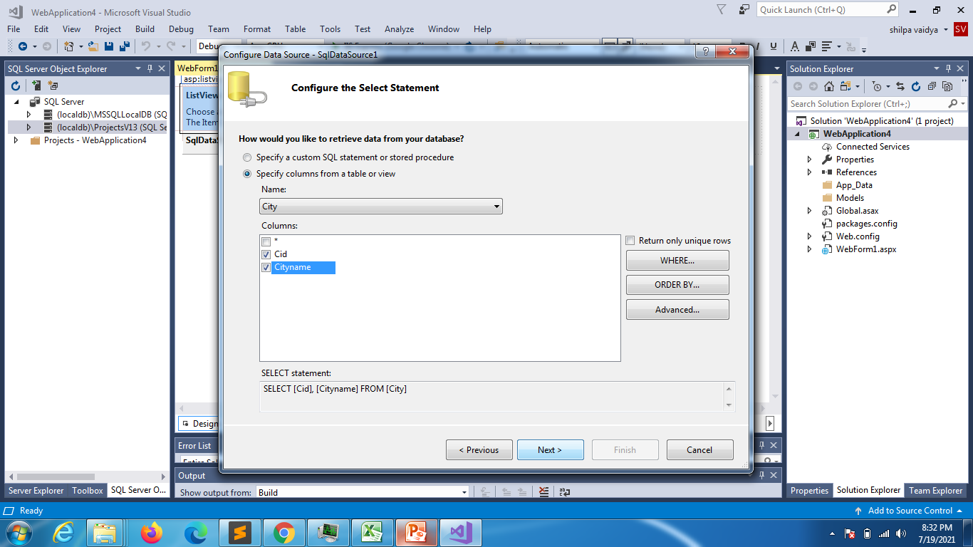

Slide 7
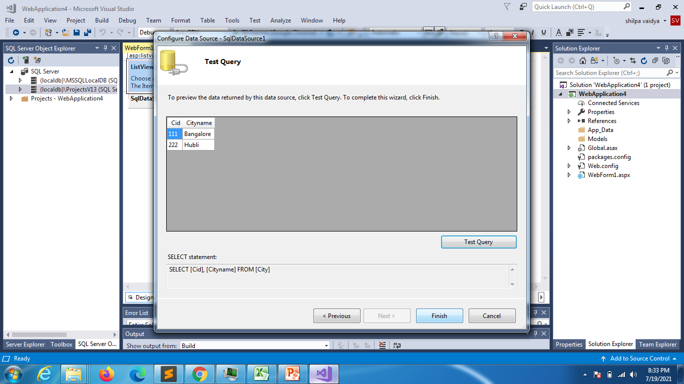

Slide 8
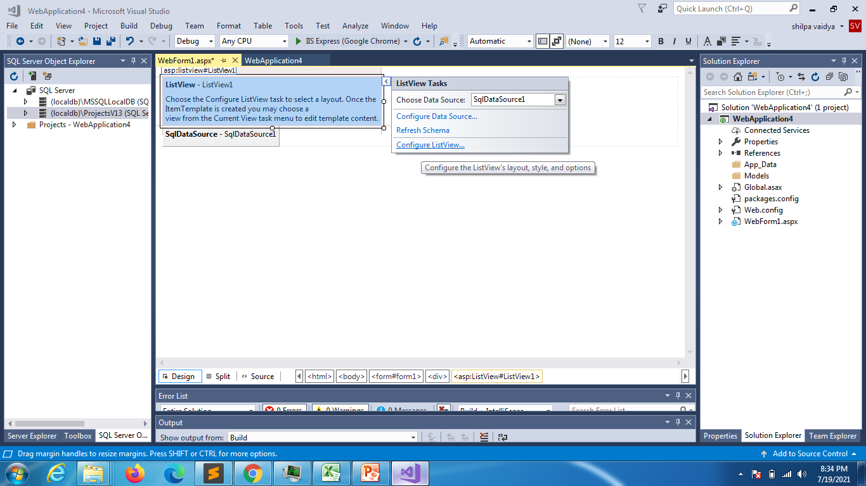

Slide 9
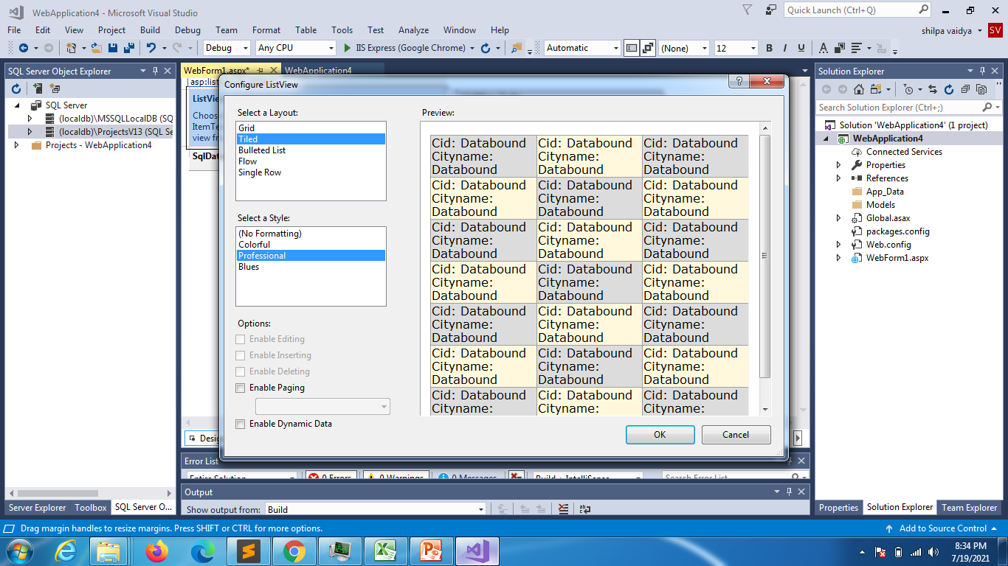

Slide 10
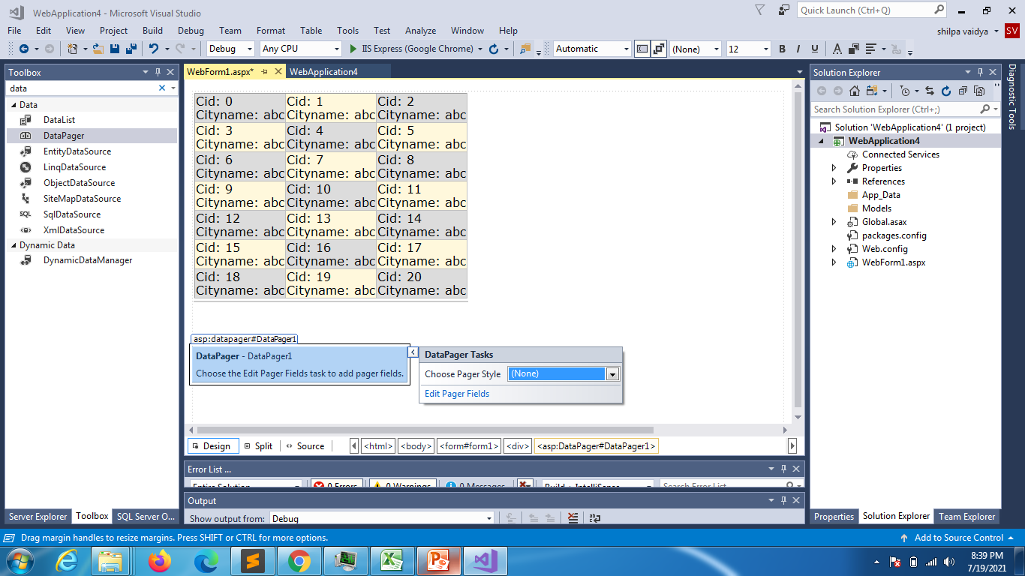

Slide 11
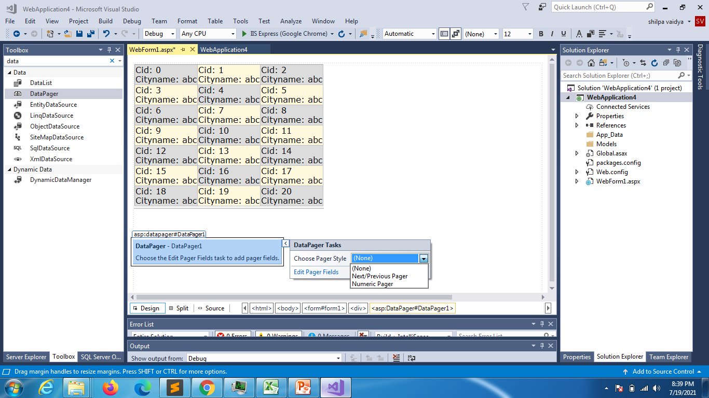

Slide 12
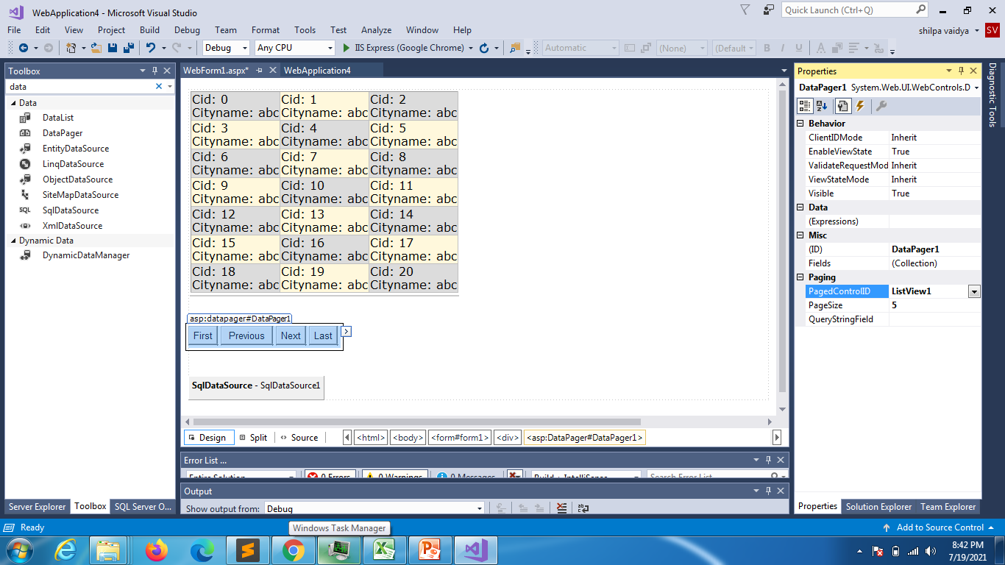

Slide 13
Query extender

Slide 14
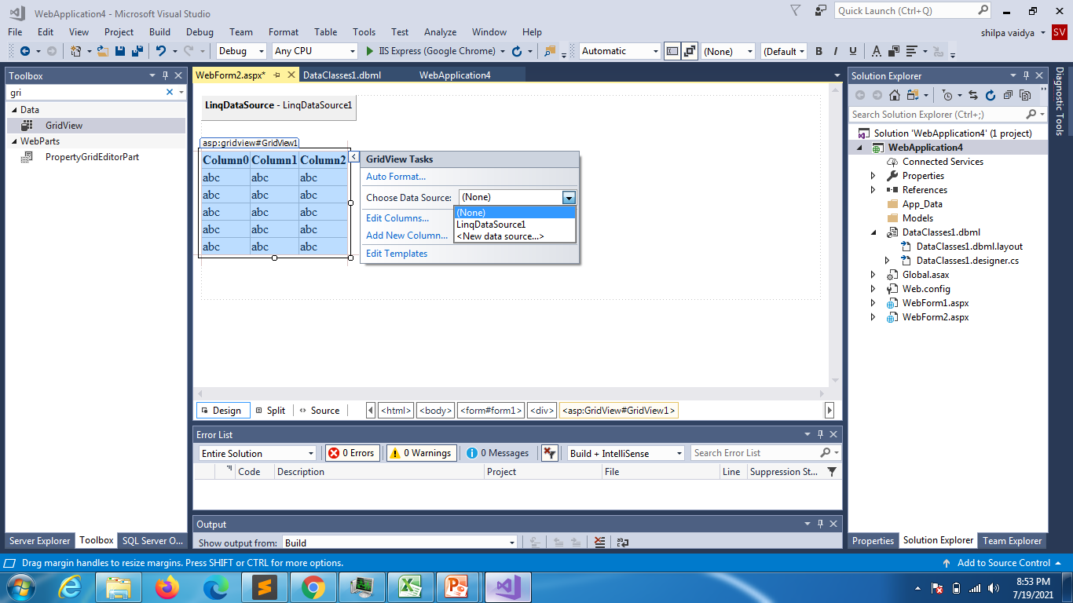

Slide 15
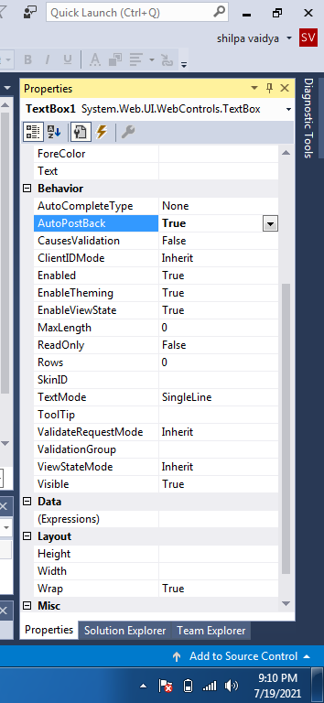
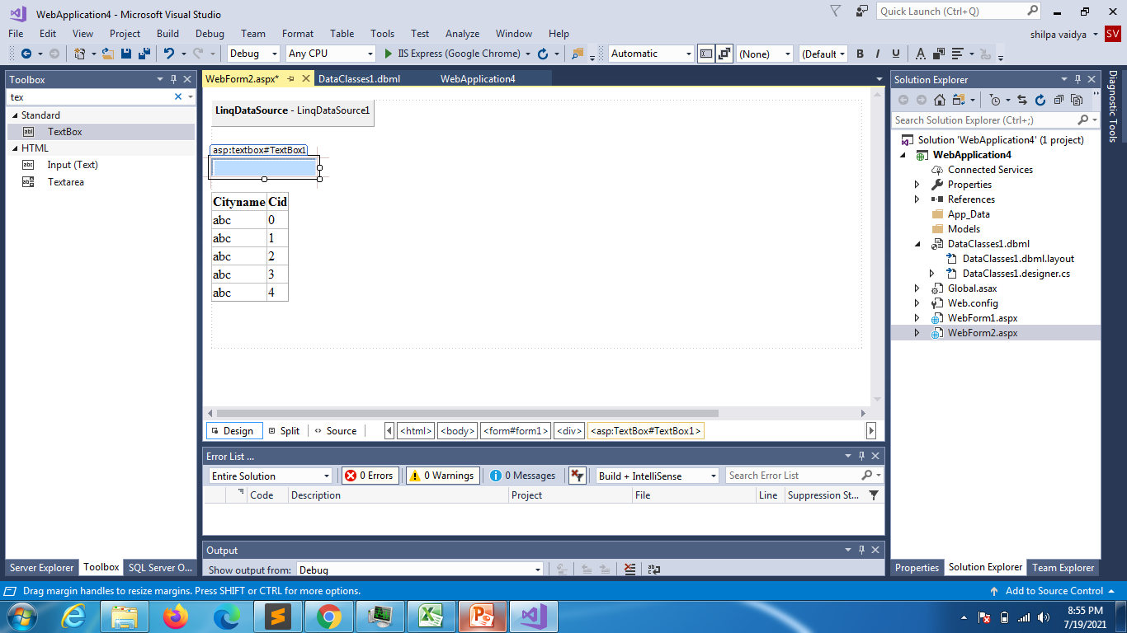

Slide 16
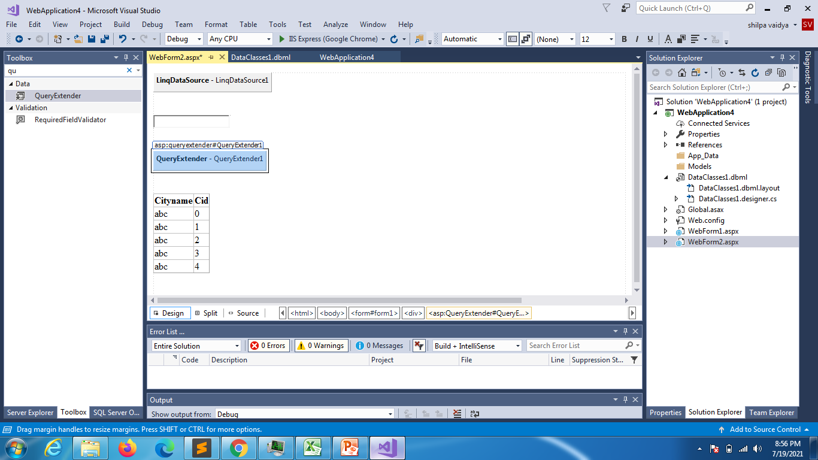

Slide 17
<%@ Page Language="C#" AutoEventWireup="true" CodeBehind="WebForm2.aspx.cs" Inherits="WebApplication4.WebForm2" %>
<!DOCTYPE html>
<html xmlns="http://www.w3.org/1999/xhtml">
<head runat="server">
<title></title>
</head>
<body>
<form id="form1" runat="server">
<asp:LinqDataSource ID="LinqDataSource1" runat="server" ContextTypeName="WebApplication4.DataClasses1DataContext" EntityTypeName="" Select="new (Cityname, Cid)" TableName="Cities">
</asp:LinqDataSource>
<div>
<br />
<br />
<asp:TextBox ID="TextBox1" runat="server"></asp:TextBox>
<br />
<br />
<asp:QueryExtender ID="QueryExtender1" runat="server" TargetControlID="LinqDataSource1">
<asp:SearchExpression DataFields="Cityname" SearchType="Contains">
<asp:ControlParameter ControlID="TextBox1" />
</asp:SearchExpression>
</asp:QueryExtender>
<br />
<asp:GridView ID="GridView1" runat="server" AutoGenerateColumns="False" DataSourceID="LinqDataSource1">
<Columns>
<asp:BoundField DataField="Cityname" HeaderText="Cityname" ReadOnly="True" SortExpression="Cityname" />
<asp:BoundField DataField="Cid" HeaderText="Cid" ReadOnly="True" SortExpression="Cid" />
</Columns>
</asp:GridView>
<br />
<br />
</div>
</form>
</body>
</html>

