Slide 1
Viewstate implementation

Slide 2
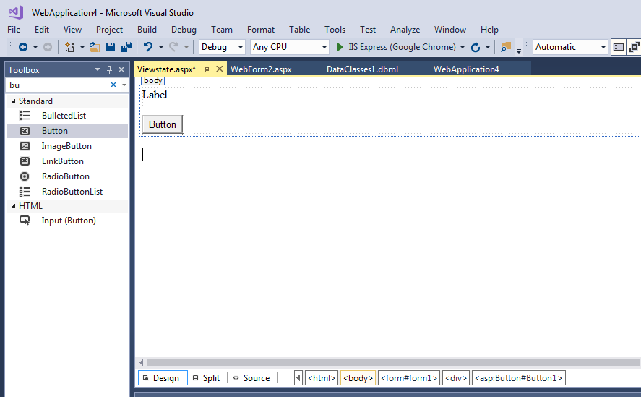

Slide 3
Run the file and check output
using System;
namespace WebApplication4
{
public partial class Viewstate : System.Web.UI.Page
{
int i = 0;
protected void Page_Load(object sender, EventArgs e)
{
}
protected void Button1_Click(object sender, EventArgs e)
{
Label1.Text = (++i).ToString();
}
}
}

Slide 4
Implementing viewstate
using System;
namespace WebApplication4
{
public partial class Viewstate : System.Web.UI.Page
{
int i = 0;
protected void Page_Load(object sender, EventArgs e)
{
if(!IsPostBack)
{
ViewState["counter"] = i;
}
}
protected void Button1_Click(object sender, EventArgs e)
{
i = (int)ViewState["counter"];
Label1.Text = (++i).ToString();
ViewState["counter"] = i;
}
}
}

Slide 5
Hidden fields

Slide 6
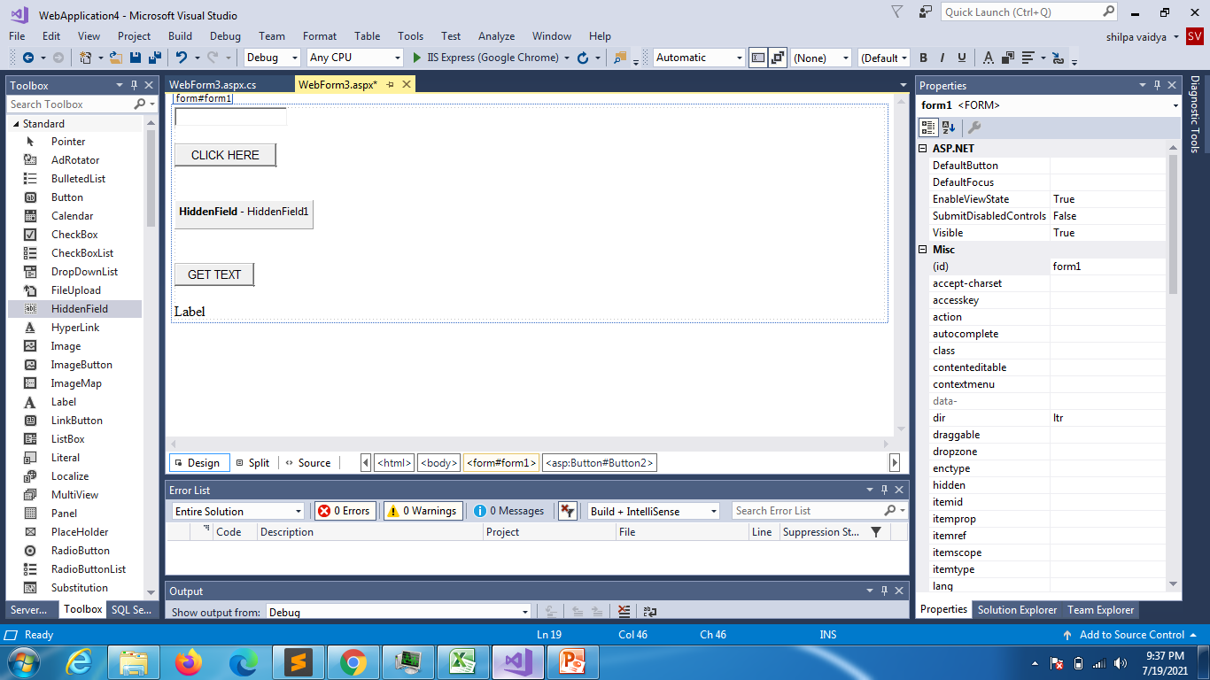

Slide 7
using System;
using System.Collections.Generic;
using System.Linq;
using System.Web;
using System.Web.UI;
using System.Web.UI.WebControls;
namespace WebApplication4
{
public partial class WebForm3 : System.Web.UI.Page
{
protected void Page_Load(object sender, EventArgs e)
{
}
protected void Button2_Click(object sender, EventArgs e)
{
Label1.Text = HiddenField1.Value;
}
protected void Button1_Click(object sender, EventArgs e)
{
HiddenField1.Value = TextBox1.Text;
}
}
}

Slide 8
Query string

Slide 9
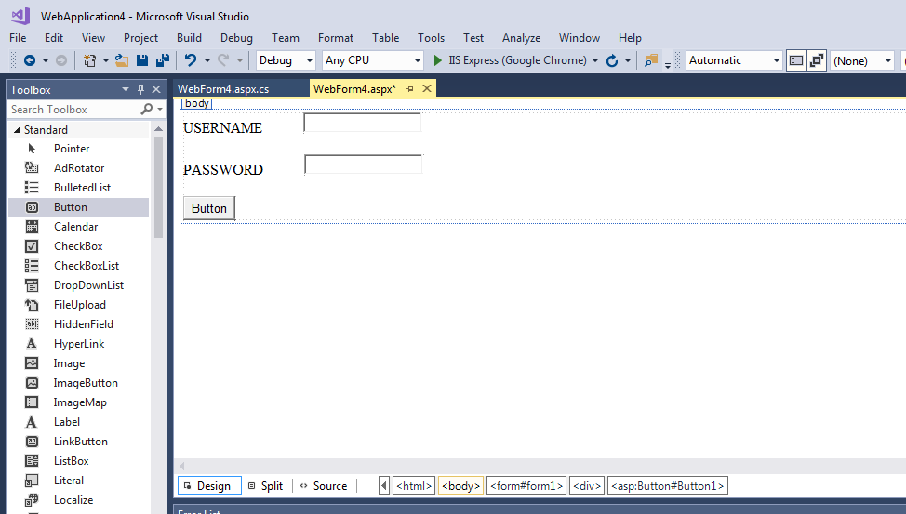

Slide 10
using System;
using System.Collections.Generic;
using System.Linq;
using System.Web;
using System.Web.UI;
using System.Web.UI.WebControls;
namespace WebApplication4
{
public partial class WebForm4 : System.Web.UI.Page
{
protected void Page_Load(object sender, EventArgs e)
{
if (!IsPostBack)
TextBox1.Focus();
}
protected void Button1_Click(object sender, EventArgs e)
{
if (TextBox1.Text == "admin" && TextBox2.Text == "admin")
Response.Redirect("WebForm5.aspx?Name=" + TextBox1.Text + "&Pwd=" + TextBox2.Text);
else
Response.Write("invalid username password");
}
}
}

Slide 11
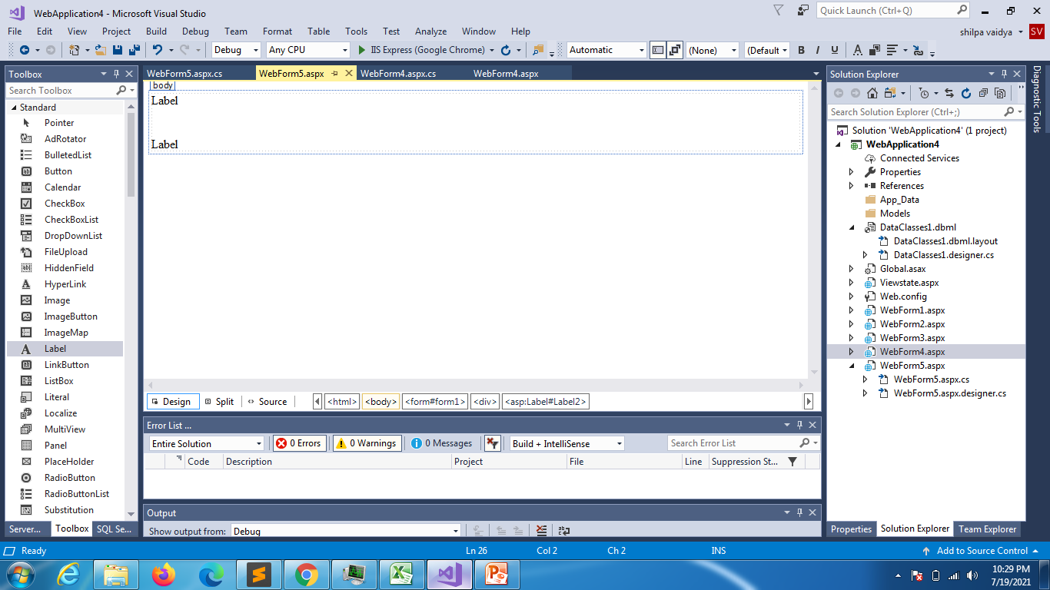

Slide 12
using System;
using System.Collections.Generic;
using System.Linq;
using System.Web;
using System.Web.UI;
using System.Web.UI.WebControls;
namespace WebApplication4
{
public partial class WebForm5 : System.Web.UI.Page
{
protected void Page_Load(object sender, EventArgs e)
{
// string name = Request.Form["TextBox1"];
// string pass = Request.Form["TextBox2"];
string n1 = Request.QueryString["name"];
string p1 = Request.QueryString["Pwd"];
Label1.Text = n1;
Label2.Text = p1;
}
}
}

