Slide 1
Skinfile

Slide 2
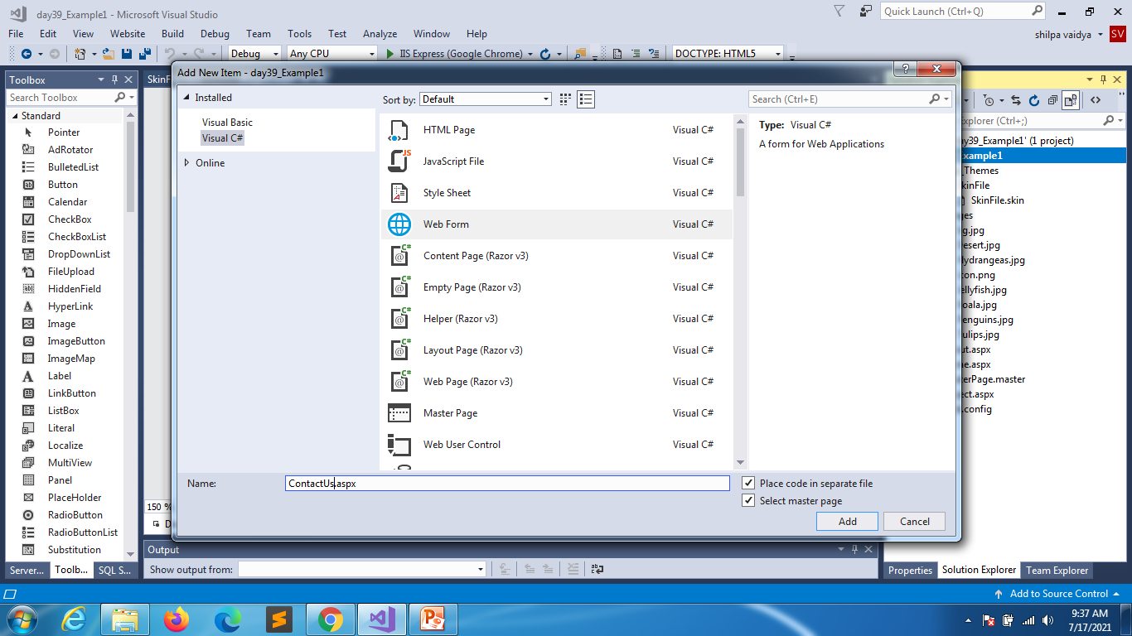
Contact us page

Slide 3
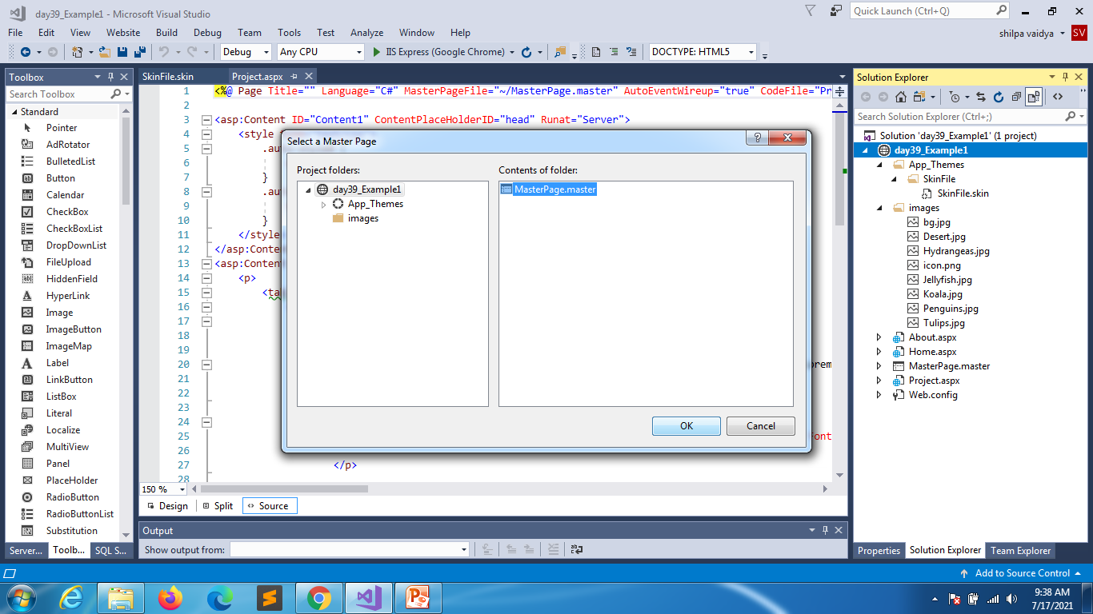

Slide 4
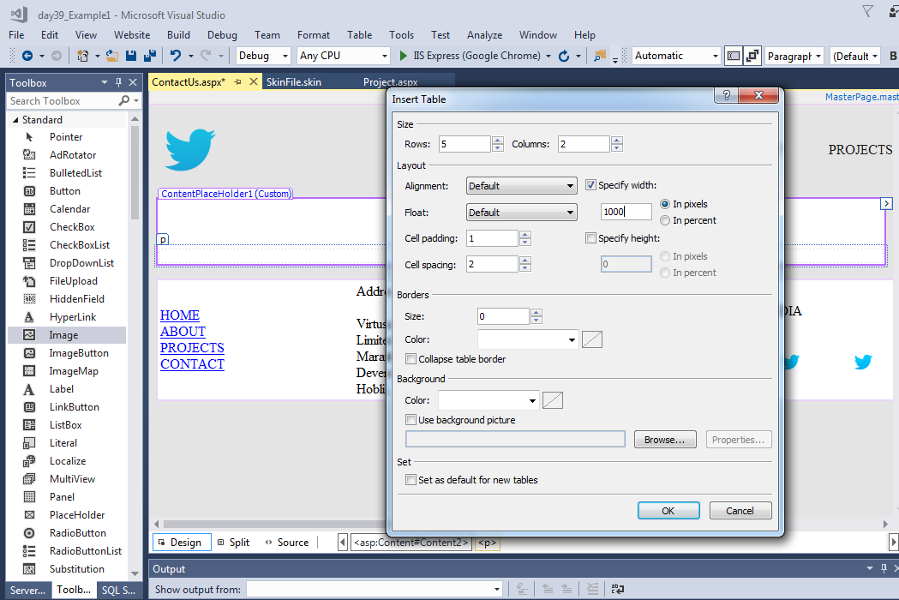

Slide 5
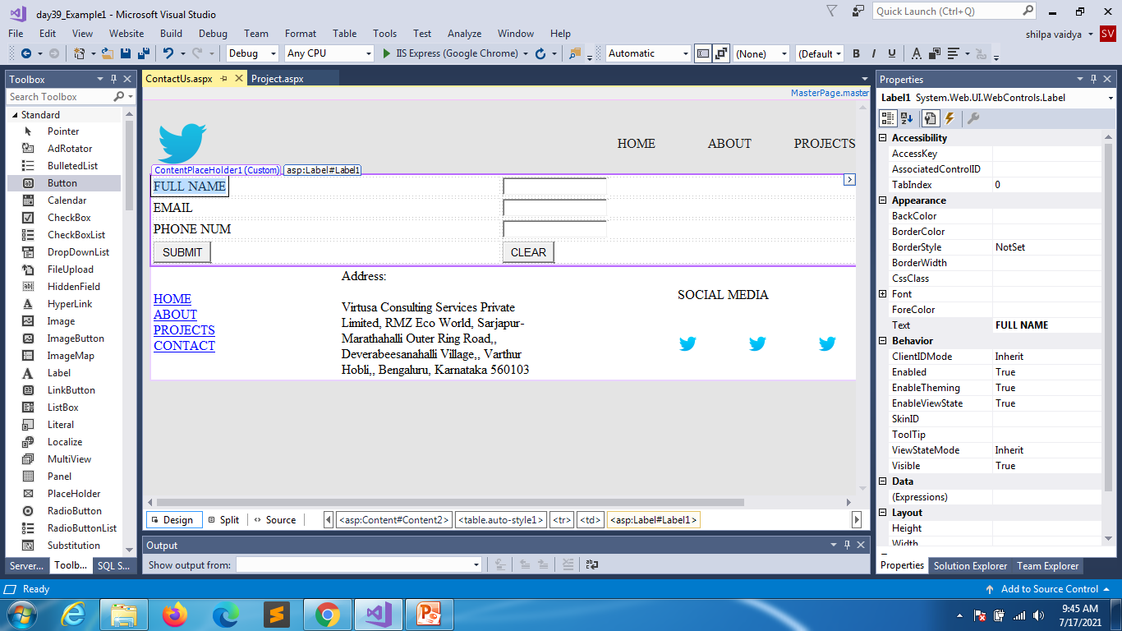

Slide 6
<%@ Page Title="" Language="C#" MasterPageFile="~/MasterPage.master" AutoEventWireup="true" CodeFile="ContactUs.aspx.cs" Inherits="ContactUs" %>
<asp:Content ID="Content1" ContentPlaceHolderID="head" Runat="Server">
</asp:Content>
<asp:Content ID="Content2" ContentPlaceHolderID="ContentPlaceHolder1" Runat="Server">
<table class="auto-style1">
<tr>
<td>
<asp:Label ID="Label1" runat="server" Text="FULL NAME"></asp:Label>
</td>
<td>
<asp:TextBox ID="txtFullname" runat="server"></asp:TextBox>
</td>
</tr>
<tr>
<td>
<asp:Label ID="Label2" runat="server" Text="EMAIL"></asp:Label>
</td>
<td>
<asp:TextBox ID="txtEmail" runat="server"></asp:TextBox>
</td>
</tr>

Slide 7
<tr>
<td>
<asp:Label ID="Label3" runat="server" Text="PHONE NUM"></asp:Label>
</td>
<td>
<asp:TextBox ID="txtPhone" runat="server"></asp:TextBox>
</td>
</tr>
<tr>
<td>
<asp:Button ID="btnSubmit" runat="server" Text="SUBMIT" />
</td>
<td>
<asp:Button ID="btnReset" runat="server" Text="CLEAR" />
</td>
</tr>
</table>
</asp:Content>

Slide 8
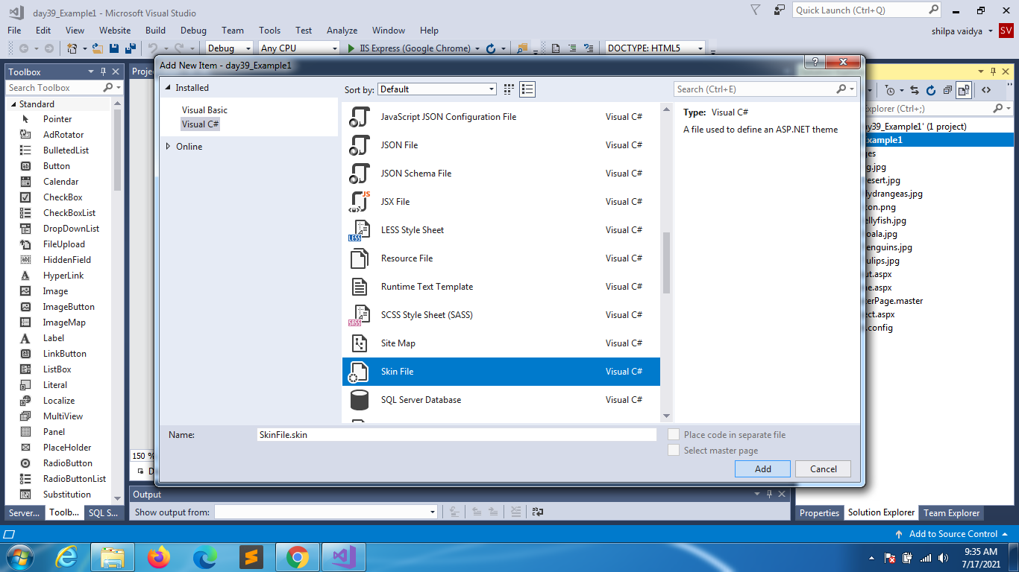

Slide 9
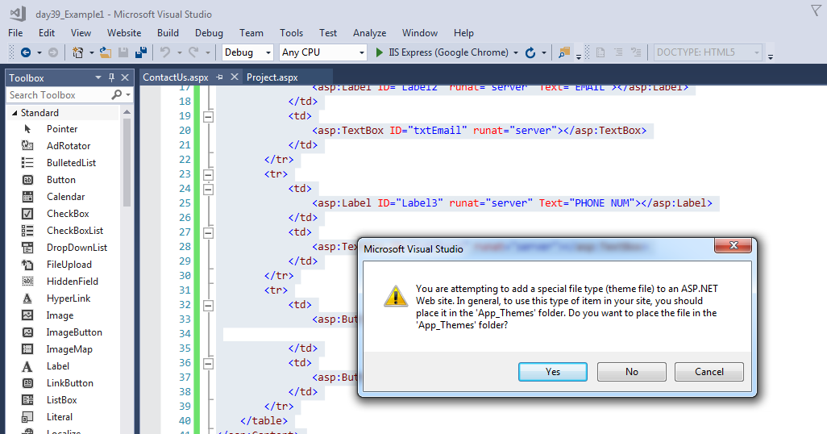
You will get a warning . Press yes

Slide 10
Inside skin file
<asp:Button SkinId="orange" runat="server" BackColor="#fc7b03" ForeColor="#fcba03" Width="110px" />
<asp:Button SkinId="red" runat="server" BackColor="#fc3103" ForeColor="white" Width="110px" />
<asp:TextBox runat="server" BackColor="#fcba03" ForeColor="#fcba03" Width="110px" Font-Bold="True" ></asp:TextBox>

Slide 11
<%@ Page Title="" Language="C#" MasterPageFile="~/MasterPage.master" AutoEventWireup="true" CodeFile="ContactUs.aspx.cs" Inherits="ContactUs" StylesheetTheme="SkinFile" %>
<asp:Content ID="Content1" ContentPlaceHolderID="head" Runat="Server">
</asp:Content>
<asp:Content ID="Content2" ContentPlaceHolderID="ContentPlaceHolder1" Runat="Server">
<table align="center" >
<tr>
<td>
<asp:Label ID="Label1" runat="server" Text="FULL NAME"></asp:Label>
</td>
<td>
<asp:TextBox ID="txtFullname" runat="server"></asp:TextBox>
</td>
</tr>
<tr>
<td>
<asp:Label ID="Label2" runat="server" Text="EMAIL"></asp:Label>
</td>
<td>
<asp:TextBox ID="txtEmail" runat="server"></asp:TextBox>
</td>
Contact US page

Slide 12
</tr>
<tr>
<td>
<asp:Label ID="Label3" runat="server" Text="PHONE NUM"></asp:Label>
</td>
<td>
<asp:TextBox ID="txtPhone" runat="server"></asp:TextBox>
</td>
</tr>
<tr>
<td>
</td>
<td>
<asp:Button ID="btnSubmit" runat="server" Text="SUBMIT" SkinID="red" />
<asp:Button ID="btnReset" runat="server" Text="CLEAR" SkinID="orange" />
</td>
</tr>
</table>
</asp:Content>

