Slide 1
Controls

Slide 2
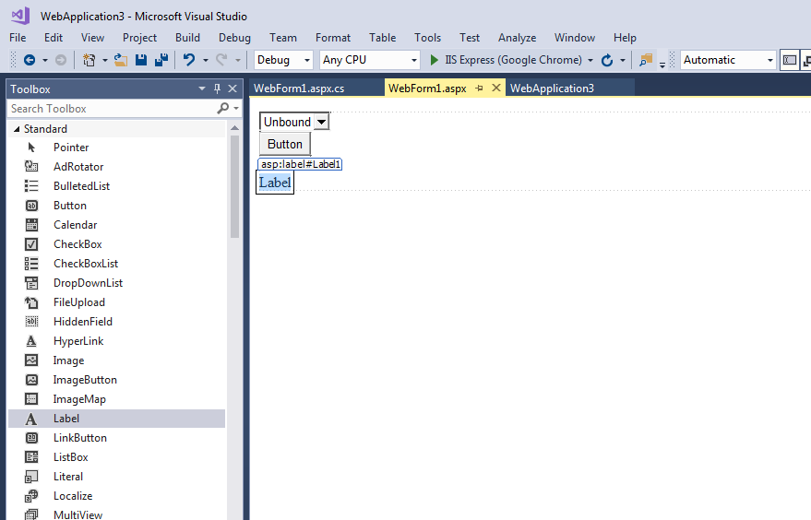

Slide 3
webform
<%@ Page Language="C#" AutoEventWireup="true" CodeBehind="WebForm1.aspx.cs" Inherits="WebApplication3.WebForm1" %>
<!DOCTYPE html>
<html xmlns="http://www.w3.org/1999/xhtml">
<head runat="server">
<title></title>
</head>
<body>
<form id="form1" runat="server">
<div>
<asp:DropDownList ID="DropDownList1" runat="server">
</asp:DropDownList>
</div>
<asp:Button ID="Button1" runat="server" Text="Button" OnClick="Button1_Click" />
<br />
<br />
<asp:Label ID="Label1" runat="server" Text="Label"></asp:Label>
</form>
</body>
</html>

Slide 4
using System;
using System.Collections.Generic;
using System.Linq;
using System.Web;
using System.Web.UI;
using System.Web.UI.WebControls;
namespace WebApplication3
{
public partial class WebForm1 : System.Web.UI.Page
{
ListItem item;
protected void Page_Load(object sender, EventArgs e)
{
item = new ListItem();
DropDownList1.Items.Add("Apple");
DropDownList1.Items.Add("Mango");
DropDownList1.Items.Add("Orange");
}
protected void Button1_Click(object sender, EventArgs e)
{
string s1 = DropDownList1.SelectedItem + " = ";
s1 += DropDownList1.SelectedValue;
Label1.Text = s1;
}
}
}
if (!IsPostBack)
{
item = new ListItem();
DropDownList1.Items.Add("Apple");
DropDownList1.Items.Add("Mango");
DropDownList1.Items.Add("Orange");
}

Slide 5
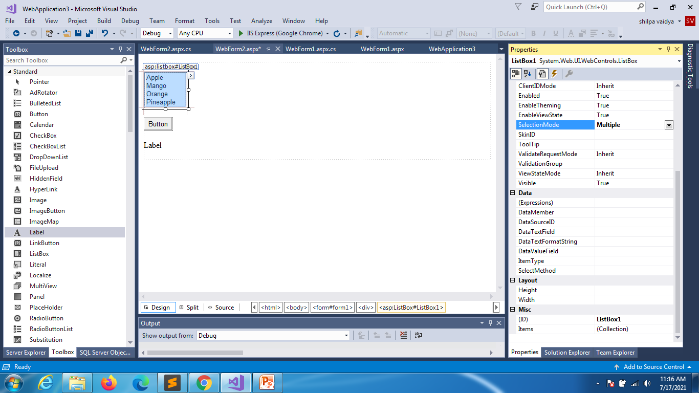
Listbox multiselect

Slide 6
using System;
using System.Collections.Generic;
using System.Linq;
using System.Web;
using System.Web.UI;
using System.Web.UI.WebControls;
namespace WebApplication3
{
public partial class WebForm2 : System.Web.UI.Page
{
protected void Page_Load(object sender, EventArgs e)
{
}
protected void Button1_Click(object sender, EventArgs e)
{
string select = "";
for(int i=0;i<ListBox1.Items.Count;i++)
{
if (ListBox1.Items[i].Selected)
select += ListBox1.Items[i].Text + " ";
}
Label1.Text = select;
}
}
}

Slide 7
Add rotator
The AdRotator control randomly selects banner graphics from a list, which is specified in an external XML schedule file. This external XML schedule file is called the advertisement file.
The AdRotator control allows you to specify the advertisement file and the type of window that the link should follow in the AdvertisementFile and the Target property respectively.
The basic syntax of adding an AdRotator is as follows:
<asp:AdRotator runat = "server" AdvertisementFile = "adfile.xml" Target = "_blank" />Before going into the details of the AdRotator control and its properties, let us look into the construction of the advertisement file.

Slide 8
The Advertisement File
The advertisement file is an XML file, which contains the information about the advertisements to be displayed.
Extensible Markup Language (XML) is a W3C standard for text document markup. It is a text-based markup language that enables you to store data in a structured format by using meaningful tags. The term 'extensible' implies that you can extend your ability to describe a document by defining meaningful tags for the application.
XML is not a language in itself, like HTML, but a set of rules for creating new markup languages. It is a meta-markup language. It allows developers to create custom tag sets for special uses. It structures, stores, and transports the information.
Following is an example of XML file:
<BOOK>
<NAME> Learn XML </NAME>
<AUTHOR> Samuel Peterson </AUTHOR>
<PUBLISHER> NSS Publications </PUBLISHER>
<PRICE> $30.00</PRICE>
</BOOK>

Slide 9
Element | Description
Advertisements | Encloses the advertisement file.
Ad | Delineates separate ad.
ImageUrl | The path of image that will be displayed.
NavigateUrl | The link that will be followed when the user clicks the ad.
AlternateText | The text that will be displayed instead of the picture if it cannot be displayed.
Keyword | Keyword identifying a group of advertisements. This is used for filtering.
Impressions | The number indicating how often an advertisement will appear.
Height | Height of the image to be displayed.
Width | Width of the image to be displayed.
Like all XML files, the advertisement file needs to be a structured text file with well-defined tags delineating the data. There are the following standard XML elements that are commonly used in the advertisement file:
Apart from these tags, customs tags with custom attributes could also be included

Slide 10
Apart from these tags, customs tags with custom attributes could also be included. The following code illustrates an advertisement file ads.xml:
<Advertisements>
<Ad>
<ImageUrl>rose1.jpg</ImageUrl>
<NavigateUrl>http://www.1800flowers.com</NavigateUrl>
<AlternateText> Order flowers, roses, gifts and more </AlternateText>
<Impressions>20</Impressions>
<Keyword>flowers</Keyword>
</Ad>
<Ad>
<ImageUrl>rose2.jpg</ImageUrl>
<NavigateUrl>http://www.babybouquets.com.au</NavigateUrl>
<AlternateText>Order roses and flowers</AlternateText>
<Impressions>20</Impressions>
<Keyword>gifts</Keyword>
</Ad>
<Ad>
<ImageUrl>rose3.jpg</ImageUrl>
<NavigateUrl>http://www.flowers2moscow.com</NavigateUrl>
<AlternateText>Send flowers to Russia</AlternateText>
<Impressions>20</Impressions>
<Keyword>russia</Keyword>
</Ad>
</Advertisements>

Slide 11
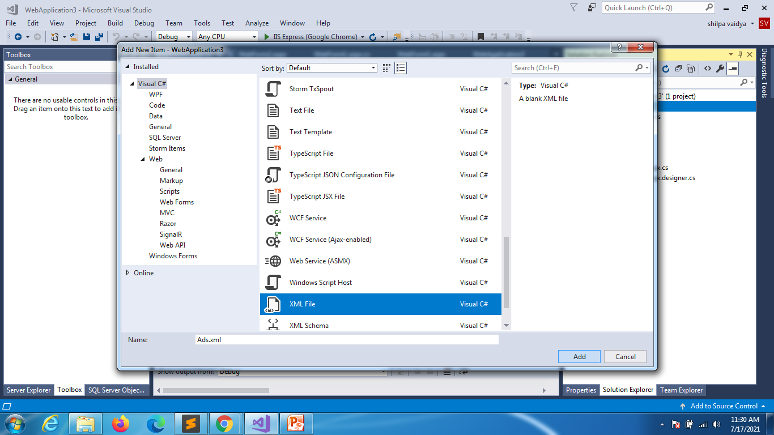
Implementation of AddXml

Slide 12
Ads.xml file
<?xml version="1.0" encoding="utf-8" ?>
<Advertisements>
<Ad>
<ImageUrl>~/images/Desert.jpg</ImageUrl>
<Navigator>https://www.google.com/</Navigator>
<AlternateText>Google.com</AlternateText>
<Impressions>3</Impressions>
</Ad>
<Ad>
<ImageUrl>~/images/Koala.jpg</ImageUrl>
<Navigator>https://www.infosys.com/</Navigator>
<AlternateText>Google.com</AlternateText>
<Impressions>2</Impressions>
</Ad>
<Ad>
<ImageUrl>~/images/Jellyfish.jpg</ImageUrl>
<Navigator>https://www.virtusa.com/</Navigator>
<AlternateText>Google.com</AlternateText>
<Impressions>1</Impressions>
</Ad>
</Advertisements>

Slide 13
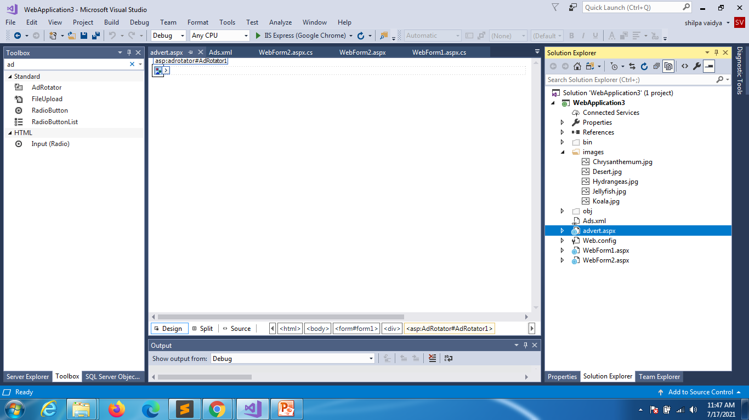
Create web form: drag and drop ad-rotator

Slide 14
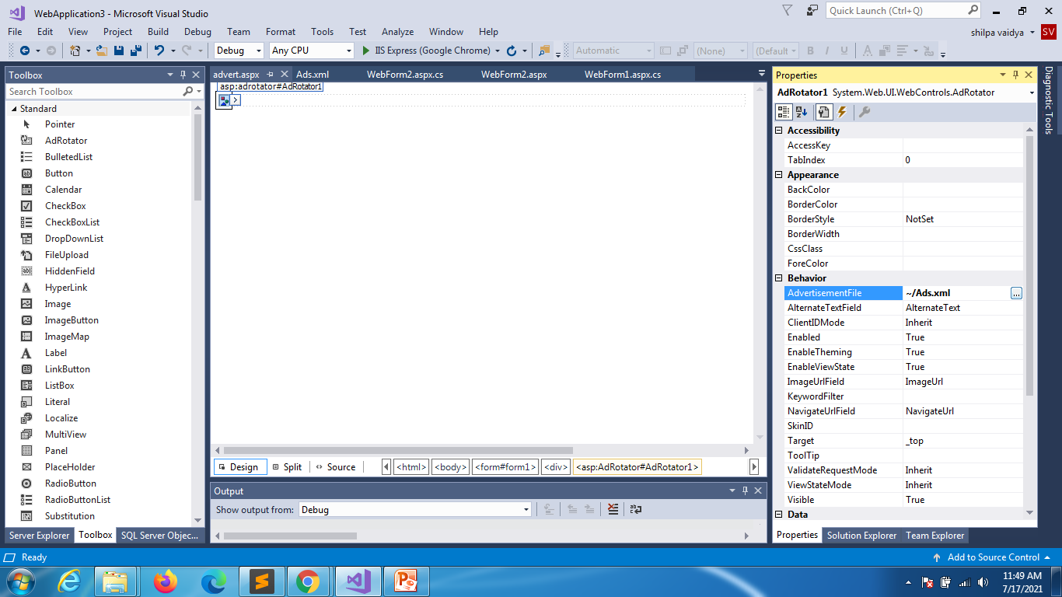

Slide 15
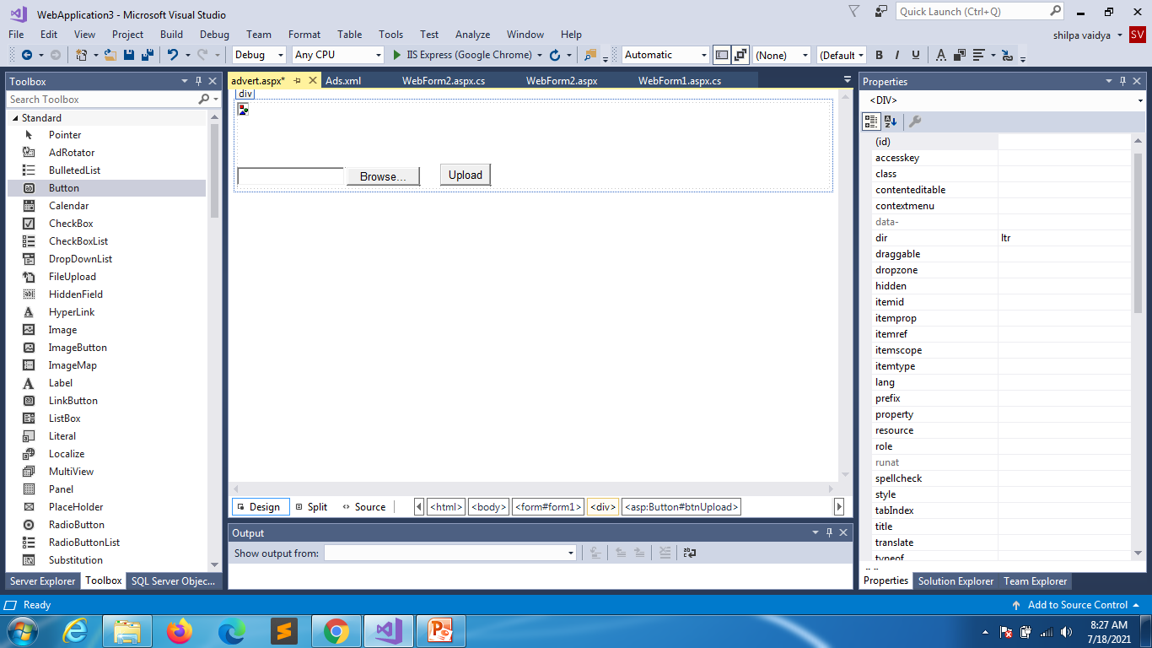
File upload

Slide 16
<%@ Page Language="C#" AutoEventWireup="true" CodeBehind="advert.aspx.cs" Inherits="WebApplication3.advert" %>
<!DOCTYPE html>
<html xmlns="http://www.w3.org/1999/xhtml">
<head runat="server">
<title></title>
</head>
<body>
<form id="form1" runat="server">
<div>
<asp:AdRotator ID="AdRotator1" runat="server" AdvertisementFile="~/Ads.xml" />
<asp:FileUpload ID="FileUpload1" runat="server" />
&nbsp;&nbsp;&nbsp;&nbsp;&nbsp;
<asp:Button ID="btnUpload" runat="server" Text="Upload" />
<br />
</div>
</form>
</body>
</html>

Slide 17
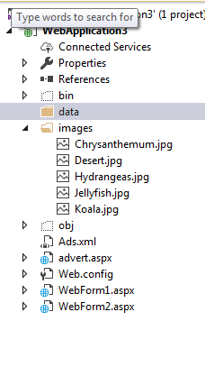
using System;
namespace WebApplication3
{
public partial class advert : System.Web.UI.Page
{
protected void Page_Load(object sender, EventArgs e)
{
}
protected void btnUpload_Click(object sender, EventArgs e)
{
string path = Server.MapPath("~/data/");
FileUpload1.SaveAs(path + FileUpload1.FileName);
}
}
}
Create data folder that will collect all the files uploaded

Slide 18
using System;
namespace WebApplication3
{
public partial class advert : System.Web.UI.Page
{
protected void btnUpload_Click(object sender, EventArgs e)
{
string path = Server.MapPath("~/data/");
//incase if you want to restrict the extension
string mime = FileUpload1.PostedFile.ContentType;
if(mime=="image/jpeg"|| mime == "image/gif"|| mime == "image/png")
{
FileUpload1.SaveAs(path + FileUpload1.FileName);
}
else
{
Response.Write("Invalid file type");
}
}
}
}

Slide 19
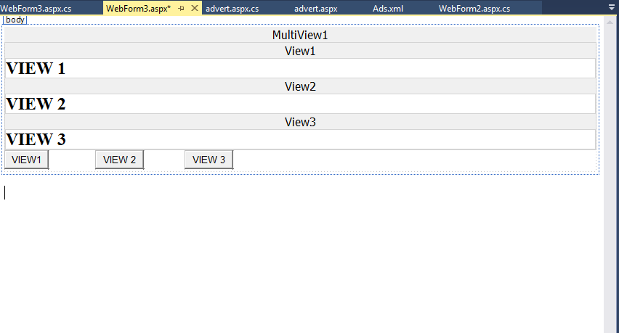
multiview

Slide 20
<%@ Page Language="C#" AutoEventWireup="true" CodeBehind="WebForm3.aspx.cs" Inherits="WebApplication3.WebForm3" %>
<!DOCTYPE html>
<html xmlns="http://www.w3.org/1999/xhtml">
<head runat="server">
<title></title>
</head>
<body>
<form id="form1" runat="server">
<div>
<asp:MultiView ID="MultiView1" runat="server">
<asp:View ID="View1" runat="server">
<h2>VIEW 1</h2>
</asp:View>
<asp:View ID="View2" runat="server">
<h2>VIEW 2</h2>
</asp:View>

Slide 21
<asp:View ID="View3" runat="server">
<h2>VIEW 3</h2>
</asp:View>
</asp:MultiView>
</div>
<asp:Button ID="btnview1" runat="server" OnClick="btnview1_Click" Text="VIEW1" />
&nbsp;&nbsp;&nbsp;&nbsp;&nbsp;&nbsp;&nbsp;&nbsp;&nbsp;&nbsp;&nbsp;&nbsp;&nbsp;&nbsp;&nbsp;
<asp:Button ID="btnview2" runat="server" OnClick="btnview2_Click" Text="VIEW 2" />
&nbsp;&nbsp;&nbsp;&nbsp;&nbsp;&nbsp;&nbsp;&nbsp;&nbsp;&nbsp;&nbsp;&nbsp;&nbsp;
<asp:Button ID="btnview3" runat="server" OnClick="btnview3_Click" Text="VIEW 3" />
</form>
</body>
</html>

Slide 22
using System;
namespace WebApplication3
{
public partial class WebForm3 : System.Web.UI.Page
{
protected void Page_Load(object sender, EventArgs e)
{
MultiView1.ActiveViewIndex = 0;
}
protected void btnview1_Click(object sender, EventArgs e)
{
MultiView1.ActiveViewIndex = 0;
}
protected void btnview2_Click(object sender, EventArgs e)
{
MultiView1.ActiveViewIndex = 1;
}
protected void btnview3_Click(object sender, EventArgs e)
{
MultiView1.ActiveViewIndex = 2;
}
}
}

Slide 23
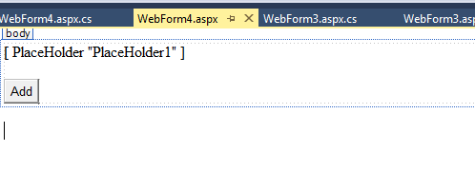
Placeholder
<%@ Page Language="C#" AutoEventWireup="true" CodeBehind="WebForm4.aspx.cs" Inherits="WebApplication3.WebForm4" %>
<!DOCTYPE html>
<html xmlns="http://www.w3.org/1999/xhtml">
<head runat="server">
<title></title>
</head>
<body>
<form id="form1" runat="server">
<div>
<asp:PlaceHolder ID="PlaceHolder1" runat="server"></asp:PlaceHolder>
<br />
<br />
<asp:Button ID="btnadd" runat="server" OnClick="btnadd_Click" Text="Add" />
</div>
</form>
</body>
</html>

Slide 24
using System;
using System.Web.UI.WebControls;
namespace WebApplication3
{
public partial class WebForm4 : System.Web.UI.Page
{
protected void Page_Load(object sender, EventArgs e)
{
}
protected void btnadd_Click(object sender, EventArgs e)
{
TextBox text = new TextBox();
Button b1 = new Button();
b1.Text = "CLICK";
PlaceHolder1.Controls.Add(text);
PlaceHolder1.Controls.Add(b1);
}
}
}

