Slide 1
Validators

Slide 2
Web.config
<?xml version="1.0"?>
<!--
For more information on how to configure your ASP.NET application, please visit
https://go.microsoft.com/fwlink/?LinkId=169433
-->
<configuration>
<!--
For a description of web.config changes see http://go.microsoft.com/fwlink/?LinkId=235367.
The following attributes can be set on the <httpRuntime> tag.
<system.Web>
<httpRuntime targetFramework="4.6.1" />
</system.Web>
-->
<appSettings>
<add key="ValidationSettings:UnobtrusiveValidationMode" value="None"/>
</appSettings>
<system.web>
<compilation debug="true" targetFramework="4.6.1"/>
<pages controlRenderingCompatibilityVersion="4.0"/>
</system.web>
</configuration>

Slide 3
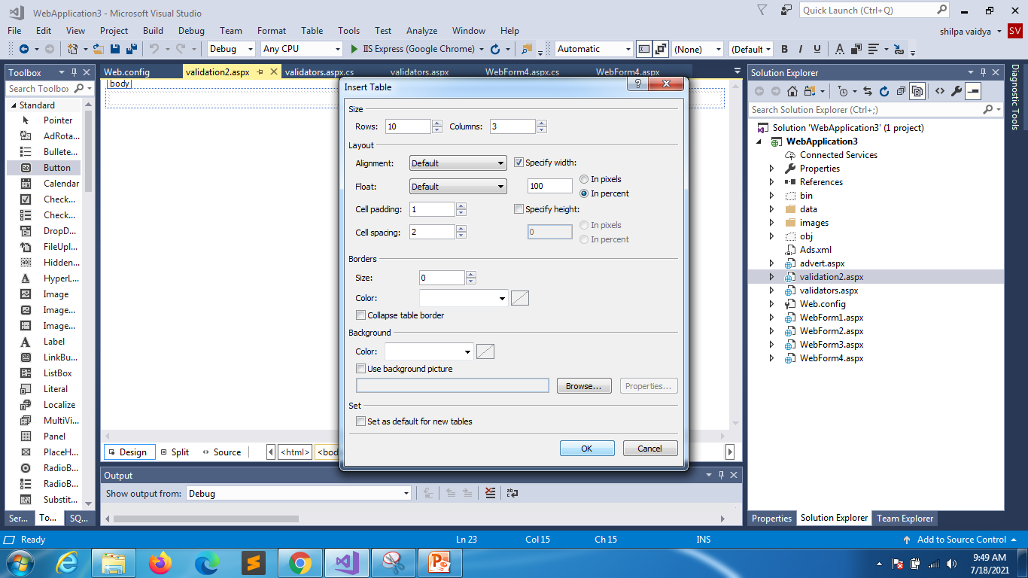

Slide 4
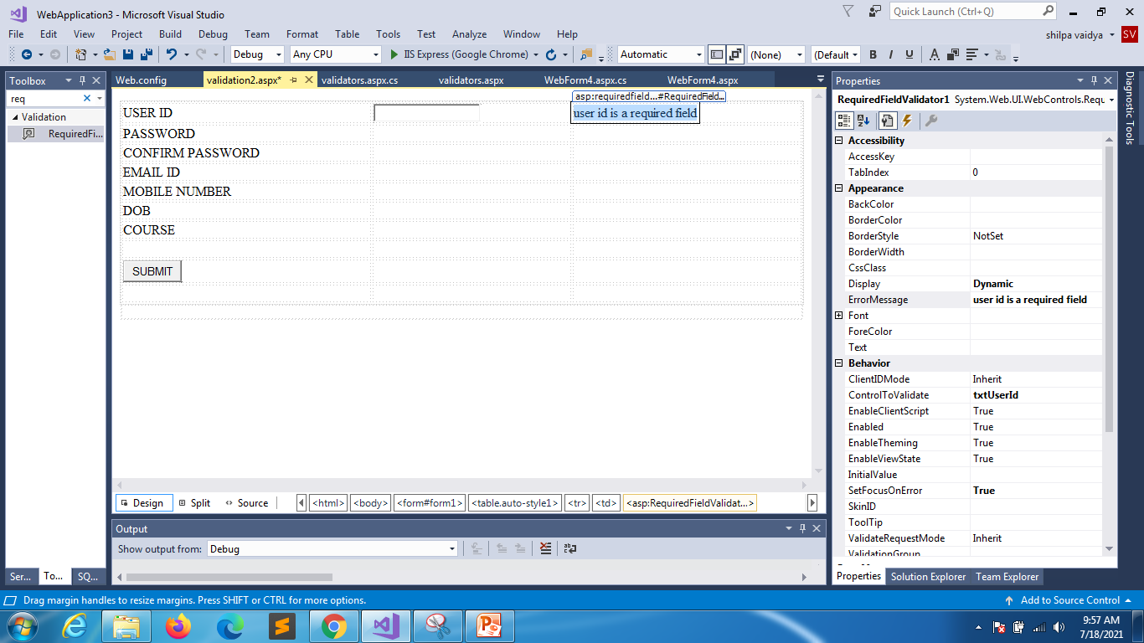
Under properties check all bold values
Notes:
REQUIRED FIELD VALIDATOR

Slide 5
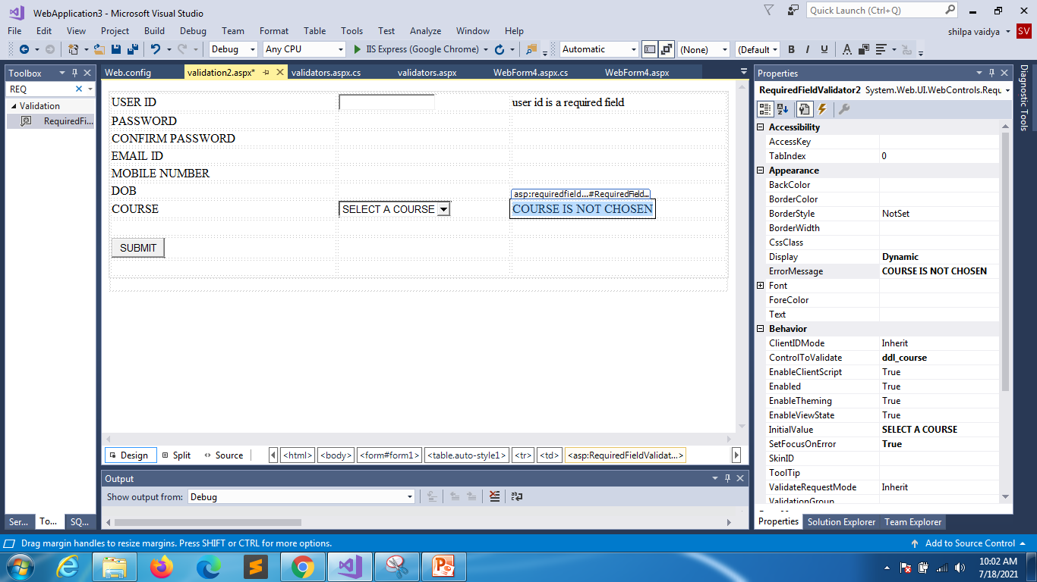
Notes:
REQUIRED FIELD VALIDATOR

Slide 6
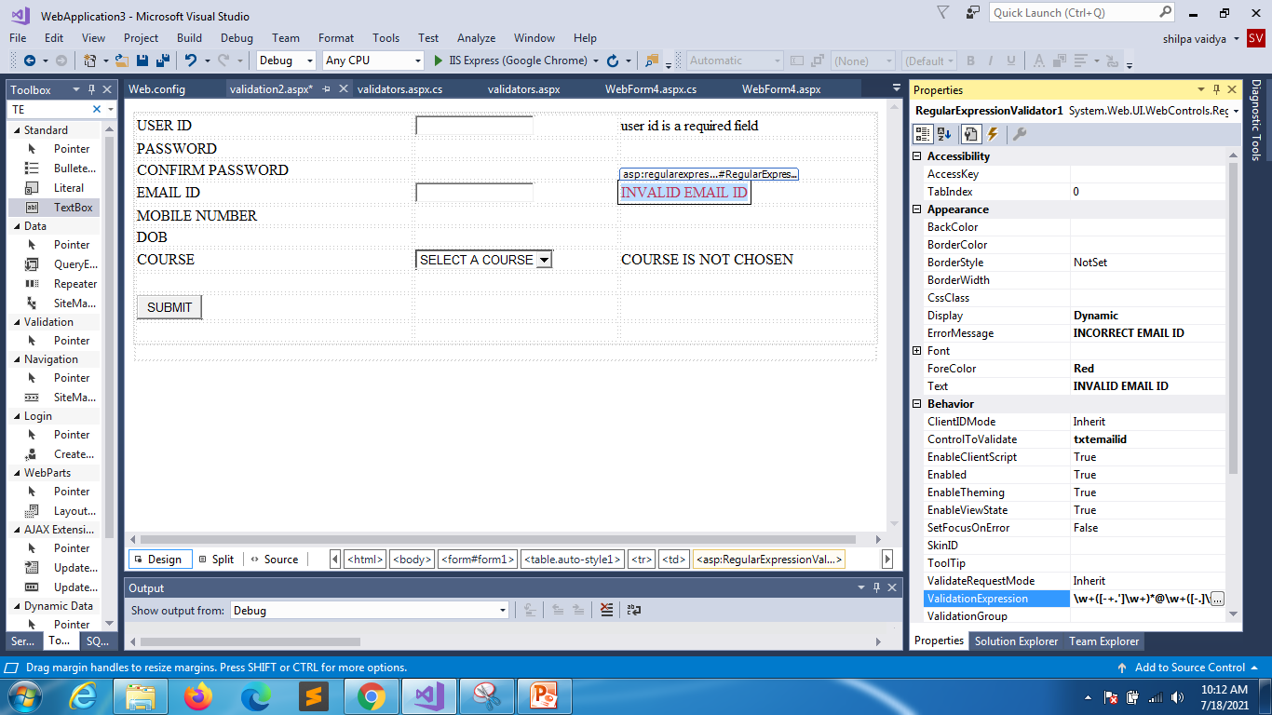
Notes:
REGULAR EXPRESSION VALIDATOR

Slide 7
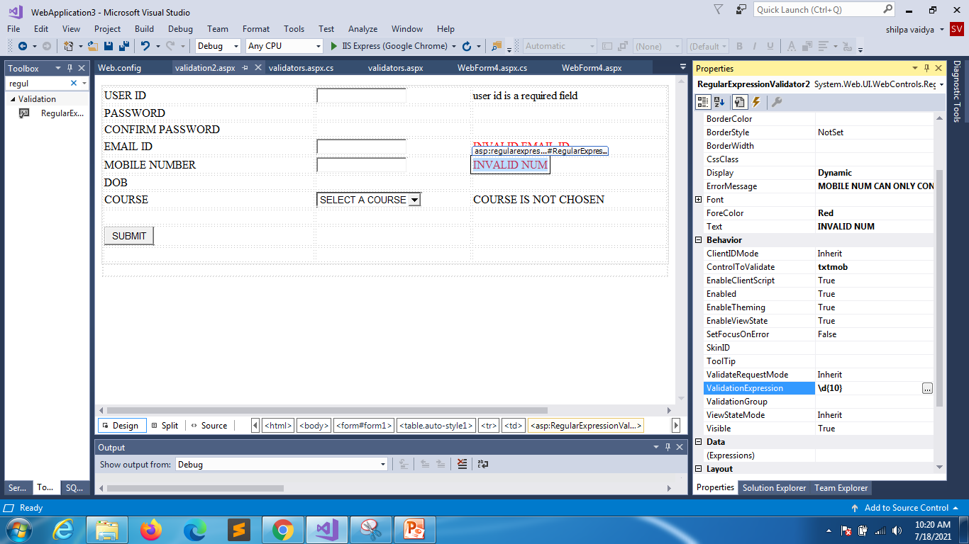
Notes:
REGULAR EXPRESSION

Slide 8
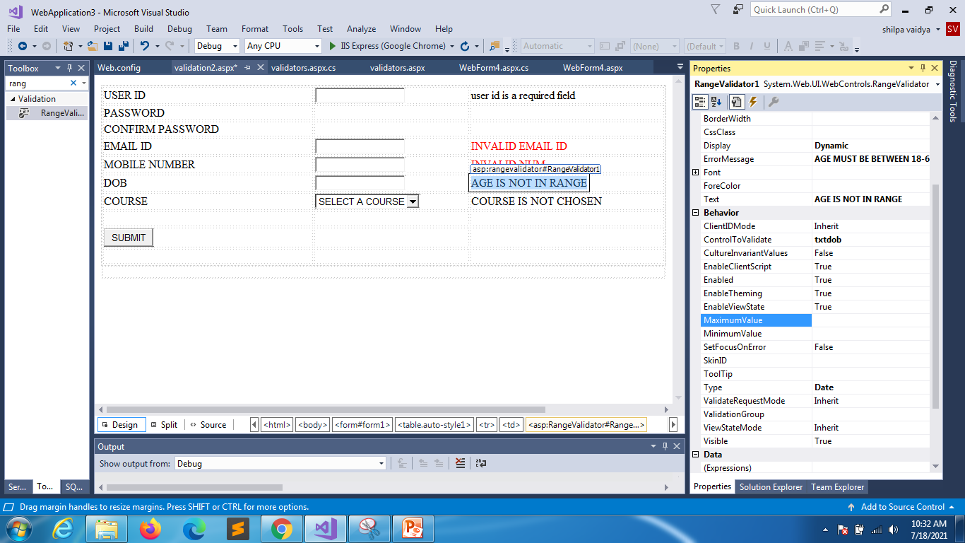
In nextslide minimum and max range is mentioned
Notes:
RANGE VALIDATOR

Slide 9
using System;
using System.Collections.Generic;
using System.Linq;
using System.Web;
using System.Web.UI;
using System.Web.UI.WebControls;
namespace WebApplication3
{
public partial class validation2 : System.Web.UI.Page
{
protected void Page_Load(object sender, EventArgs e)
{
RangeValidator1.MinimumValue = DateTime.Now.AddYears(-60).ToShortDateString();
RangeValidator1.MaximumValue = DateTime.Now.AddYears(-18).ToShortDateString();
}
}
}
Notes:
RangeValidator

Slide 10
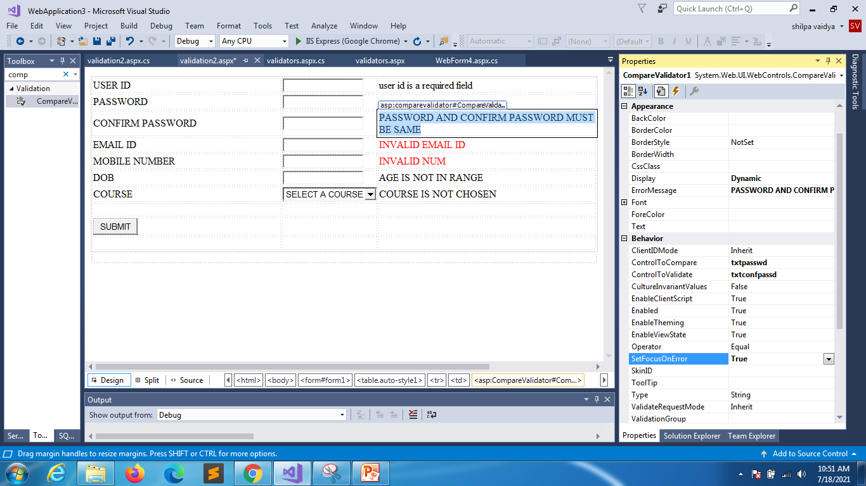
Notes:
COMPARE VALIDATOR

Slide 11
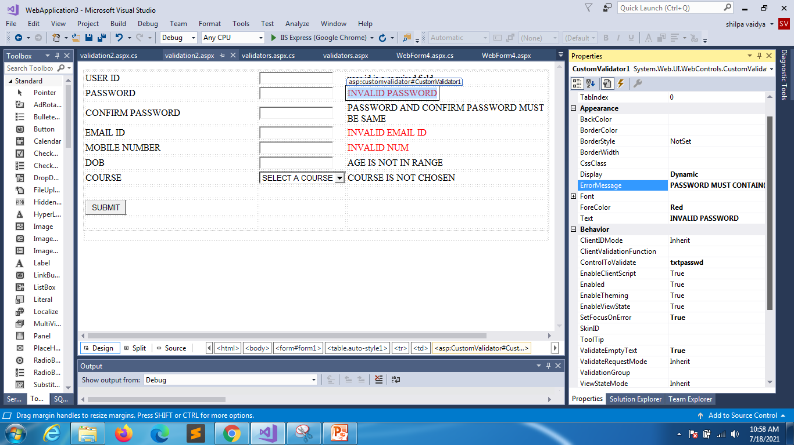
In nextslide validation is mentioned double click on invalid password to get function at backend

Slide 12
using System;
namespace WebApplication3
{
public partial class validation2 : System.Web.UI.Page
{
protected void Page_Load(object sender, EventArgs e)
{
RangeValidator1.MinimumValue = DateTime.Now.AddYears(-60).ToShortDateString();
RangeValidator1.MaximumValue = DateTime.Now.AddYears(-18).ToShortDateString();
}
protected void CustomValidator1_ServerValidate(object source, ServerValidateEventArgs args)
{
int len = args.Value.Length;
if (len >= 8 && len <= 15)
args.IsValid = true;
else
args.IsValid = false;
}
}
}

