Slide 1
sitemap

Slide 2
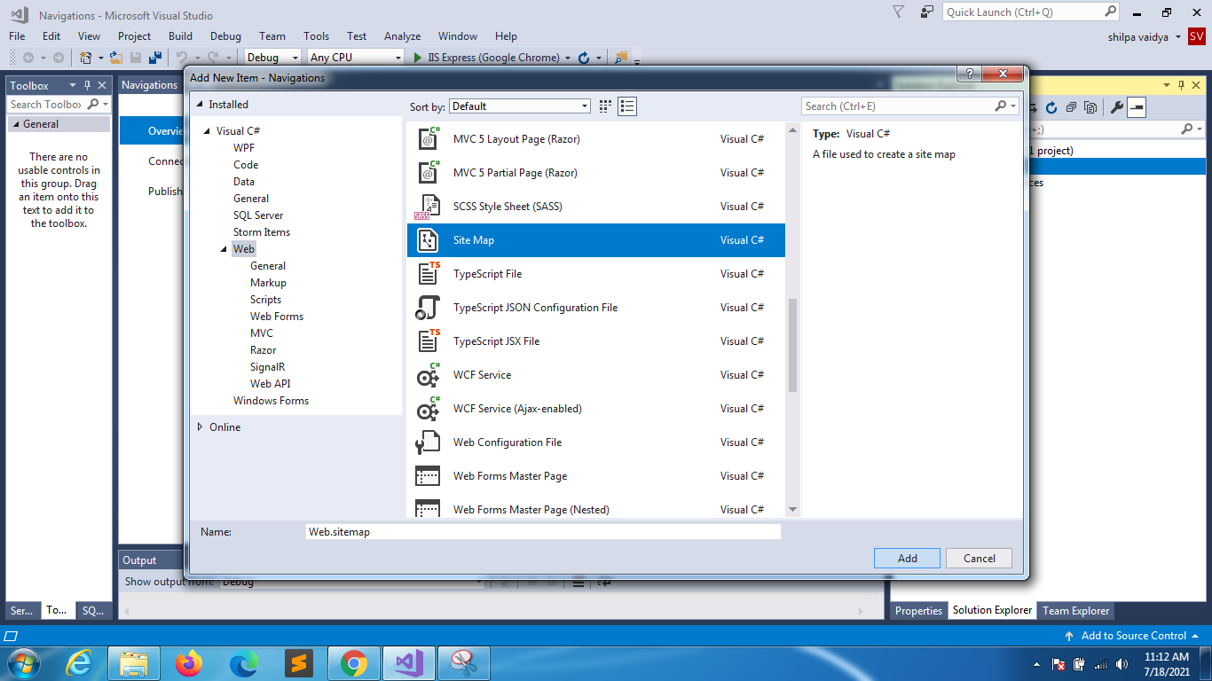

Slide 3
sitemap
<?xml version="1.0" encoding="utf-8" ?>
<siteMap xmlns="http://schemas.microsoft.com/AspNet/SiteMap-File-1.0" >
<siteMapNode url="~/Home.aspx" title="HOME" description="Home page for website">
<siteMapNode url="~/About.aspx" title="ABOUT" description="ABOUT US PAGE" />
<siteMapNode url="~/Products.aspx" title="PRODUCTS" description="PRODUCTS" >
<siteMapNode url="~/Product1.aspx" title="PRODUCT1" description="PRODUCT1" />
<siteMapNode url="~/Product2.aspx" title="PRODUCT2" description="PRODUCT2" />
<siteMapNode url="~/Product3.aspx" title="PRODUCT3" description="PRODUCT3" >
<siteMapNode url="~/Product3a.aspx" title="PRODUCT3a" description="PRODUCT3a" />
</siteMapNode>
<siteMapNode url="~/Product4.aspx" title="PRODUCT4" description="PRODUCT2" />
</siteMapNode>
</siteMapNode>
</siteMap>

Slide 4
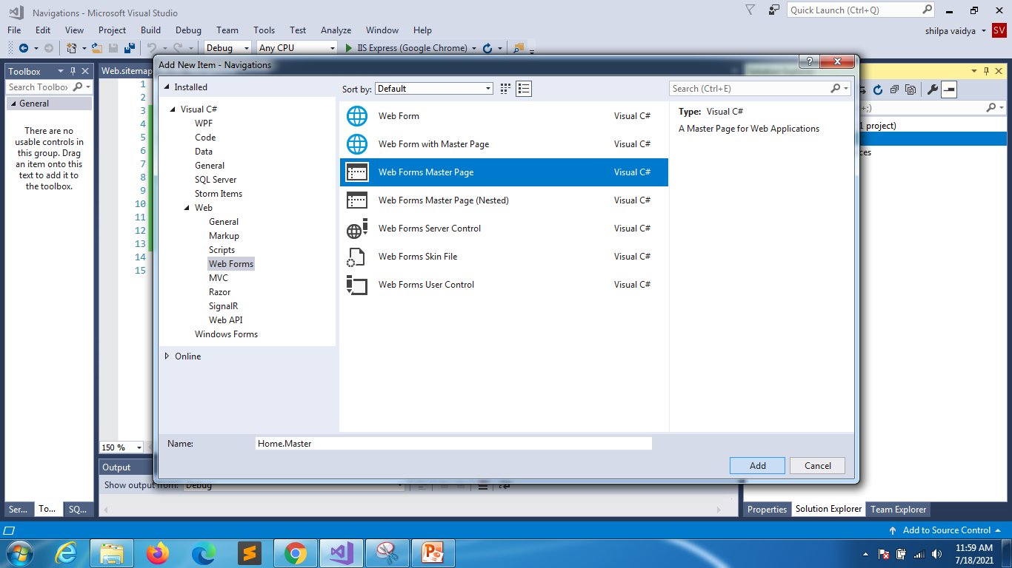
Create master page

Slide 5
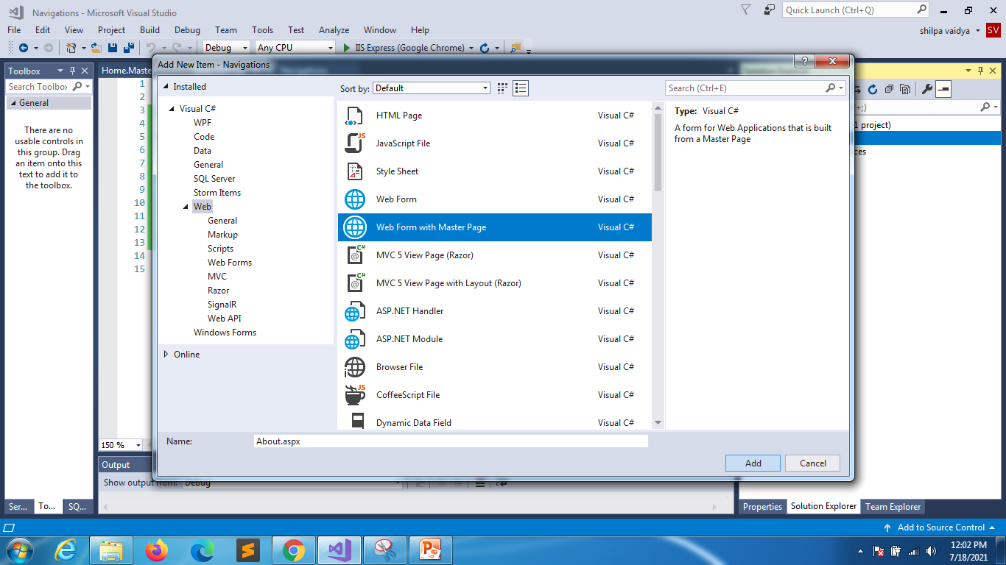

Slide 6
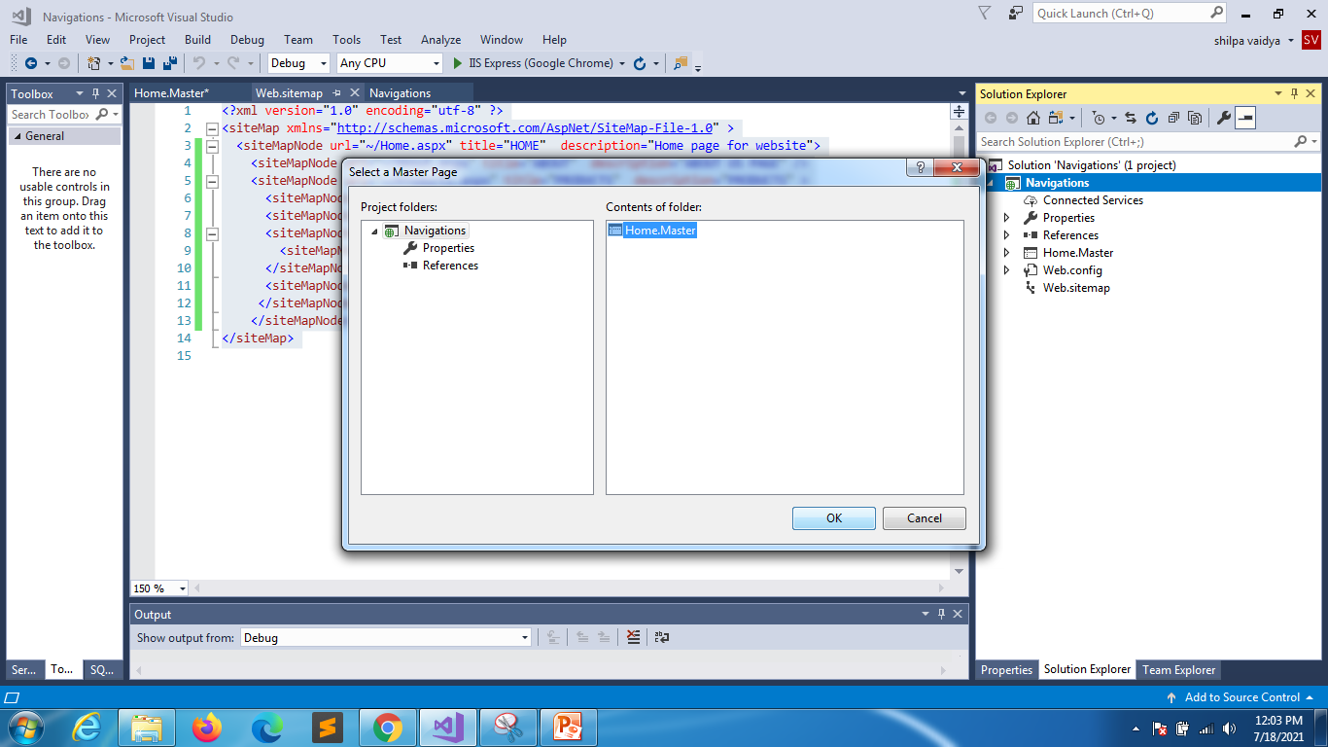

Slide 7
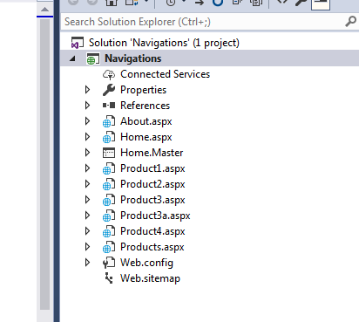
Create files according to the
sitemap

Slide 8
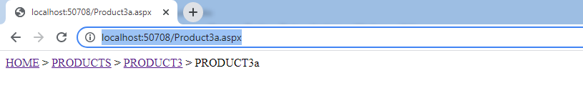
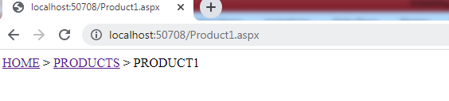

Slide 9
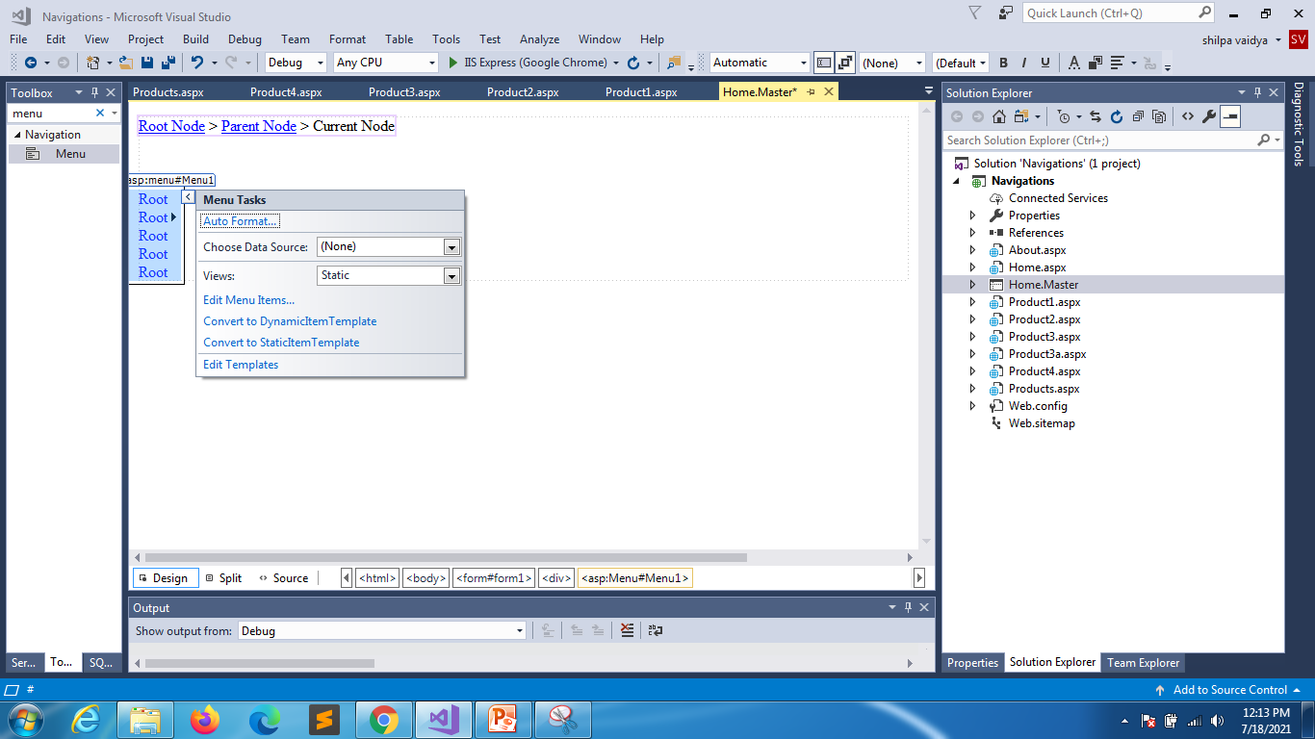

Slide 10
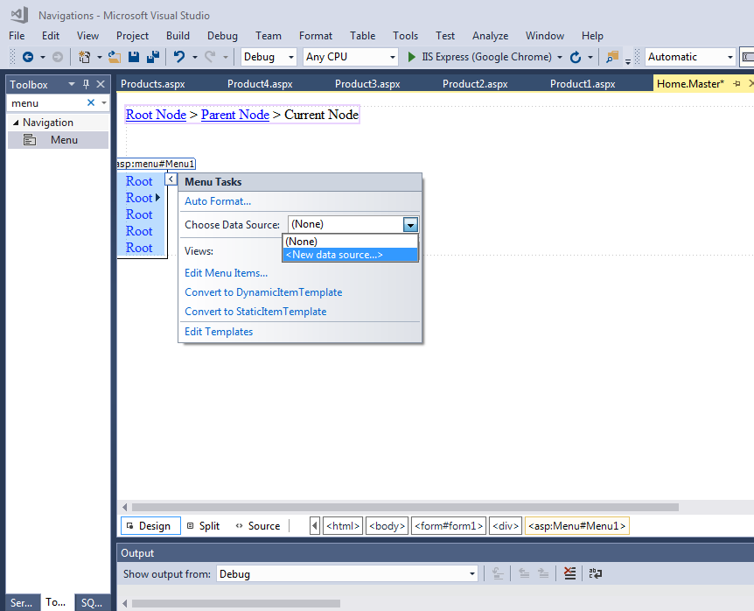

Slide 11
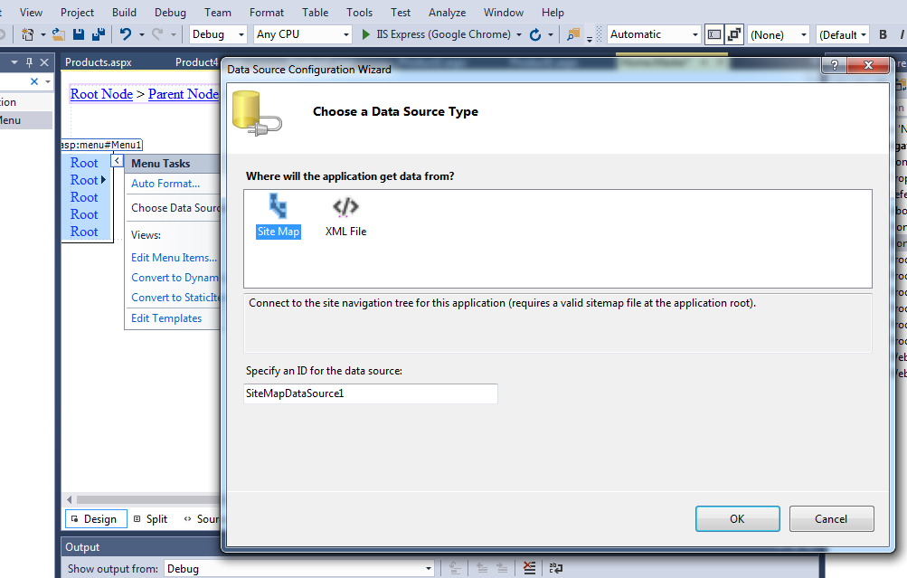

Slide 12
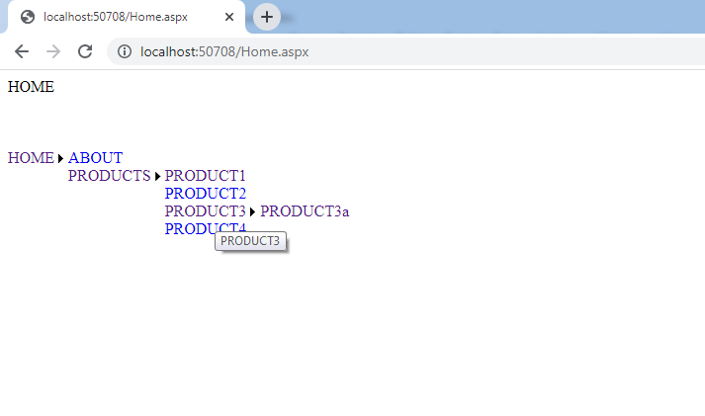

Slide 13
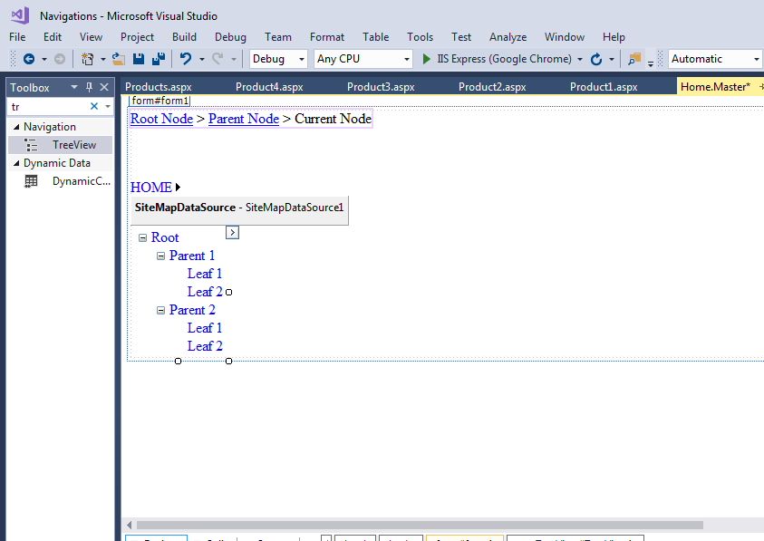

Slide 14
