Slide 1
Control directive

Slide 2
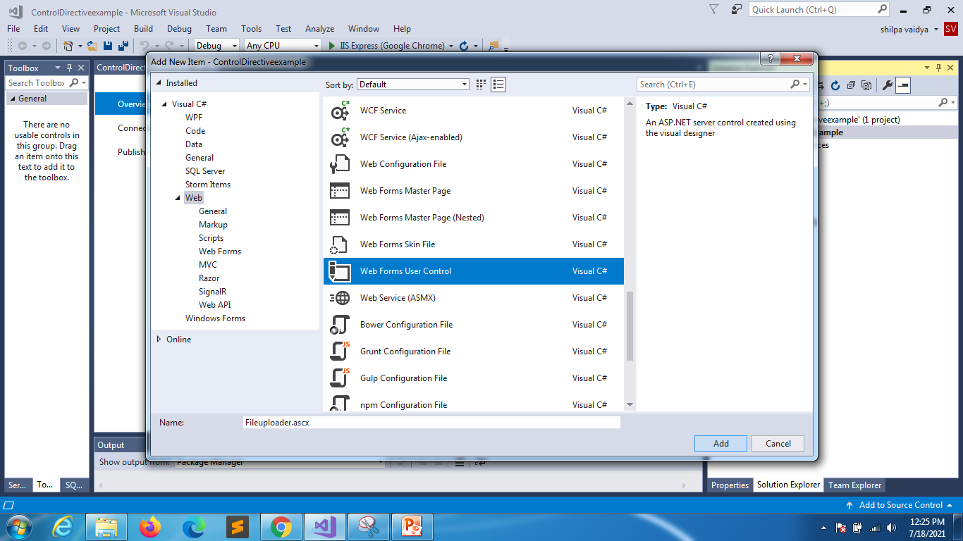

Slide 3
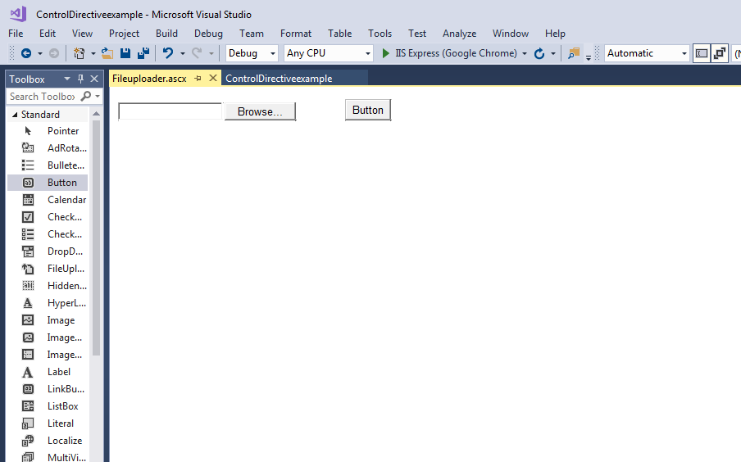

Slide 4
Fileuploader
using System;
namespace ControlDirectiveexample
{
public partial class Fileuploader : System.Web.UI.UserControl
{
protected void Page_Load(object sender, EventArgs e)
{
}
protected void Button1_Click(object sender, EventArgs e)
{
string path = Server.MapPath("~/");
FileUpload1.SaveAs(path + FileUpload1.FileName);
}
}
}

Slide 5
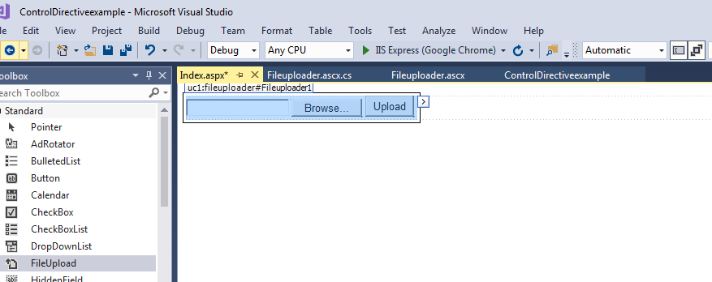
Create index.aspx
Build file
Drag and drop file uplader to index.aspx

Slide 6
Fileuploader after changes rebuild
using System;
namespace ControlDirectiveexample
{
public partial class Fileuploader : System.Web.UI.UserControl
{
string fileloc = "";
public string Filelocation
{
get
{
return fileloc == "" ? "" :fileloc + "/";
}
set
{
fileloc = value;
}
}
protected void Page_Load(object sender, EventArgs e)
{
}
protected void Button1_Click(object sender, EventArgs e)
{
string path = Server.MapPath("~/"+Filelocation);
FileUpload1.SaveAs(path + FileUpload1.FileName);
}
}
}

Slide 7
Index.aspx
Drag and drop fileuploadercontrol
Make changes in onload
using System;
using System.Collections.Generic;
using System.Linq;
using System.Web;
using System.Web.UI;
using System.Web.UI.WebControls;
namespace ControlDirectiveexample
{
public partial class Index : System.Web.UI.Page
{
protected void Page_Load(object sender, EventArgs e)
{
Fileuploader1.Filelocation = "Myfolder";
}
}
}
Create a new folder with name Myfolder

