Slide 1
Entity framework

Slide 2
Entity framework
What is Entity Framework?
Prior to .NET 3.5, we (developers) often used to write ADO.NET code or Enterprise Data Access Block to save or retrieve application data from the underlying database. We used to open a connection to the database, create a DataSet to fetch or submit the data to the database, convert data from the DataSet to .NET objects or vice-versa to apply business rules. This was a cumbersome and error prone process. Microsoft has provided a framework called "Entity Framework" to automate all these database related activities for your application.
Entity Framework is an open-source ORM framework for .NET applications supported by Microsoft. It enables developers to work with data using objects of domain specific classes without focusing on the underlying database tables and columns where this data is stored. With the Entity Framework, developers can work at a higher level of abstraction when they deal with data, and can create and maintain data-oriented applications with less code compared with traditional applications.
Official Definition: “Entity Framework is an object-relational mapper (O/RM) that enables .NET developers to work with a database using .NET objects. It eliminates the need for most of the data-access code that developers usually need to write.”
The following figure illustrates where the Entity Framework fits into your application.
As per the above figure, Entity Framework fits between the business entities (domain classes) and the database. It saves data stored in the properties of business entities and also retrieves data from the database and converts it to business entities objects automatically.

Slide 3
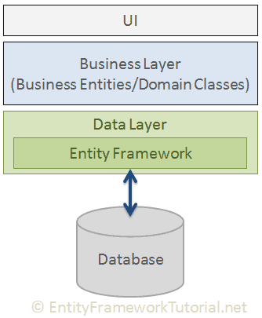

Slide 4
Entity Framework Features
Cross-platform: EF Core is a cross-platform framework which can run on Windows, Linux and Mac.
Modelling: EF (Entity Framework) creates an EDM (Entity Data Model) based on POCO (Plain Old CLR Object) entities with get/set properties of different data types. It uses this model when querying or saving entity data to the underlying database.
Querying: EF allows us to use LINQ queries (C#/VB.NET) to retrieve data from the underlying database. The database provider will translate this LINQ queries to the database-specific query language (e.g. SQL for a relational database). EF also allows us to execute raw SQL queries directly to the database.
Change Tracking: EF keeps track of changes occurred to instances of your entities (Property values) which need to be submitted to the database.
Saving: EF executes INSERT, UPDATE, and DELETE commands to the database based on the changes occurred to your entities when you call the SaveChanges() method. EF also provides the asynchronous SaveChangesAsync() method.
Concurrency: EF uses Optimistic Concurrency by default to protect overwriting changes made by another user since data was fetched from the database.
Transactions: EF performs automatic transaction management while querying or saving data. It also provides options to customize transaction management.
Caching: EF includes first level of caching out of the box. So, repeated querying will return data from the cache instead of hitting the database.
Built-in Conventions: EF follows conventions over the configuration programming pattern, and includes a set of default rules which automatically configure the EF model.
Configurations: EF allows us to configure the EF model by using data annotation attributes or Fluent API to override default conventions.
Migrations: EF provides a set of migration commands that can be executed on the NuGet Package Manager Console or the Command Line Interface to create or manage underlying database Schema.

Slide 5
EF 6 Version History
EF Version | Release Year | .NET Framework
EF 6 | 2013 | .NET 4.0 & .NET 4.5, VS 2012
EF 5 | 2012 | .NET 4.0, VS 2012
EF 4.3 | 2011 | .NET 4.0, VS 2012
EF 4.0 | 2010 | .NET 4.0, VS 2010
EF 1.0 (or 3.5) | 2008 | .NET 3.5 SP1, VS 2008

Slide 6
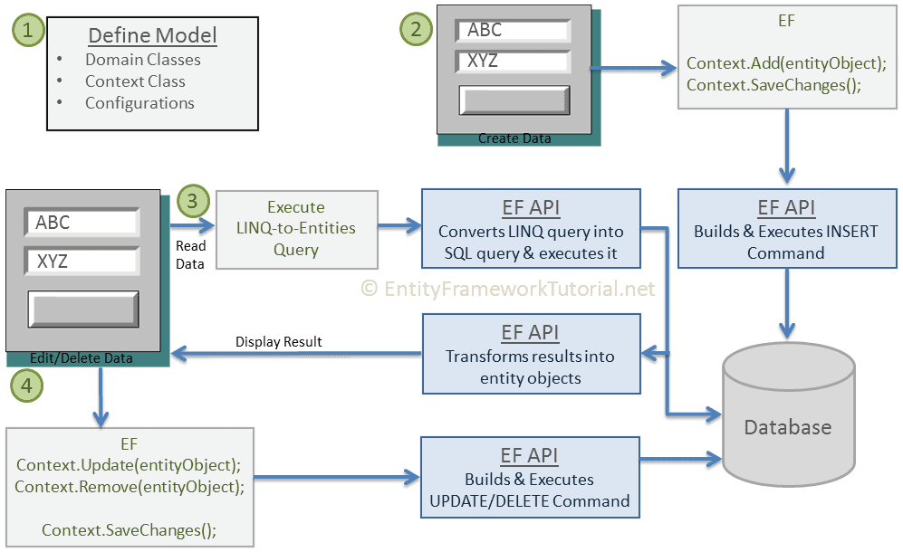
Basic Workflow in Entity Framework

Slide 7
Basic Workflow in Entity Framework
Here you will learn about the basic CRUD workflow using Entity Framework.
The following figure illustrates the basic workflow.
Let's understand the above EF workflow:
First of all, you need to define your model. Defining the model includes defining your domain classes, context class derived from DbContext, and configurations (if any). EF will perform CRUD operations based on your model.
To insert data, add a domain object to a context and call the SaveChanges() method. EF API will build an appropriate INSERT command and execute it to the database.
To read data, execute the LINQ-to-Entities query in your preferred language (C#/VB.NET). EF API will convert this query into SQL query for the underlying relational database and execute it. The result will be transformed into domain (entity) objects and displayed on the UI.
To edit or delete data, update or remove entity objects from a context and call the SaveChanges() method. EF API will build the appropriate UPDATE or DELETE command and execute it to the database.

Slide 8
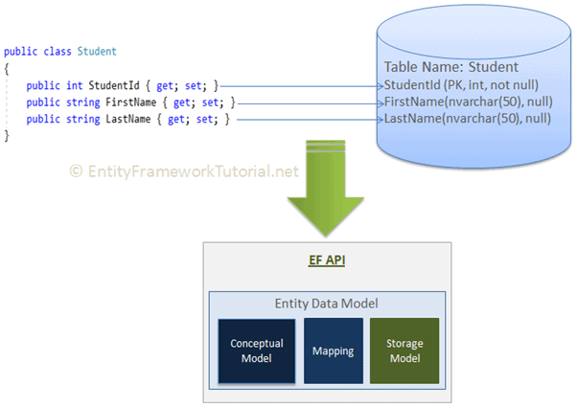
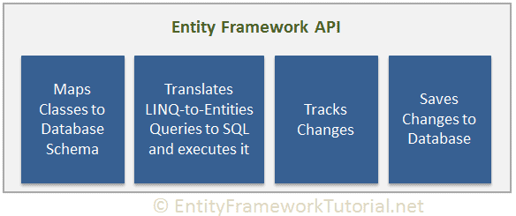
How Entity Framework Works?
Entity Framework API (EF6 & EF Core) includes the ability to map domain (entity) classes to the database schema, translate & execute LINQ queries to SQL, track changes occurred on entities during their lifetime, and save changes to the database.

Slide 9
Entity Data Model
The very first task of EF API is to build an Entity Data Model (EDM). EDM is an in-memory representation of the entire metadata: conceptual model, storage model, and mapping between them.
Conceptual Model: EF builds the conceptual model from your domain classes, context class, default conventions followed in your domain classes, and configurations.
Storage Model: EF builds the storage model for the underlying database schema. In the code-first approach, this will be inferred from the conceptual model. In the database-first approach, this will be inferred from the targeted database.
Mappings: EF includes mapping information on how the conceptual model maps to the database schema (storage model).
EF performs CRUD operations using this EDM. It uses EDM in building SQL queries from LINQ queries, building INSERT, UPDATE, and DELETE commands, and transform database result into entity objects.

Slide 10
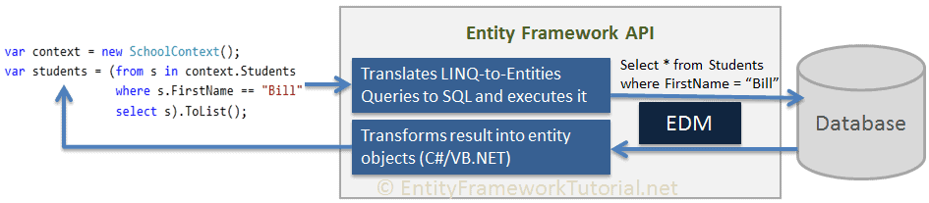
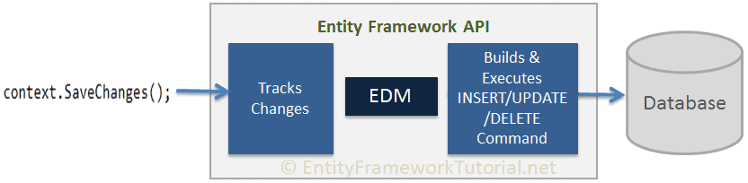
Querying
EF API translates LINQ-to-Entities queries to SQL queries for relational databases using EDM and also converts results back to entity objects.
Saving
EF API infers INSERT, UPDATE, and DELETE commands based on the state of entities when the SaveChanges() method is called. The ChangeTrack keeps track of the states of each entity as and when an action is performed.

Slide 11
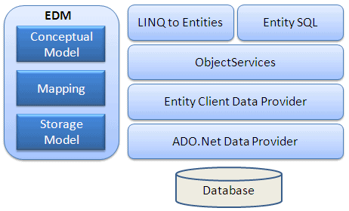
Entity Framework Architecture

Slide 12
EDM (Entity Data Model): EDM consists of three main parts - Conceptual model, Mapping and Storage model.
Conceptual Model: The conceptual model contains the model classes and their relationships. This will be independent from your database table design.
Storage Model: The storage model is the database design model which includes tables, views, stored procedures, and their relationships and keys.
Mapping: Mapping consists of information about how the conceptual model is mapped to the storage model.
LINQ to Entities: LINQ-to-Entities (L2E) is a query language used to write queries against the object model. It returns entities, which are defined in the conceptual model. You can use your LINQ skills here.
Entity SQL: Entity SQL is another query language (For EF 6 only) just like LINQ to Entities. However, it is a little more difficult than L2E and the developer will have to learn it separately.
Object Service: Object service is a main entry point for accessing data from the database and returning it back. Object service is responsible for materialization, which is the process of converting data returned from an entity client data provider (next layer) to an entity object structure.
Entity Client Data Provider: The main responsibility of this layer is to convert LINQ-to-Entities or Entity SQL queries into a SQL query which is understood by the underlying database. It communicates with the ADO.Net data provider which in turn sends or retrieves data from the database.
ADO.Net Data Provider: This layer communicates with the database using standard ADO.Net.

Slide 13
Context Class in Entity Framework
The context class is a most important class while working with EF 6 or EF Core. It represent a session with the underlying database using which you can perform CRUD (Create, Read, Update, Delete) operations.
The context class in Entity Framework is a class which derives from System.Data.Entity.DbContextDbContext in EF 6 and EF Core both. An instance of the context class represents Unit Of Work and Repository patterns wherein it can combine multiple changes under a single database transaction.
The context class is used to query or save data to the database. It is also used to configure domain classes, database related mappings, change tracking settings, caching, transaction etc.
The following SchoolContext class is an example of a context class.

Slide 14
using System.Data.Entity;
public class SchoolContext : DbContext {
public SchoolContext() { } // Entities public DbSet<Student> Students { get; set; } public DbSet<StudentAddress> StudentAddresses { get; set; }
public DbSet<Grade> Grades { get; set; }
}

Slide 15
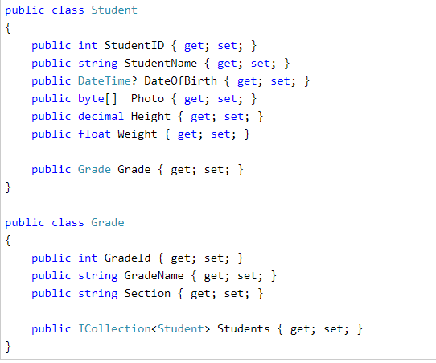
What is an Entity in Entity Framework?
An entity in Entity Framework is a class that maps to a database table. This class must be included as a DbSet<TEntity> type property in the DbContext class. EF API maps each entity to a table and each property of an entity to a column in the database.
For example, the following Student, and Grade are domain classes in the school application.

Slide 16
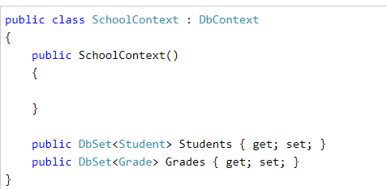
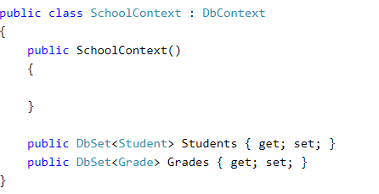
What is an Entity in Entity Framework?
The classes become entities when they are included as DbSet<TEntity> properties in a context class (the class which derives from DbContext), as shown below
context class, Students, and Grades properties of type DbSet<TEntity> are called entity sets. The Student, and Grade are entities.

Slide 17
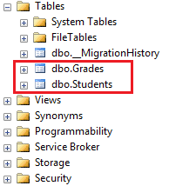
What is an Entity in Entity Framework?
EF API will create the Students and Grades tables in the database, as shown here.

Slide 18
Scalar and navigation properties
An Entity can include two types of properties: Scalar Properties and Navigation Properties.

Slide 19
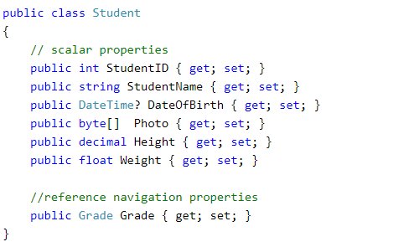
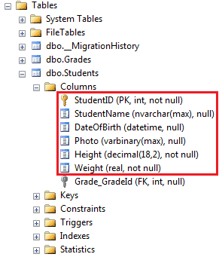
Scalar
The primitive type properties are called scalar properties. Each scalar property maps to a column in the database table which stores an actual data.
For example,
StudentID, StudentName, DateOfBirth,
Photo,
Height,
Weight are the scalar properties in the Student entity class.

Slide 20
Navigation property
The navigation property represents a relationship to another entity.
There are two types of navigation properties:
Reference Navigation
Collection Navigation

Slide 21
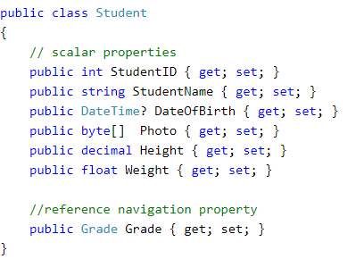
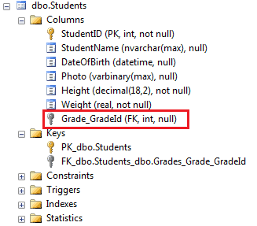
Reference Navigation Property
If an entity includes a property of another entity type, it is called a Reference Navigation Property. It points to a single entity and represents multiplicity of one (1) in the entity relationships.
EF API will create a ForeignKey column in the table for the navigation properties that points to a PrimaryKey of another table in the database. For example, Grade are reference navigation properties in the above Student entity class.
EF API will create a ForeignKey Grade_GradeId in the Students table

Slide 22
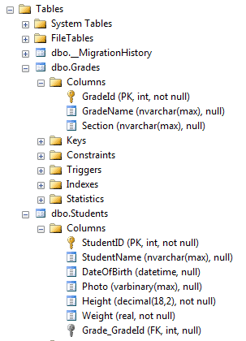
Collection Navigation Property
If an entity includes a property of generic collection of an entity type, it is called a collection navigation property. It represents multiplicity of many (*).
EF API does not create any column for the collection navigation property in the related table of an entity, but it creates a column in the table of an entity of generic collection.
For example, the following Grade entity contains a generic collection navigation property ICollection<Student>. Here, the Student entity is specified as generic type, so EF API will create a column Grade_GradeId in the Students table in the database.

Slide 23
types
Types of Entities in Entity Framework
There are two types of Entities in Entity Framework:
POCO Entities
Dynamic Proxy Entities.

Slide 24
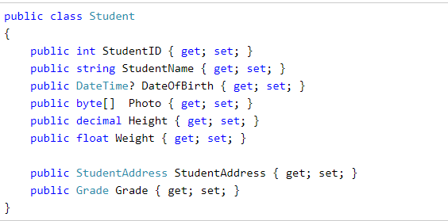
POCO Entities (Plain Old CLR Object)
A POCO entity is a class that doesn't depend on any framework-specific base class. It is like any other normal .NET CLR class, which is why it is called "Plain Old CLR Objects".
POCO entities are supported in both EF 6 and EF Core.
These POCO entities (also known as persistence-ignorant objects) support most of the same query, insert, update, and delete behaviors as entity types that are generated by the Entity Data Model. The following is an example of Student POCO entity.

Slide 25
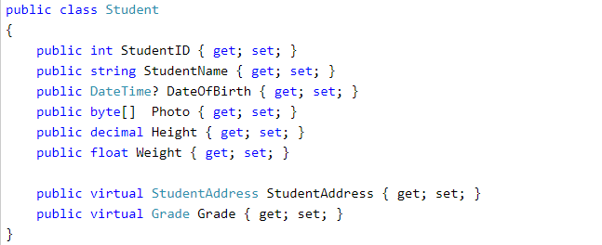
Dynamic Proxy Entities (POCO Proxy)
Dynamic Proxy is a runtime proxy class which wraps POCO entity. Dynamic proxy entities allow lazy loading.
A POCO entity should meet the following requirements to become a POCO proxy:
A POCO class must be declared with public access.
A POCO class must not be sealed (NotInheritable in Visual Basic).
A POCO class must not be abstract (MustInherit in Visual Basic).
Each navigation property must be declared as public, virtual.
Each collection property must be ICollection<T>.
The ProxyCreationEnabled option must NOT be false (default is true) in context class.
The following POCO entity meets all of the above requirements to become a dynamic proxy entity at runtime.

Slide 26


Note: By default, dynamic proxy is enabled for every entity. However, you can disable dynamic proxy by setting context.Configuration.ProxyCreationEnabled = false; in the context class.
At runtime, EF API will create an instance of dynamic proxy for the above Student entity. The type of dynamic proxy for Student will be System.Data.Entity.DynamicProxies.Student, as shown below:
Use ObjectContext.GetObjectType() to find the underlying wrapped type by the dynamic proxy as shown below:

Slide 27
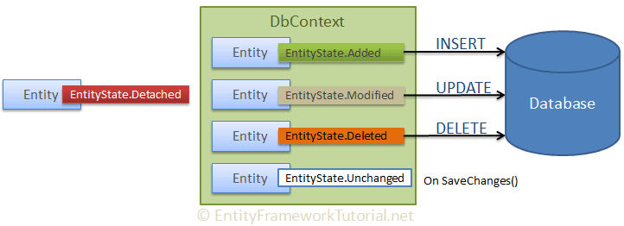
The entity state

Slide 28
EF API maintains the state of each entity during its lifetime. Each entity has a state based on the operation performed on it via the context class. The entity state represented by an enum System.Data.Entity.EntityState in EF 6 and Microsoft.EntityFrameworkCore.EntityState in EF Core with the following values:
Added
Modified
Deleted
Unchanged
Detached
The Context not only holds the reference to all the entity objects as soon as retrieved from the database, but also keeps track of entity states and maintains modifications made to the properties of the entity. This feature is known as Change Tracking.
The change in entity state from the Unchanged to the Modified state is the only state that's automatically handled by the context. All other changes must be made explicitly using proper methods of DbContext or DbSet. (You will learn about these methods in EF 6 and EF Core sections.)
EF API builds and executes the INSERT, UPDATE, and DELETE commands based on the state of an entity when the context.SaveChanges() method is called. It executes the INSERT command for the entities with Added state, the UPDATE command for the entities with Modified state and the DELETE command for the entities in Deleted state. The context does not track entities in the Detached state. The following figure illustrates the significance of entity states:

Slide 29
Development Approaches with Entity Framework
There are three different approaches you can use while developing your application using Entity Framework:
Database-First
Code-First
Model-First

Slide 30
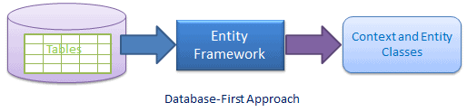
Database-First Approach
In the database-first development approach, you generate the context and entities for the existing database using EDM wizard integrated in Visual Studio or executing EF commands.
EF 6 supports the database-first approach extensively. Visit EF 6 DB-First section to learn about the database-first approach using EF 6.
EF Core includes limited support for this approach.

Slide 31
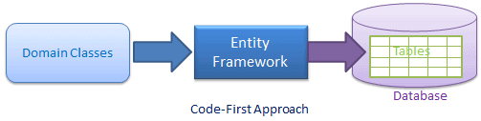
Code-First Approach
Use this approach when you do not have an existing database for your application. In the code-first approach, you start writing your entities (domain classes) and context class first and then create the database from these classes using migration commands.
Developers who follow the Domain-Driven Design (DDD) principles, prefer to begin with coding their domain classes first and then generate the database required to persist their data.

Slide 32
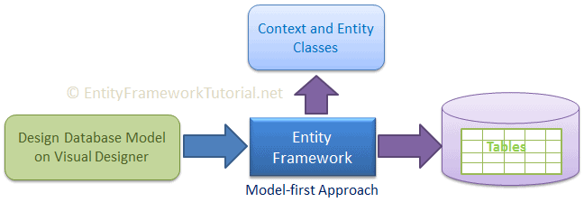
Model-First Approach
In the model-first approach, you create entities, relationships, and inheritance hierarchies directly on the visual designer integrated in Visual Studio and then generate entities, the context class, and the database script from your visual model.

Slide 33
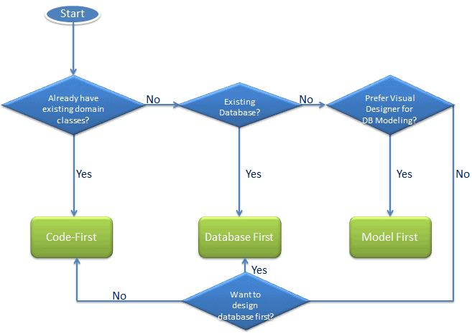
Choosing the Development Approach for Your Application
As per the above figure, if you already have an existing application with domain classes, then you can use the code-first approach because you can create a database from your existing classes. If you have an existing database, then you can create an EDM from an existing database in the database-first approach. If you do not have an existing database or domain classes, and you prefer to design your DB model on the visual designer, then go for the Model-first approach.

