Slide 1
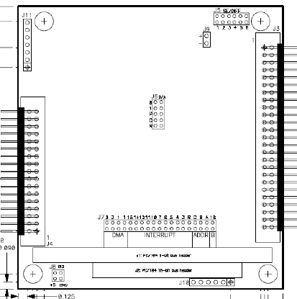
DMM32DXAT Jumper configuration
Notes:
This is a schematic of the jumper settings for the Diamond Systems DMM32DXAT analog/digI/O card. The settings are:
Jumper block 7:
Base Address: 0x300 = J7-A IN; B,C OUT
IRQ: IRQ5 = J7-5 IN
IRQ sharing = J7-R IN
Jumper block 5
Single-ended inputs 0-31 = J5-1,2 IN; 3-6 OUT
Jumper block 6
D/A output Fixed 0-5 VDC = J6-GN1,GN0,B/U IN; F/~V OUT
Jumper block 8
Dig I/O pulled-up to +5 VDC = J8-+5 IN; GND OUT

Slide 2
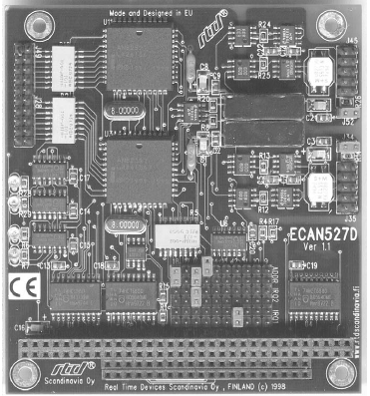
RTD ECAN527D CAN card configuration
Notes:
This is a schematic of the jumper settings for the RTD ECAN527D CAN card. The settings are:
ADDR range:D8xxx = 15, 16, 18 IN; 17 OUT
IRQ2: 7
IRQ1: 10

Slide 3
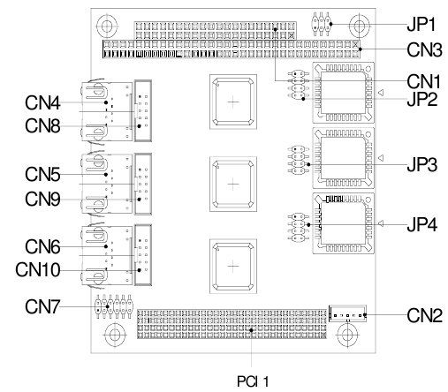
Aaeon PCM-3730 PC/104 Plus
Triple-Ethernet card configuration
Notes:
This is a schematic of the jumper settings for the Aaeon PCM-3730 Triple-ethernet card. The settings are:
JP1 – Disable LAN interface
No interfaces disabled = JP1-1-2, 3-4, 5-6 OUT
JP2-interrupt for LAN1
INTA = JP2-1-2 IN; 3-4, 5-6, 7-8 OUT
JP3-interrupt for LAN2
INTB = JP3-3-4 IN; 1-2, 5-6, 7-8 OUT
JP4-interrupt for LAN3
INTC = JP4-5-6 IN; 1-2, 3-4, 7-8 OUT

Slide 4
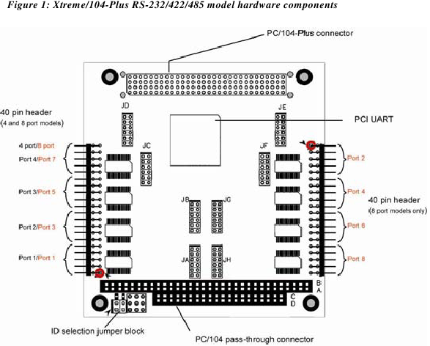
Notes:
This is a schematic of the jumper settings for the Connect Tech Xtreme104plus 8-port serial extender card. This is a PCI device, so the base address and IRQ level are set by the operating system. Its ID in the stack is set by ID selection jumper block The setting is:
ID3 = left jumper, right jumper IN

