Slide 1


Multimedia Analysis and Retrieval
Lab Project: Speed Sign Detection
and Recognition System
Team Members:
Aya Kamel 329043
Mahmoud Aly 329003

Slide 2
TSR Systems
- Feature added to modern cars in the later years.
- Gives the vehicle the ability to detect and recognize traffic signs on the road.
- Initiated by Mobileye and Continental AG in 2008.
- Deployed by various vehicles manufactures nowadays.

Slide 3
Previous Approaches
- Local features extraction using Haar wavelets [1].
- Genetic Algorithms for features extraction [2].
- Different classifying techniques are used for building a training model like AdaBoost, Neural networks and Gaussian models.

Slide 4
Traffic Signs Properties
- Different algorithms used different significant properties of the traffic signs to ease detecting it like :-
- Color (Bright Red)
- Shape (Circular)
- Motion information for tracking.

Slide 5
Implementation
The implementation is divided into 2 main stages:
Traffic Sign Candidate Detection
Candidate Recognition
What is new?
No training

Slide 6
Detection Approach
Color segmentation as first filtering phase to get rid or irrelevant information.
Apply a double search technique:
1. Applying Hough circles to the filtered image after eroding and dilating (to detect mass).
2. Applying Canny Edge Detector then applying the Hough circles on the edges.

Slide 7
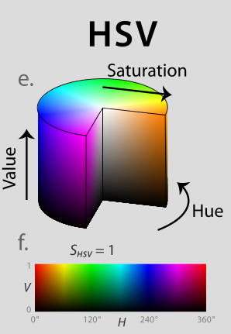
Color Segmentation – Step 1
Convert the image into HSV color space.
Why?
Because it holds more
Information about colors than
RGB space
Image from: http://en.wikipedia.org/wiki/HSL_and_HSV

Slide 8
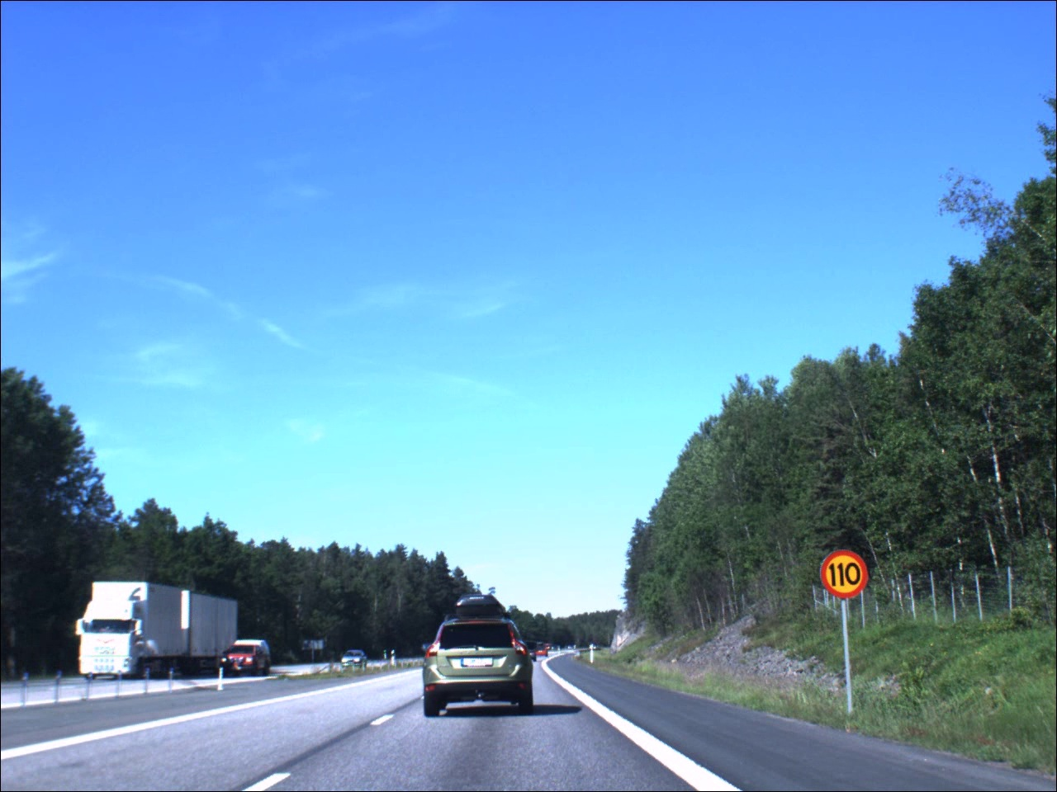
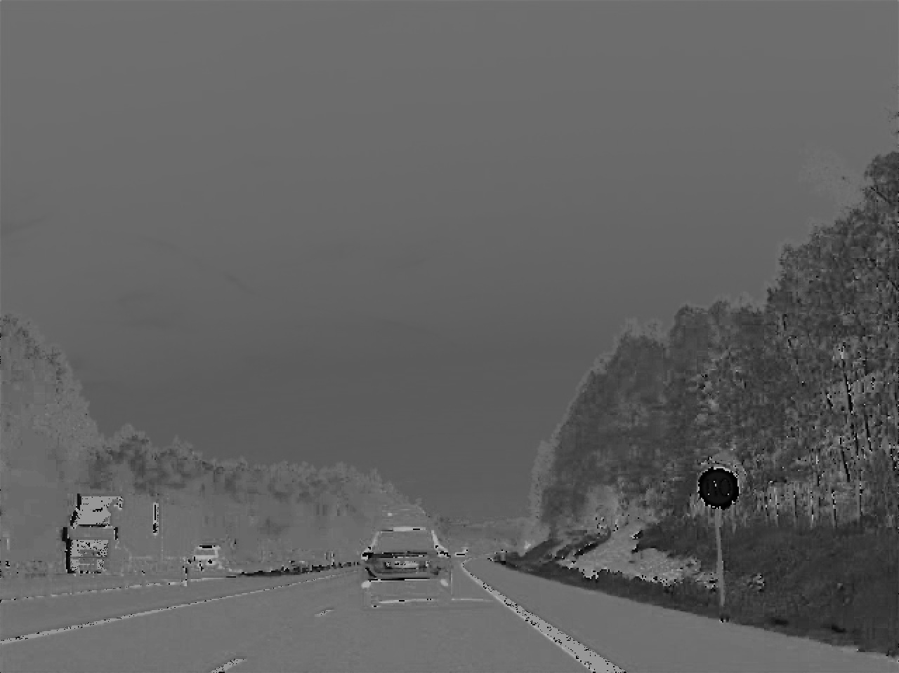
Color Segmentation – Step 1
Convert the image into HSV color space.

Slide 9
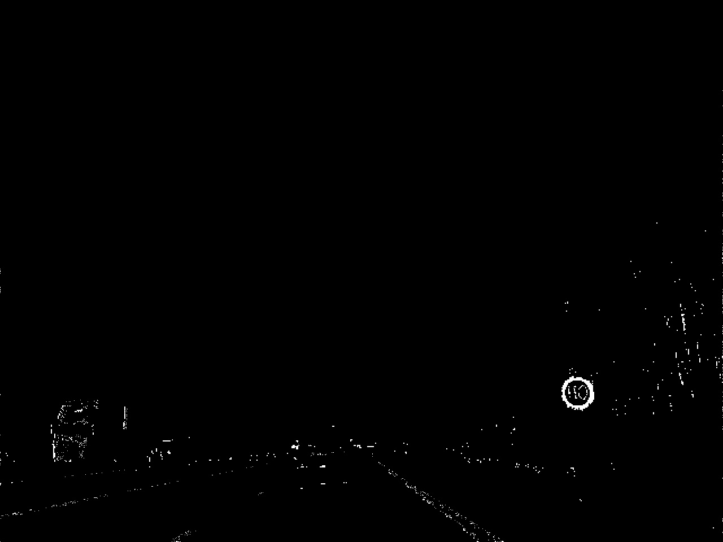
Color Segmentation – Step 2
Filter out irrelevant hue information
Remove all hue values between 10 and 230 using opencv built-in thresholding function.

Slide 10
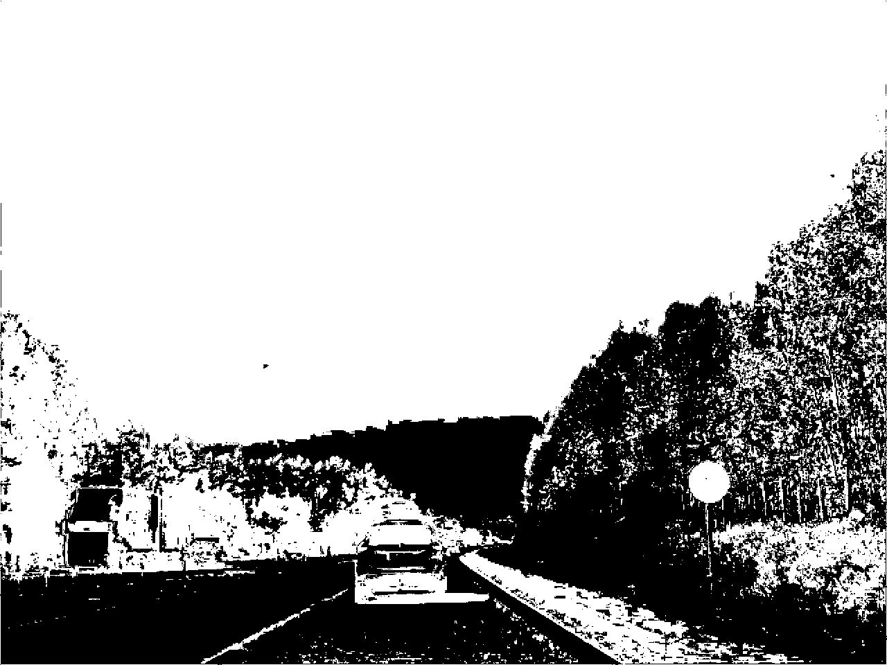
Color Segmentation – Step 3
Filter out low Saturation values
Calculate a saturation mask.
Multiply it by the filtered hue image.

Slide 11

Double Search – Step 1
Apply erosion and dilation to filtered image
To fill in circular masses and/or thicken them

Slide 12

Double Search – Step 2
Apply canny detector to the resulting image
To detect circular edges in an image (double check)

Slide 13
Double Search – Step 3
Hough Transform:
Is a feature extraction technique using voting method to order the features according to how close it is to the desired shape.
It was applied to both, the eroded/dilated image and the edge map of the image.

Slide 14

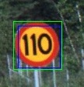
Double Search – Step 3 (Result)
Blue boxes: Circles from eroded/dilated image.
Green boxes: Circles from edge map.

Slide 15
Detection in a Video
Before claiming that a detected circle is a traffic sign candidate, some constraints:
Both techniques must have detected this box.
It has to be detected in a previous frame.

Slide 16
Demo

Slide 17

Implementation
The implementation is divided into 2 main stages:
Traffic Sign Candidate Detection
Candidate Recognition
What is new?
No training

Slide 18
Candidate Recognition Approach
Extract the candidate from the image
Apply template matching using different sign templates from the database at different sizes.
Choose the template with least squared error rate per frame.

Slide 19

Extracting the candidate
Crop the 50x50 pixels around the detected circle center.
Convert this patch to grayscale
Apply Histogram Equalization to eliminate lighting conditions.

Slide 20
Template Matching
Resize the template to different sizes to overcome different depths of the candidate image.
Choose the minimum error from all sizes as the score for each template.
Choose the minimum error from all templates as the recognition result for the frame.

Slide 21
Recognition in a Video
For each frame in a burst of frames in which a sign is detected, the best 2 matching results are awarded points 1st Best Match: 10 points
2nd Best Match: 1 point
In the end of each burst, the template which the highest score is considered to be the recognition result.
An exception is when the same result is returned from 10 consecutive frames

Slide 22
Implementation
The implementation is divided into 2 main stages:
Traffic Sign Candidate Detection
Candidate Recognition
What is new?
No training

Slide 23
Results
For Detection based on 18 videos
Precision was : 86% (31 TPs , 5 FPs)
Recall was : 88% (31 TPs , 4 FNs)
For Recognition based on 13 videos
Accuracy was : 72% (10 TPs , 4 FPs)

Slide 24
Demo

Slide 25
Future Work
Using tensor LDA for recognition → needs training.
Using a more advanced color segmentation approach because it has its drawbacks (example a sun set scene)

Slide 26
References
[1] Bahlmann, C.; Ying Zhu; Ramesh, V.; Pellkofer, M.; Koehler, T., "A system for traffic sign detection, tracking, and recognition using color, shape, and motion information," Intelligent Vehicles Symposium, 2005. Proceedings. IEEE , vol., no., pp.255,260, 6-8 June 2005
[2] A. De La Escalera and J. M A Armingol and M. Mata, “Traffic sign recognition and analysis for intelligent vehicles”, Image and Vision Computing, 2003. Volume 21, pages 247-258.
Dataset from:
[3] Fredrik Larsson and Michael Felsberg, Using Fourier Descriptors and Spatial Models for Traffic Sign Recognition, In Proceedings of the 17th Scandinavian Conference on Image Analysis, SCIA 2011, LNCS 6688, pp. 238-249

