Slide 1
ELECTRICITY PRICES PREDICTION
6203
PHASE 1: Problem Definition and Design Thinking

Slide 2
OVERVIEW
INTRODUCTION
METHODOLOGY
ELECTRICITY PRICE FORECASTING USING LSTM
CASE STUDY
CONCLUSION

Slide 3
INTRODUCTION
In a Electricity Prediction, there are some Factors which affects the Prices which includes Electricity costs, demand and Supply Of the Electricity.
Here , Long Short Term Memory (LSTM) is proposed which network is Capable of Learning Long Sequences with long time Lags.
Many Exogenous Factors are also considered as inputs to the network , also includes the Forecasted System Demand , Historical Prices, Hour Of the day , Day of the week, Week of the year and holidays Information.
We Propose To use LSTM model for 24Hours ahead Price Due to the strong Ability Of LSTM to memorize the previous price trend During Training.
Simulation Models requires Detailed System Operation Parameters to build the model.
They Focus More Quality Issues rather than during Learning Process .

Slide 4
METHODOLOGY
The Objective Of the Presented Methodology is to predict the day ahead Electricity Price, given historical Price data and exogenous Variables .
A.)PREPROCESSING:
Both the negativeprices caused by Transmission Constraints and extremelyHigh prices caused by Shortage Of power Supply appear in two markets .
Logarithm Of the data To do the prediction Which is defined as: Ldt=ln(pdt)
d---→day
t----→time Step
P---→Electricity Price
B.)LSTM NEUTRAL NETWORK:
The Weights update scheme may stop the Neutral Network from further training.
The key Idea Behind The LSTM is to regulate the cell States using Different Types of Gates includes Input, Forget and Output gates.
(Ct-1)----->State of the cell
Ct---------->Next state

Slide 5
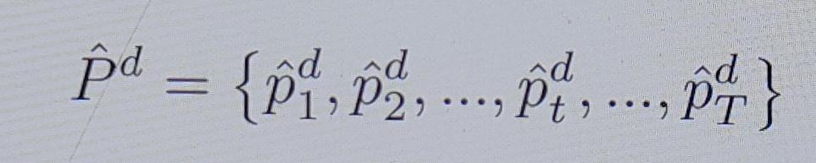
ELECTRICITY PRICE Forecasting USING LSTM
We Propose to apply Stacked LSTM with Multiple layers to Predict the electricity Price and this performance of the model can be influenced by the number of LSTM layers which includes Input time Steps, Structure of Forecasting Manner and Input variables.
The Actual Price Values at day d are denoted as:
T can be 24 for a hourly market and 48 for a half hourly market.
The Structure of LSTM network based on a model in a recursive manner for multiple steps forecasting.

Slide 6
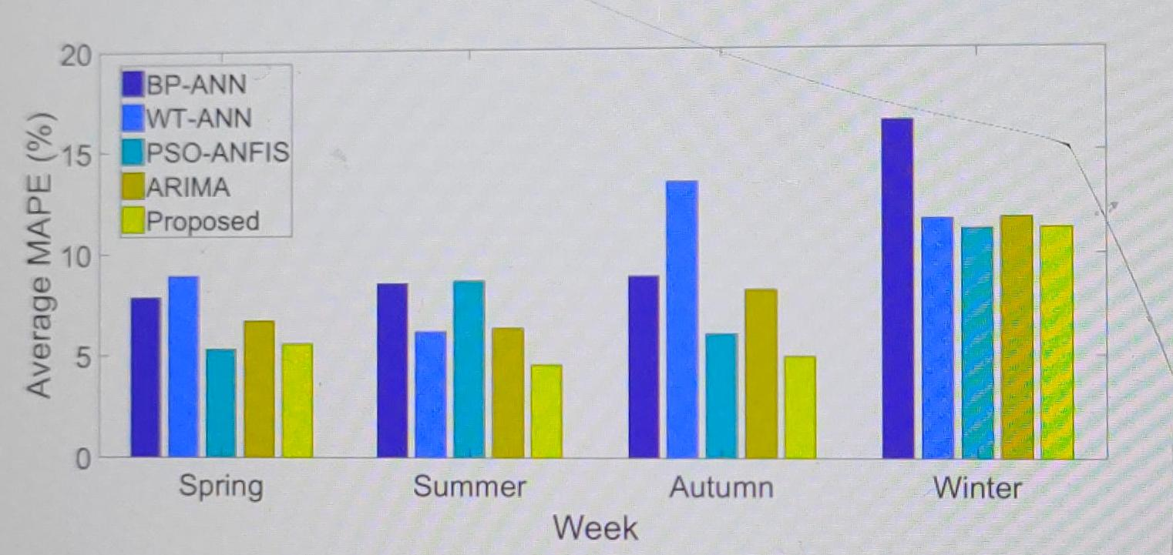
CASE STUDY
The Price data and exogenous Variables from 3 months prior to the first day of each test week are used as training datasets and 20% of the training date is used for Validation.
Four one-week periods representing four different seasons in 2013 are selected from VIC market for testing.

Slide 7
CONCLUSION
We Proposed a Multilayer LSTM based model for forecasting the day-ahead Electricity Prices due to its ability to bridge long time Lags of inputs and remembering the historical trend Information in time Series.
The Performance of the Proposed method is compared with other four popular methods used in the market (BP-ANN,WT-ANN,PSO-ANFIS and SARIMA)

