Slide 1
Networking Basics
Dept. of ICE

Slide 2
Contents:
Computer Networks: LAN, MAN, WAN, HAN
Network topologies
Client-server network
Network Protocols

Slide 3
Lecture-1
This Lesson Covers:
What is computer networks?
Evolution of computer networks
Overview of networks:
LAN/MAN/WAN/Internet

Slide 4
Network: A connected system of objects or people
Computer network: A collection of computers and other hardware devices connected together so users can share hardware, software, and data, and electronically communicate to each other.

Slide 5
Computer networks converging with telephone and other communications networks
Networks range from small private networks to the Internet (largest network in the world)

Slide 6
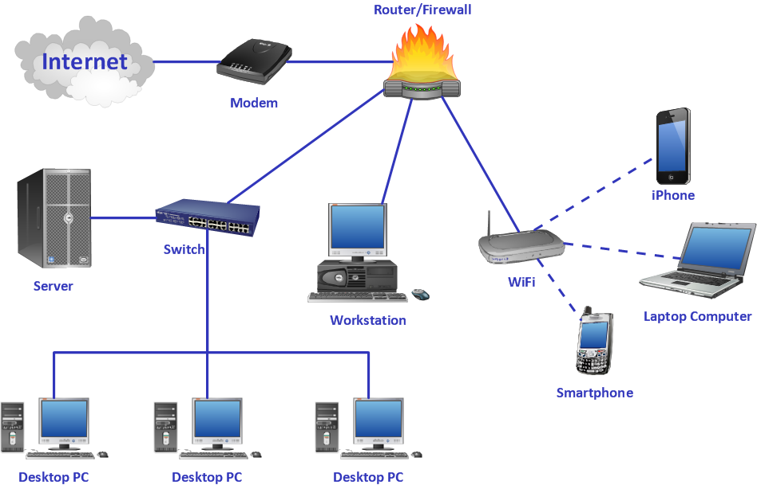
Computer Network:

Slide 7
The purpose of the network is to serve users, which can be humans or processes.
Network links can be point-to-point or multipoint and implemented with several transmission media.
Information exchanged can be represented in multiple media (audio, text, video, images, etc.),Services provided to users can vary widely.

Slide 8
Computer networks started
as a mean for:
‘Distributed processing
Communicating among people (electronic mail, conferencing)
Increasing system
reliability

Slide 9
History of Computer Networks
1950s - 1960s: Terminal-Oriented Computer Networks
1960s – 1970s: Computer-to-Computer Networks: the ARPANET – first Wide Area Network (WAN)
1980s: Local Area Networks (LANs)
1980s: The Internet(most superior telecommunication network)

Slide 10
Types of Networks
Three types of networks:
1. Local Area Network (LAN)
2. Metropolitan Area Network (MAN)
3. Wide Area Network (WAN)

Slide 11
Local Area Network (LAN)
Covers a small region of space, typically a single building.
LAN is the smallest network compared to other networks.
The simplest form of LAN is to connect two computers together
LAN is operated within a limited physical area such as at home, school, a single building or several buildings.

Slide 12
A network which consists of less than 500 interconnected devices across several buildings, is still recognized as a LAN.
LAN is very high speed network (from previously 10Mbps) to 100Mbps,which is faster than MAN and WAN.

Slide 13
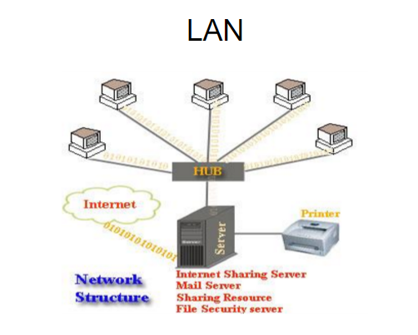

Slide 14
Metropolitan Area Network (MAN)
Is collection of LANs with the same geographical area, for instance a city.
MAN is a network of computers located at different sites within a large physical area, such as a city.
MAN often acts as a high speed network(although not as fast as LAN) to allow sharing of regional resources.

Slide 15
MAN can defined as a group of computers and network devices connected together within a large physical area.
For example: Companies that have several branches within the Dhaka city such as banks, might find a MAN useful to them.

Slide 16
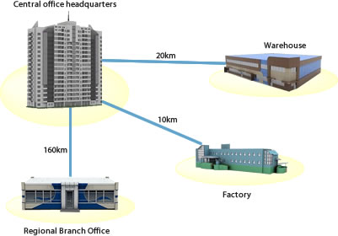
MAN

Slide 17
Wide Area Network (WAN)
WAN is the largest network of all network types.
The internet is the largest WAN in the world.
WAN generally covers large distances such as states, countries or continents.

Slide 18
WAN is group of MANs or LANs or the mixture of both network.
An example in the society using WAN is the banking organization.

Slide 19
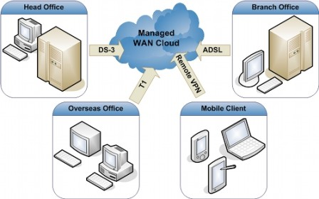
WAN

Slide 20
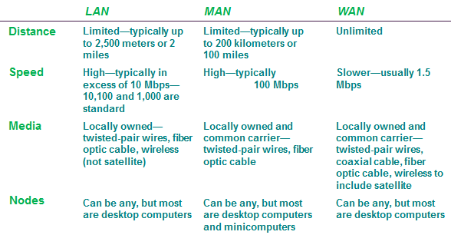
LAN/MAN/WAN Comparison

Slide 21
Home Area Network (HAN)
A home network or home area network (HAN) is a type of local area network with the purpose to facilitate communication among digital devices present inside or within the close vicinity of a home. Devices capable of participating in this network, for example, smart devices such as network printers and handheld mobile computers, often gain enhanced emergent capabilities through their ability to interact.

Slide 22
These additional capabilities can be used to increase the quality of life inside the home in a variety of ways, such as automation of repetitious tasks, increased personal productivity, enhanced home security, and easier access to entertainment.

Slide 23
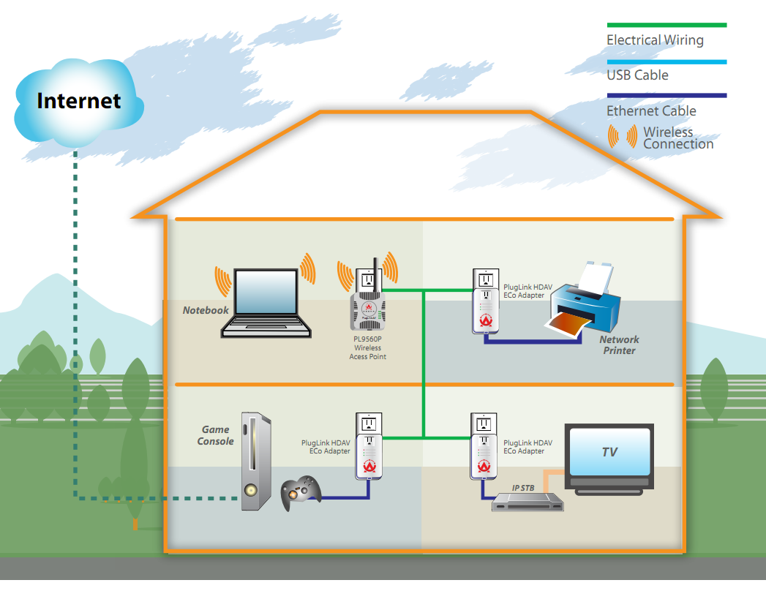
HAN

Slide 24
Thank You

Slide 25
Lecture-2
This Lesson Covers:
Network Topologies
What is Topology
Different Topologies
Advantages and Disadvantages of different Topologies

Slide 26
What is Topology?
The pattern of interconnection of nodes in a network is called the Topology.
The factors while selecting a Topology
Cost
Flexibility
Reliability

Slide 27
Different Topologies
There are five common types of network Topologies.
The Star Topology
The Bus Topology
The Ring Topology
The Tree Topology
Mesh Topology
Another type is Graph Topology

Slide 28
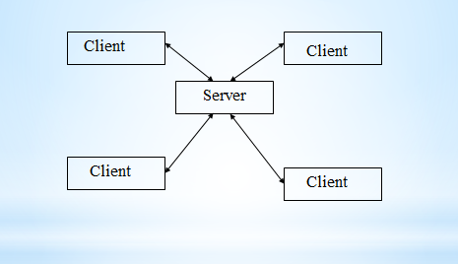
The Star Topology

Slide 29
  All nodes are connected to a central node by a single path
  This is used for data processing and voice communication networks
  Advantages
    Ease of service
    One device per connection
    Centralized control/Problem diagnosis
    Simple access protocols

Slide 30
  Disadvantages
    Long cable length
    Difficult to expand
    Central node dependency

Slide 31
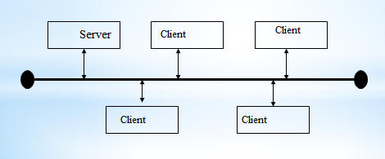
The Bus Topology

Slide 32
  Popular topology for data network
  Single transmission medium onto which various nodes are attached
  Normally coaxial cable is used
  Terminators at both end of BUS absorb signal, removing it from BUS

Slide 33
  Advantages
    Short cable length and simple wiring layout
    Resilient Architecture
    Easy to extend
  Disadvantages
    Fault diagnosis is difficult
    Fault isolation is difficult
    Repeater configuration
    Nodes must be intelligent

Slide 34
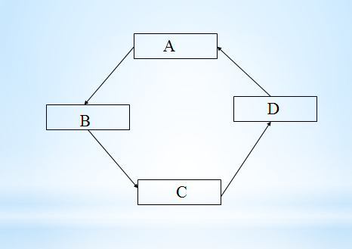
The Ring Topology

Slide 35
  Each node is connected to two and only two neighboring nodes
  Data is accepted from one neighboring node transmitted to other
  Data travels in one direction
  After passing through each node, it returns to sending node, which removes it

Slide 36
  Advantages
    Short cable length
    No wiring closest space required
    Suitable for optical fibers
  Disadvantages
    Node failure causes network failure
    Difficult to diagnose faults
    Network reconfiguration is difficult

Slide 37
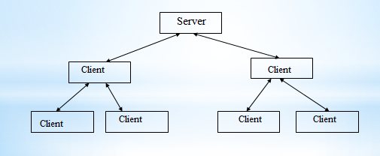
The Tree Topology

Slide 38
    Variation of BUS topology
    Tree structure with central root branching and
    sub branching to the extremities of network
    Transmission is same as BUS
    Also known as Hybrid Topology

Slide 39
Advantages of Tree Topology
It is an extension of Star and bus Topologies, so in networks where these topologies can't be implemented individually for reasons related to scalability, tree topology is the best alternative.
Expansion of Network is possible and easy.

Slide 40
Here, we divide the whole network into segments (star networks), which can be easily managed and maintained.
Error detection and correction is easy.
Each segment is provided with dedicated point-to-point wiring to the central hub.
If one segment is damaged, other segments are not affected.

Slide 41
Disadvantages of Tree Topology
Because of its basic structure, tree topology, relies heavily on the main bus cable, if it breaks whole network is crippled.
As more and more nodes and segments are added, the maintenance becomes difficult.
Scalability of the network depends on the type of cable used.

Slide 42
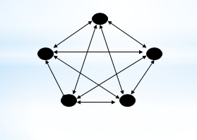
Mesh Topology

Slide 43
  Each node is connected to more than one node
  This provide an alternate route mechanism
  Excellent for long distance networking
  Supports back-up and rerouting
  Used in large internetworking environments with stars, rings and buses as nodes

Slide 44
Advantages
The arrangement of the network nodes is such that it is possible to transmit data from one node to many other nodes at the same time.
The failure of a single node does not cause the entire network to fail as there are alternate paths for data transmission.

Slide 45
It can handle heavy traffic, as there are dedicated paths between any two network nodes.
Point-to-point contact between every pair of nodes, makes it easy to identify faults.

Slide 46
Disadvantages
The arrangement wherein every network node is connected to every other node of the network, many connections serve no major purpose. This leads to redundancy of many network connections.

Slide 47
A lot of cabling is required. Thus, the costs incurred in setup and maintenance are high.
Owing to its complexity, the administration of a mesh network is difficult.

Slide 48
Lecture-3
This Lesson Covers:
What is Client-server network
What is computer server ?
Components of Client Server Network
Introduction to Network Protocols
The Need for a Protocol Architecture
key features of a protocol

Slide 49
Definition of Client-Server Network
The term ‘Client-Server’ refers to the Network Architecture ,where one or more computers are connected to a server . That one or more computer (the Client) sends a service request to another computer (the Server).

Slide 50
A client-server network is essentially a connected set of computers like a peer-to-peer network but it has a ‘master’ computer called the server, which uses software called a ‘network operating system’ to control what happens on the network. The computers that you use on the network are called ‘clients’ because they are ‘served’ by the server, for example, the client may ask to load a piece of software.

Slide 51
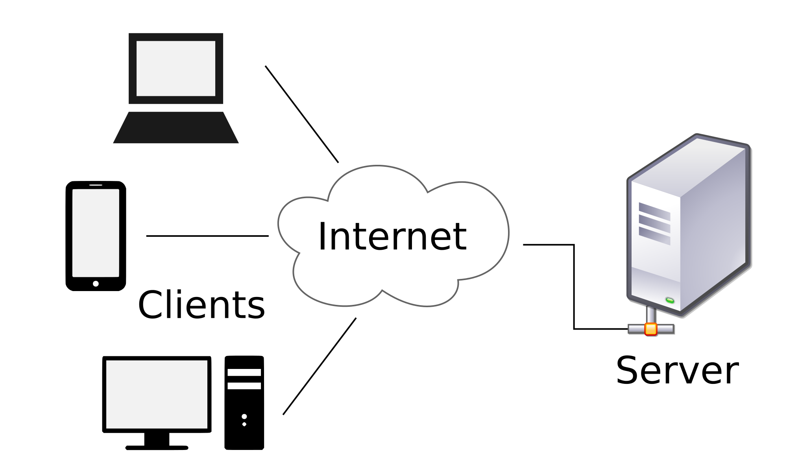

Slide 52
What is computer server?
A computer server is the powerful computer, or the set of computers connected to each other, which provide services to other systems. They usually have database integrated in them, and are very powerful machines with very advanced configuration. They process the requests of client machines. Their role is to make management of network easy and uniform.

Slide 53
Features of Servers
1) They have large storage capacity.
2) They are able to provide information to many computers simultaneously, therefore have large RAM.
3) Its processor speed is high, as it may have to execute multi-tasking too.

Slide 54
Components of Client Server Network
1)Clients or Workstations.
2) Servers.
3) Network Devices :- They connect the clients and servers, and at the same time ensure proper collision free routing of information.
4) Other components like scanner, printer, etc. can also be connected to network architecture.

Slide 55
Definition of network protocol
A network protocol defines rules and conventions for communication between network devices. Protocols for computer networking all generally use packet switching techniques to send and receive messages in the form of packets.

Slide 56
Network protocols include mechanisms for devices to identify and make connections with each other, as well as formatting rules that specify how data is packaged into messages sent and received.

Slide 57
Some protocols also support message acknowledgement and data compression designed for reliable and/or high-performance network communication. Hundreds of different computer network protocols have been developed each designed for specific purposes and environments.

Slide 58
Internet Protocols
The Internet Protocol family contains a set of related and the most widely used network protocols.
Beside Internet Protocol (IP) itself, higher-level protocols like TCP, UDP, HTTP, and FTP all integrate with IP to provide additional capabilities.

Slide 59
Thank You

