Slide 1
Overview
Communication is the transfer of information from one place to another.
This should be done
- as efficiently as possible
- with as much fidelity/reliability as possible
- as securely as possible
Communication System: Components/subsystems act together to accomplish information transfer/exchange.
Process describing transfer of information, data, instructions between one or more systems through some media

Slide 2
Communication Systems
  Examples
    people, computers, cell phones, etc.
    Computer communication systems
Receivers and transmitters: desktop computers, mainframe computers, etc.
Communication channel
TX
RX
RX
RX
Amp/Adaptor
Communication
media

Slide 3
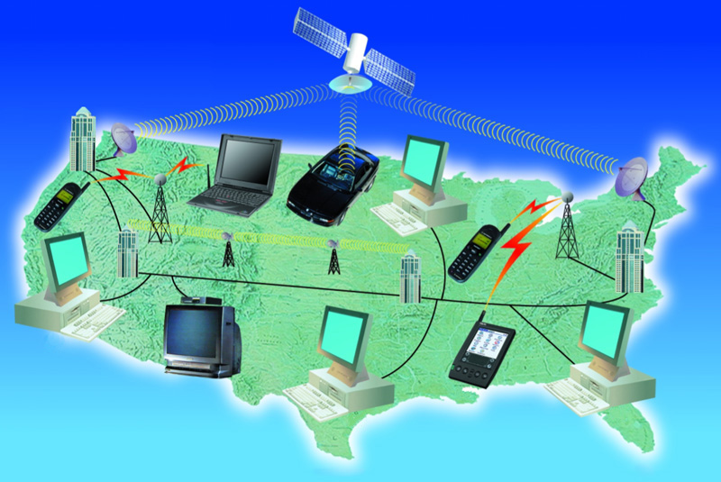
Communications Components
Basic components of a communication system
  Communication technologies
  Communication devices
  Communication channels
  Communication software

Slide 4
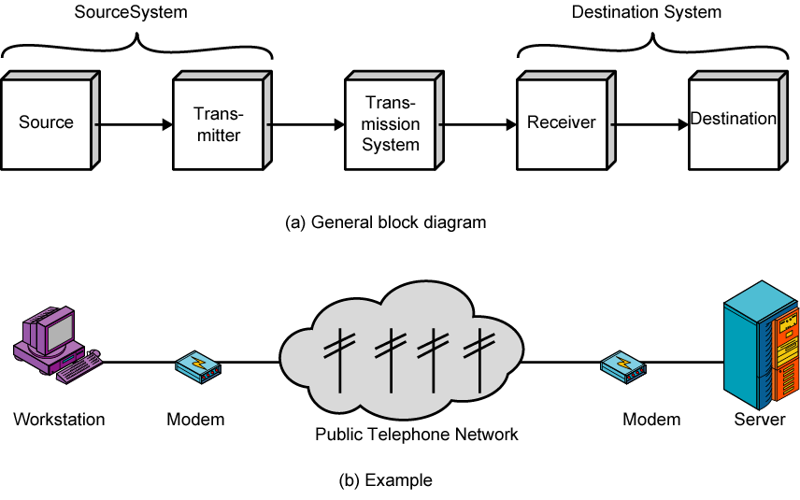
A Communications Model

Slide 5
Elements of a Communication System
Input message
Output message
Input Transducer
Output Transducer
Transmitter
Channel
Receiver

Slide 6
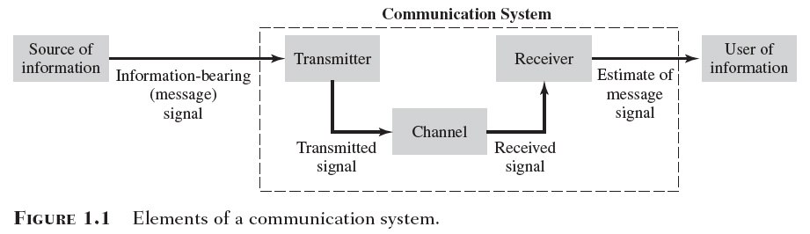

Slide 7
Input Transducer: The message produced by a source must be converted by a transducer to a form suitable for the particular type of communication system.
Example: In electrical communications, speech waves are converted by a microphone to voltage variation.
Transmitter: The transmitter processes the input signal to produce a signal suits to the characteristics of the transmission channel.
Signal processing for transmission almost always involves modulation and may also include coding. In addition to modulation, other functions performed by the transmitter are amplification, filtering and coupling the modulated signal to the channel.

Slide 8
Channel: The channel can have different forms: The atmosphere (or free space), coaxial cable, fiber optic, waveguide, etc.
The signal undergoes some amount of degradation from noise, interference and distortion
Receiver: The receiver’s function is to extract the desired signal from the received signal at the channel output and to convert it to a form suitable for the output transducer.
Other functions performed by the receiver: amplification (the received signal may be extremely weak), demodulation and filtering.
Output Transducer: Converts the electric signal at its input into the form desired by the system user.
Example: Loudspeaker, personal computer (PC), tape recorders.

Slide 9
Communication systems encompass many and highly diverse applications
  Radios, television, wireless communications, satellite communications, deep-space communications, telephony, data networks, Internet, and quite a few others.

Slide 10

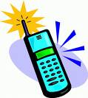
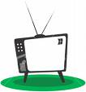
To be transmitted, Information (Data) must be transformed to electromagnetic signals.

Slide 11
1.2 Applications
  Broadcasting
    Which involves the use of a single powerful transmitter and numerous receivers that are relatively inexpensive to build
  point-to-point communications
    In which the communication process takes place over a link between a single transmitter and a single receiver.

Slide 12
Radio
  Broadcasting
    AM and FM radio
      The voices are transmitted from broadcasting stations that operate in our neighborhood
    Television
      Transmits visual images and voice
  Point-to-point communication
    Satellite communication
      Built around a satellite in geostationary orbit, relies on line-of-sight radio propagation for the operation of an uplink and a downlink

Slide 13
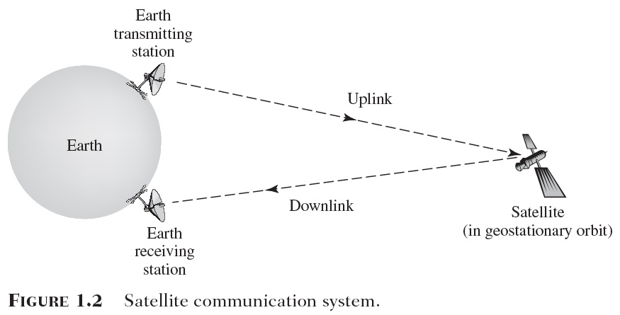
Back
Next

Slide 14
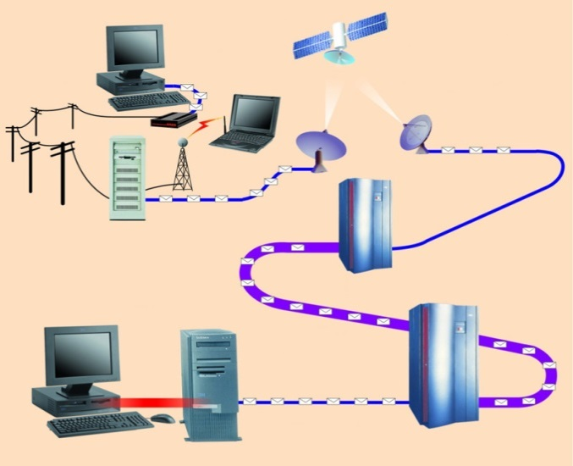
Communication Channels
A channel is a path between two communication devices
Channel capacity: How much data can be passed through the channel (bit/sec)
  Also called channel bandwidth
  The smaller the pipe the slower data transfer!
Consists of one or more transmission media
  Materials carrying the signal
  Two types:
    Physical: wire cable
    Wireless: Air
T1 lines
T1 lines
destination network server
T3 lines
T1 lines

Slide 15
Physical Transmission Media
A tangible media
  Examples: Twisted-pair cable, coaxial cable, Fiber-optics, etc.
Twisted-pair cable:
  One or more twisted wires bundled together (why?)
  Made of copper
Coax-Cable:
  Consists of single copper wire surrounded by three layers of insulating and metal materials
  Typically used for cable TV
Fiber-optics:
  Strands of glass or plastic used to transmit light
  Very high capacity, low noise, small size, less suitable to natural disturbances

Slide 16
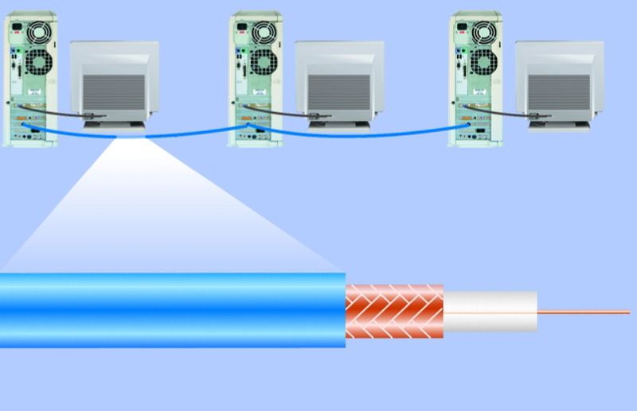
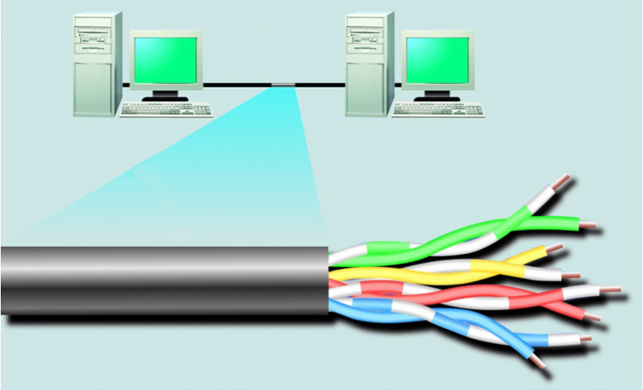
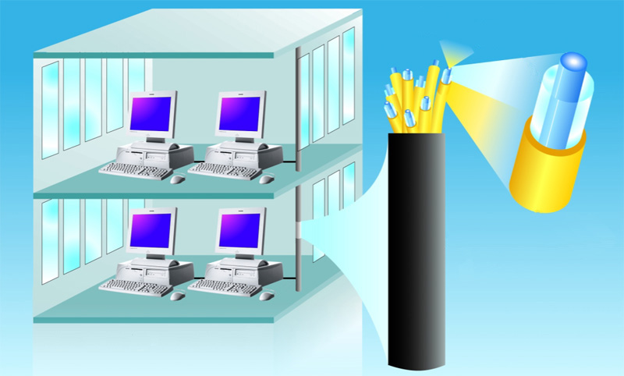
Physical Transmission Media
woven or braided metal
twisted-pair cable
twisted-pair wire
copper wire
plastic outer coating
insulating material
optical fiber core
glass cladding
protective coating

Slide 17
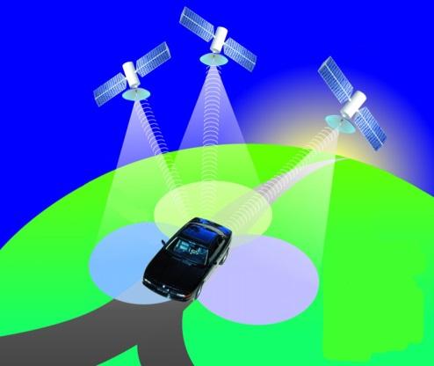
Wireless Transmission Media
Broadcast Radio
  Distribute signals through the air over long distance
  Uses an antenna
  Typically for stationary locations
  Can be short range
Cellular Radio
  A form of broadcast radio used for mobile communication
  High frequency radio waves to transmit voice or data
  Utilizes frequency-reuse

Slide 18
Wireless Transmission Media
Microwaves
  Radio waves providing high speed transmission
  They are point-to-point (can’t be obstructed)
  Used for satellite communication
Infrared (IR)
  Wireless transmission media that sends signals using infrared light- waves - Such as?

Slide 19
ANALOG AND DIGITAL
Data (Information) can be analog or digital. The term analog data refers to information that is continuous; digital data refers to information that has discrete states. Analog data take on continuous values. Digital data take on discrete values.
Signals passing through the communication channel can be Digital, or analog
  Analog signals: continuous electrical waves
  Digital signals: individual electrical pulses (bits)

Slide 20
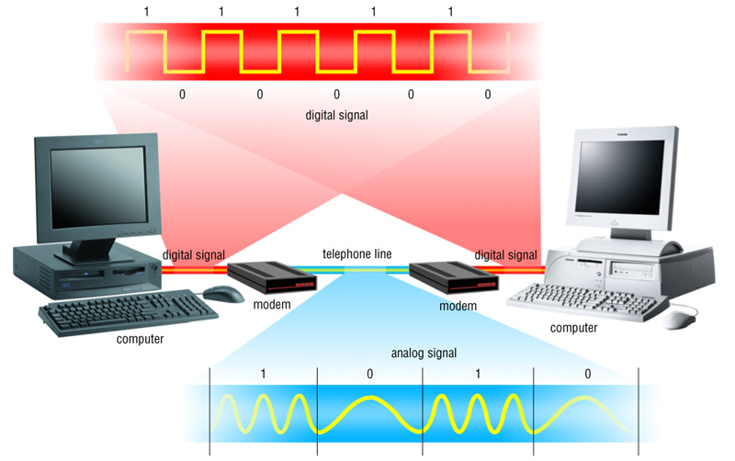
Communication Systems

Slide 21
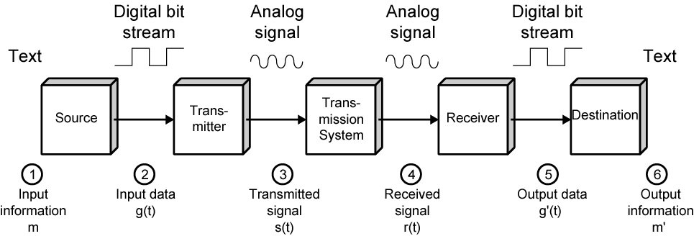
Data Communications Model

Slide 22

Figure Comparison of analog and digital signals

Slide 23
Information Representation Using Analog Signals
Information can be represented using analog signals
Analog signals cannot be manipulated easily
Analog signals must be digitized for computer processing
  They must also be presented in binary form for computer processing

Slide 24
There are many kinds of information sources, which can be categorized into two distinct message categories, analog and digital.
an analog communication system should deliver this waveform with a specified degree of fidelity.
a digital communication system should deliver data with a specified degree of accuracy in a specified amount of time.
Analog and Digital Communication Systems

Slide 25
The Advantages of Digitization
Information can be processed by the computer
Easy transmission of information over the Internet and other computer networks
Minimize loss of quality during transmission

Slide 26
Digital Advantage
Processing using computer technology
Programmable services
Better quality due to being able to reconstruct exact digital patterns at the receiving end
Faster communication speeds are possible

Slide 27
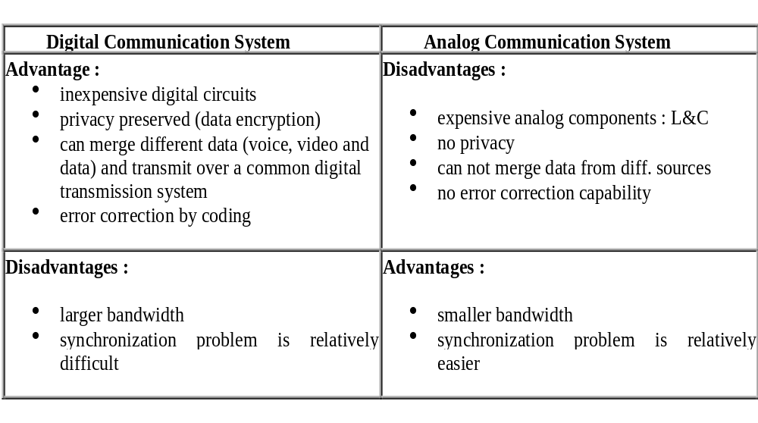
Comparisons of Digital and Analog Communication Systems

Slide 28

Wi-Fi Technology

Slide 29
Introduction
Definitions:
Wi-Fi stands for ( Wireless Fidelity) which is a brand originally licensed by the Wi-Fi Alliance to describe the underlying technology of wireless local area networks (WLAN) based on the IEEE 802.11 specifications.

Slide 30
What is Wi-Fi?
Short for wireless fidelity.
It is a wireless technology that uses radio frequency to transmit data through the air.
Wi-Fi is based on the 802.11 standard:
  802.11a
  802.11b
  802.11g

Slide 31
IEEE 802.11 Family
Protocol | Release | Freq. (GHz) | Data Rate (Mbit/s) (Typical / Max) | Range (m) (Indoor/outdoor)
A | Sep 1999 | 5 / 3.7 | 20 / 54 | 35 / 120
B | Sep 1999 | 2.4 | 5.5 / 11 | 35 / 140
G | Jun 2003 | 2.4 | 22 / 54 | 38 / 140
N | Oct 2009 | 2.4 / 5 | 110+ / 300+ | 70 / 250

Slide 32
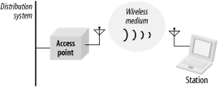
Wireless LAN Networks

Slide 33




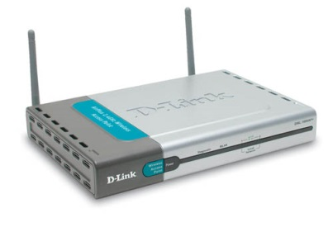

WLAN Architecture—Infrastructure Mode
To Wired Network

Slide 34
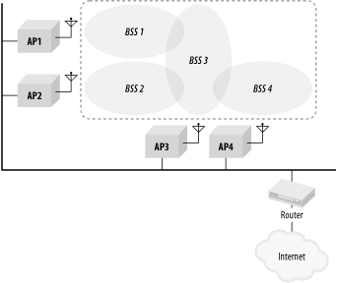
Extended Service Area

Slide 35
Infrastructure network
There is an Access Point (AP), which becomes the hub of a “star topology.”
Any communication has to go through AP. If a Mobile Station (MS), like a computer, a PDA, or a phone, wants to communicate with another MS, it needs to send the information to AP first, then AP sends it to the destination MS
Multiple APs can be connected together and handle a large number of clients.
Used by the majority of WLANs in homes and businesses.

Slide 36


Wi-Fi Certification
The Wi-Fi CERTIFIED logo from the Wi-Fi Alliance.
  Rigorous interoperability testing requirements.
  Certifies the interoperability of 802.11 products from the many different vendors.

Slide 37
Basic Operation & Applications
Wi-Fi was intended to be used for mobile computing devices, such as laptops, in LANs, but it is now often used for increasingly more applications, including Internet access and basic connectivity of consumer electronics such as televisions and DVD players.
Wi-Fi can be used by cars in highways to support an Intelligent Transportation System to increase safety.

Slide 38
With a Wi-Fi device, such as a computer, telephone, or personal digital assistant (PDA) can connect to the Internet when he is in the region of an access point. The region covered by one or several access points is called a hotspot.
Hotspots can range from a single room to large open areas.
Wi-Fi also allows connectivity in peer-to-peer mode, which enables devices to connect directly with each other.

Slide 39
How Wi-Fi Works
Radio waves are the keys which make Wi-Fi networking possible.
These radio signals are transmitted from antennas and picked up by Wi-Fi receivers such as computers and cell phones that are equipped with Wi-Fi cards.
The Wi-Fi card will read the signals and thus create an internet connection between the user and the network.

Slide 40

The typical Wi-Fi setup contains one or more Access Points (APs) and one or more clients.
The Wi-Fi standard leaves connection criteria and roaming totally open to the client. This is a strength of Wi-Fi, but also means that one wireless adapter may perform substantially better than the other.

Slide 41

Wireless Standards
Sensors
IEEE 802.15.4
(Zigbee Alliance)
RFID
(AutoID Center)
RAN
IEEE 802.22
WAN
3GPP (GPRS/UMTS)
3GPP2 (1X--/CDMA2000)
GSMA, OMA
IEEE 802.20
IEEE 802.16e
IEEE 802.21, IEEE 802.18 802.19
MAN
IEEE 802.16d WiMAX
ETSI HiperMAN & HIPERACCESS
IEEE 802.11
Wi-Fi Alliance
LAN
ETSI-BRAN HiperLAN2
IEEE 802.15.3 UWB, Bluetooth
Wi-Media, BTSIG, MBOA
PAN
ETSI HiperPAN
Notes:
ETSI HIPERMAN following 256 OFDM mode of 802.16a

Slide 42
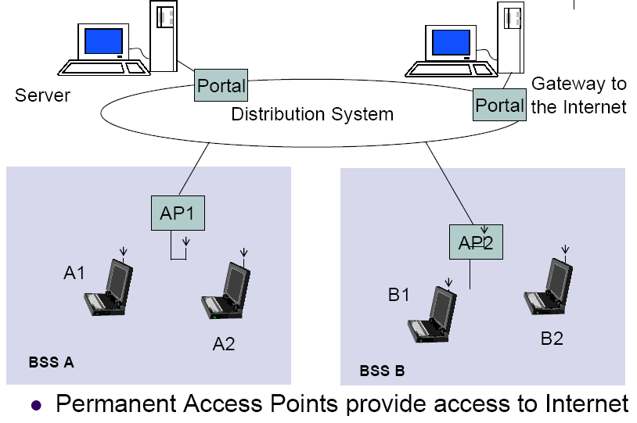
Infrastructure Network

Slide 43
Advantages of Wi-Fi
Allows LANs to be deployed without cabling. Spaces where cables cannot be run, such as outdoor areas and historical buildings, can host wireless LANs.
Wi-Fi networks support roaming, in which a mobile client station such as a laptop computer can move from one access point to another as the user moves around a building or area.
Wi-Fi is suitable for latency-sensitive applications
(such as voice and video) and small form-factor devices.

Slide 44
Advantages
Freedom – You can work from any location that you can get a signal.
Setup Cost – No cabling required.
Flexibility – Quick and easy to setup in temp or permanent space.
Scaleable – Can be expanded with growth.
Mobile Access – Can access the network on the move.

Slide 45
Disadvantages of Wi-Fi
Wi-Fi networks have limited range. A typical Wi-Fi home with a stock antenna might have a range of 45 m (150 ft) indoors and 90 m (300 ft) outdoors.
Interference of a closed or encrypted access point with other open access points in the area.
Wi-Fi networks can be monitored and used to read and copy data (including personal information) transmitted over the network.

Slide 46
Disadvantages
Speed – Slower than cable.
Range – Affected by various medium.
  Travels best through open space.
  Reduced by walls, glass, water, etc
Security – Greater exposure to risks.
  Unauthorized access.
  Compromising data.
  Denial of service.

Slide 47
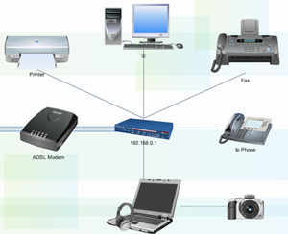
Network Technologies
Personal area network (PAN)
  A low range computer network
  PANs can be used for communication among the personal devices themselves
  Wired with computer buses such as USB and FireWire.
Wireless personal area network (WPAN)
  Uses network technologies such as IrDA, Bluetooth, UWB, Z-Wave and ZigBee
Internet Mobile Protocols
  Supporting multimedia Internet traffic
  IGMP & MBONE for multicasting
  RTP, RTCP, & RSVP (used to handle multimedia on the Internet)
VoIP

Slide 48
The Name –Bluetooth?
The name is attributed to Harald Bluetooth was king of Denmark around the turn of the last millennium.

Slide 49
Bluetooth is a new standard developed by a group of electronics manufacturers that will allow any sort of electronic equipment -- from computers and cell phones to keyboards and headphones -- to make its own connections, without wires, cables or any direct action from a user.
A key difference with other existing wireless technologies is that bluetooth enables combined usability models based on functions provided by different devices.

Slide 50
The Bluetooth Special Interest Group comprises more than 1000 companies.The major companies who created the technology include
  Intel
  3 com
  Ericcson
  IBM
  Motorola
  Nokia
  Toshiba

Slide 51
Present wireless technology like infra red data communication has two problems –1)Line of Sight 2) One to One
Using data synchronizing– e.g. hot syn on a PDA --- problem of using the right cradle and cable.
BLUETOOTH OVERCOMES THESE PROBLEMS

Slide 52
Bluetooth Overview
Wireless technology for short-range voice and data communication
Low-cost and low-power
Provides a communication platform between a wide range of “smart” devices
Not limited to “line of sight” communication

Slide 53
Bluetooth
  Uses radio frequency
  Typically used for close distances (short range- 33 feet or so)
  Transmits at 1Mbps
  Used for handheld computers to communicate with the desktop

Slide 54
Bluetooth
Wireless Personal Area Networks (WPAN)
Design goal
  Cable replacement
  Low cost
  Low power
  Small size
  For mobile devices
Standard: IEEE 802.15.1

Slide 55
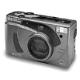
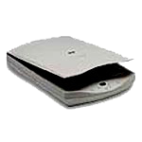
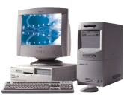
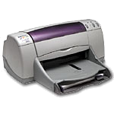
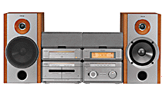

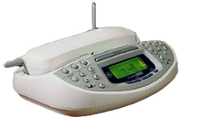
Motivation
Digital Camera
Computer
Scanner
Inkjet
Printer
Home Audio System
PDA
Cell Phone
Cordless Phone
Base Station

Slide 56
Bluetooth Applications
Automatic synchronization between mobile and stationary devices
Connecting mobile users to the internet using bluetooth-enabled wire-bound connection ports
Dynamic creation of private networks

Slide 57
The Basic Idea
Bluetooth is a standard for a small , cheap radio chip to be plugged into computers, printers, mobile phones, etc
Bluetooth chip is designed to replace cables. Information normally carried by the cable, is transmitted at a special frequency to a receiver Bluetooth chip.
These devices can form a quick ad-hoc secure “piconet” and start communication.
Connections in the “piconets” can occur even when mobile.

Slide 58
“Piconet”
  A collection of devices connected via Bluetooth technology in an ad hoc fashion.
  A piconet starts with two connected devices, and may grow to eight connected devices.
  All Bluetooth devices are peer units and have identical implementations. However, when establishing a piconet, one unit will act as a Master and the other(s) as slave(s) for the duration of the piconet connection.

Slide 59
Connecting to Internet
Being able to gain access to the Internet by using “Bluetooth access points”
  Access point is used as a gateway to the internet
  Both the access point and the device are Bluetooth-enabled
  An example of Service Discovery Protocol
    Access point provides a service to the device

Slide 60
Ad Hoc Networks
Up to 8 devices can be actively connected in master/slave configuration
Piconets can be combined to form scatternets providing unlimited device connectivity

Slide 61
Requirements
Low cost as cables – chip $5
Secure as cables – must support authentication and encryption
Must support both data and voice.
Must connect to a variety of devices.
Must be able to function in a noisy environment.
Data rates – 721kbps , using the 2.45Ghz radio frequency band –I.S.M (Industrial, scientific and medical)
Must support many simultaneous and private “piconets”.
Must be low power, compact and global.

Slide 62
Bluetooth Radio
Uses 2.4 GHz ISM band spread spectrum radio (2400 – 2483.5 MHz)
Advantages
  Free
  Open to everyone worldwide
Disadvantages
  Can be noisy (microwaves, cordless phones, garage door openers)

Slide 63
WiFi vs. Bluetooth
 | Bluetooth | Wifi
Specifications authority | Bluetooth SIG | IEEE, WECA
Year of development | 1994 | 1991
Bandwidth | Low ( 800 Kbps ) | High (11 Mbps )
Hardware requirement | Bluetooth adaptor on all the devices connecting with each other | Wireless adaptors on all the devices of the network, a wireless router and/or wireless access points
Cost | Low | High
Power Consumption | Low | High
Frequency | 2.4 GHz | 2.4 GHz
Security | It is less secure | It is more secure
Range | 10 meters | 100 meters
Primary Devices | Mobile phones, mouse, keyboards,office and industrial automation devices | Notebook computers, desktopcomputers, servers
Ease of Use | Fairly simple to use. Can be used to connect upto seven devices at a time. It is easy to switch between devices or find and connect to any device. | It is more complex and requires configuration of hardware and software.

Slide 64
WiMAX
  Worldwide Interoperability for Microwave Access
  Provides wireless transmission of data from point-to-multipoint links to portable and fully mobile internet access (up to 3 Mbit/s)
  The intent is to deliver the last mile wireless broadband access as an alternative to cable and DSL
  Based on the IEEE 802.16(d/e) standard (also called Broadband Wireless Access)

Slide 65
Wireless Technology Differences
Standard | Family | Downlink (Mbps) | Uplink (Mbps) | Coverage
WiFi | 802.11 | 11/54/150/300 |  | 100m
WiMAX | 802.16e | 144 | 35 | 10km
UMTS (3G) /HSPA (3.5G) | 3GPP | 14.4 | 5.76 | 30km
LTE (4G) | 3GPP | 360 | 80 | 30km
MobiHoc '10

Slide 66


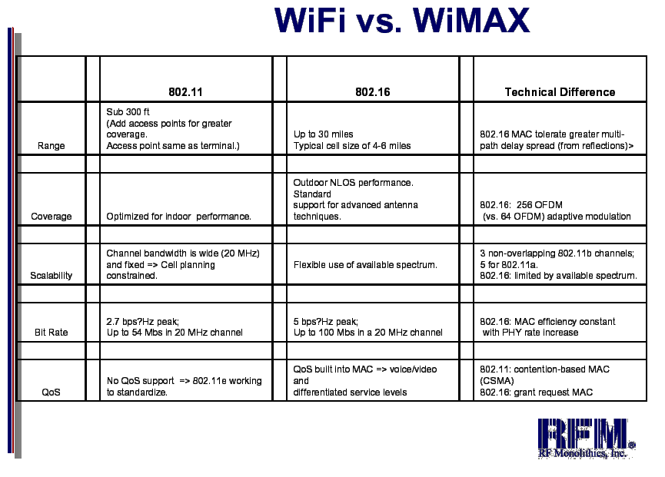
vs

Slide 67
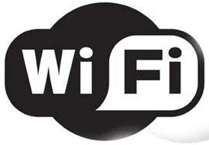
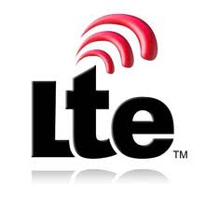

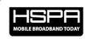
Wireless Broadband Technologies
802.11n
Throughput
4G
802.11 a/b/g
3.5G
Coverage Range
MobiHoc '10

Slide 68
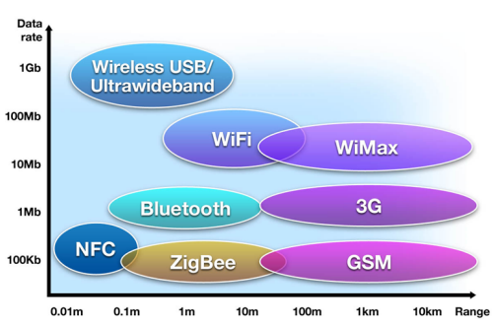
Comparison Between Similar Technologies³

Slide 69
We can say that it is more likely that Wi-Max could compete with other cellular phone protocols such as GSM, UMTS or CDMA. However, Wi-Fi is ideal for VoIP applications like in a corporate LAN environment.

Slide 70
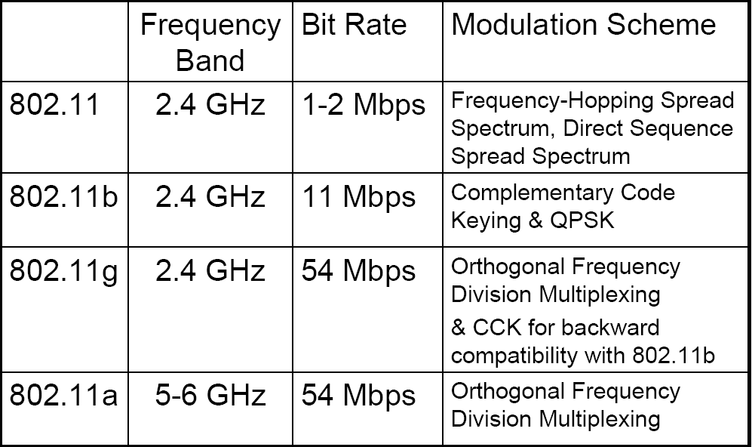
IEEE 802.11 Wireless LANs:
Physical Layer Options

Slide 71
Network Examples
Intranets
  Used for private networks
  May implement a firewall
    Hardware and software that restricts access to data and information on a network

Slide 72


