Slide 1
Development of Microfluidic Sensor
Shika Rao
2019A3PS1237H

Slide 2
Implementation Plan for Project

Slide 3
Timeline
Goal | By 1 Oct 2021 | By 15 November 2021 | By 5 December 2021
1 | Background research on general components involved in the project | Implementation | Leftover
2 | Specific research related to the project | Report | Finishing Changes
3 | Report

Slide 4
Objectives
Aims to contribute to medical research on Urinary Tract Infections (UTIs):
- Microfluidic biosensor –
For nitrite detection in urine to indicate Urinary Tract Infection (UTI).
- Deep Learning –
To classify UTIs other than Bacterial UTIs, from microscopic images containing various urine sediments.
Aims to present a thorough study of various projects carried out in this field towards a similar aim.

Slide 5
Motivation
A focus on optoelectronic devices in medical applications was chosen due to it’s many uses in electronics and healthcare like pulse oximeters and glucose testing for diabetes.
Nitrite is used for detecting Bacterial Urinary Tract Infections so focus is on a nitrite microfluidic biosensor.
I am currently doing a deep learning course and I finished an image processing course the previous semester, so I can carry out the automatic detection and classification of the urine sediments.

Slide 6
Implementation Details of Project

Slide 7
Organization
Introduction
Intro to urinary tract infections and medical procedure currently followed.
Introduction to colorimetric analysis and MEMS sensors for nitrite.
Introduction to deep learning in urine sediment images.
Review of Literature- Previous work on the related fields.
Colorimetric analysis and/or MEMS sensors for nitrite detection
Deep learning or Image Processing for Urine Sediment Detection and Classification

Slide 8
Methodology and Results
Microfluidic sensor for detection of nitrite
- Colorimetric Reagent
- Creo Parametric Design
- COMSOL simulation
- Optoelectronic Detection
Deep Learning for detection and classification of the sediment
- Dataset collection
- Object Detection and Classification

Slide 9
Introduction
Urinary Tract Infection Diagnosis:
Visual Exam
Chemical Exam – Microfluidic chip can be used here
For quantitative analysis of nitrite in urine sample.
Microscopic Exam – Deep Learning can be used here
For imaging of urine sediment.

Slide 10
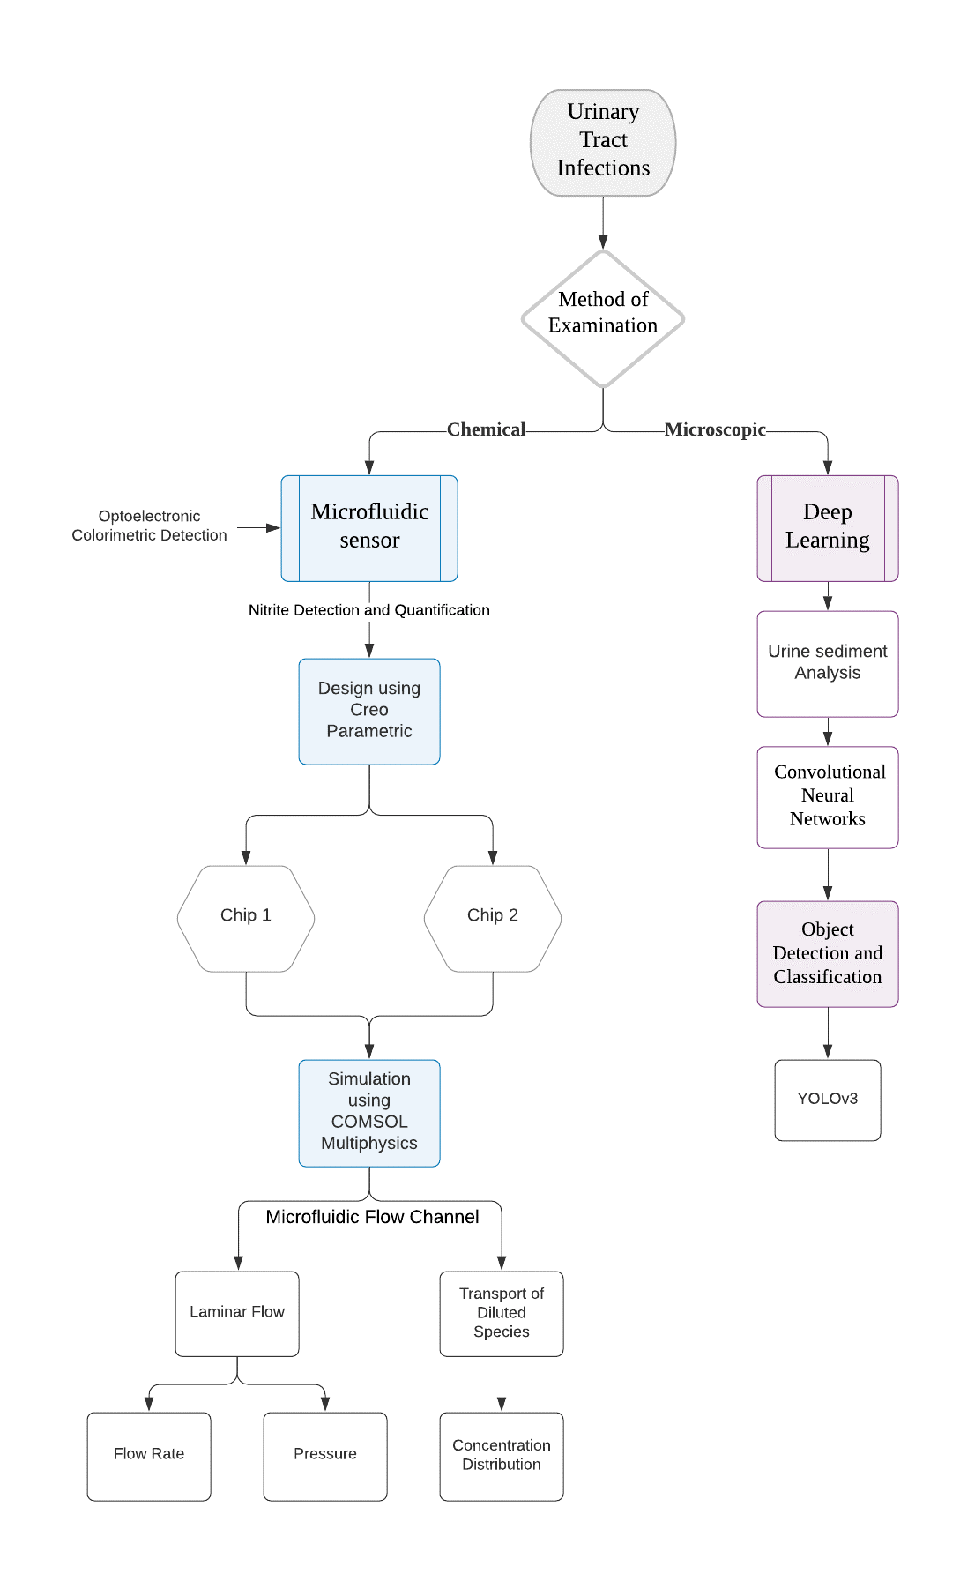
Methodology

Slide 11
Part1: Chemical Analysis of UTI- Microfluidic Sensor

Slide 12
Workflow
Microfluidic sensor for detection of nitrite
- Creo Parametric Designs
- COMSOL simulation
- Optoelectronic Detection and Colorimetric Analysis

Slide 13
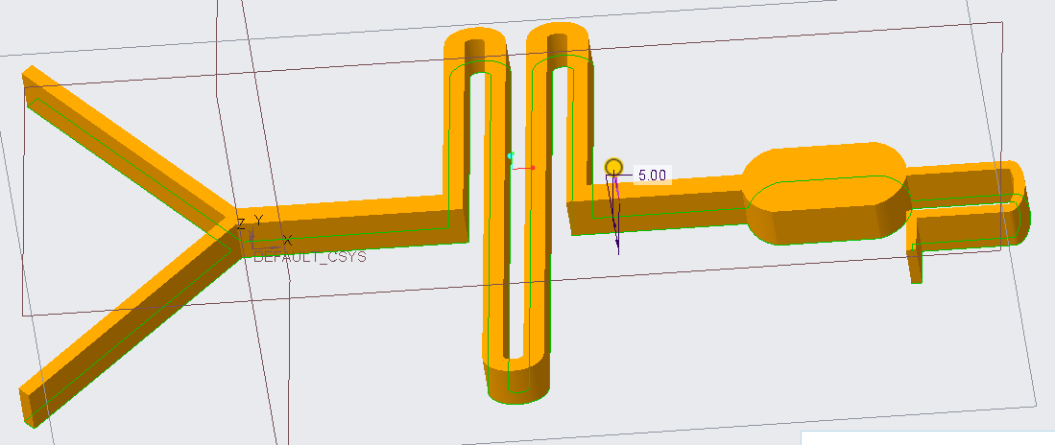
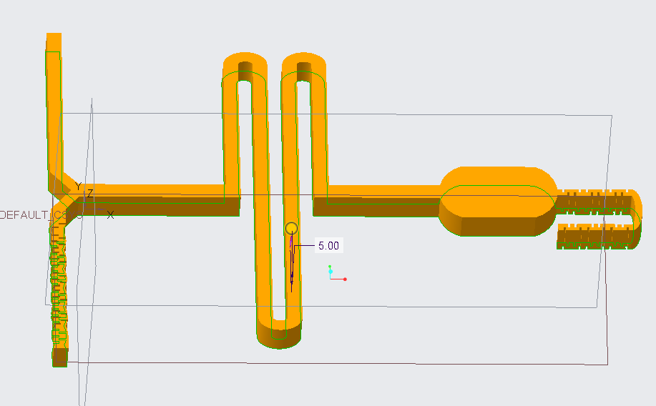
Creo Parametric Design
Chip1 Chip2

Slide 14
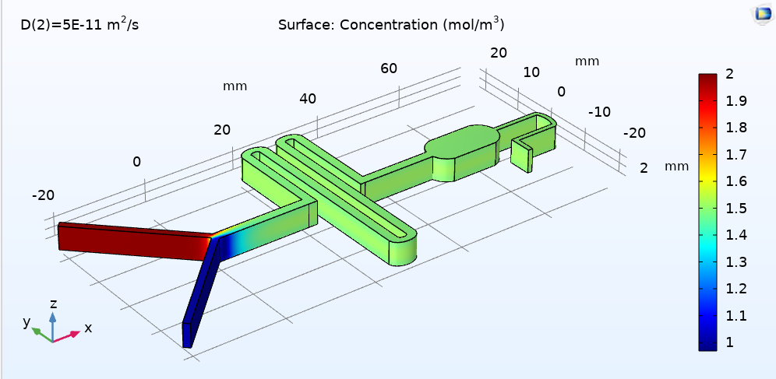
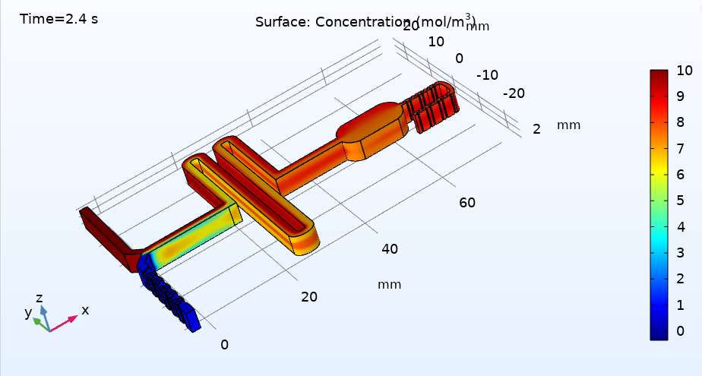
COMSOL Simulation
Concentration- Transport of Diluted Species and Laminar Flow coupled Physics
Chip1:
Chip2:

Slide 15
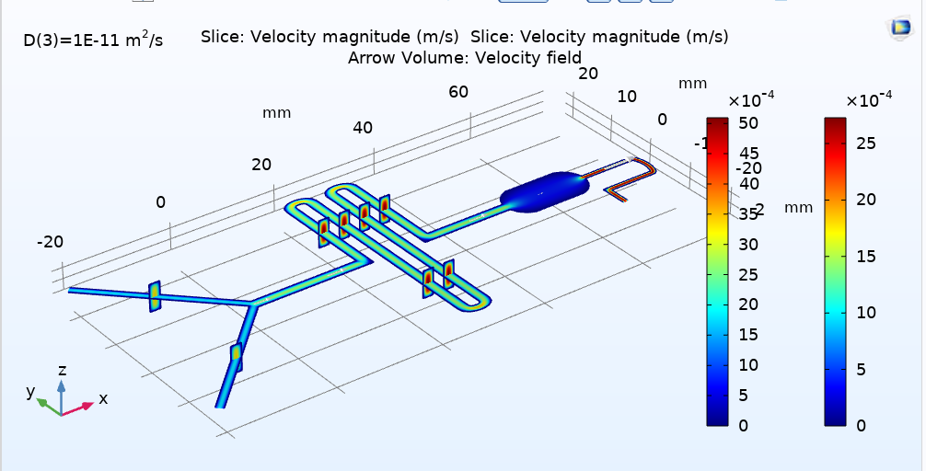
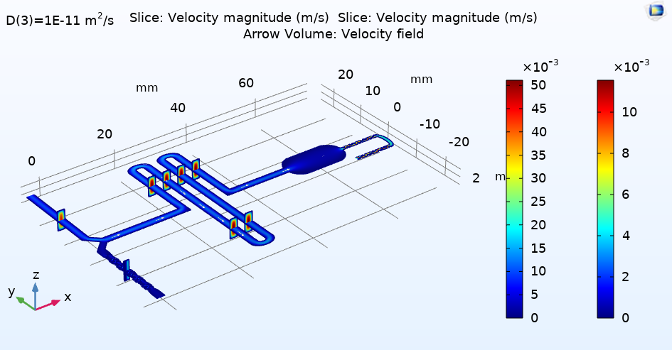
Velocity Profile- Laminar Flow Physics
Chip1:
Chip2:

Slide 16
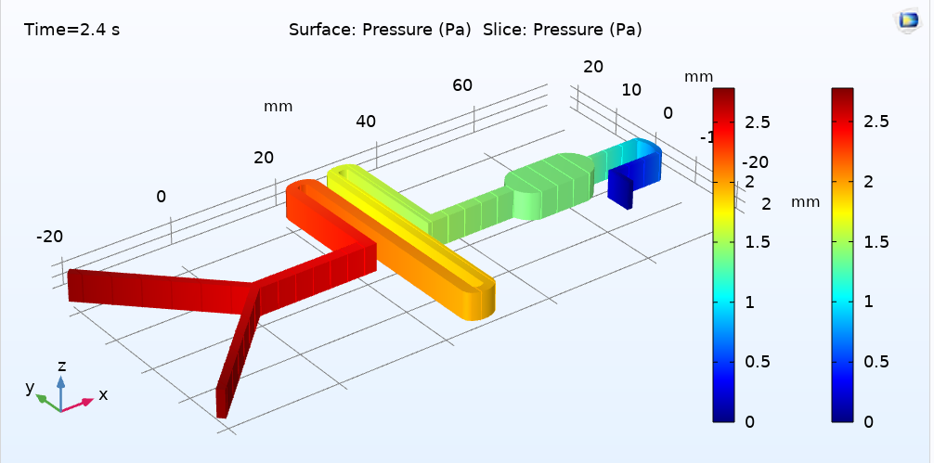
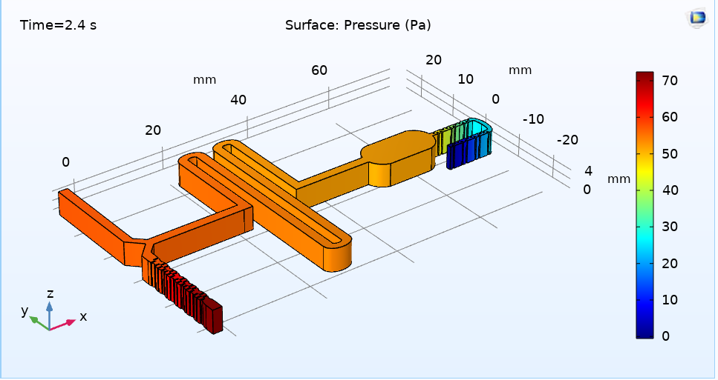
Pressure profile- Laminar Flow Physics
Chip1:
Chip2:

Slide 17
Colorimetric Analysis using Optoelectronic Detection
The use of optoelectronic components, such as LED and photodetectors
Voltmeter reading to correlate the voltage output to quantity of nitrite in analyte
Microcontroller and Analog to Digital Converter (ADC) to display through flexible numeric display (FND)
Microcontroller and display through Smartphone Application
2. Conventional UV-vis spectrophotometers which directly quantify the nitrite content

Slide 18
Part2: Microscopic Analysis- Deep Learning

Slide 19
Workflow
Deep Learning for detection and classification of the sediment
- Dataset collection
- Object Detection and Classification using YOLOv3 Algorithm

Slide 20
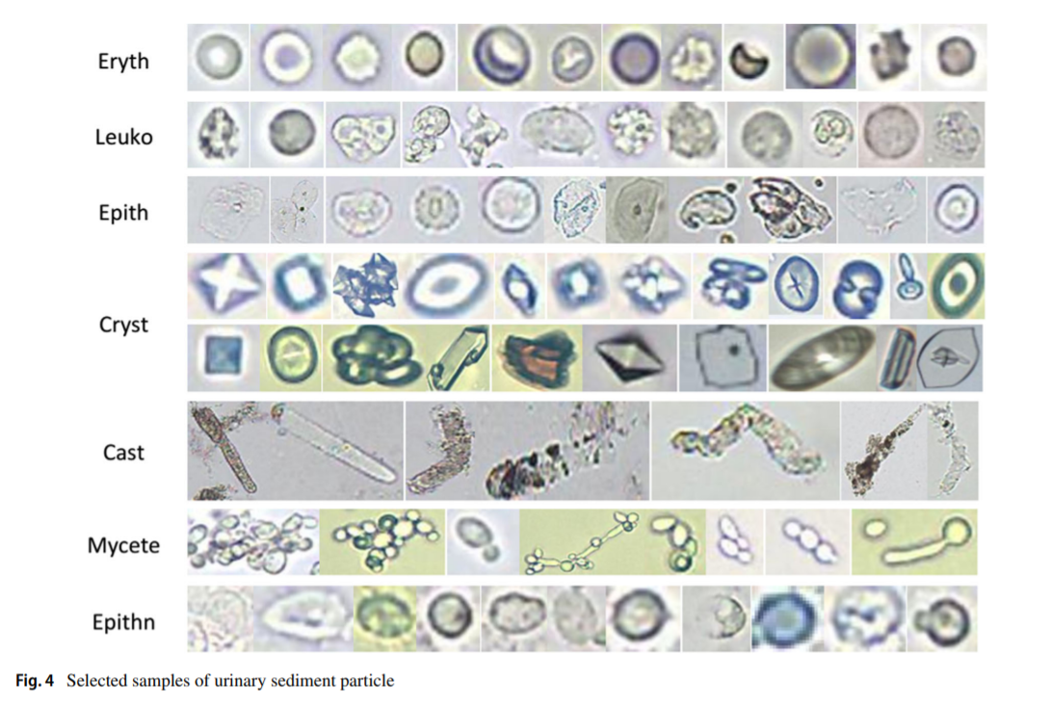
Dataset

Slide 21
Metrics of Assessment of Model
True Positive- TP was considered for IoU ≥ 0.5
False Positive- FP for IoU < 0.5 (Indicates a wrong detection)
False Negative- FN is assigned when no corresponding ground truth is detected.
Precision (P)= TP / (TP + FP)
Recall (R) = TP / (TP + FN)
The average precision (AP) is estimated by the area under the precision–recall curve.

Slide 22
Results
Confidence Threshold | TP | FP | FN | Average IoU | Precision | Recall | F1 score | mAP@0.5
0.25 | 39387 | 7571 | 2848 | 64.86 % | 0.84 | 0.93 | 0.88 | 0.924018
Class ID | Class Name | True Positive (TP) | False Positive (FP) | Average Precision (AP)
0 | cast | 3137 | 686 | 90.91 %
1 | cryst | 1555 | 285 | 94.66 %
2 | epith | 5814 | 1835 | 91.62 %
3 | epithn | 617 | 124 | 86.11 %
4 | eryth | 20318 | 2545 | 94.14 %
5 | leuko | 5997 | 1731 | 95.65 %
6 | mycete | 1949 | 365 | 93.72 %

Slide 23
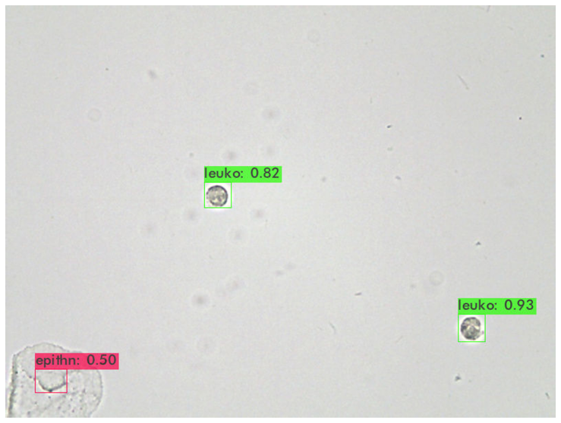
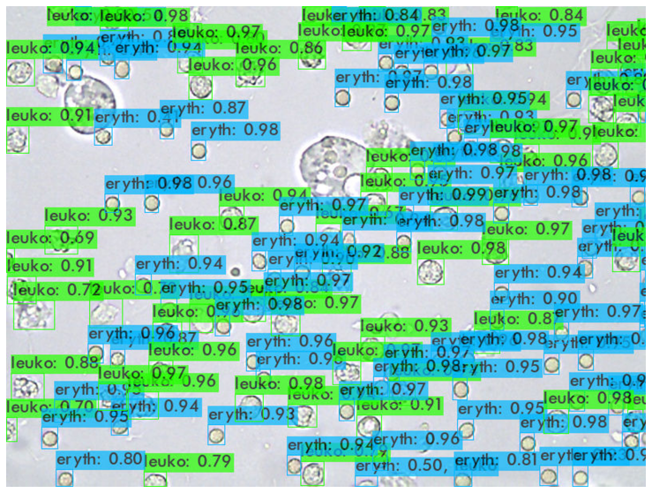
Test images Performance

Slide 24
Conclusion

Slide 25
Future Scope
There is a relationship between the quantity of nitrite in urine samples and UTI but further research has to be conducted to model the relationship.
In cases wherein the urine culture test is mandatory to provide valuable information on the detection of the type of bacterial UTI, a microfluidic lab on chip system could be designed for speedy test results as compared to the current 24 – 72 hours time range.
Further research can also be done to understand the relationship between the quantity of nitrite and the type of bacteria.

Slide 26
Thank You!

