Slide 1


A MACHINE-LEARNING-BASED APPROACH TO EXPEDITE PREDICTING EFFECTIVE METAMATERIAL PROPERTIES FOR ELECTROMAGNETIC TRANSMISSION CONTROL
Presented by
Yakub Ali (C211079)
Sarawar Hossain (C211068)
MD. Tasbiul Karim Tahsin (C211078)
Supervised by
Prof. Mohammed Shamsul Alam
Professor
Department of CSE,IIUC
CSE-4800
Page-1
2025

Slide 2
OUTLINE
Background Of the Study
Dataset & perameter
Objective
Introduction
Problem Statement
Literature Review
Model & Result
Analysis
Metamaterials
SUMMARY
Design
Future Work
Time line
Conclusion
CSE-4800
Page-2
2025

Slide 3
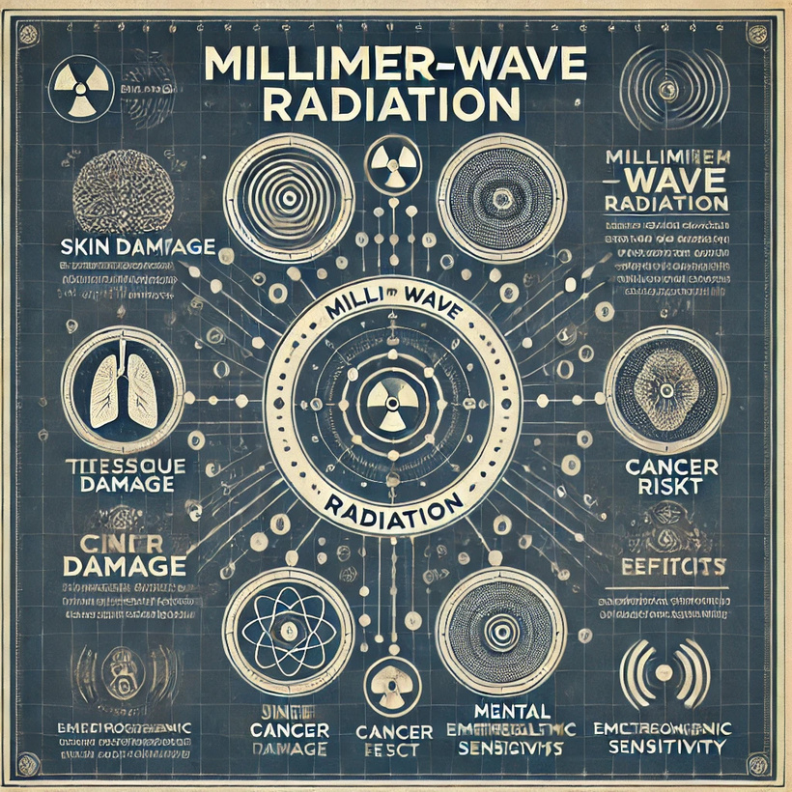
BACKGROUND OF THE STUDY
  Metamaterials are used to control electromagnetic wave transmission by absorbing, redirecting, or filtering radiation,minimizing unnecessary exposure.
  They help reduce potential health hazards from long-term 5G or EM radiation while improving communication efficiency and safety.
Page-3
CSE-4800
2025

Slide 4

INTRODUCTION
Metamaterials are revolutionizing EM radiation control, but their design is slow and costly. Our work uses machine learning and deep learning to predict metamaterial properties quickly, enabling efficient design for applications like 5G. By combining simulations and AI, we aim to accelerate the development of next-generation EM materials.
Page-4
CSE-4800
2025

Slide 5

METAMATERIALS
Metamaterials are engineered materials with unique structures that manipulate electromagnetic waves in ways not found in natural materials. Their unique properties come from structural design, rather than just their composition.
CSE-4800
Page-5
2025

Slide 6
SUMMARY
Desining metamaterials are quite complex & time consuming but using the ML, backward designing approach for (20-32 GHz) frequency makes it quite simple & easy.
CSE-4800
Page-6
2025

Slide 7





TIMELINE
Proposal
Submission
Manual Design Create
Dataset
Preparation
Data
Analysis
Final Submission
Create API
Page-7
CSE-4800
2025

Slide 8

OBJECTIVE
1.Optimize Metamaterial Designs
2.Create Dataset
3.Develop a Machine Learning Model:Optimize Metamaterial design
4.Validate Predictions
Page-8
CSE-4800
2025

Slide 9

PROBLEM STATEMENT
  Traditional parameter extraction is slow
  Computationally expensive
  Need for fast, accurate prediction
  Limited labeled data
Page-9
CSE-4800
2025

Slide 10
LITERATURE REVIEW
Author’s | Model’s | Method’s | Key Contribution | Research Focus
Zhu et al. | Deep Learning, GA | Hybrid Optimization (GA + DL) | Multi-objective optimization for metamaterials | AI-assisted metamaterial absorbers
Ma et al. | Inverse ANN, CNN | Inverse Design Optimization | Adaptive structural optimization for metamaterials | Design of metamaterial mechanical structures
Harper et al. | CNN, Autoencoders | Neural Architecture Search | Efficient architecture search for meta-device design | ML-based discovery of optimized unit cells
Kumar et al. | MLP, RNN | Physics-Informed Machine Learning | Hybrid ML for physics-guided metamaterial design | Physics-integrated machine learning for metamaterials
Page-10

Slide 11
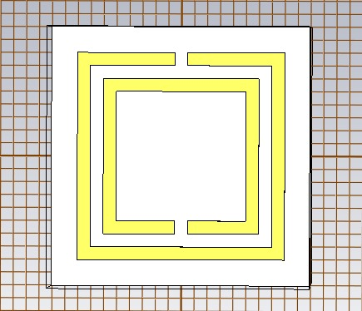
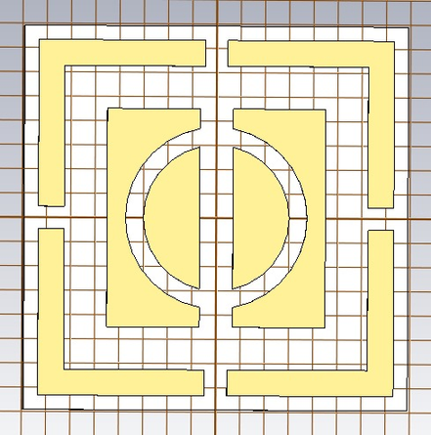

DESIGN COMPARASION
2-3 GHz
6-8GHz
13-15GHz
Page-11
CSE-4800
2025

Slide 12
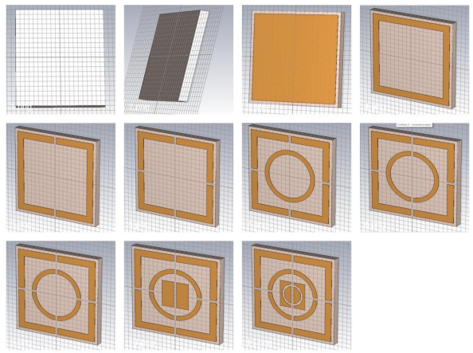
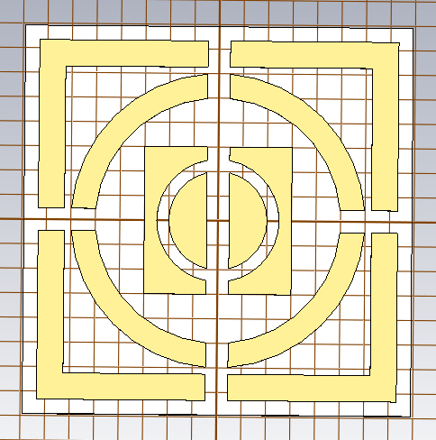
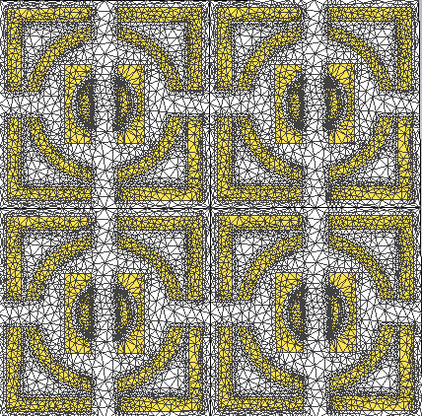
STPES OF COMPLETING (DESIGN)
Page-12
CSE-4800
2025

Slide 13

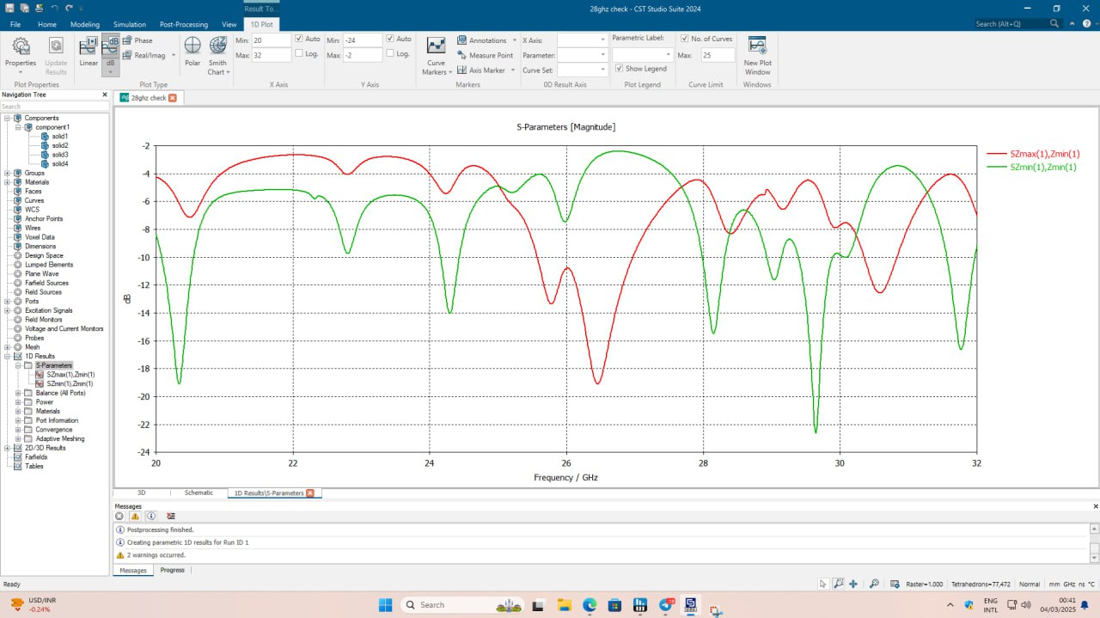
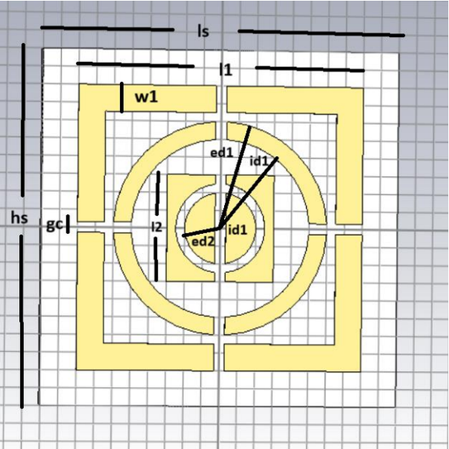
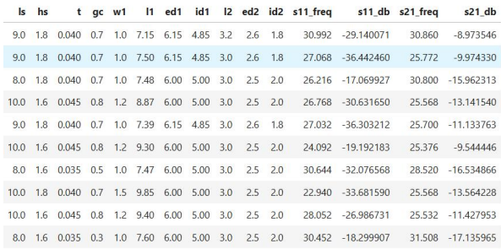
FINAL DESIGN AND OUTPUT
DATASET AND PERAMETER
10
Design parameters:
  ls: Substrate length
  hs: Substrate height
  t: Copper thickness
  gc: Global cut width
  l1: Outer box length
  w1: Outer box width
  ed1, id1: Outer circle radious
  l2: Inner box dimension
  ed2, id2: Inner circle radious
CSE-4800
2025
Page-13

Slide 14
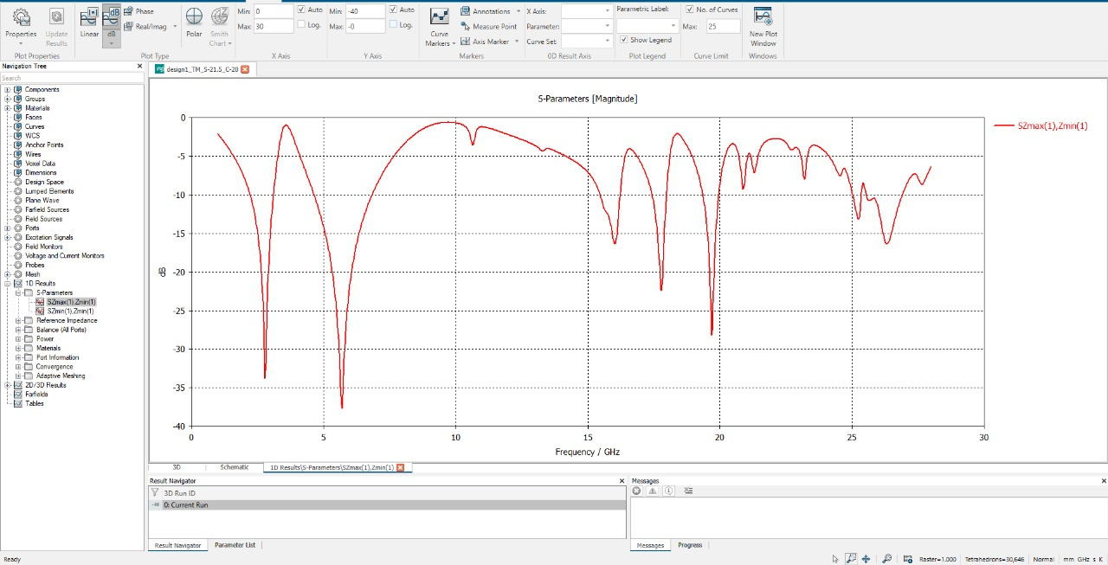
SIMULATION (OUTPUT)
S₁₁ (Reflection Coefficient):
a) It measures how much of the incident wave is reflected back from the device or material.
b) S₁₁ = -10 dB (10% reflection)
Page-14
CSE-4800
2025

Slide 15
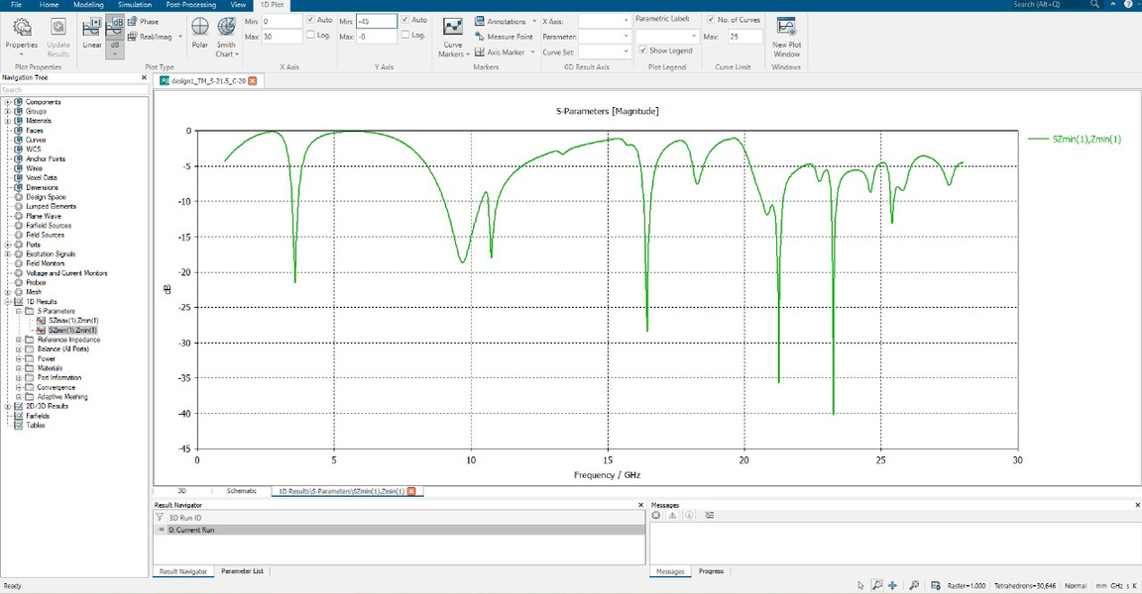
SIMULATION (OUTPUT)
S₂₁ (Transmission Coefficient):
a) This parameter describes how much of the input signal is transmitted from the input port (port 1) to the output port (port 2).
b) S₂₁ = -10 dB (0.1% transmission)
Page-15
CSE-4800
2025

Slide 16
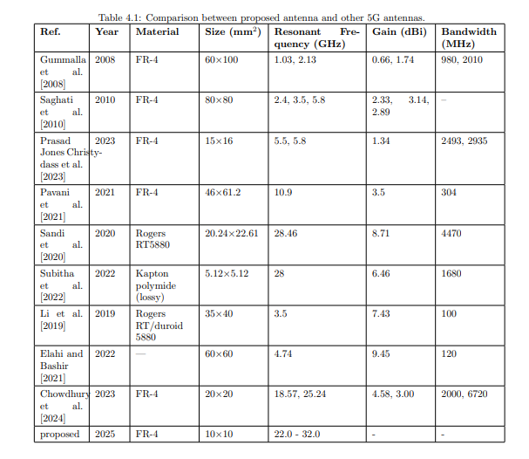
DATASET BENCHMARK
Page-16
CSE-4800
2025

Slide 17
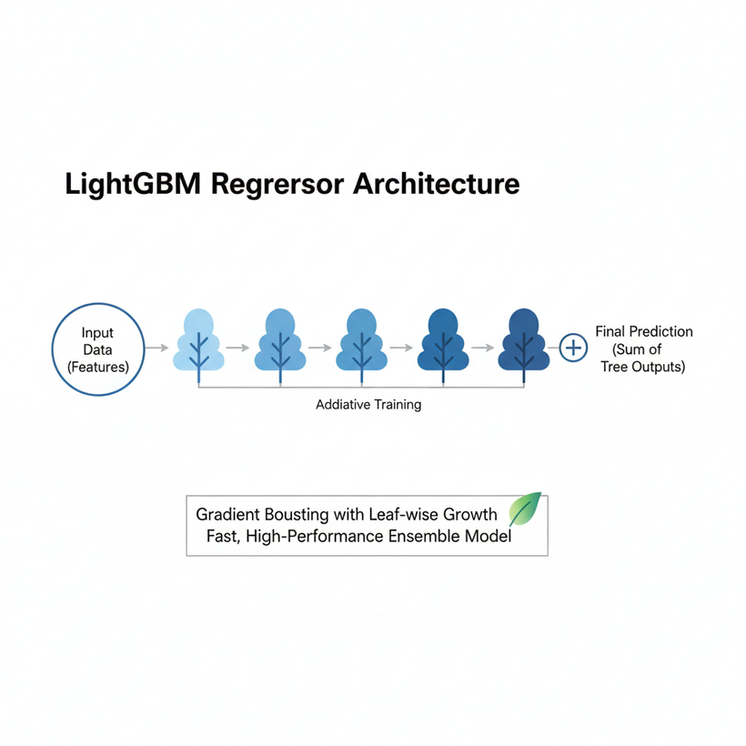
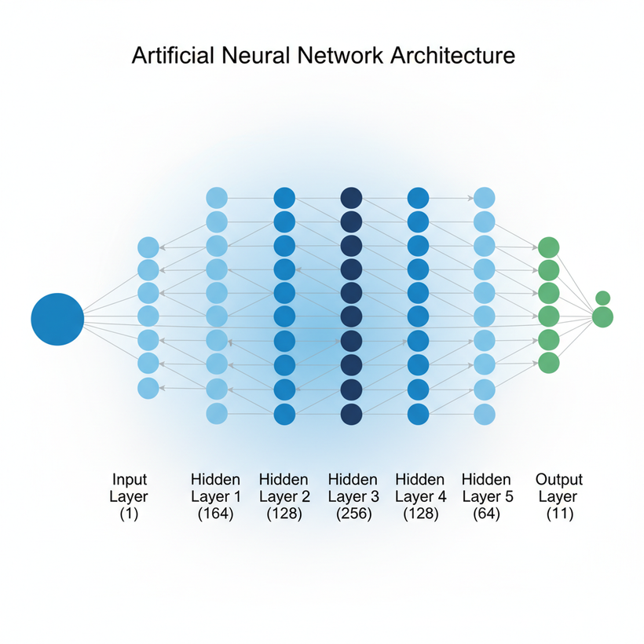
MACHINE LEARNING MODEL
Page-17
CSE-4800
2025

Slide 18
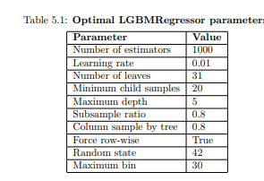
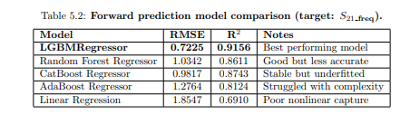
FORWARD PREDICTION
CSE-4800
Page-18
2025

Slide 19
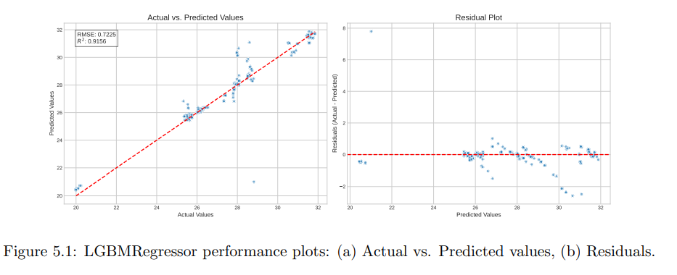
FORWARD PREDICTION
Page-19
CSE-4800
2025

Slide 20
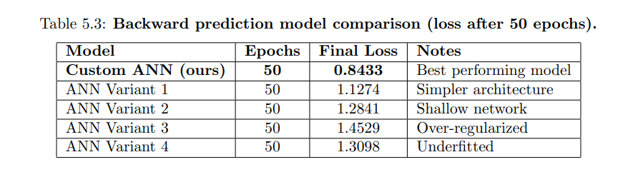
BACKWARD PREDICTION
CSE-4800
Page-20
2025

Slide 21
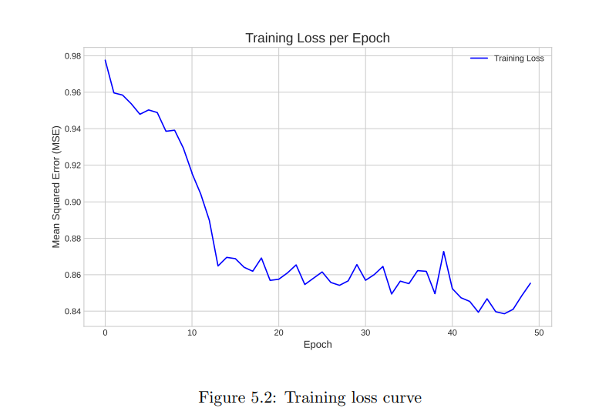
BACKWARD PREDICTION
CSE-4800
Page-21
2025

Slide 22
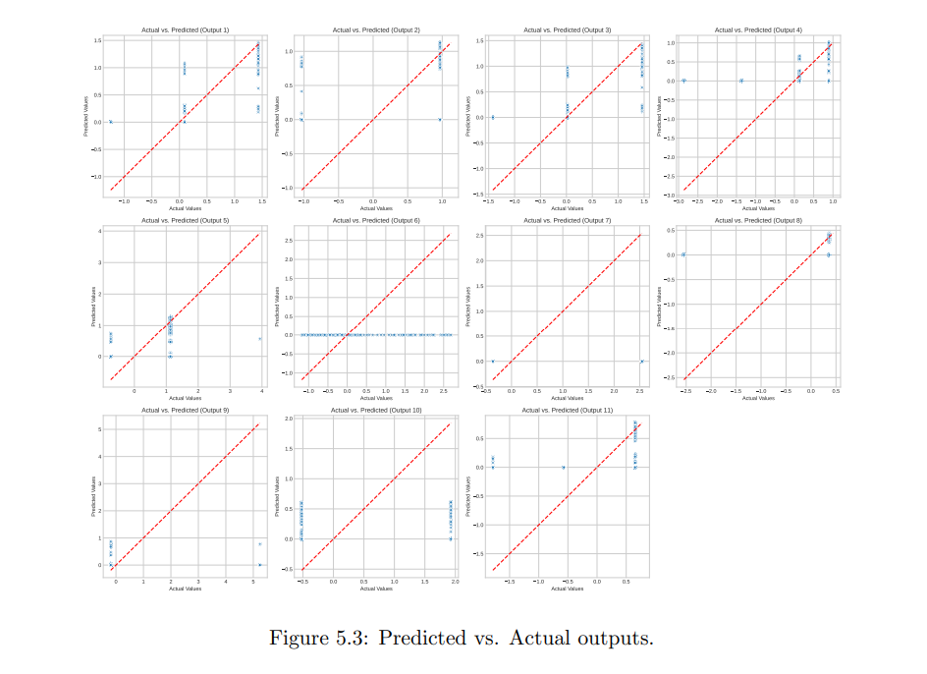
BACKWARD PREDICTION
CSE-4800
Page-22
2025

Slide 23
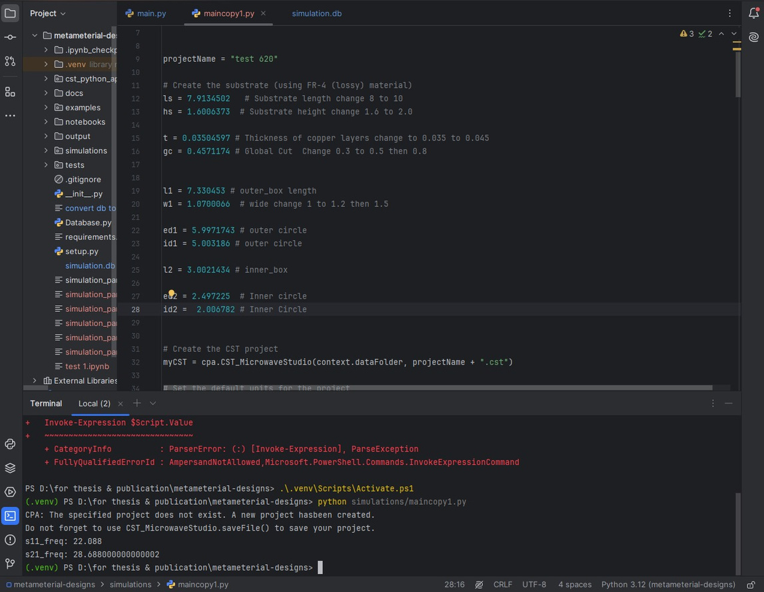
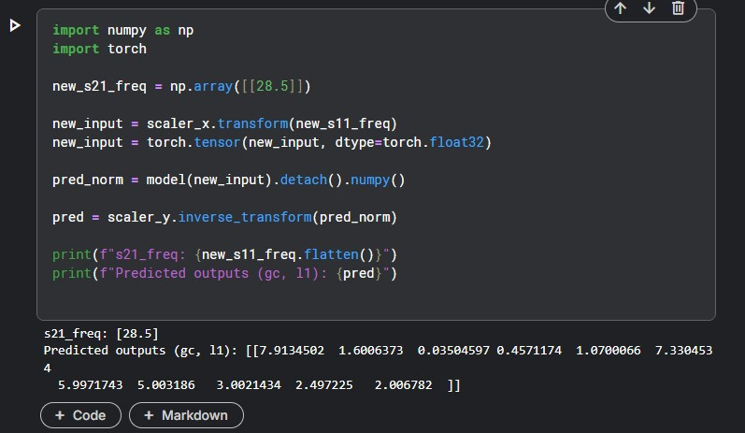
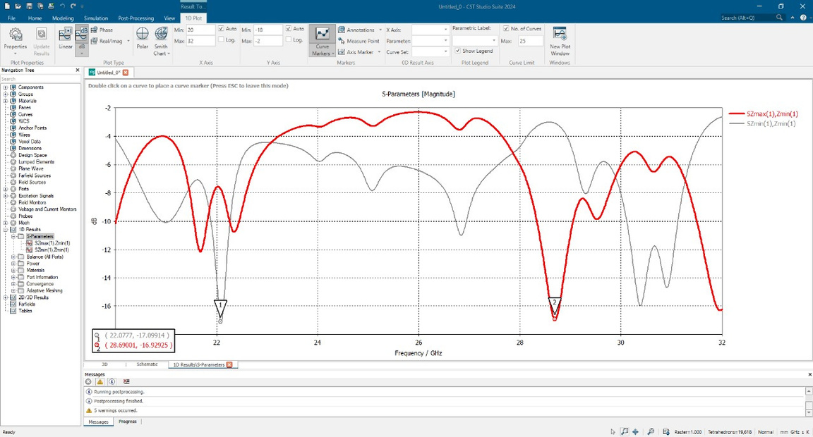
RESULT VALIDATION
Page-23
CSE-4800
2025

Slide 24
FUTURE WORK
  Larger Dataset
  Improving Generative Models (GANs)
  Hybrid Deep Learning Models (FNN, GNN)
  Improved Real-Time Use
  Broadening Applications
  Integration with Fabrication
Page-24
CSE-4800
2025

Slide 25

CONCLUSION
Our machine-learning-based approach offers a transformative solution for accelerating the design and optimization of metamaterials for electromagnetic radiation reduction. By leveraging data-driven models, we can predict effective material properties with unprecedented speed and accuracy. This work highlights the immense potential of AI to revolutionize metamaterial design, paving the way for faster innovation and practical implementation.
CSE-4800
Page-25
2025

Slide 26





T
H
A
N
K
Y
O
U
CSE-4800
2025

