Slide 1
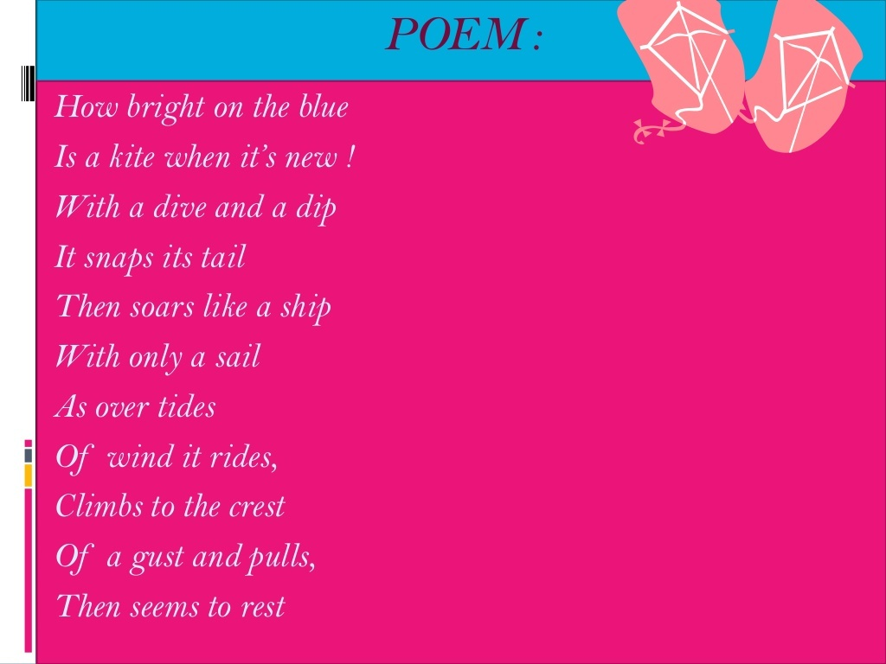

Slide 2
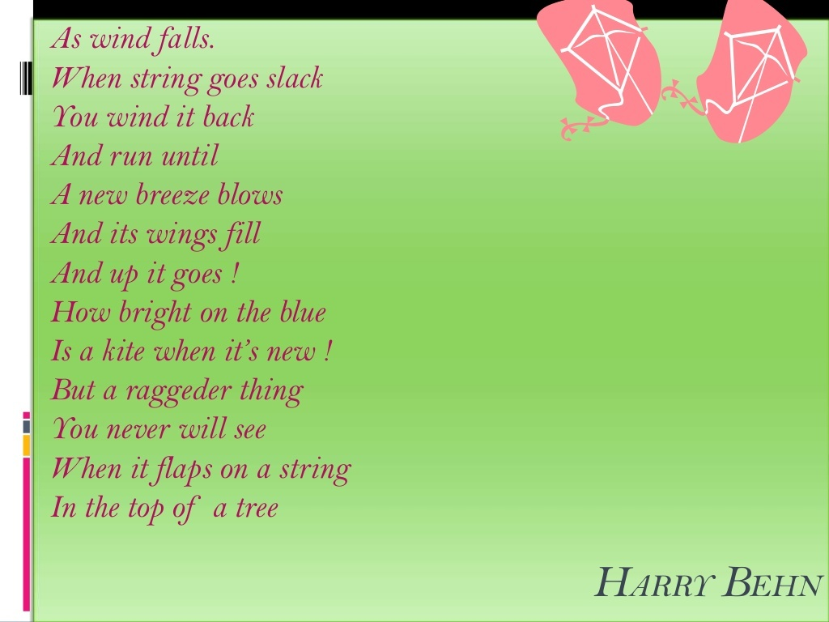

Slide 3
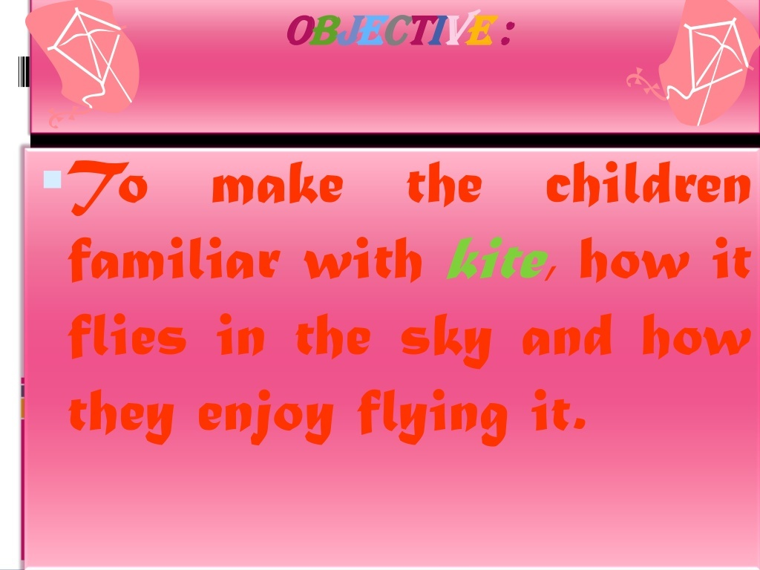

Slide 4
The Kite-Harry Behn
Vocabulary
Sail- a piece of fabric attached to a boat
Tides of wind- gusts of wind
Rides- travels,. Snaps- moves with noise
Crest- top of the wave
Gust- sudden strong wind
Falls- loose intensity
Slack- loose
wind-coil
Falls- flutters
String-cord. ,Raggeder- more torn and dirty

Slide 5
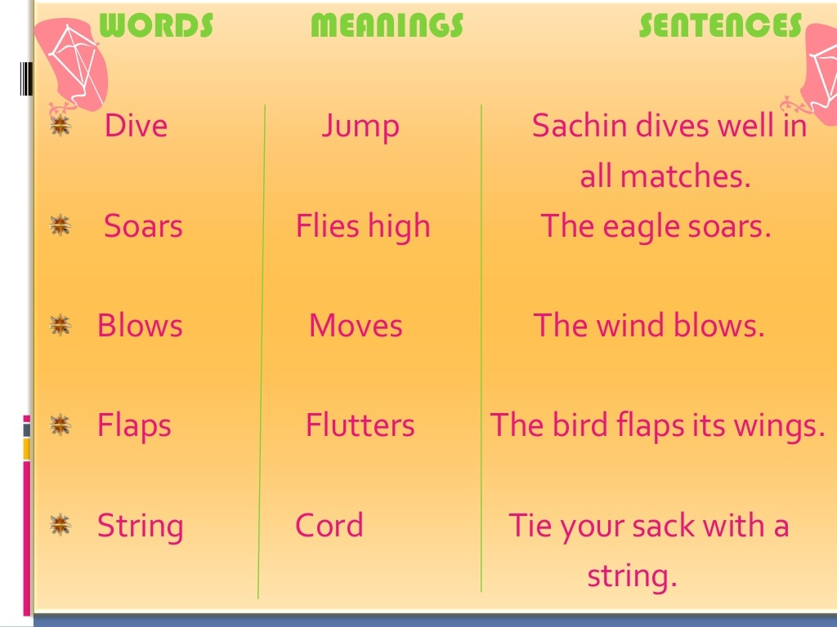

Slide 6
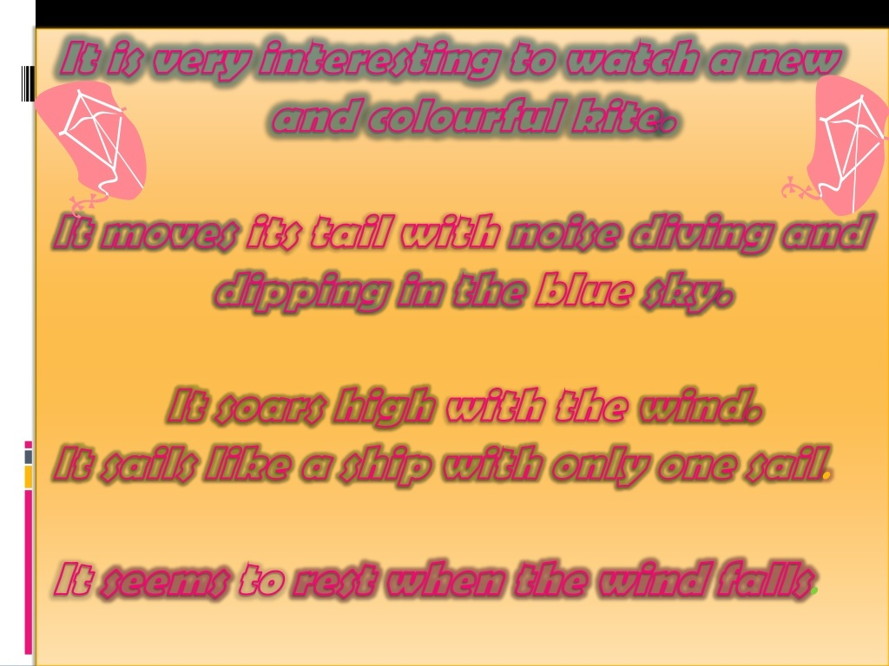

Slide 7
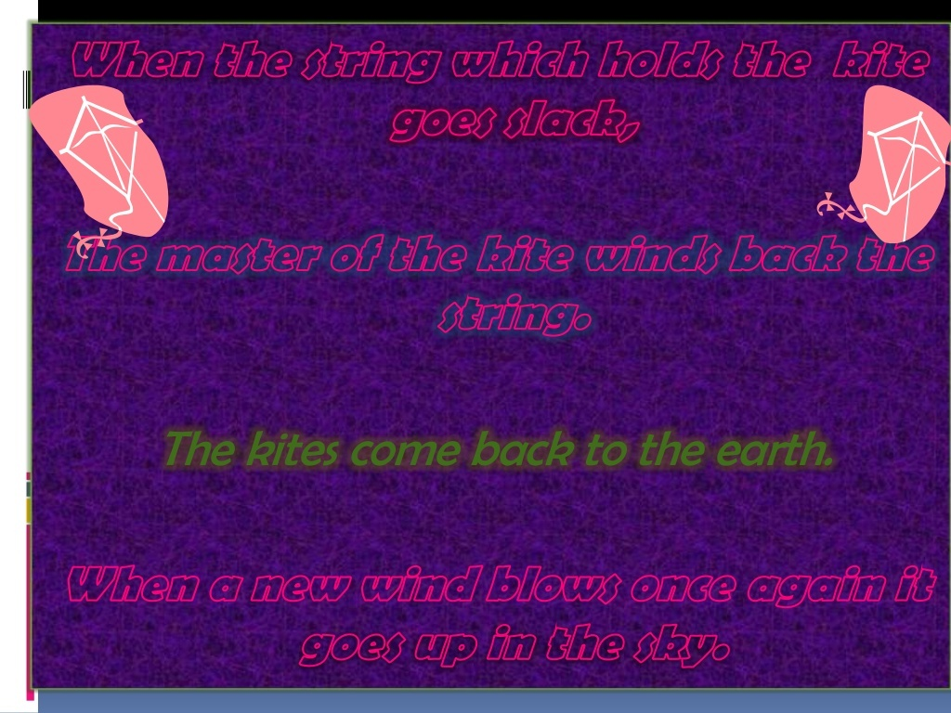

Slide 8
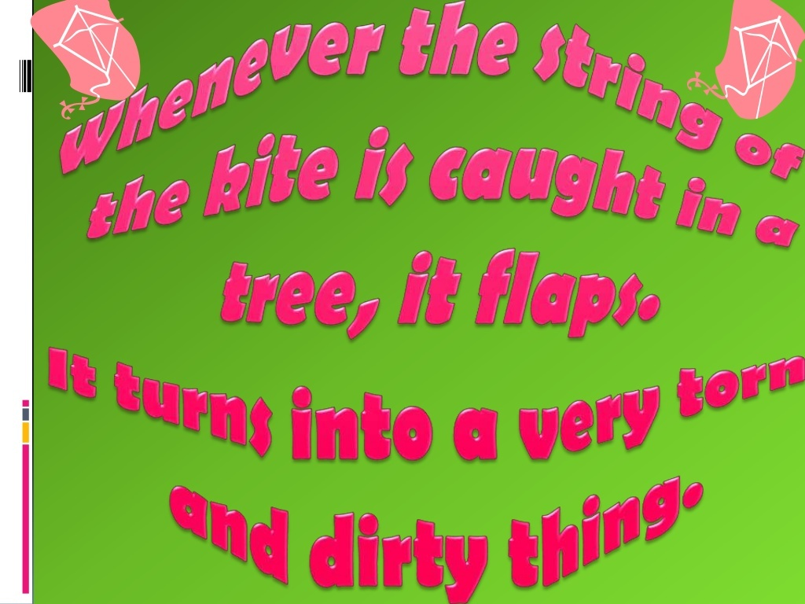

Slide 9
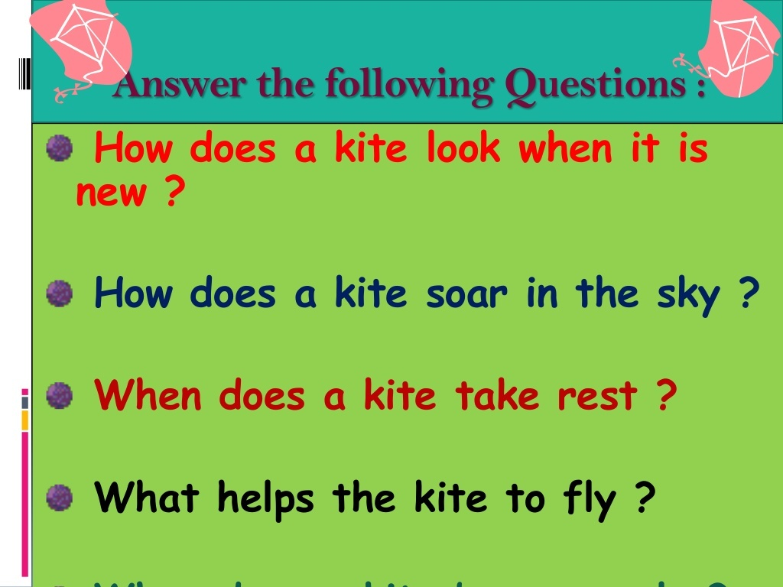

Slide 10
