Slide 1
International System of Numeration
How many lakhs make a million?
How many millions make a crore?
Fill in the blanks:
(a) 1 lakh = _______ ten thousand.
(b) 1 million = _______ hundred thousand.
(c) 1 crore = _______ ten lakh.
(d) 1 crore = _______ million.
(e) 1 million = _______ lakh.
International system
M | Th | O
3 | 3 | 3
Indian system
C | L | th | O
2 | 2 | 2 | 3

Slide 2
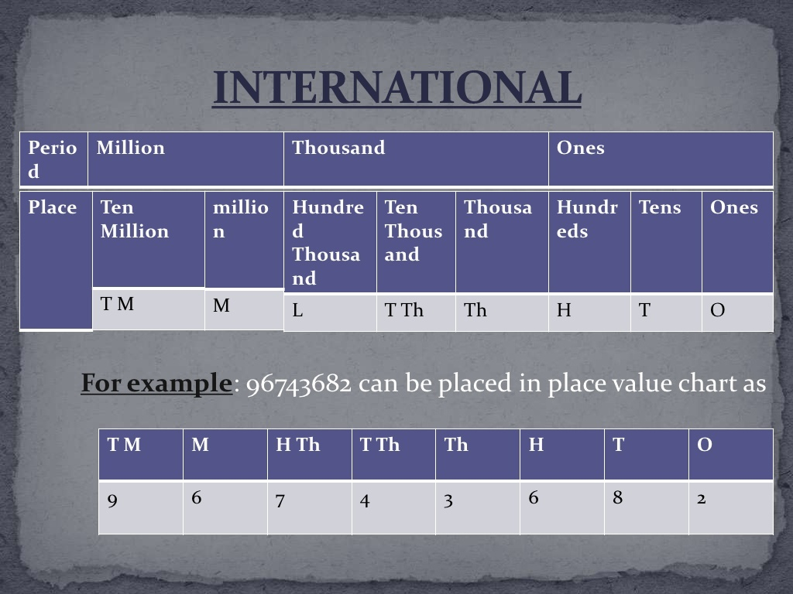

Slide 3
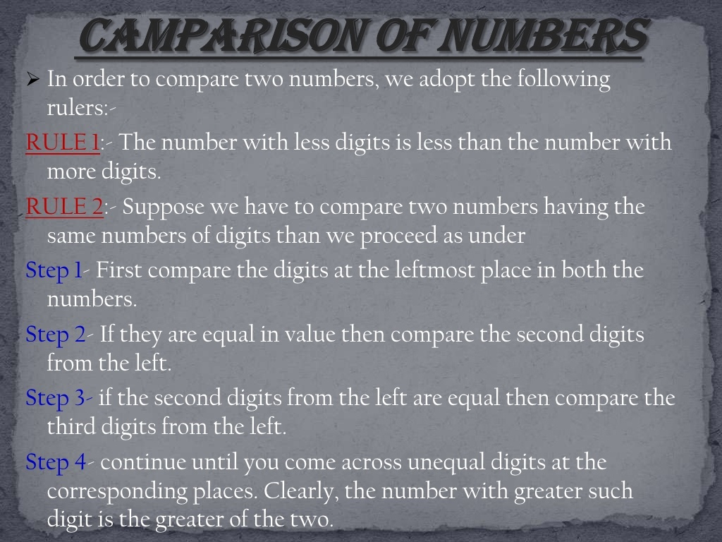

Slide 4
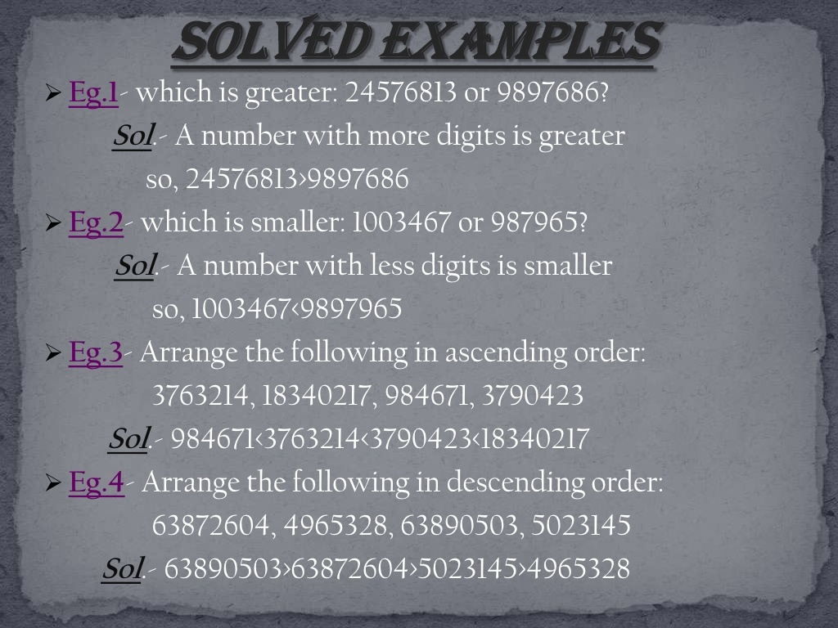
Notes:
everyone should mute

Slide 5
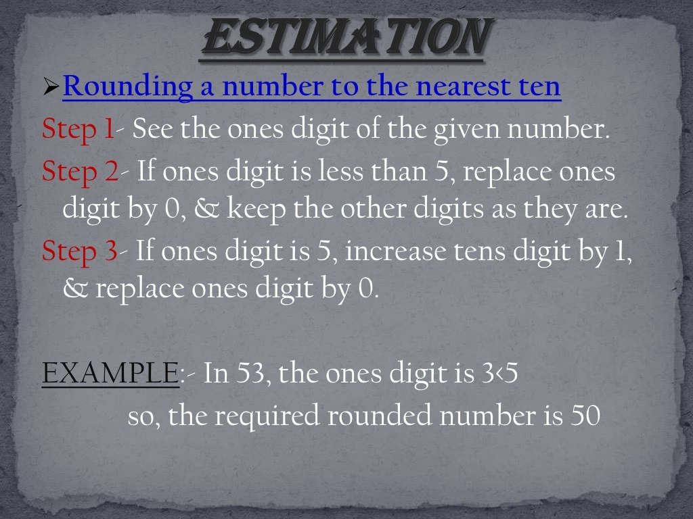

Slide 6
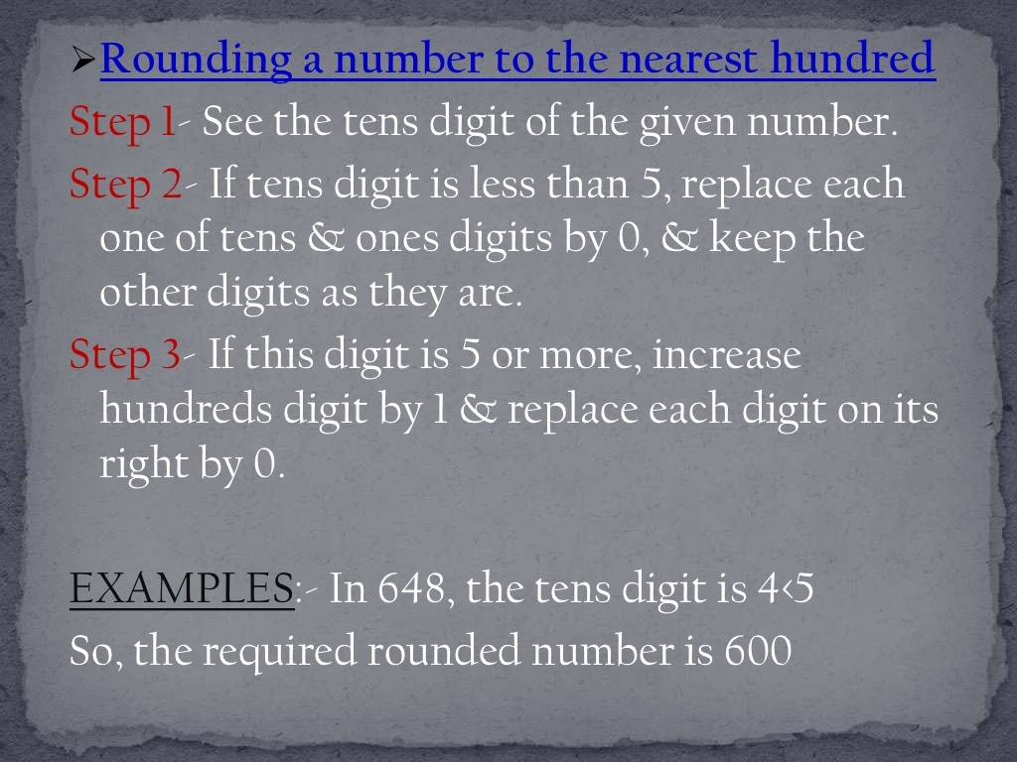

Slide 9
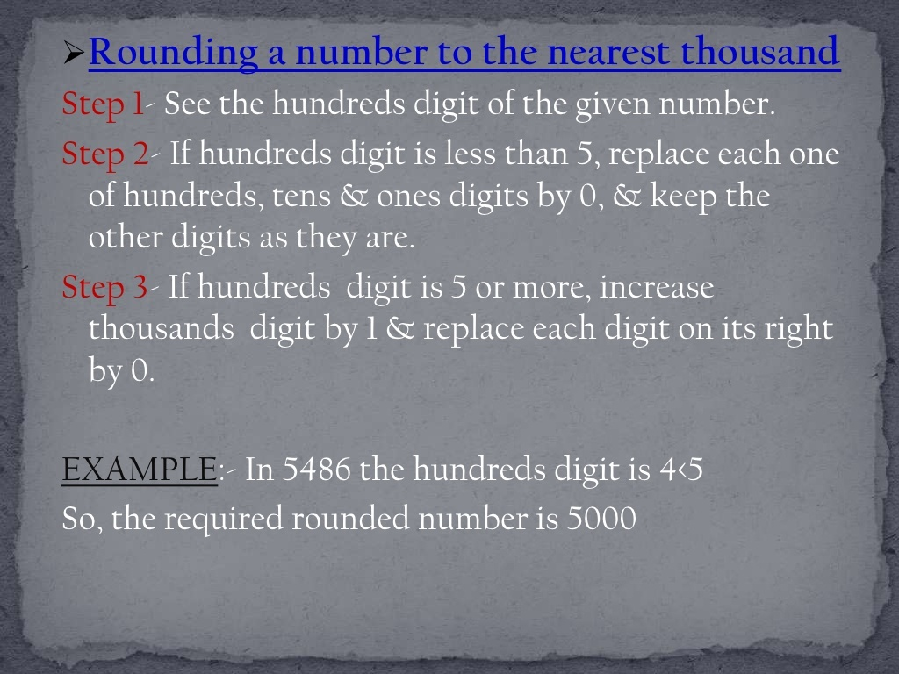

Slide 10
