Slide 2
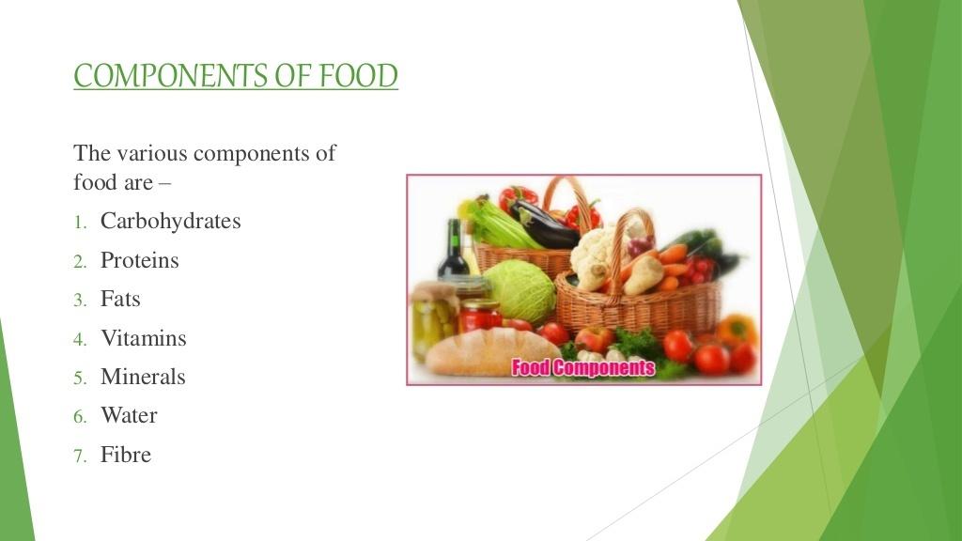

Slide 3
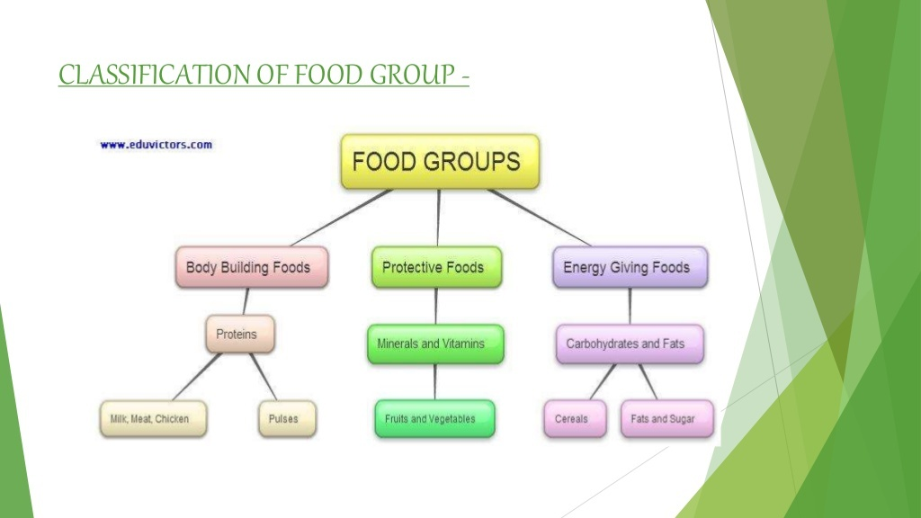

Slide 4


Slide 5
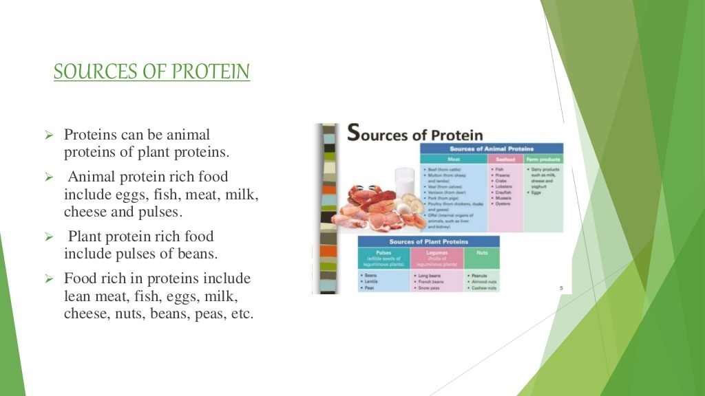

Slide 6
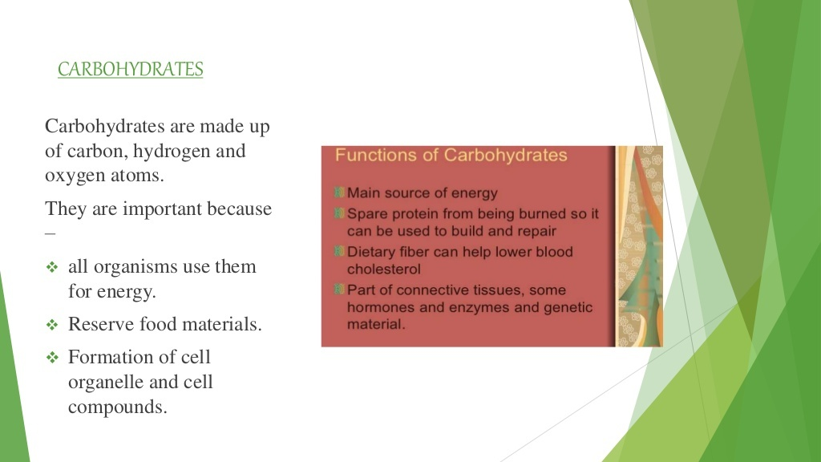

Slide 7
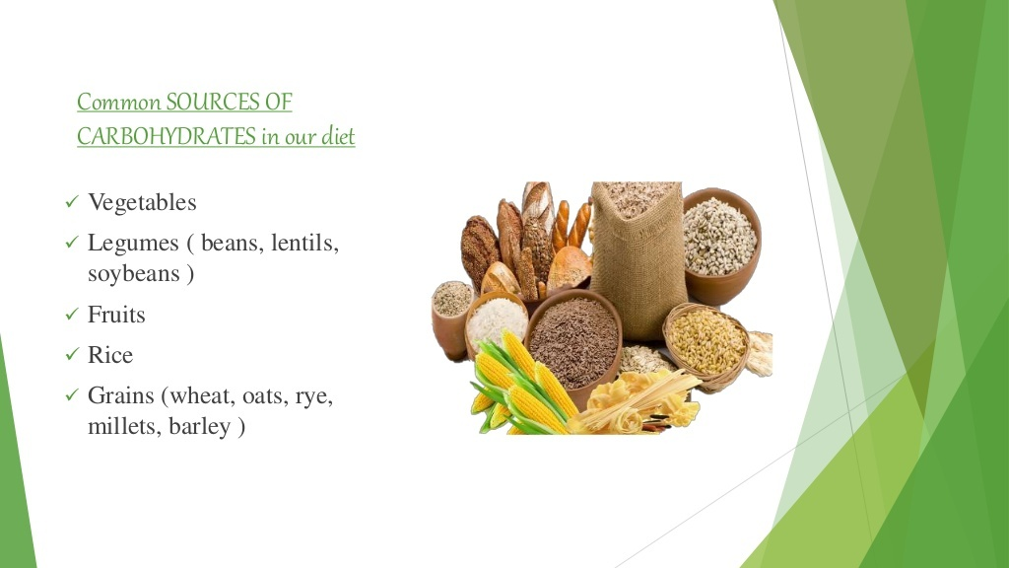

Slide 8
Activity-1
To test the presence of starch in the food items
Take a small quantity of food item for example a piece of potato.
Crush it and put it in a test tube
Add 2-3 drops of iodine solution to it
If the colour of food item changes to blue - black, it contains starch

Slide 9


Slide 10
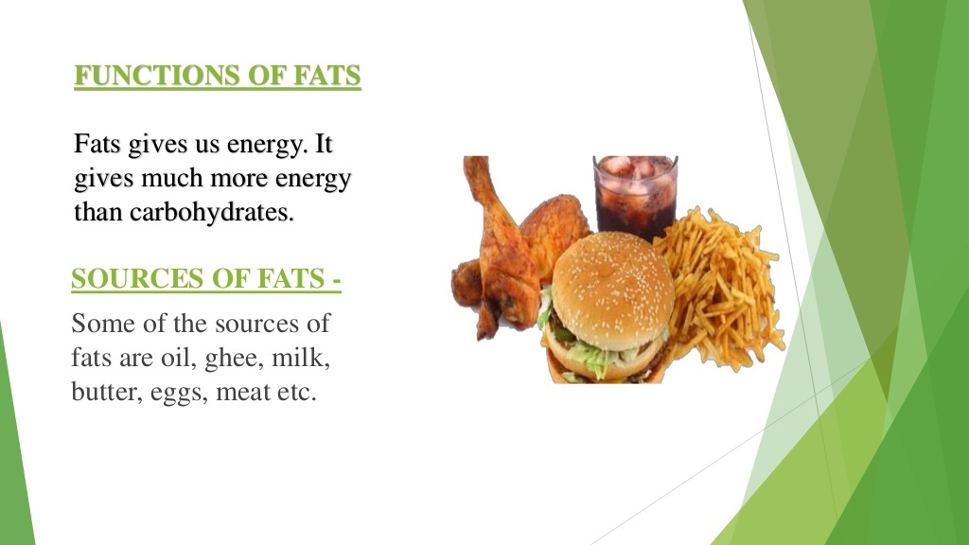

Slide 11


Slide 12
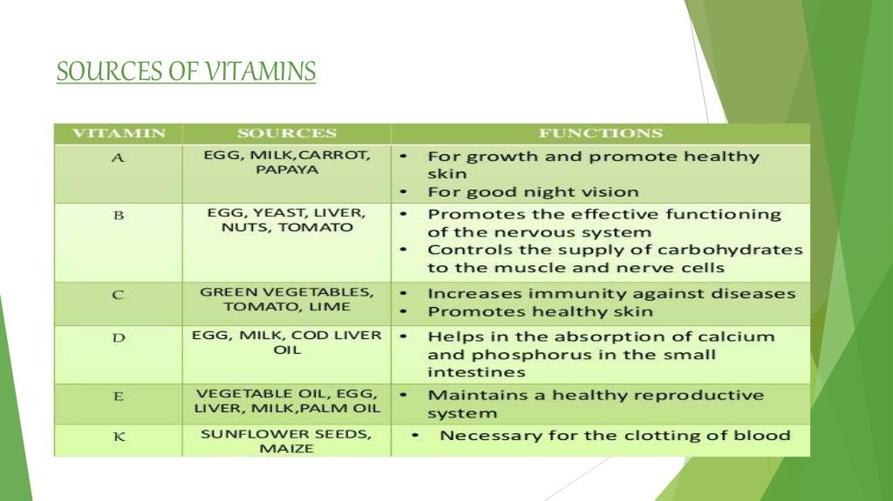

Slide 13
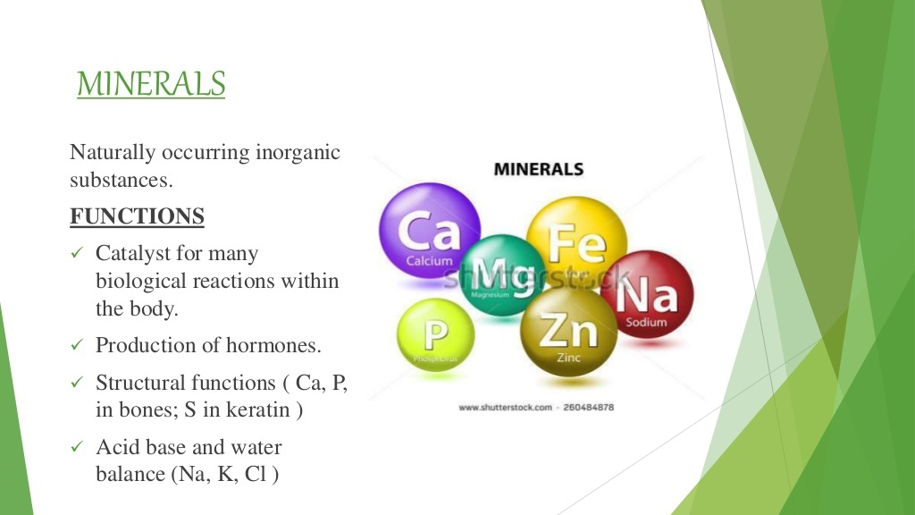

Slide 14
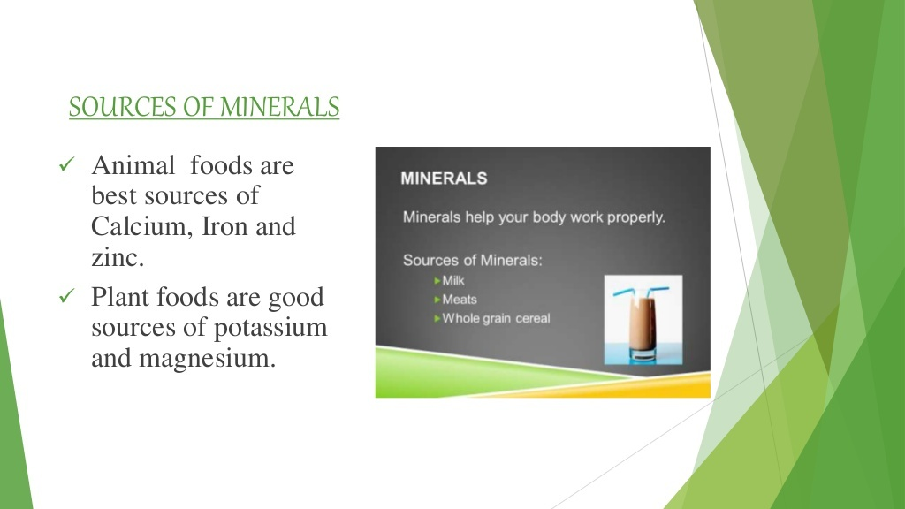

Slide 15


Slide 16


Slide 17
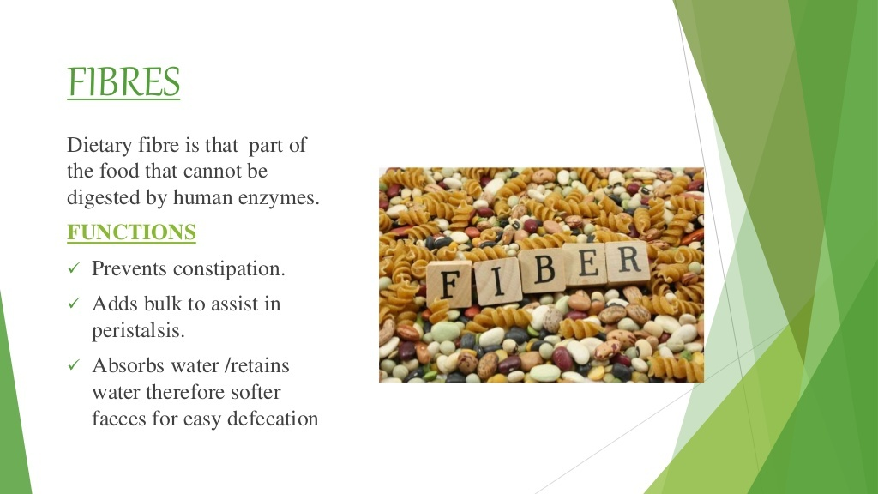

Slide 18
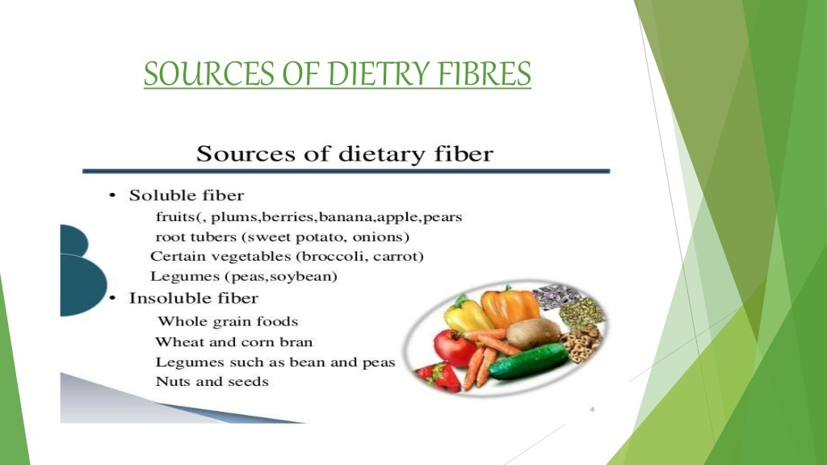

Slide 19
By - RRC

