Slide 1
Lecture 5-1 Monte Carlo Technique
Min Sup Hur
Mar. 28 2023
Notes:
This template can be used as a starter file for presenting training materials in a group setting.
Sections
Sections can help to organize your slides or facilitate collaboration between multiple authors. On the Home tab under Slides, click Section, and then click Add Section.
Notes
Use the Notes pane for delivery notes or to provide additional details for the audience. You can see these notes in Presenter View during your presentation.
Keep in mind the font size (important for accessibility, visibility, videotaping, and online production)
Coordinated colors
Pay particular attention to the graphs, charts, and text boxes.
Consider that attendees will print in black and white or grayscale. Run a test print to make sure your colors work when printed in pure black and white and grayscale.
Graphics, tables, and graphs
Keep it simple: If possible, use consistent, non-distracting styles and colors.
Label all graphs and tables.

Slide 2
Outline
Monte Carlo and Pseudo Random Numbers
Linear Congruential Generator
Uniformity and non-Correlation of Random Numbers
Random Number Generator in Python
Acceptance-Rejection Technique
Integration by Monte Carlo Technique
Notes:
Give a brief overview of the presentation. Describe the major focus of the presentation and why it is important.
Introduce each of the major topics.
To provide a road map for the audience, you can repeat this Overview slide throughout the presentation, highlighting the particular topic you will discuss next.

Slide 3

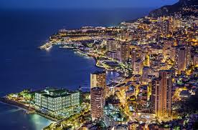

Monte Carlo and Pseudo Random Numbers
“Monte Carlo methods are a broad class of computational algorithms that rely on repeated random sampling to obtain numerical results.” - Wikipedia, ’Monte Carlo method’.
People say that the name ‘Monte Carlo’ method has its origin in the gambling city of Monaco.
In gambling, probability is the key issue, and probability is closely related with the randomness.
Having a ‘good’ random number generator is very essential in Monte Carlo methods.
Computer should use particular algorithms to generate random numbers. Hence the random is actually deterministic.
However, as long as the generated numbers are not correlated to each other, and not that predictable, the number sets can be considered as ‘pseudo random numbers’.
Notes:
This is another option for an overview using transitions to advance through several slides.

Slide 4
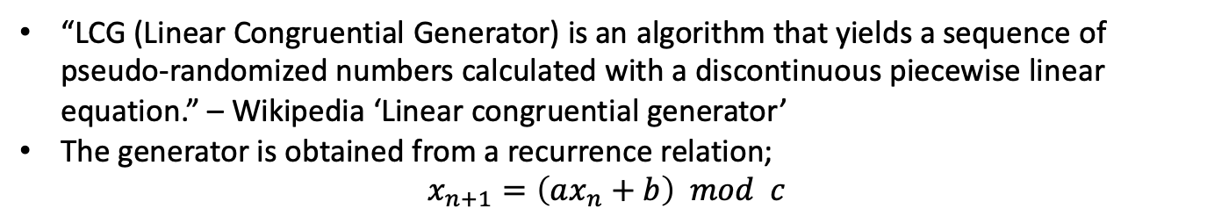
Linear Congruential Generator
“LCG (Linear Congruential Generator) is an algorithm that yields a sequence of pseudo-randomized numbers calculated with a discontinuous piecewise linear equation.” – Wikipedia ‘Linear congruential generator’
The generator is obtained from a recurrence relation;
$$x_{n+1}=\left(ax_{n}+b\right) mod c$$
Example 1. Using a loop in python, find a set of pseudo-random numbers for a=5, b=3 and c=8. You start from a ‘seed’ number x₀=1. How many random numbers can you get before you return to the seed number?
Answer:
x0=1; x=x0
i=0
while x != x0 or i==0:
x=(5*x+3)%8
print(x)
i+=1
Notes:
This is another option for an overview using transitions to advance through several slides.

Slide 5
RANDU
RANDU is a famous, but obsolete LCG-type random number generator.
In RANDU,
a=65539, b=0, c=2³¹
Example 2. Using the parameters above, generate 1000 pseudorandom numbers. Start from a seed number x₀=1. Make a plot of points (n, x_{n}). For the point plots rather than the line plot, use ‘ro’ option in plot(). Ex. plot(n,xn,’ro’).
Answer: Look at ‘MC-randu.py’.
Notes:
This is another option for an overview using transitions to advance through several slides.

Slide 6
Uniformity of Distribution
For a set of random numbers to be useful, it should be uniformly distributed.
f(x)
f(x)dx
0
x
x+dx
1
Example 3. Construct a distribution of 100 pseudorandom numbers using RANDU. Watch how the distribution changes as you increase the number of random numbers, to 1000, 10000, and 100000.
Answer: Look at ‘MC-randu.py’.
Notes:
This is another option for an overview using transitions to advance through several slides.

Slide 7
Note: Distribution of Data Points
Before we move forward, let’s find how to construct the distribution of data points.
As an example, consider a data set of 1D or 2D positions. E.g. (1.2, 0.2, 3.5, …) for 1D and ((1,2), (2,4), …) for 2D. We find the number density.
+w₂/Α
Δx
+w₁/Α
0th order
Δx
+1
2D linear
w₄
w₃
δx
Δy
1st order
δy
w₁
w₂
+(Δx-δx)/Δx
+δx/Δx
+w₃/Α
δx
+w₄/Α
Α=ΔxΔy
To find the mesh index the particle belongs to, use the integer-truncation.
w₁=δxδy/ΔxΔy
w₂=(Δx−δx)δy/ΔxΔy
w₃=(Δx−δx)(Δy−δy)/ΔxΔy
x=10.82
w₄=δx(Δy−δy)/ΔxΔy
9
10
11
12
Mesh index of the particle = int(x) = 10
Notes:
This is another option for an overview using transitions to advance through several slides.

Slide 8
Correlation between Random Numbers
For a set of random numbers to be useful, there should NOT be correlation between the elements.
y_{n}
y_{n}
x_{n}
x_{n}
Correlated
Uncorrelated
Example 4. Construct a set of 3D points, where the components are three consecutive random numbers from RANDU, i.e. (x_{n}, x_{n+1}, x_{n+2}). Make a 3D scattered plot. Rotate the 3D figure in different ways using your mouse, to find some interesting feature.
Answer: Look at ‘MC-randu2.py’.
Notes:
This is another option for an overview using transitions to advance through several slides.

Slide 9
Pseudorandom Numbers in Python
In python, they use Mersenne Twister, which is ‘by far the most widely used general-purpose pseudorandom number generator’. – Wikipedia.
It is based on the Mersenne prime number, 2^{n}-1. Mathematical details are not covered in this class.
Example 5. Repeat Example 3 (the uniformity check) with the python built-in random number generator.
Answer: Look at ‘MC-random.py’.
Example 6. Repeat Example 4 (the correlation check) with the python built-in random number generator.
Answer: Look at ‘MC-random2.py’.
Notes:
This is another option for an overview using transitions to advance through several slides.

Slide 10
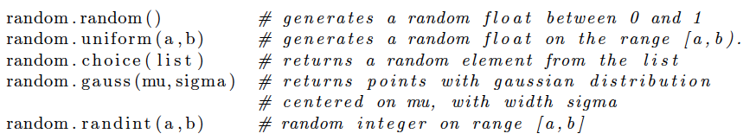
Useful Functions
There are several useful functions in random package.
Example 7. Using gauss() function of python, create a set of data points, which are Gaussian-distributed. Visualize the distribution.
Answer: Look at ‘MC-gaussian.py’.
Notes:
This is another option for an overview using transitions to advance through several slides.

Slide 11
Acceptance-Rejection Technique
For construction of a general distribution, use the acceptance-rejection technique.
f(x)
Generate a random number V in the interval [0,x_{max}]
Evaluate the distribution f(x) at V.
Generate another random number T in the interval [0,fmax]. V and T should not be correlated.
Compare f(V) and T. If T<f(V), accept. Otherwise, reject.
Repeat this process for desired number of points.
f_{max}
0
V
x_{max}
Example 8. Create 1000 data points of 1D positions, which are distributed over [0,1] by a sine function from 0 through π.
Answer: Look at ‘MC-sinDistr.py’.
0
1
Notes:
This is another option for an overview using transitions to advance through several slides.

Slide 12
Integration by Monte-Carlo Technique
Similar to the Acceptance-Rejection technique; when n random points are accepted out of N, the integration is proportional to n/N.
As an example, calculate π using the figure in the right.
Generate a random number r1, r2 in domain [0,1]
Compare the distance with the radius 1. If it is smaller than 1, then accept (red dots). Otherwise, reject (blue dots)
The calculation results is π/4=N_{red}/N_{total}
Example 9. Calculate π using Monte-Carlo method.
Answer:
import random
import numpy as np
N=int(input("number of random numbers="))
sum=0
for i in range(N):
r1=random.random(); r2=random.random(); r=np.sqrt(r1**2+r2**2)
if r<=1.0:
sum +=1
print(4.0*sum/N)
Notes:
This is another option for an overview using transitions to advance through several slides.

Slide 13
End of Lecture 5-1
Notes:
Use a section header for each of the topics, so there is a clear transition to the audience.

