Slide 1


Smart Mobility Engineering Lab
(ISE3231)
Week _ Lecture
ISE Department Prof. Mehdi Pirahandeh
School of Global Convergence Studies

Slide 2

Maze Solving Robot with Optimal Path
1
School of Global Convergence Studies

Slide 3

Contents
Custom Maze Creation
Slam Gmapping on Custom World
Navigation and Maze Solving
School of Global Convergence Studies

Slide 4
Custom Maze Creation

Slide 5
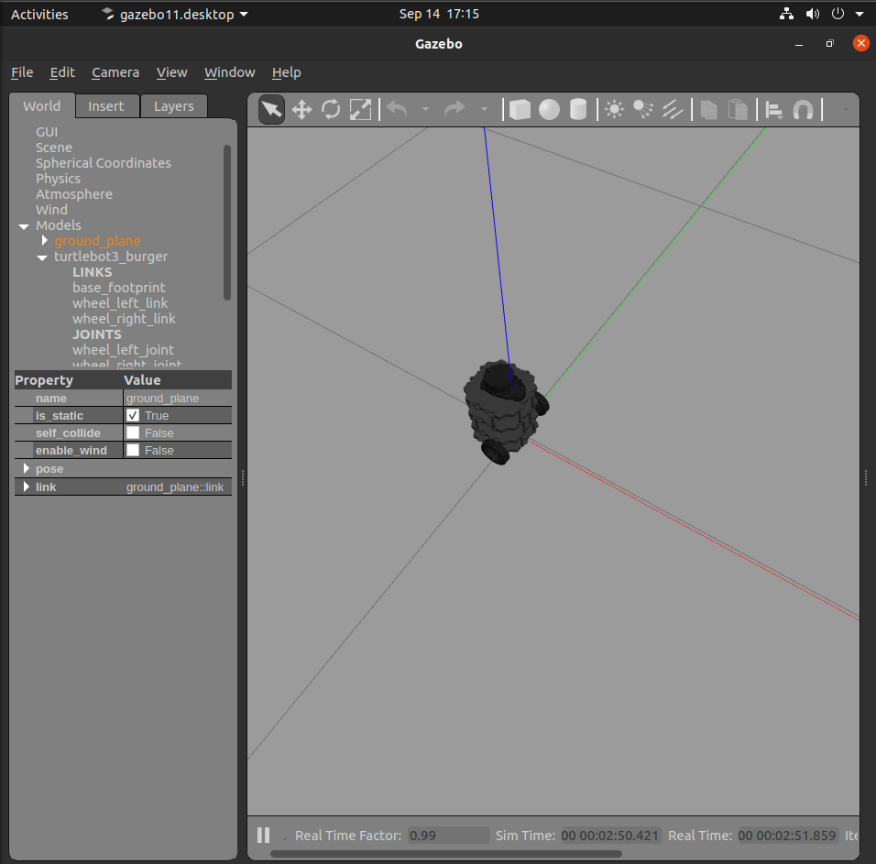
Custom World
School of Global Convergence Studies
Notes:
Launch the empty world

Slide 6
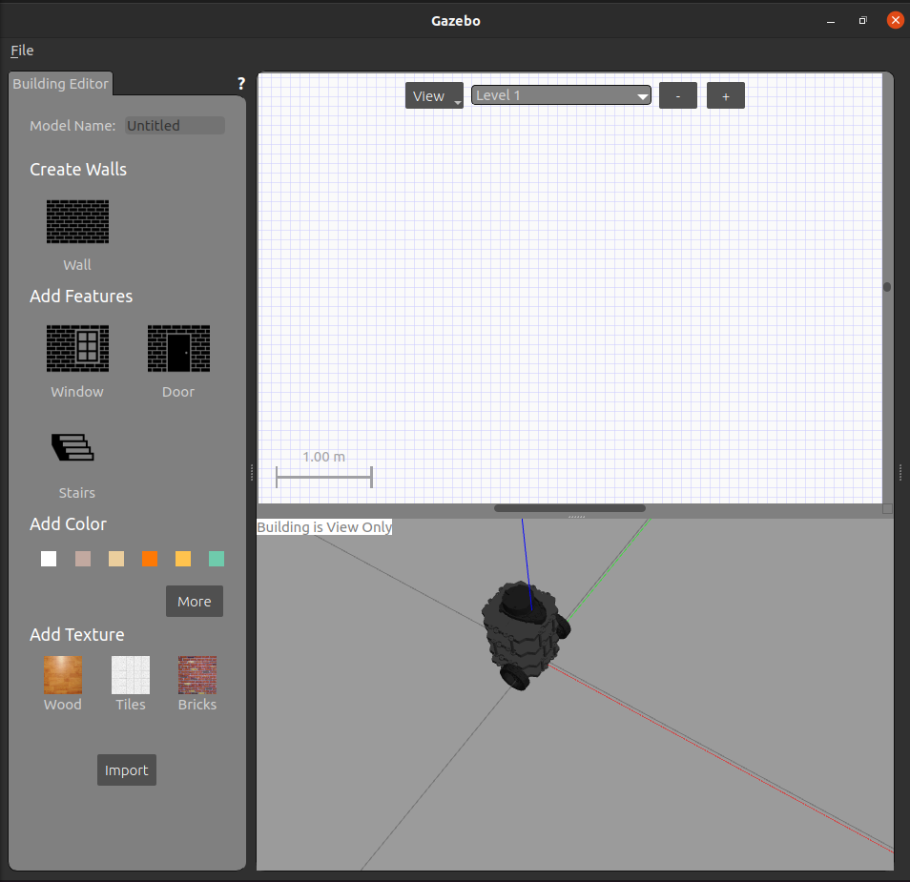
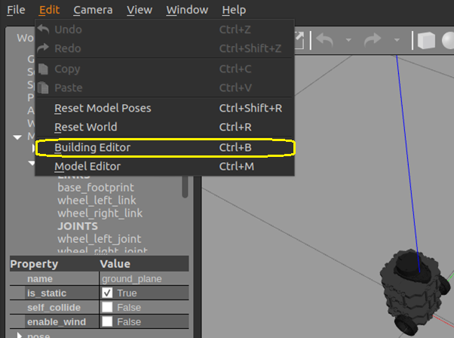
Sub-Chapter
Content
School of Global Convergence Studies
Notes:
Edit -> Building Editor to create a custom simulated environment

Slide 7
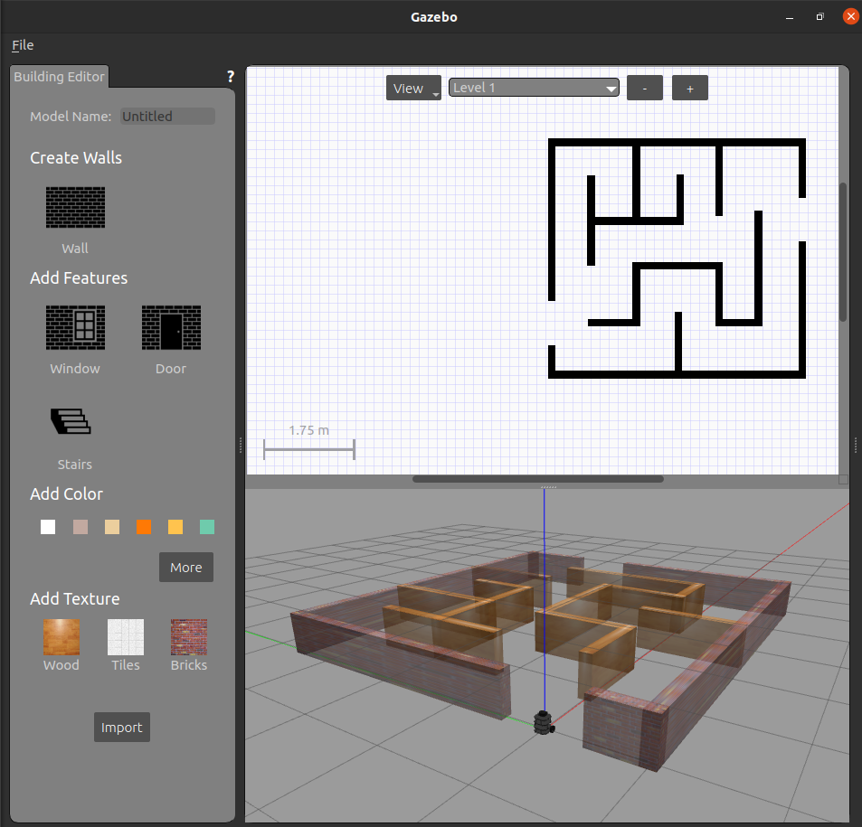
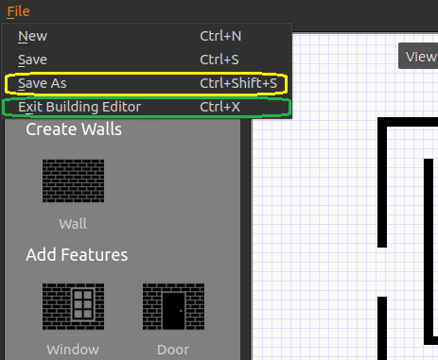
Custom World
School of Global Convergence Studies
Notes:
Create a custom maze and save as maze_01
Then exit Building Editor to come back to the world

Slide 8
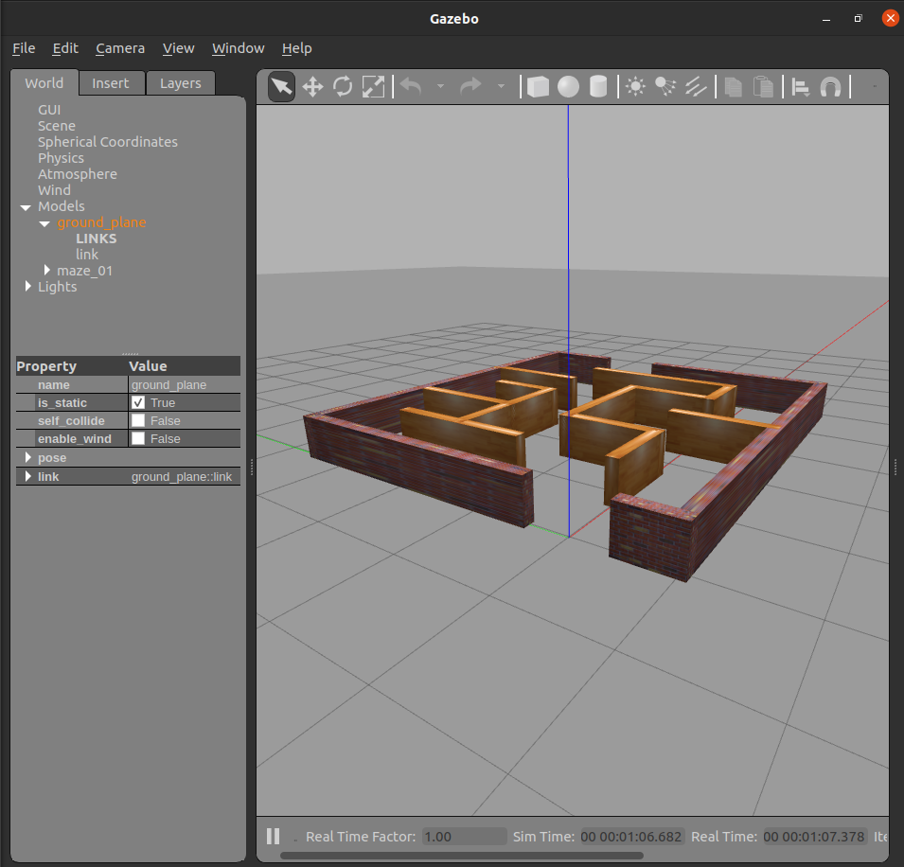
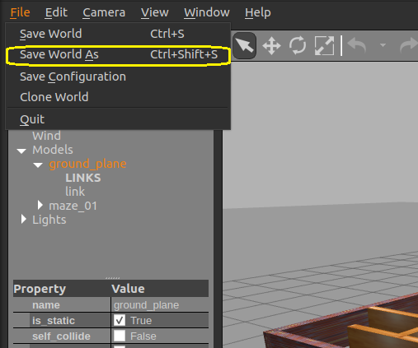
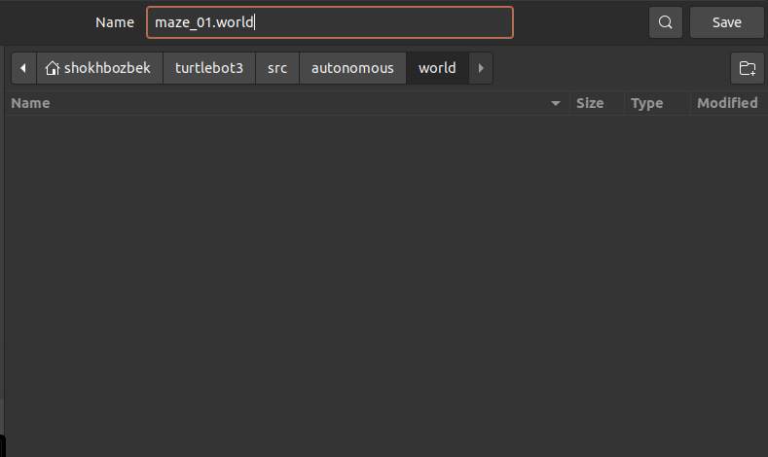
Custom World
School of Global Convergence Studies
Notes:
remove the robot from the world and save as world file in “(workspace dir)/src/autonomous/world” as maze_01.world
* Right click on the robot end press the delete key to remove the robot from the simulated world

Slide 9
II. SLAM G-Mapping on Custom World

Slide 10
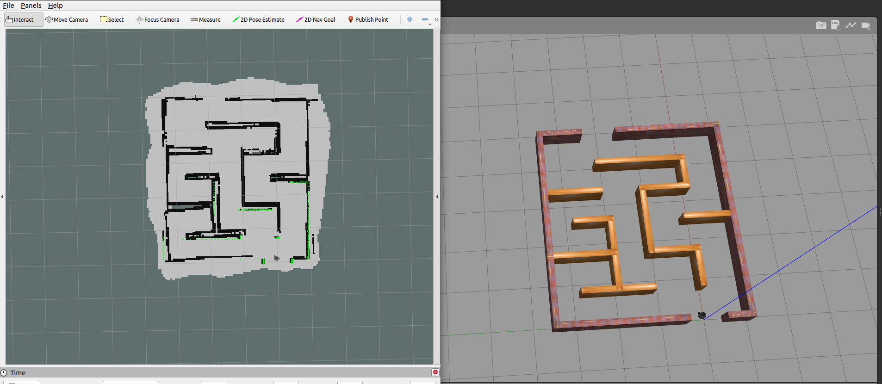
SLAM
School of Global Convergence Studies
Notes:
Control the robot and draw the map of the custom simulated world

Slide 11
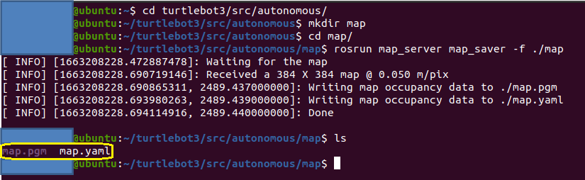
SLAM
School of Global Convergence Studies
Notes:
Open the new terminal and follow the commands to save the map

Slide 12
III. Navigation and Maze Solving

Slide 13
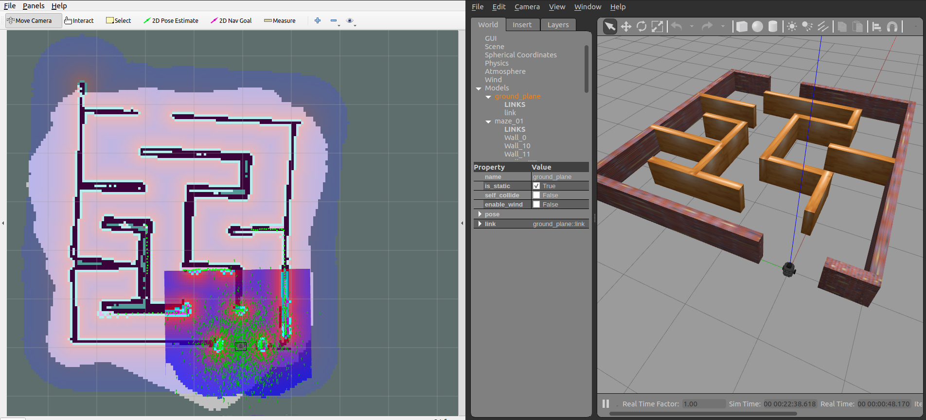
Navigation
School of Global Convergence Studies
Notes:
You can correct the location of the turtlebot3 by using ‘2D Pose Estimate’ according to the location of the robot and its direction

Slide 14
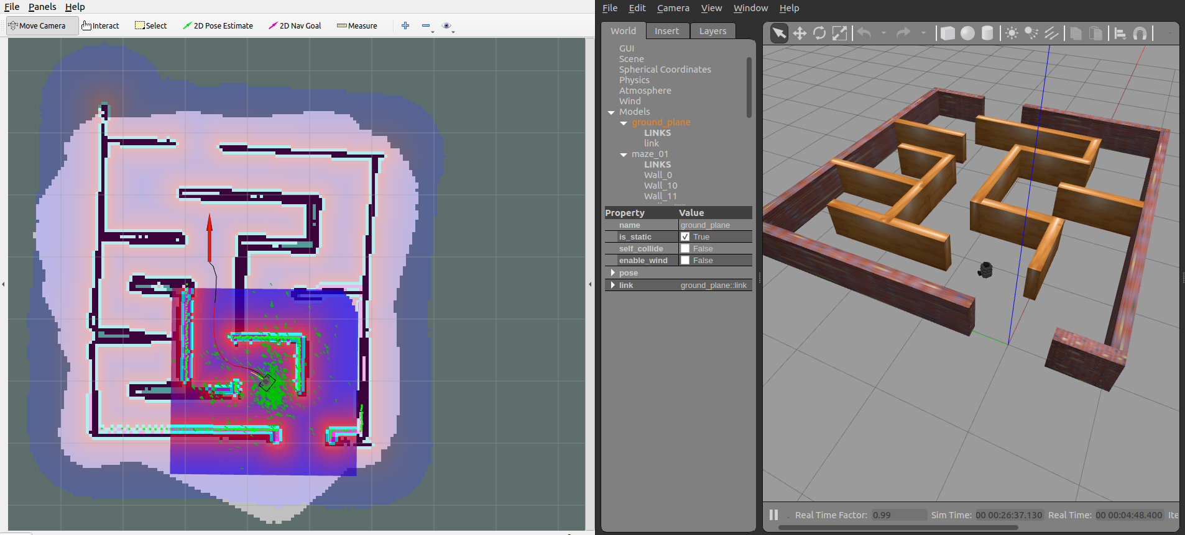
Navigation
School of Global Convergence Studies
Notes:
Try to give a goal for a robot and it goes to the goal itself
Do this by using ‘2D Nav Goal’. Set the location and final direction

Slide 15
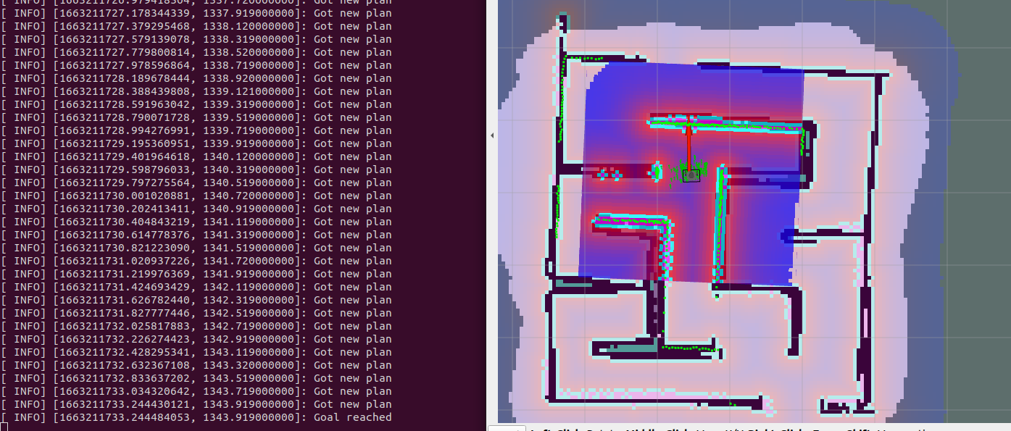
Navigation
School of Global Convergence Studies
Notes:
You may try the exit position as a goal and look how the robot get that goal through the maze

