Slide 1
Heart Attack
Team Two_Knight_Stand
Kieran Dolan
Anhad Anuja
Tyrone Nolasco

Slide 2


Idle Clicker + Rhythm Game = Max Dopamine
Rewards the player with idle activity and big incremental numbers
Rewards the player with active rhythm game aspects and big combos
+

Slide 3
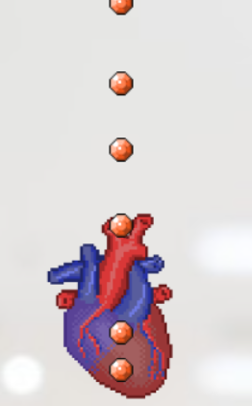
Our Game
Theming: All items revolve around affecting a heart’s BPM, using anything from a Red Bull to a defibrillator.
Joules act as currency for you to buy your upgrades which can be obtained every successful tap
BPM acts as a multiplier for your combo
The longer you maintain your combo the more Joules you’ll get per click

Slide 4
Our Technology Stack
HTML canvas to handle all of the rhythm game animations
MongoDB to handle all of the data
React for general UI, state management and communicating with MongoDB

Slide 5
Challenges
Choosing frameworks
We wanted to use Firebase but because our game required updating data quickly, we decided against it
First time game design and development
We attempted OAuth & SocketIO as a way to keep track of data but ended up scrapping it because we couldn’t get it to work

Slide 6
Demo

Slide 7
Stretch Goals
Joules per second - rhythm game aspect was the focus of our development
Prestige system - once you reached a specified large amount of joules you could be able to reset all of your items and upgrades in return for a more impactful upgrade
Song imports - rhythm matched song playing but our app sticked with a basic beat to follow

Slide 8
Thank you for listening!!

