Slide 1
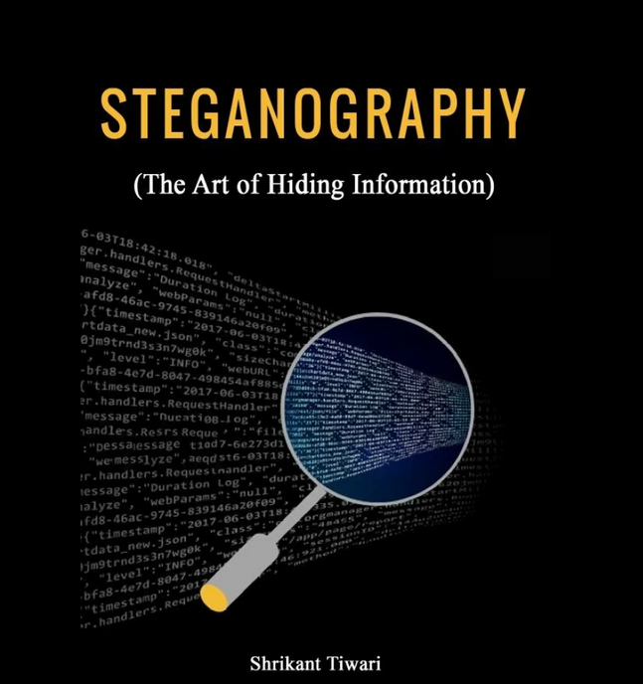
Unveiling the Invisible an In-depth Analysis of Text Steganography
Authors of the presentation: Vladislava Gusakova and Vsevolod Zimovets

Slide 2
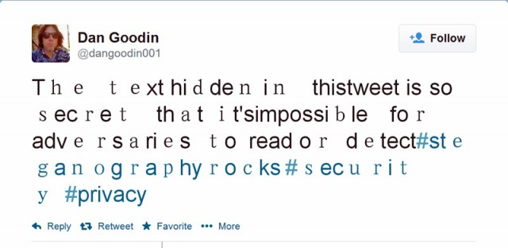
Table of Contents
Objectives
Introduction
Text modification methods
Methodology
Results
Discussion
Conclusions

Slide 3

Objectives
To introduce what steganography is
To tell about the main methods of text steganography
Provide an algorithm for the White Spacing method
Analyse the disadvantages of text steganography

Slide 4

Introduction
Text steganography is the art and science of concealing hidden messages inside ordinary text without raising red flags.

Slide 5
Text modification methods
Text steganography can be classified into different types based on the techniques used to hide the secret message in the text.
A. Linguistic Steganography
Synonym Substitution
2) Word Order Change
Words | Synonyms
Leave | Depart, Go away
Port | Harbour, Dock
Subsequent | Successive, Later
Consequence | Result, Effect
American Spelling | British Spelling
Favorite | Favourite
Criticize | Criticise
Fulfill | Fulfil
Center | Centre
Dialog | Dialogue

Slide 6
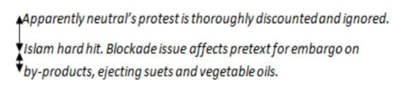
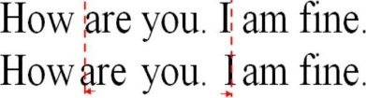
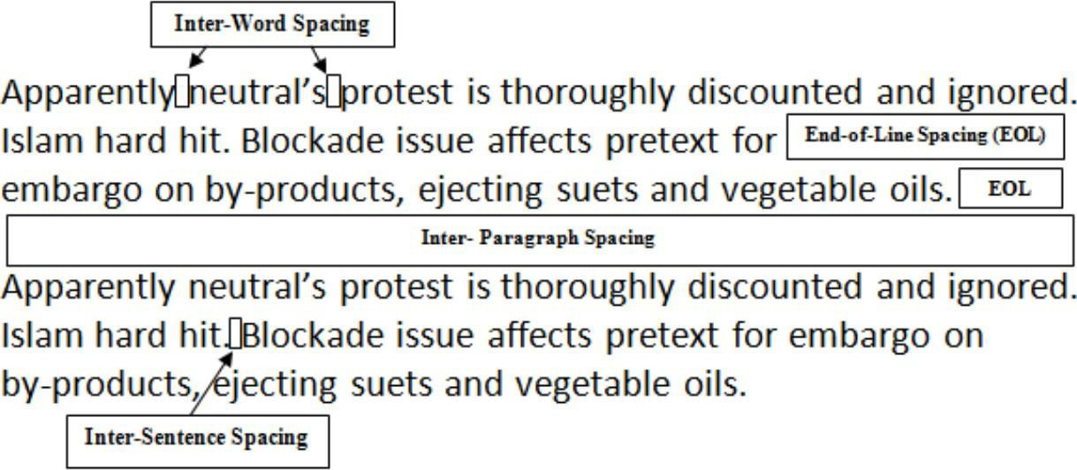
B. Alignment Modification
Line Shifting
2) Word Shifting
C. White Spacing

Slide 7
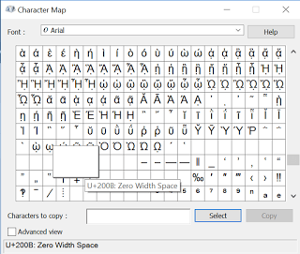
Methodology
A group of Unicode characters known as zerowidth characters are those that, when rendered, have no discernible representation. These characters are employed in a variety of contexts, such as text steganography, to conceal information within text without changing how it appears on the surface.
Zero-width characters come in a variety of forms that can be steganographically used. Typical illustrations include:
Zero-Width Space (U+200B)
Zero-Width Joiner (U+200D) and Zero-Width Non-Joiner (U+200C)
Zero-Width Non-Breaking Space (U+FEFF)

Slide 8
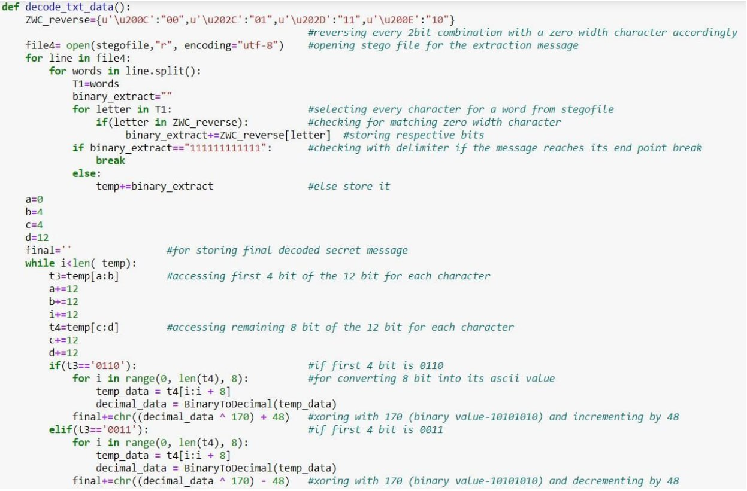
Results
Text Steganography Encoding Algorithm

Slide 9
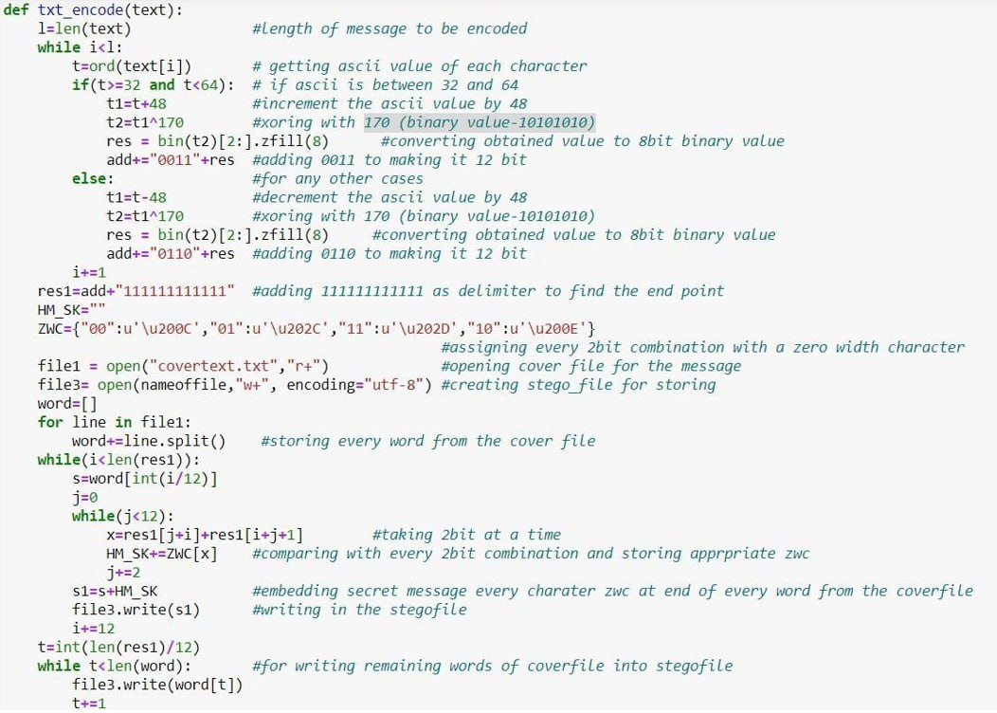
An algorithm for decoding text steganography

Slide 10

Discussion
The challenges of resilience and detection present notable obstacles within the domain of text steganography. However, it is crucial to guarantee that the covert data remains confidential and imperceptible to unapproved entities. Notwithstanding, antagonists may utilise diverse techniques, including statistical analysis or textual comparison, to detect the existence of concealed messages.

Slide 11
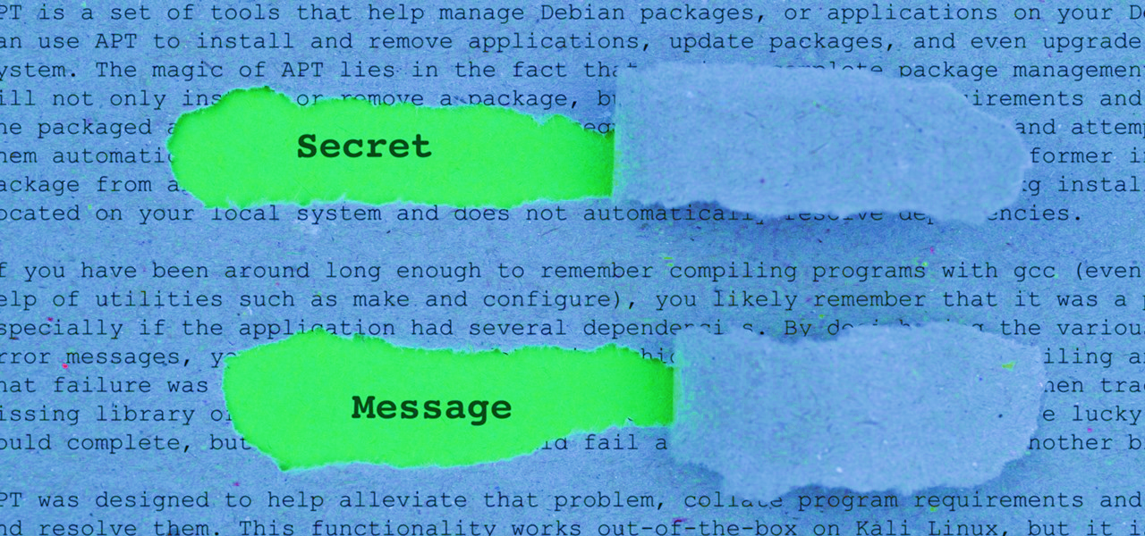
Conclusions
Text steganography is a useful technique for secret communication and data authentication in many different fields. Applications for it can be found in a variety of fields, including encrypted messaging, digital rights management, covert information transmission, and cybersecurity. Text steganography, however, faces a number of difficulties that scholars are working to solve.

Slide 12

Thank you for your attention

